Slide 1
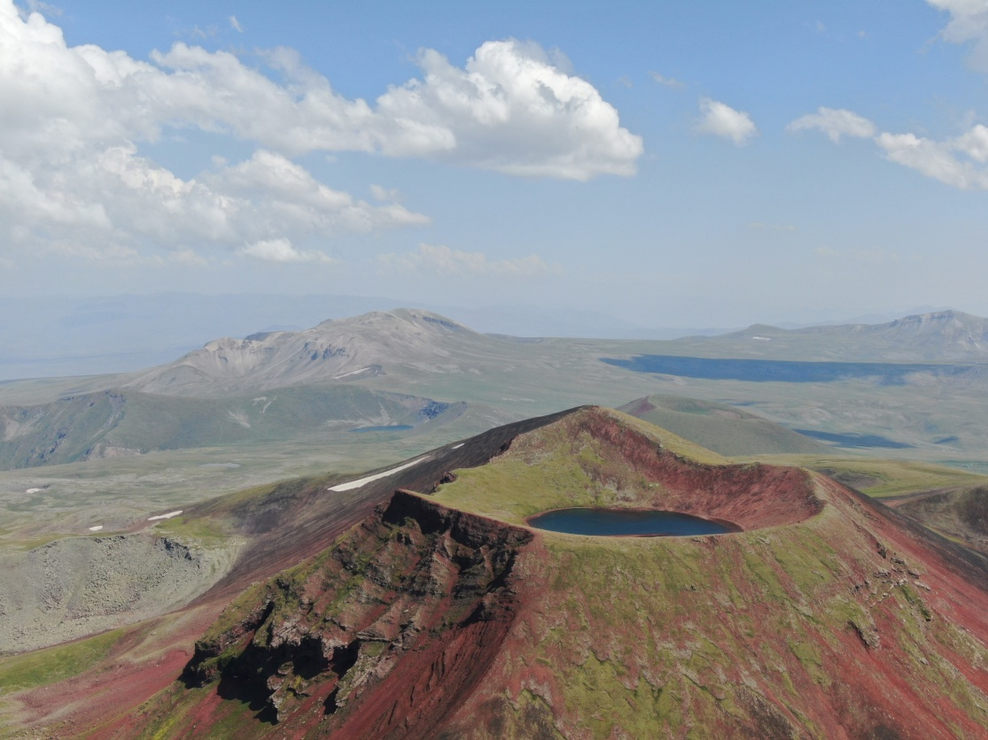




«Տեֆրոխրոնոլոգիա եվ Հայաստանում հրաբխային մոխրի թափման վտանգը»
23RL-1E042 ծածկագրով գիտական թեմա
Կազմակերպություն՝ Երկրաբանական գիտությունների ինստիտուտ
Լիդսի Համալսարան, Մեծ Բրիտանիա
Ղեկավար՝ Իվան Սավով
Երկրաբանական գիտությունների ինստիտուտ
Համաղեկավար՝ Էդմոնդ Գրիգորյան
Կատարողներ՝ Խաչատուր Մելիքսեթյան
Գևորգ Նավասարդյան
Արմինե Բաղդասարյան
Համեստ Գրիգորյան
Աժդահակ հրաբուխ
Գեղամա հրաբխային
բարձրավանդակ

Slide 2
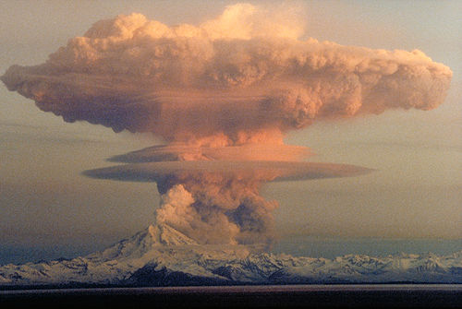
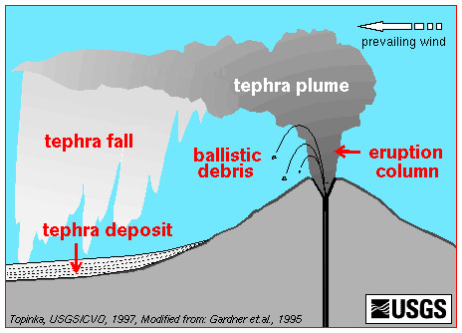
What is tephra?
The fall and deposition of pyroclastic material such as ash, pumice and scoria occur when these particles (generally called tephra) are lifted by an explosive eruption to altitudes of several kilometers to tens of kilometers during explosive eruptions
Mount Redoubt ash cloud on April 21, 1990, Photo by Robert Clucas, Alaska Volcano Observatory

Slide 3
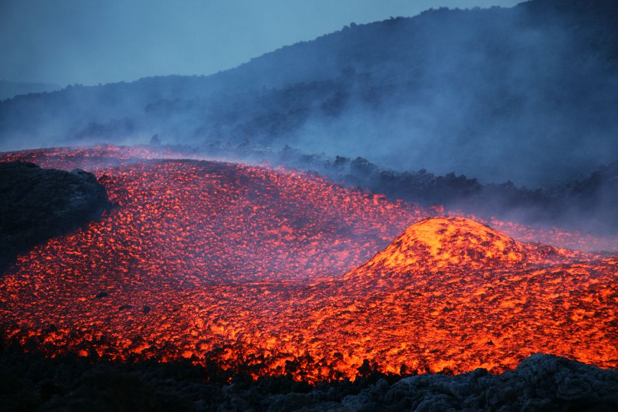
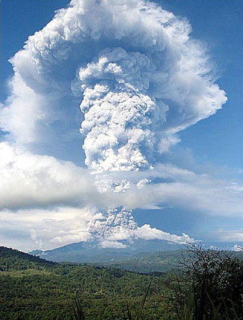
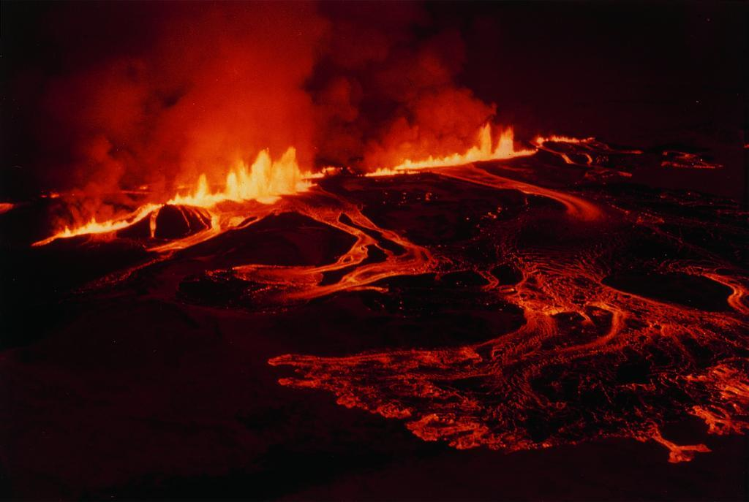
Types of volcanic eruptions
Effusive
(Lava flows)
Explosive
eruption column height may reach 10-50 km and rarely more.
Many subtypes or styles:
Pelean, vulcanian, plinian, strombolian, hawaian, icelandic etc.

Slide 4
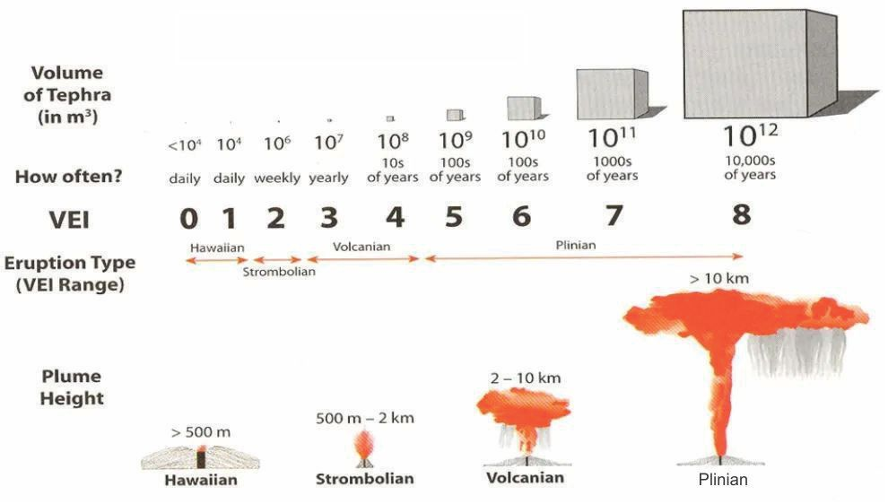
Volcanic explosivity index VEI (magnitude)

Slide 5
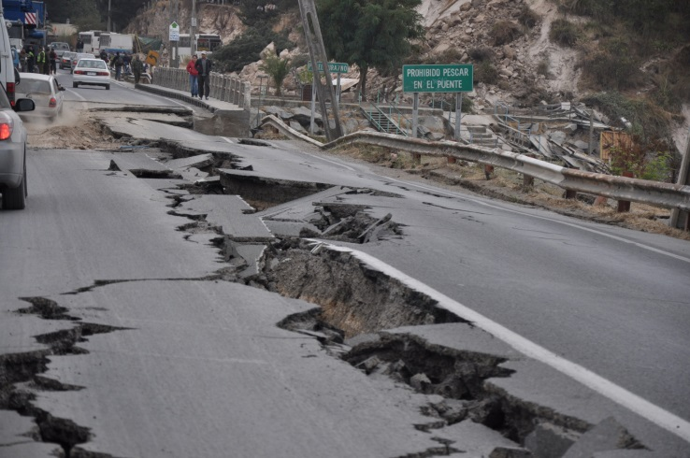
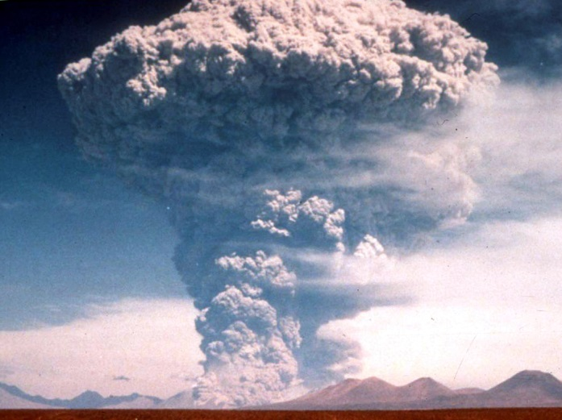
Strong Earthquakes vs. violent volcanic eruptions
Recurrence rate
Recurrence rate of earthquakes М ≥5 (USGS)
Recurrence rate of violent explosive eruptions (VOGRIPA)
Magnitude | Average Annually
8 and higher | 1
7 - 7.9 | 15
6 - 6.9 | 134
5 - 5.9 | 1319
VEI (magnitude) | One per years
8 | 20-40 ka?
7 | 500
6 | 75
5 | 25

Slide 6
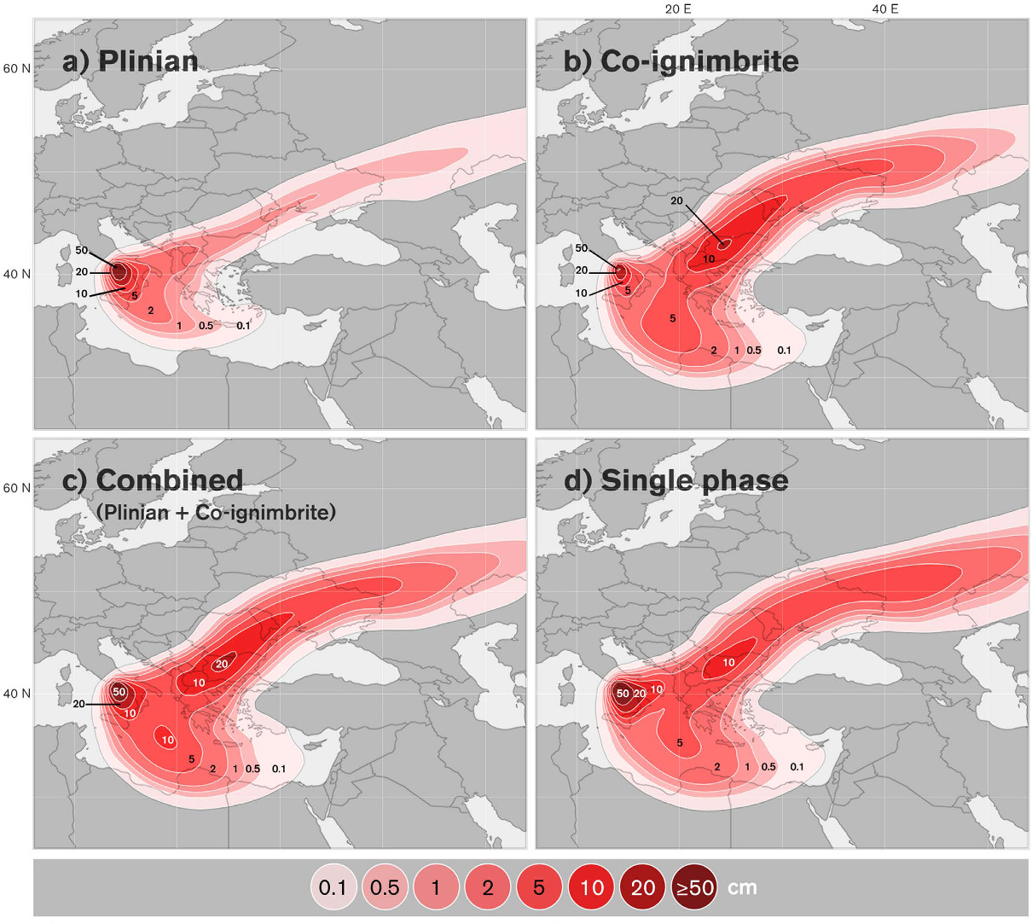
Campanian Ignimbrite eruption, Age 39.9 ka
Ash distribution/Isopach maps (cm) from inversion for different phases of Campanian Ignimbrite eruption: M=8
(a) Plinian phase, (b) co-ignimbrite phase, (c) combined two-phase and, (d) single-phase (Marti et al., 2015).

Slide 7
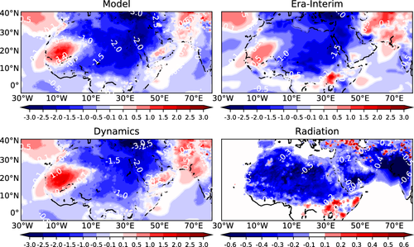
Pinatubo 1991 M=6 eruption climatic coolling effect.
In 1992-1994 -3ºC average annual temperature in Armenia region.
Resulted long and cold winters – up to -25 ºC in Yerevan
(Մութ ու Ցուրտ տարիներ)

Slide 8
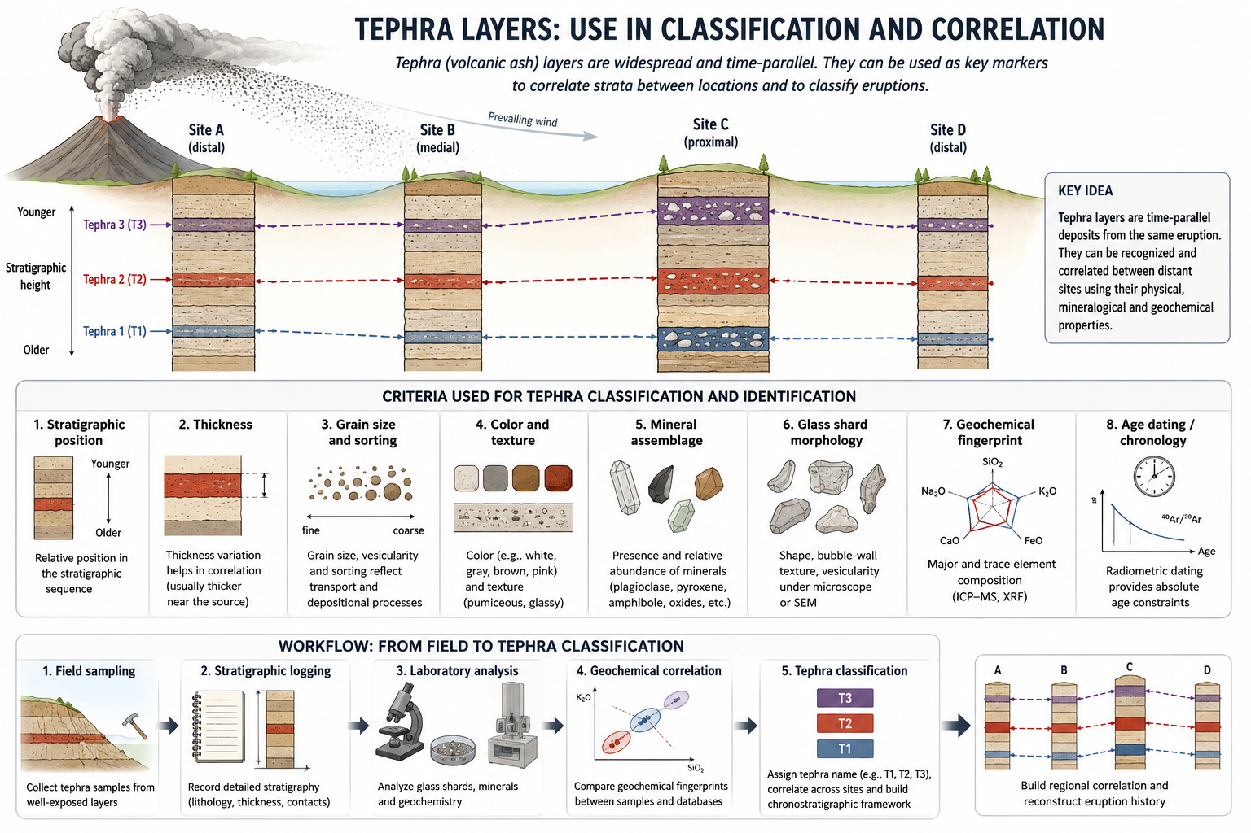

Slide 9
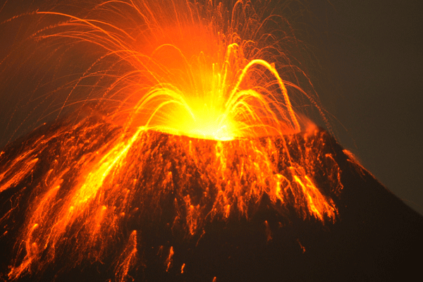
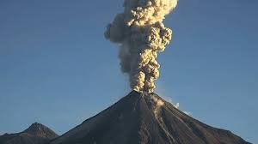
What are the criteria to consider volcano as capable to produce hazards (active or potentially active??)
Activity in Holocene (last 11.700 years BP)
Active volcano
Activity in Late Pleistocene ( last 128.000 years BP), Sometimes extended to Middle Pleistocene 774.000 -129.000 years BP)
Potentially active volcano

Slide 10
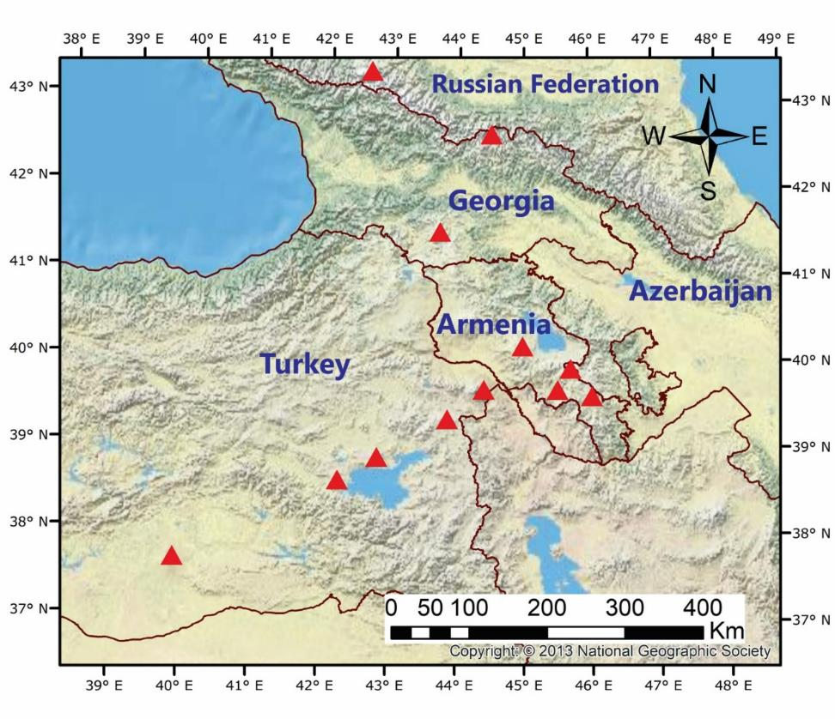
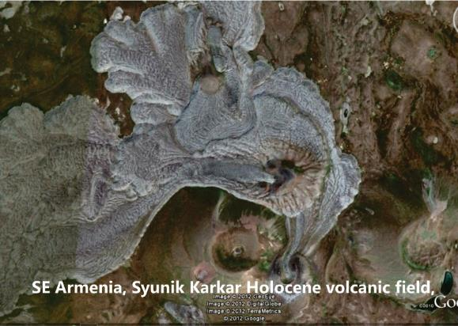
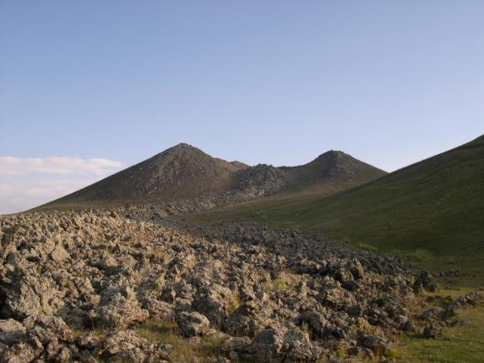
Nazeli Holocene volcano, Syunik volcanic highland, south Armenia
Holocene-historical volcanoes of Armenian Highlands
Post-collisional volcanism initiated 10 Ma and lasted to Holocene and historical times

Slide 11
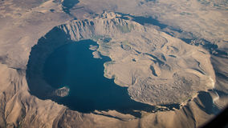
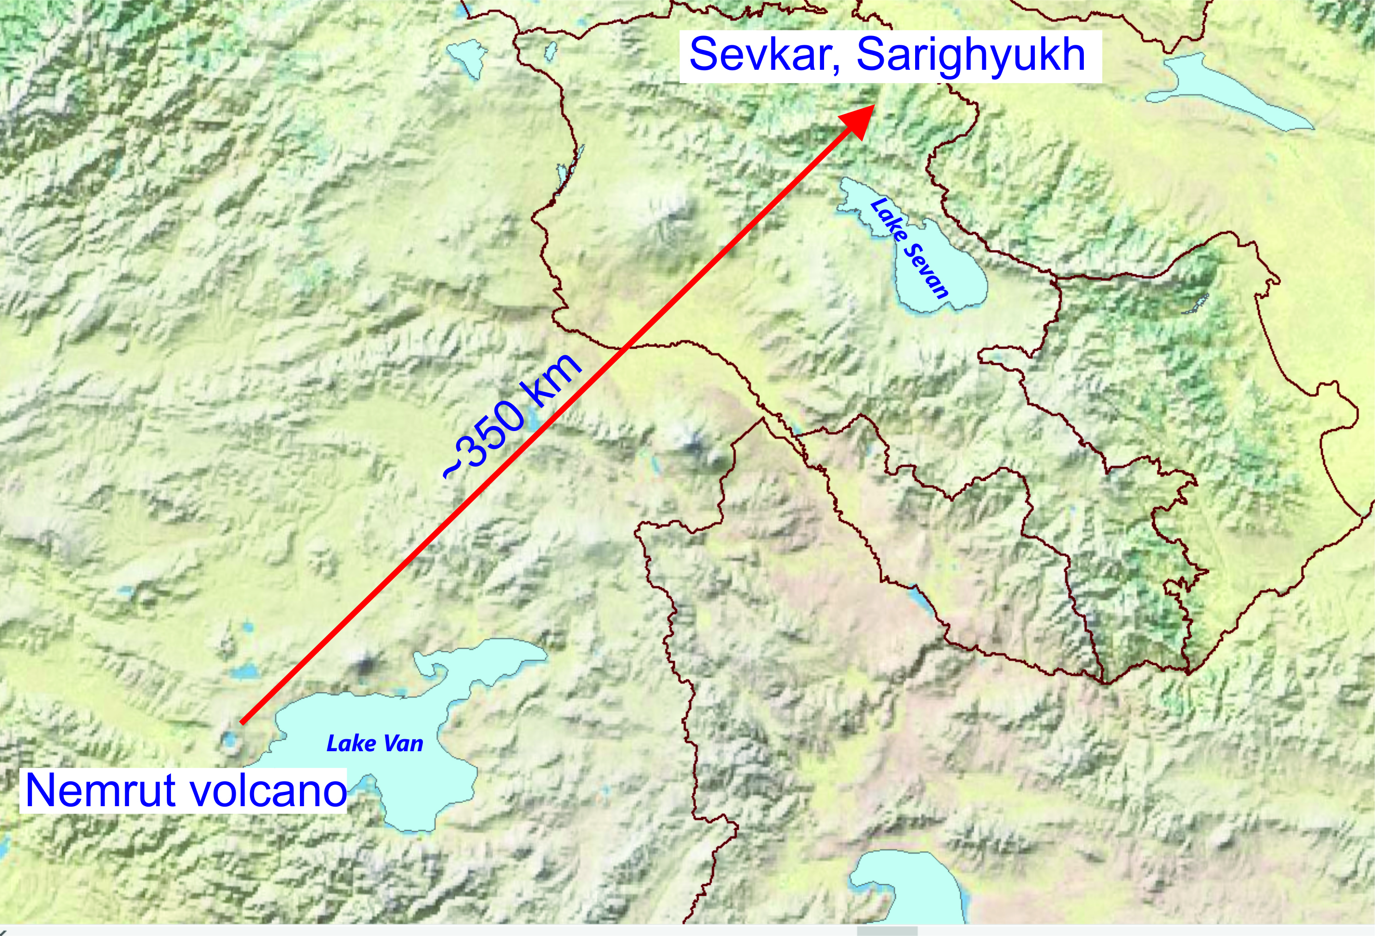
Nemrut volcano, eastern Turkey, Capable to produce VEI-6 explosive eruptions, last eruption 15th Century
Achajur area
Historical eruption of Nemrut volcano are dated to 1441 according to historical observations (in “Memory Notes of Armenian Chronicles” of the 15th century)
Based on geochemistry and 40Ar/39Ar age (194 Ka ± 8.5), we established, that tephra fallout is related to VEI-6 eruption of Nemrut volcano (189.2-194.5 Ka), named AP-1 eruption and described.

Slide 12
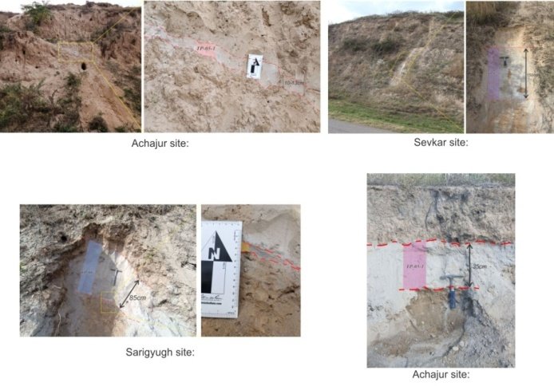
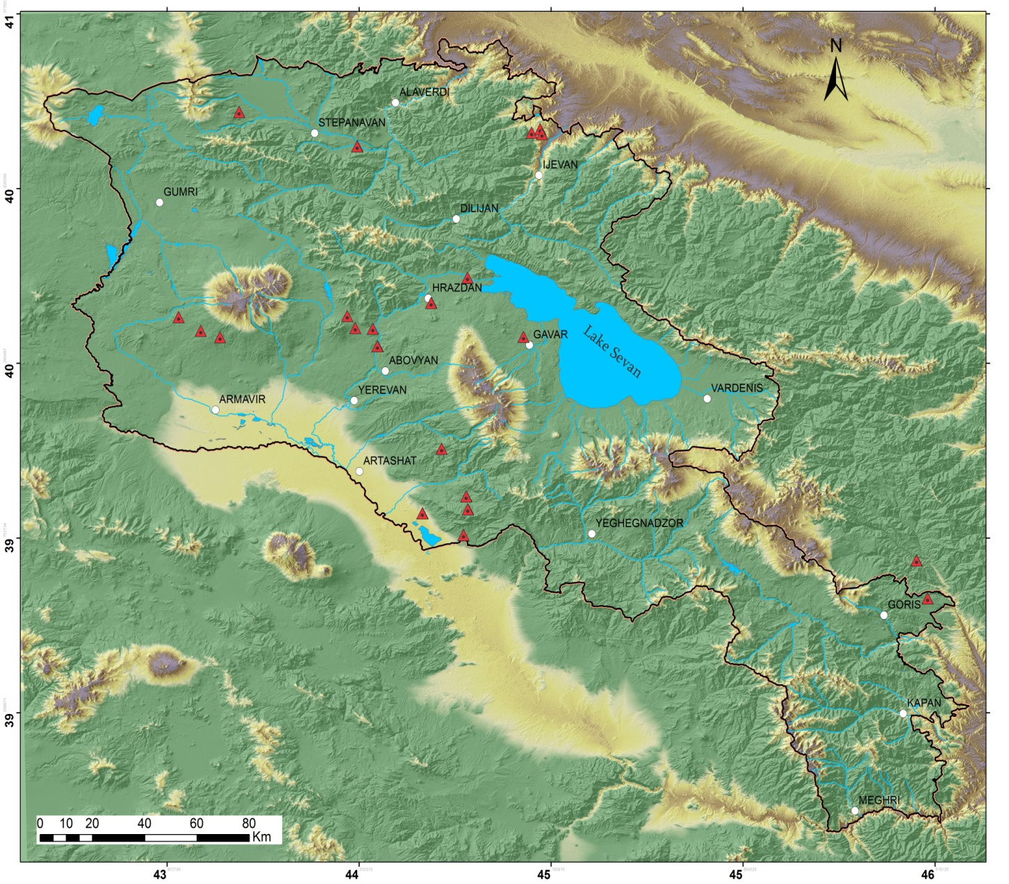
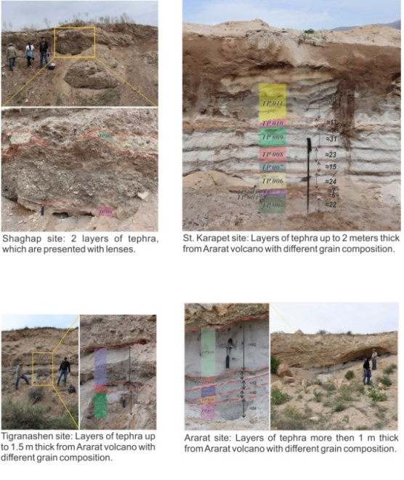
The location of some tephra deposits in the territory of Armenia.

Slide 13
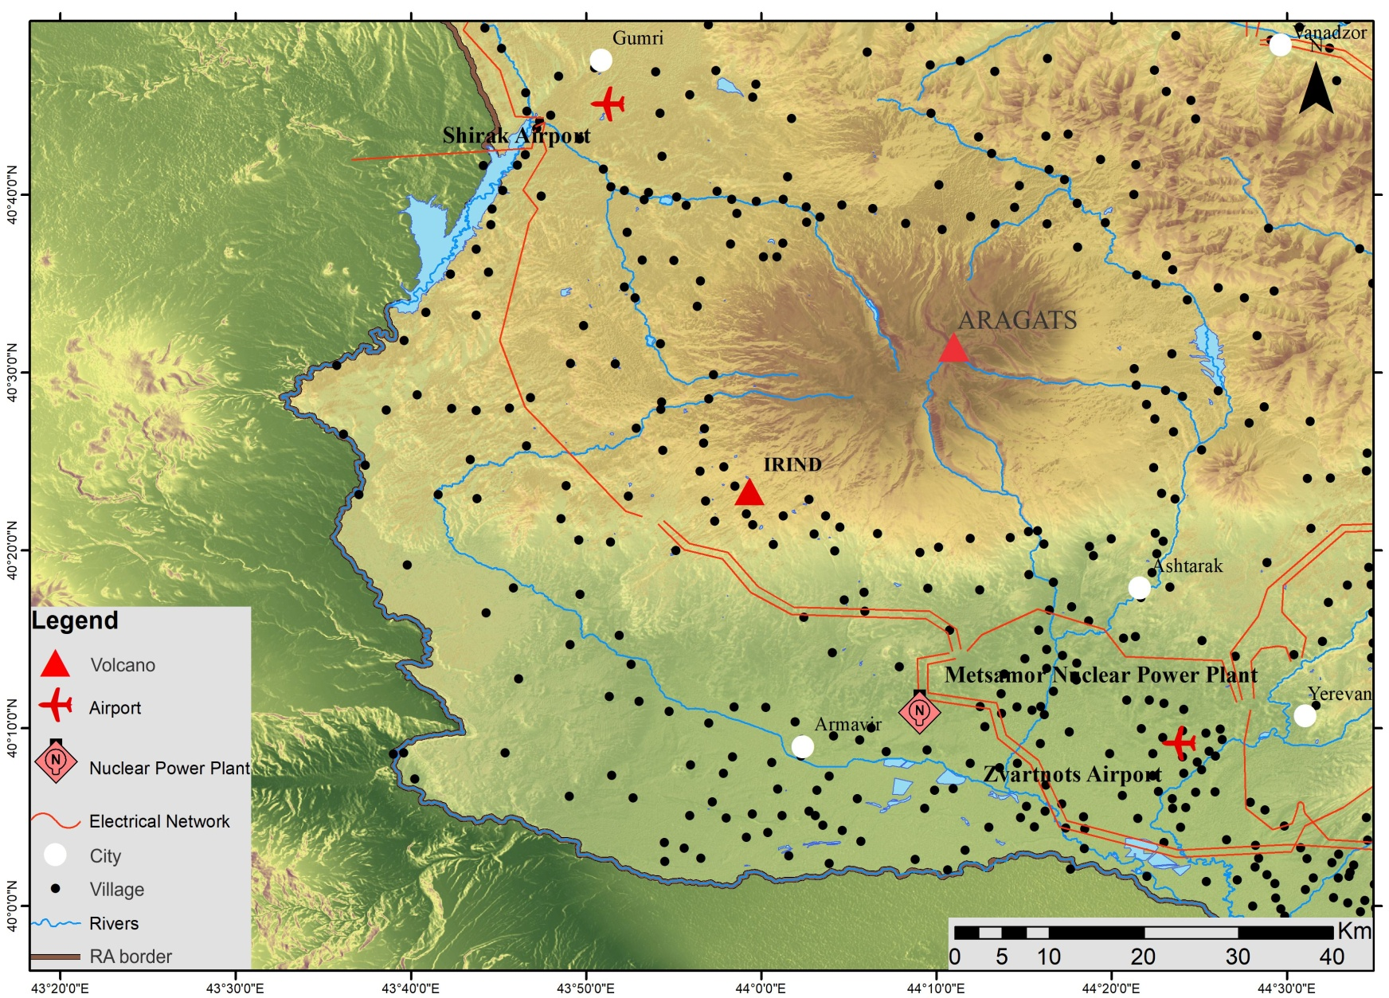
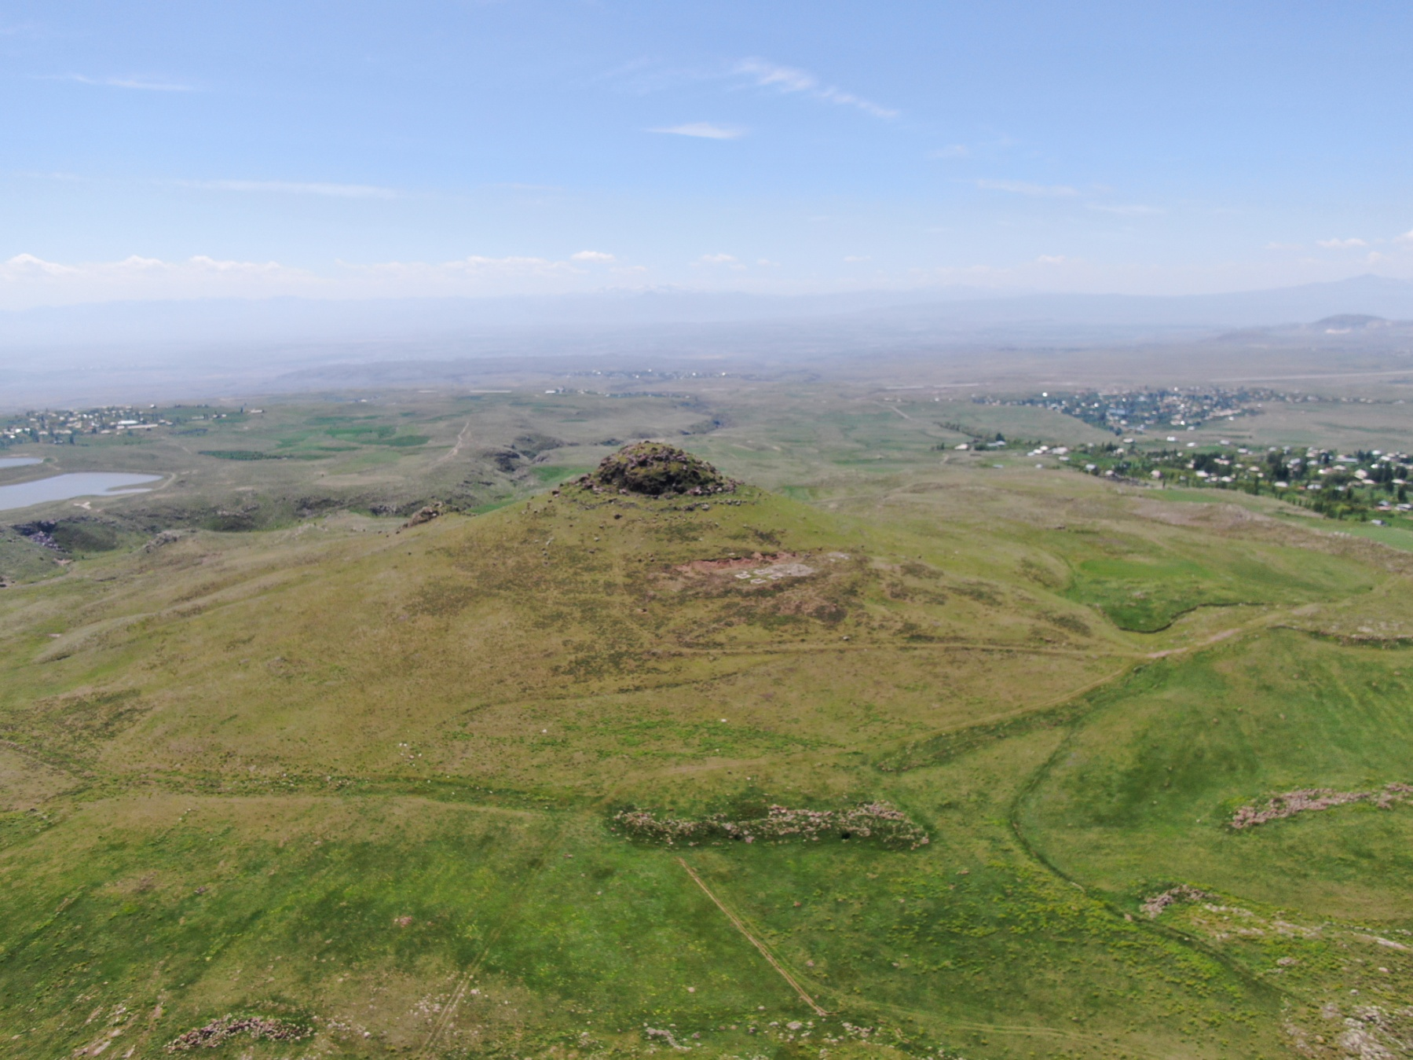
Irind volcano (case study)
Age: 0.490 ± 0.028 Ma (⁴⁰Ar/³⁹Ar method)

Slide 14
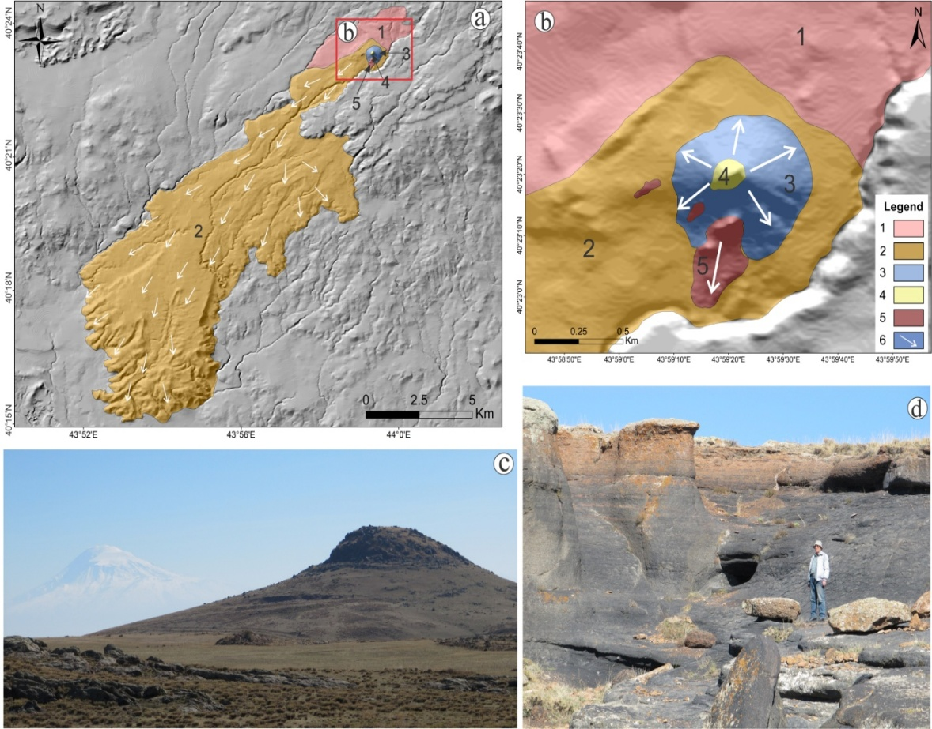
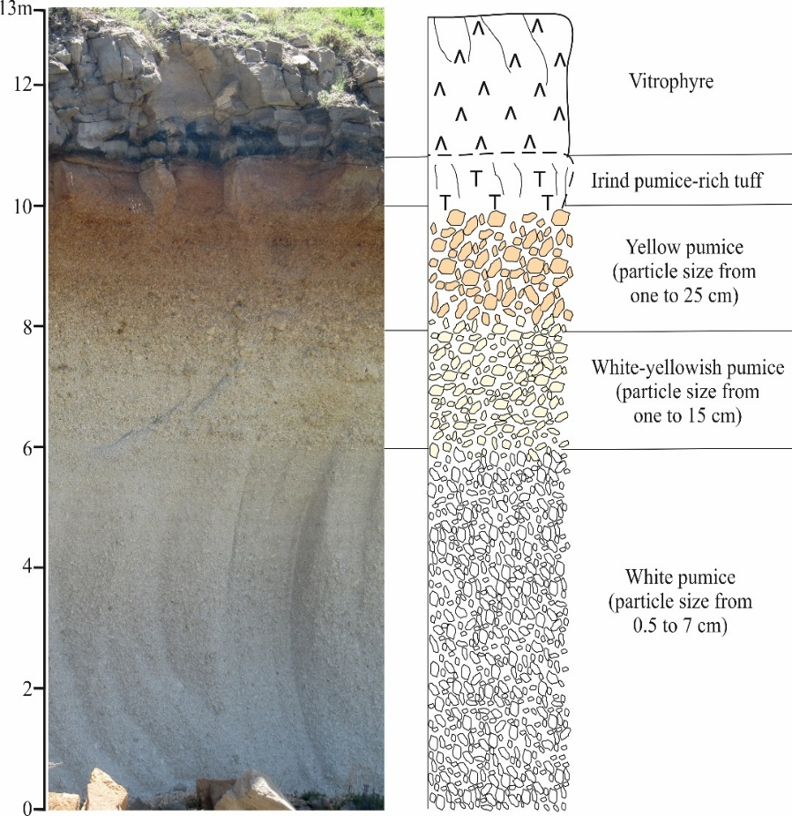
Geological settings and volcano-stratigraphy
The eruption is classified as Sub-Plinian with a VEI of 4–5. The explosive volume is estimated at 0.1–1 km³. The effusive phase produced lava flows with a total volume of 2.9–3.6 km³, extending 18 km from the vent to form the Ashnak plateau.
Overview (a) and close-up (b) sketch maps of Irind volcano and its products. Legend: 1. Explosive Sub-Plinian phase, 2. Effusive phase, 3. The contour of the volcanic edifice of Irind volcano, 4. Trachydacite dome (plug) of Irind volcano, 5. Lavas from a system of cracks. White arrows show directions of lava flows (c) Photograph of the vent/plug of Irind volcano with Ararat stratovolcano in the background (in white). (d) Black-reddish column-collapse vitrophyre outcropping on the western flank of Irind volcano
Geological section of the pyroclastic fall and flow deposits of the Irind volcano outcropping 13 m northwest from the top of Irind volcano.

Slide 15
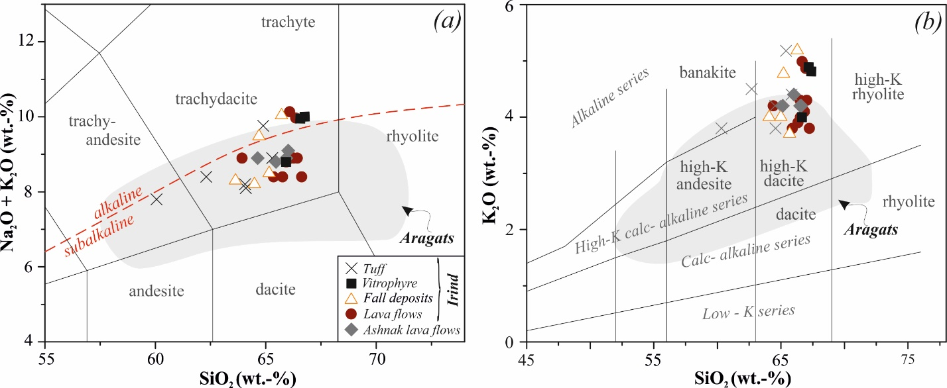
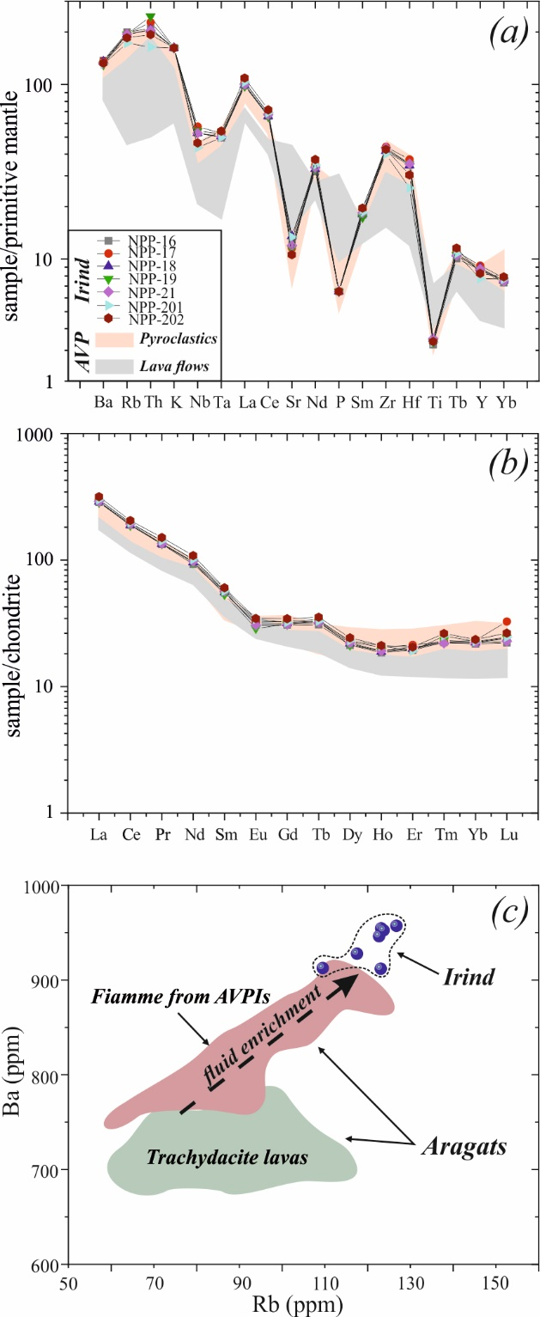
  Geochemistry
Element variation diagrams of Irind products in comparison with the one from AVP (data from Gevorgyan et al., 2018 and Meliksetian, 2012); (a) incompatible trace elements normalized to the primitive mantle and (b) chondrite-normalized REE patterns (Sun and McDonough, 1989). c) Ba vs Rb diagram showing the fluid enrichment of the Irind trachytes and trachydacites (blue dots) vs. to the Aragats trachydacites (green field, data from Meliksetian, 2012) and fiamme from AVPIs (AVP ignimbrites: data from Gevorgyan et al., 2018).
Chemical composition of Irind and Aragats products, as well as Ashnak lava flows according to the a) TAS-diagram (modified after LeBas & Streckeisen, 1991) and b) K₂O vs SiO₂ (modified after Peccerillo & Taylor, 1976). Alkaline/sub-alkaline boundary after Irvine and Baragar (1971). Plotted data of Aragats pyroclastics and lavas from Gevorgyan et al. (2018) and Meliksetian (2012).

Slide 16
Tephra dispersion numerical modelling:
Tephra2 code
Eruption Parameters
Wind profile requirements

Slide 17
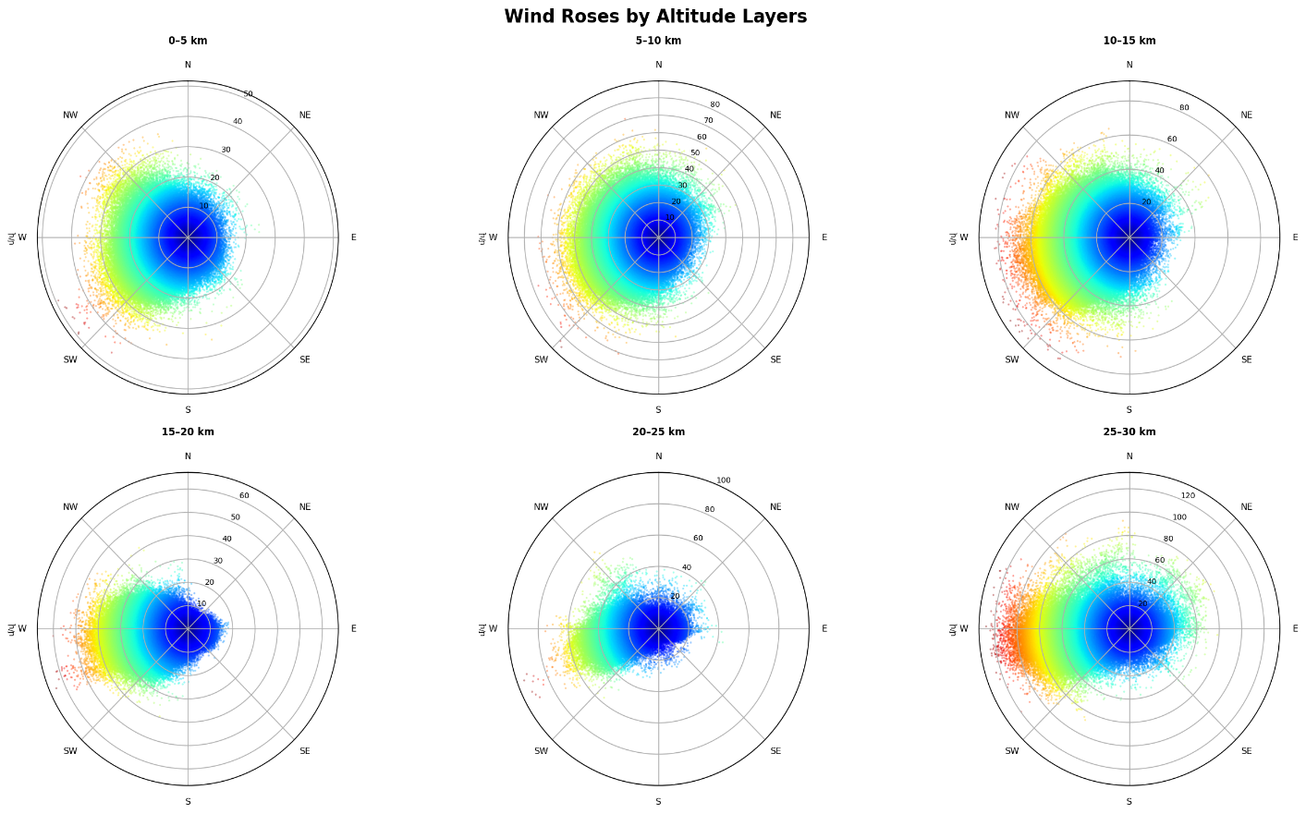
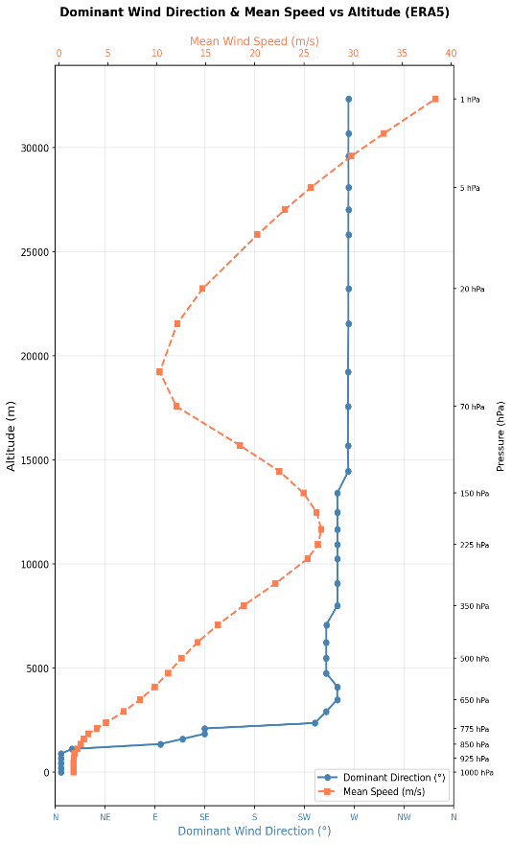
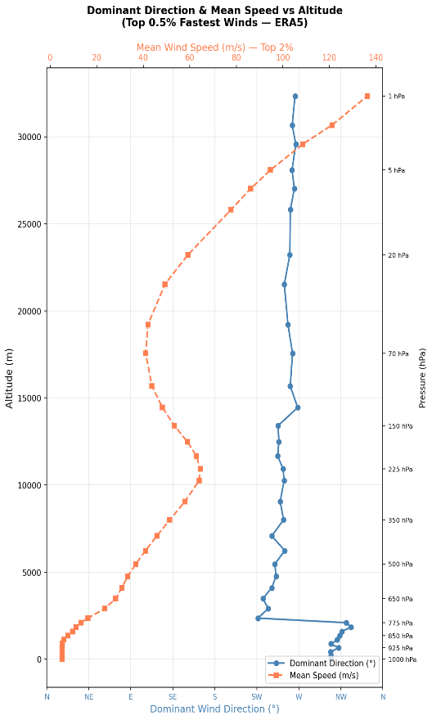
To construct probability maps for Irind eruption and tephra dispersal scenarios, a wind dataset for the area was obtained from the ERA5 global dataset for the period 1970–2024 with a temporal resolution of every 3 hours across 13 pressure levels.

Slide 18
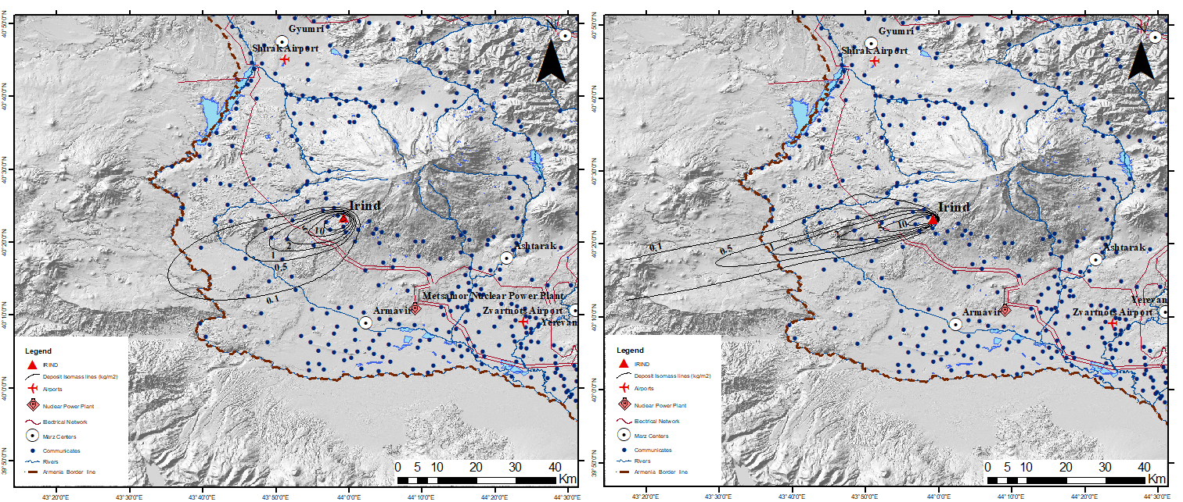
Tephra2 simulation
A
B
Calculated hazard map for a volcanic column height of 6 km and a mass of 1×10⁹ kg.
A. Under conditions of prevailing wind direction and average wind speed.
B. Under conditions of prevailing wind direction and maximum wind speed.

Slide 19
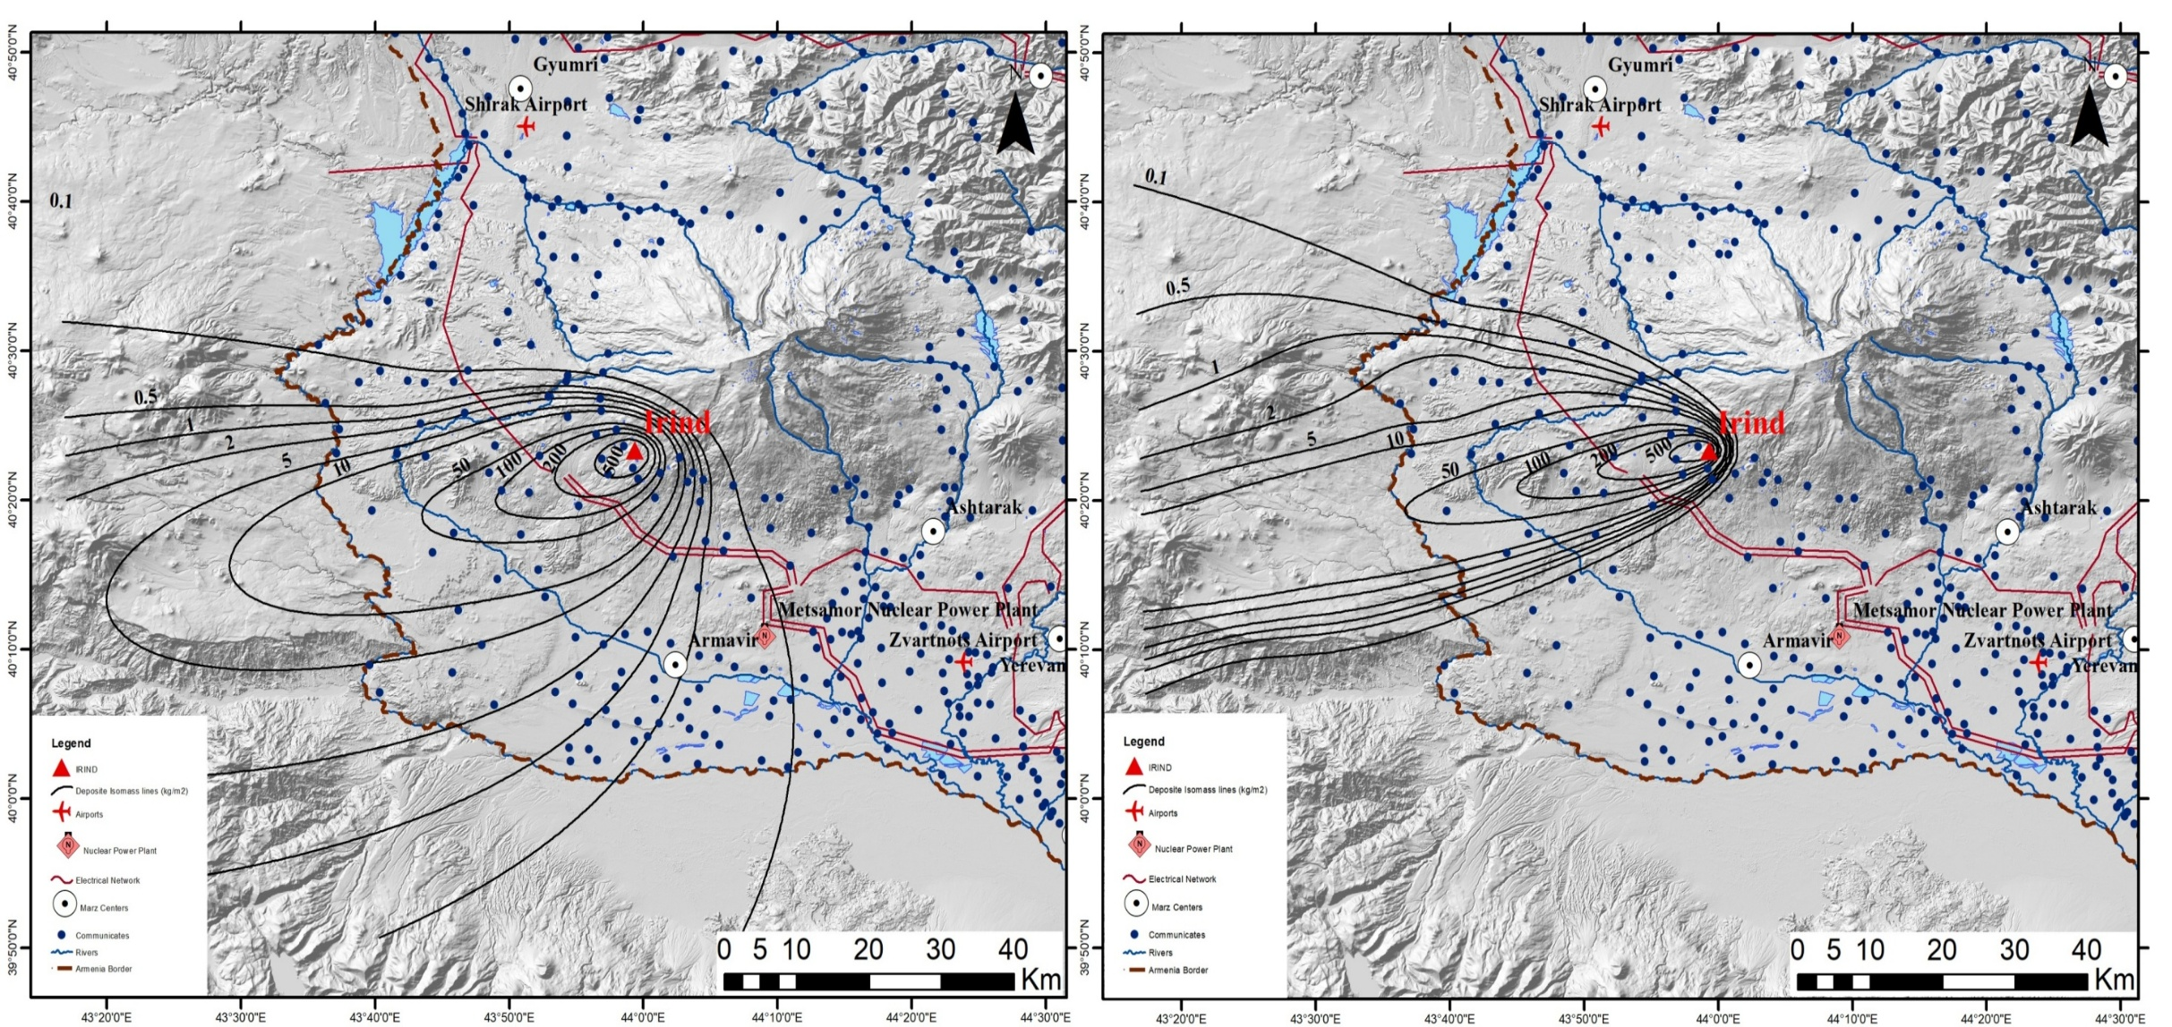
Tephra2 simulation
A
B
Calculated hazard map for a volcanic column height of 10 km and a mass of 1×10¹¹ kg.
A. Under conditions of prevailing wind direction and average wind speed.
B. Under conditions of prevailing wind direction and maximum wind speed.

Slide 20
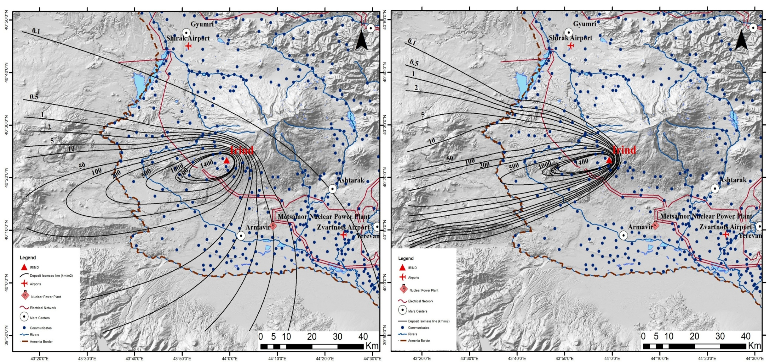
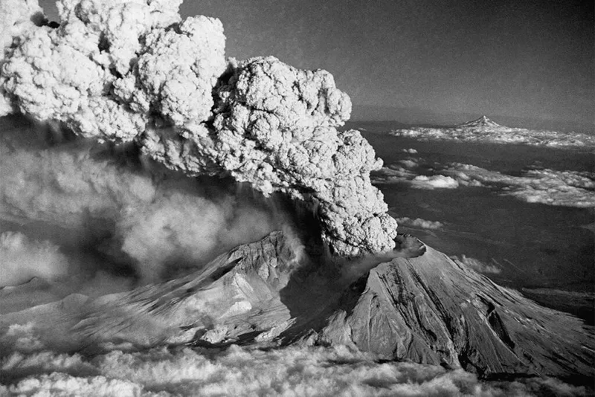
Tephra2 simulation
A
B
St. Helens Volcano (USA)
Eruption of May 18, 1980.
Calculated hazard map for a volcanic column height of 12 km and a mass of 1×10¹² kg.
A. Under conditions of prevailing wind direction and average wind speed.
B. Under conditions of prevailing wind direction and maximum wind speed.

Slide 21
Published paper
No
Submitted papers (under review)
Q1 journal – 3
Q2 journal – 1
Conference
Grigoryan E., Meliksetian Kh., Savov I., Navasardyan G., Gevorgyan R., Bangoyan M. - Geochemical features and source of the eruption of tephras found in the Achajur area (NE Armenia) - Tephra: Chronology, Stratigraphy, Hazards, & Climate, 2024, Catania, Italy
Grigoryan E., Savov I., Navasardyan G., Sahakyan N., Bangoyan M., Plinain fall deposits from Ararat stratovolcano preserved in Armenia, ՛՛CONTINENTAL COLLISION ZONE VOLCANISM AND ASSOCIATED HAZARDS՛՛ CONFERENCE, 2023, Yerevan, Armenia
Navasardyan G., Grigoryan E., Savov I., Halama R., Baghasaryan A., Grigoryan H., Meliksetian Kh., Geological structure and volcanic evolution of the Arailer polygenetic volcano (Armenia), International Conference "GEOLOGY IN THE 21ST CENTURY“, 2025 Yerevan, Armenia, 7-9 October.
Grigoryan H., Meliksetian Kh., Savov I., Navasardyan G., Gevorgyav R., Halama R., Baghasaryan A., Grigoryan E., Tephra dispersal modelling and hazard assessment of sub-plinian eruptions: the example of the Irind vent, Armenia, International Conference "GEOLOGY IN THE 21ST CENTURY“, 2025 Yerevan, Armenia, 7-9 October.
Baghasaryan A., Meliksetian Kh., Savov I., Navasardyan G., Halama R., Gevorgyav R., Grigoryan H., Grigoryan E., Voghjaberd formation of the Gegham plateau (Armenia): evidence for stratovolcano or caldera activity in the Late Miocene–Pliocene, International Conference "GEOLOGY IN THE 21ST CENTURY“, 2025 Yerevan, Armenia, 7-9 October.

Slide 22
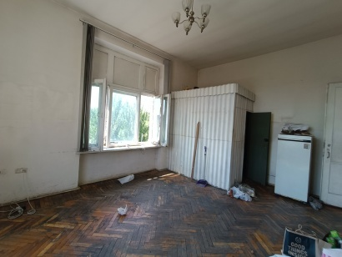
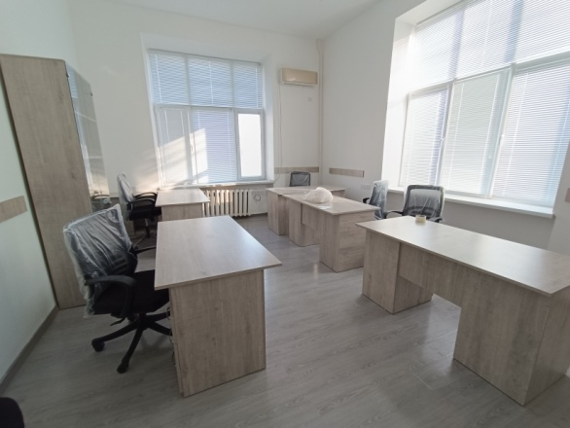
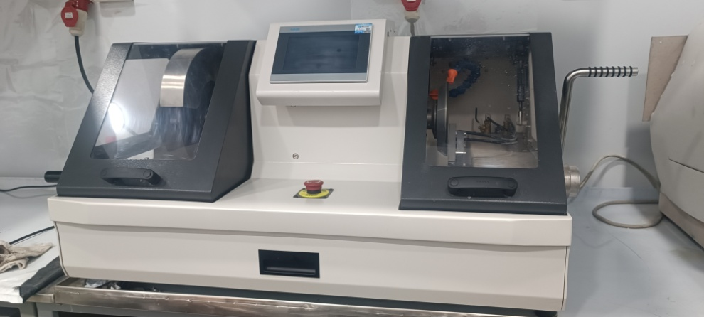
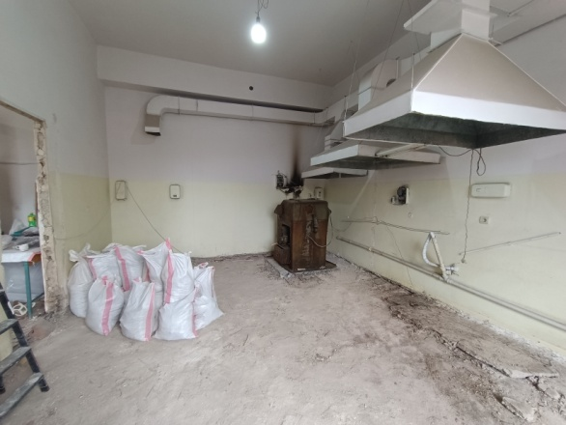
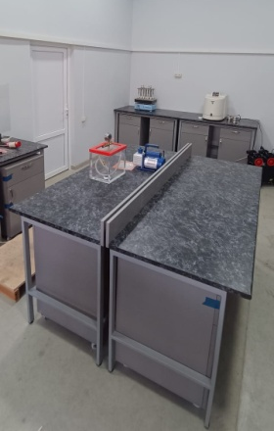


Renovation
Equipment

Slide 23
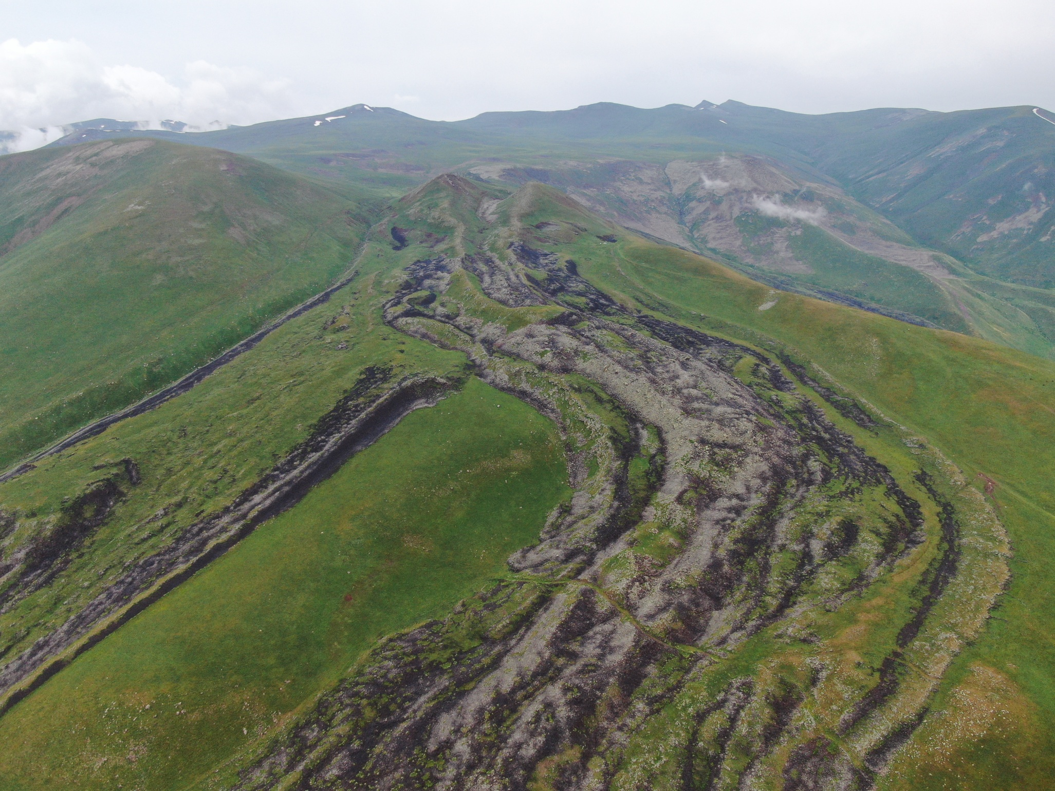
Thank you for your attention
Սմբատասար հրաբուխ
Վարդենիսի հրաբխային
բարձրավանդակ

