Slide 1
Double-Transition Metals MXenes as electrodes of supercapacitors: A DFT study
Hamidreza Jouypazadeh
Postdoctoral Researcher
Computational Materials Science Lab
The Center of Materials Science and Nanotechnology
Yerevan State University

Slide 2
Introduction

Slide 3
Capacitors VS. Batteries
Capacitors
Batteries
High power density
(low charging and discharging time)
High lifecycle
Low energy density
Low power density
(high charging and discharging time)
Low lifecycle
High energy density

Slide 4
Ragone plot for different energy storage devices

Slide 5
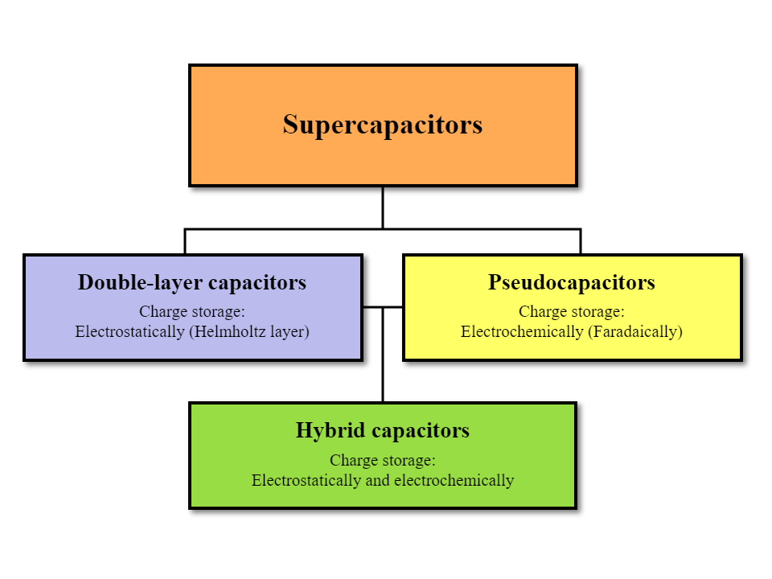

Slide 6
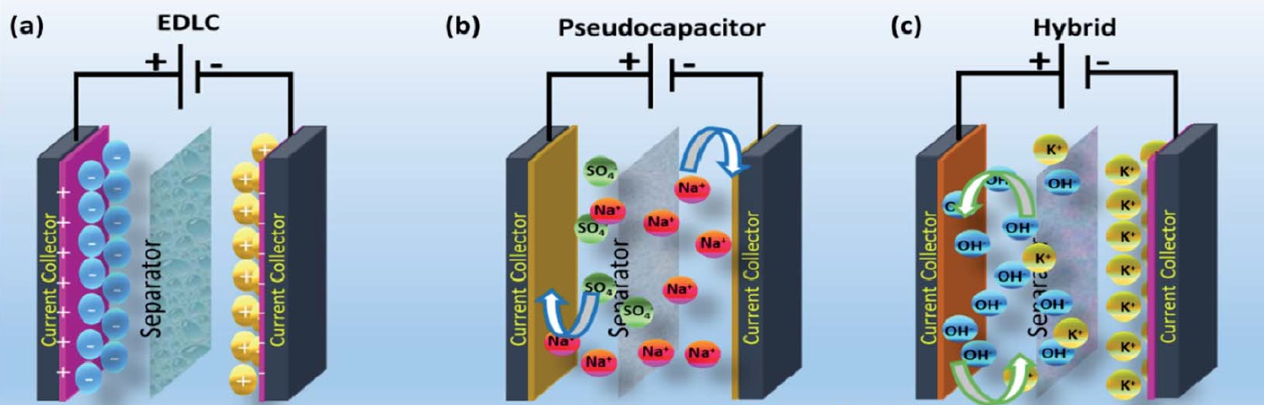
Supercapacitors

Slide 7
Electric Double-Layer
Capacitors (EDLC)
Pseudo Capacitors
(PC)
Storing the charge via double layer formation at electrode/electrolyte interface
Excellent electrochemical stability
Excellent rate performance
Better charge-transfer kinetics
Storing the charge based on the rapid redox reactions at the surface or near surface
Storing higher charge than double-layer capacitors (10-100 times)

Slide 8
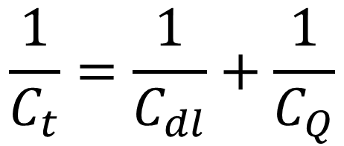
The Capacitance of EDLC
Porous Carbon: surface area: 1500 m²/g
Cdl = 30-70 µF/cm² CSC=4-5 µF/cm²
This limitation is originated from the Density of States near Fermi level
Density of States near Fermi level Quantum Capacitance

Slide 9



Quantum Capacitance
Differential Quantum Capacitance:

Slide 10

Total energy storage capacitance is based on integrated value over a complete charge-discharge cycle
Integrated Quantum Capacitance:

Slide 11
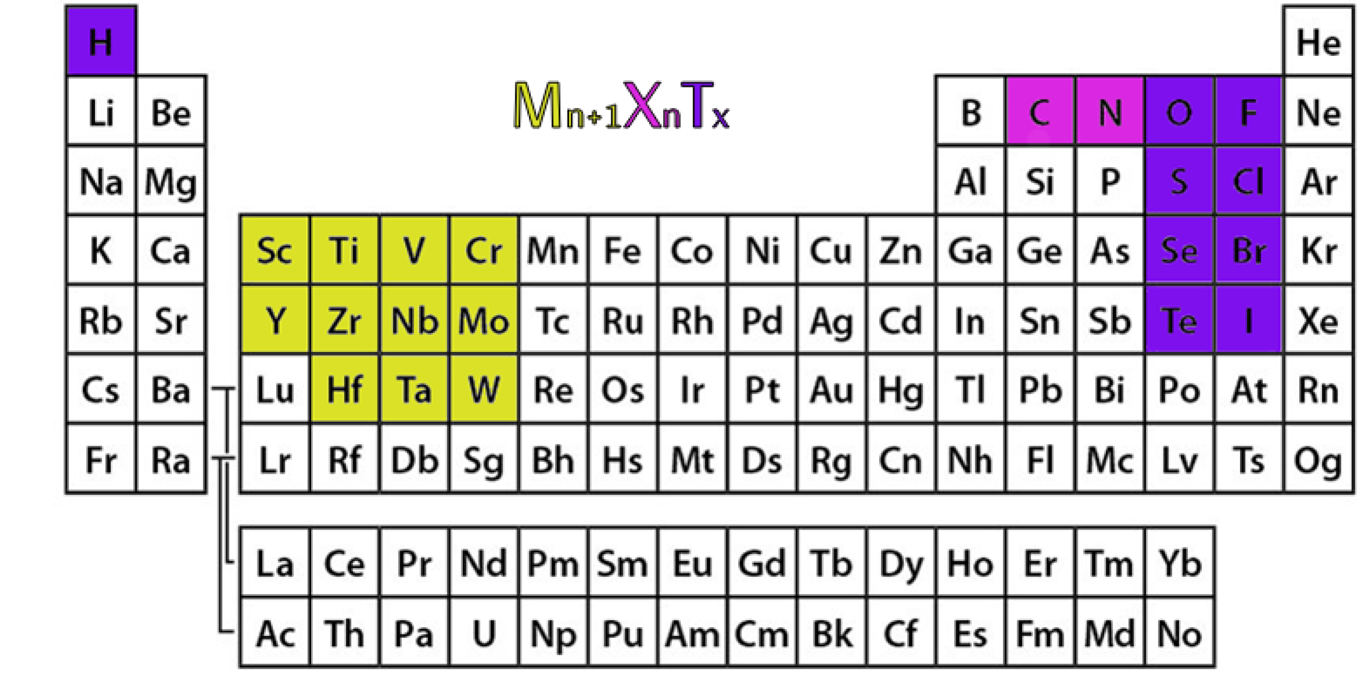
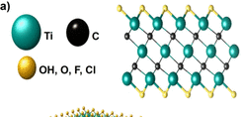
2D transition metal carbides, nitrides, and carbonitrides
MXenes
M. Naguib, M. Kurtoglu, V. Presser, J. Lu, J. Niu, M. Heon, L. Hultman, Y. Gogotsi and M. W. Barsoum, Advanced Materials, 2011, 23, 4248–4253.

Slide 12
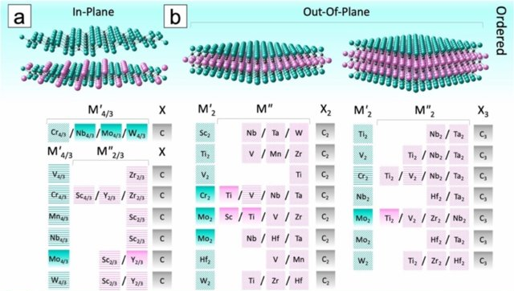
DTM Mxenes
M_{x-y}M’_{y}X_{x-1}T_{x}
.Anasori, Y. Xie, M. Beidaghi, J. Lu, B. C. Hosler, L. Hultman, P. R. Kent, Y. Gogotsi and M. W. Barsoum, ACS nano, 2015, 9, 9507–9516.

Slide 13
Background
MXenes
VxCx-1Ty
MoxCx-1Ty
TixCx-1Ty
ZrxCx-1Ty
ScxCx-1Ty
DTM
MXenes
Zr2MC2O2
ScHfCO2
Cr2/3Sc1/3CO2
Mo2Ti2C3O2

Slide 14
Our work
Mo-Ti
Mo-V
Ti-V
  MoTiC
  Mo2TiC2
  Ti2MoC2
  Mo2Ti2C3
  Ti2Mo2C3
  MoVC
  Mo2VC2
  V2MoC2
  Mo2V2C3
  V2Mo2C3
  TiVC
  Ti2VC2
  V2TiC2
  Ti2V2C3
  V2Ti2C3

Slide 15
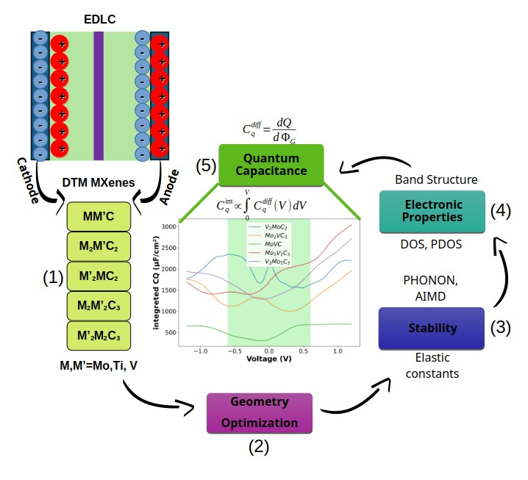

Slide 16
Results

Slide 17
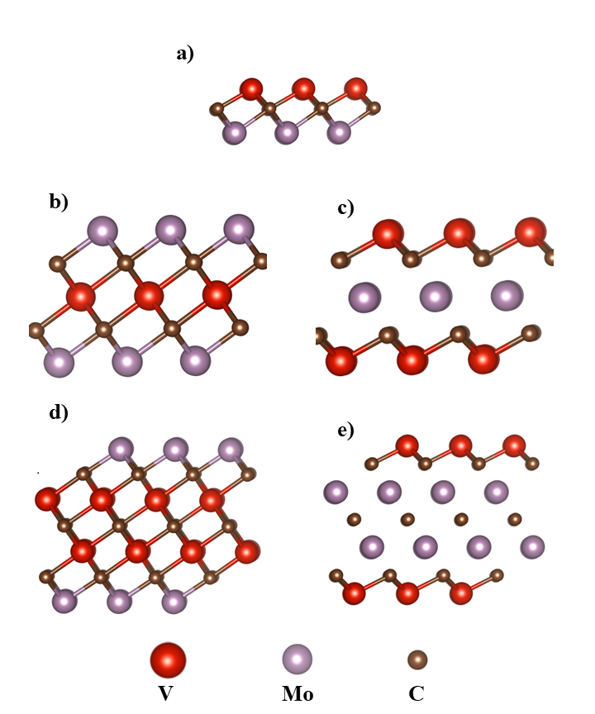
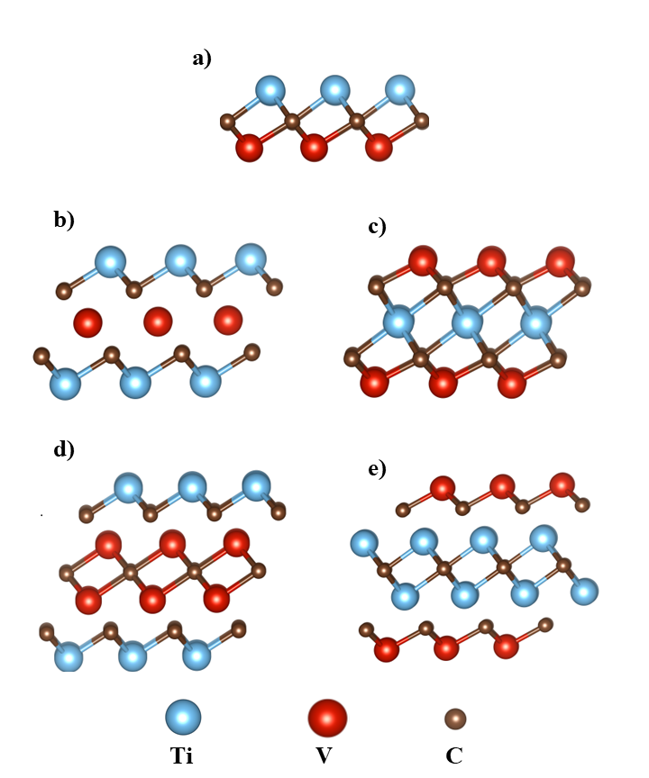
Structures of the DTM MXenes
MoxTiyCx+y-1
MoxVyCx+y-1
TixVyCx+y-1

Slide 18
Stability
10 ps AIMD: small fluctuation in Energy
Undeformed Geometry
Phonon dispersion: No Imaginary modes observed
Elastic Constants: stiffer than corresponding mono-TM Mxenes
Mxenes three and four TM layer are as stiff as graphene

Slide 19
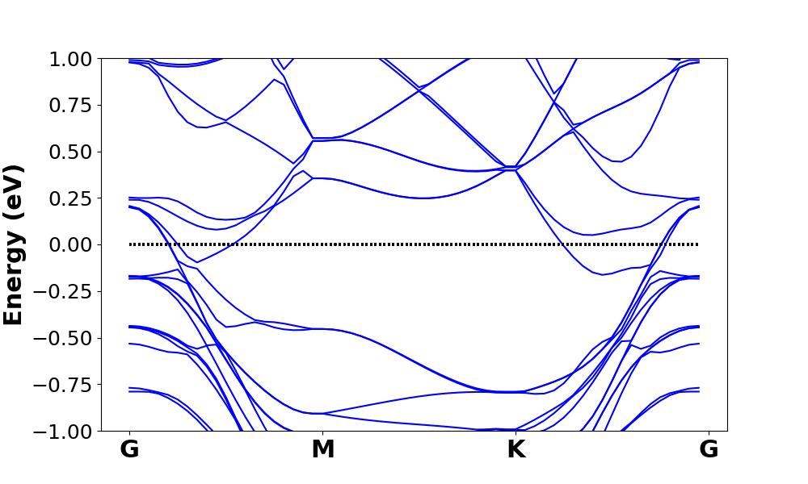
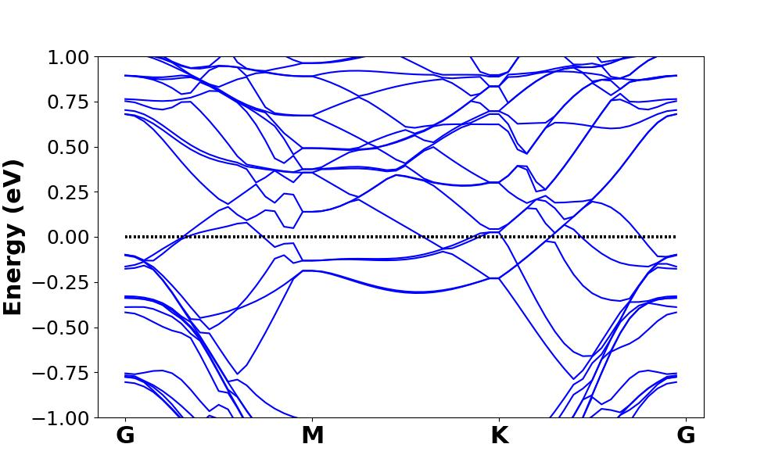
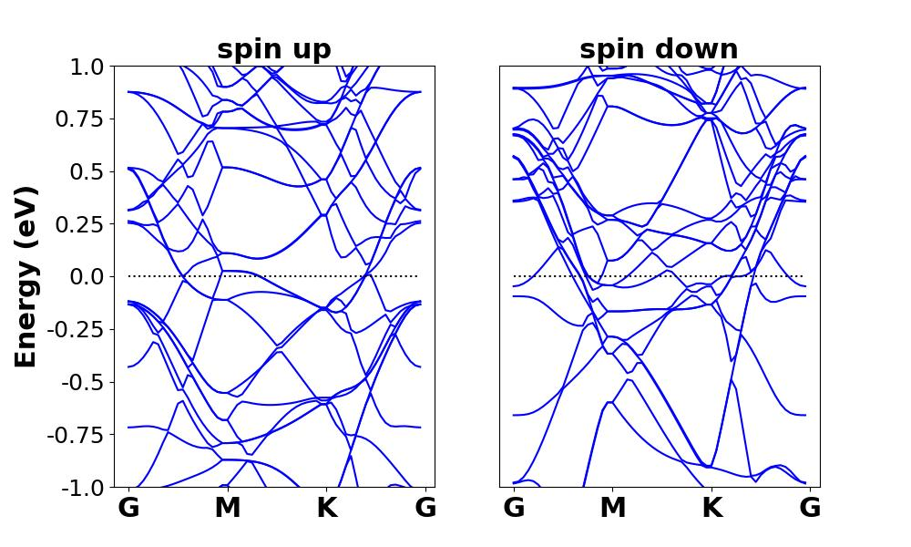
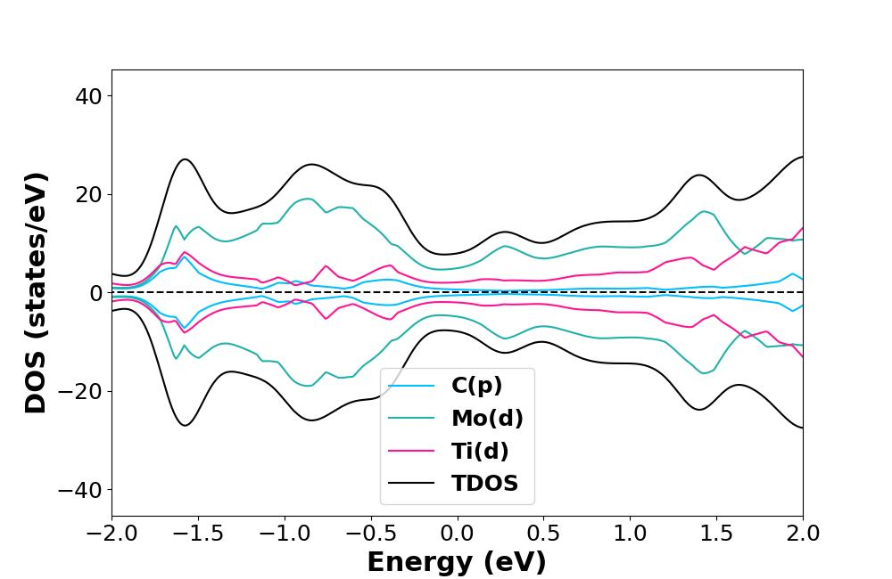
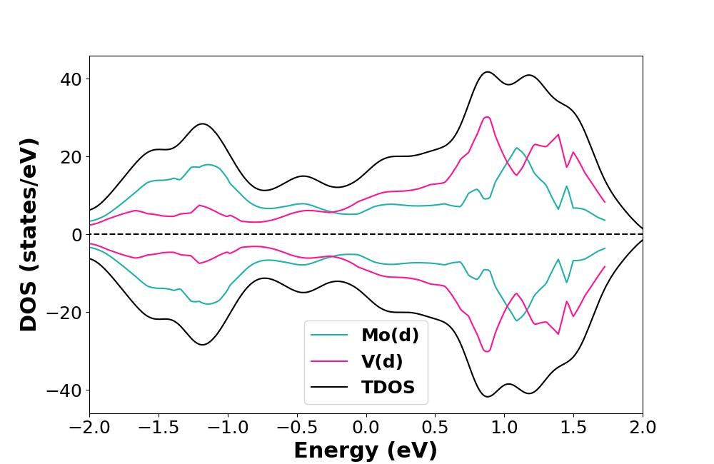
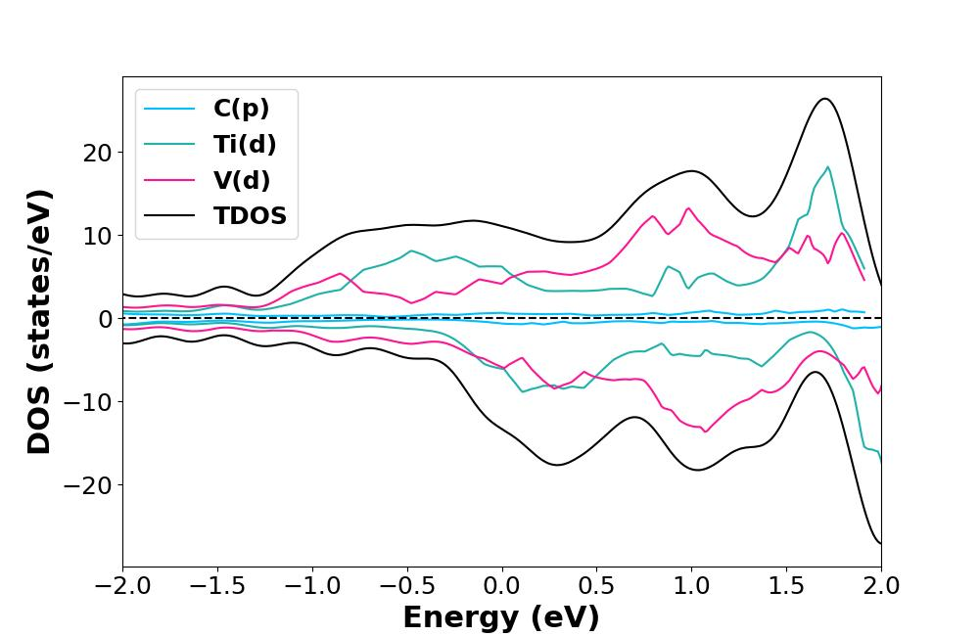
Electronic Properties
Mo2Ti2C3
Mo2V2C3
Ti2V2C3

Slide 20
quantum capacitance
MoxTiyCx+y-1

Slide 21
quantum capacitance
MoxVyCx+y-1

Slide 22
quantum capacitance
TixVyCx+y-1

Slide 23
Conclusion

Slide 24
Mo-Ti DTM MXenes:
The peak of quantum capacitance: 641.39 to 1051.76 μF/cm² in aqueous electrolytes 641.39 to 1053.79 μF/cm² in ionic/organic systems.
The highest quantum capacitance: Ti2Mo2C3 under negative bias (cathode)

Slide 25
Mo-V DTM Mxenes
Mo2VC2, V2MoC2, Mo2V2C3, and V2Mo2C3 reaching peak values of 979.49 to 1521.08 μF/cm² in ionic/organic electrolytes under positive bias (anode) except for V2MoC2
In aqueous electrolytes: 665.54 to 1117.17 μF/cm²
  Mo2VC2, and V2MoC2: cathode
  Mo2V2C3, and V2Mo2C3: anode

Slide 26
Ti-V DTM MXenes:
The Top quantum capacitance of Ti2V2C3 reaches 1443.40 μF/cm² across ionic/organic and 1323.85 at aqueous electrolyte types (anode).
The top quantum Capacitance of V2Ti2C3 exceeds 1200 μF/cm² in negative bias (cathode)

Slide 27

Thanks for your attention
Thanks For Your Attention…

