Slide 1



Hayarpi Javrushyan
PES 2026
YSU, Research Institute of Biology
Laboratory of Basic and Pathological Biochemistry
hg.javrushyan@ysu.am
https://www.linkedin.com/in/hayarpi-javrushyan-496a37122/
Dilijan 2026

Slide 2
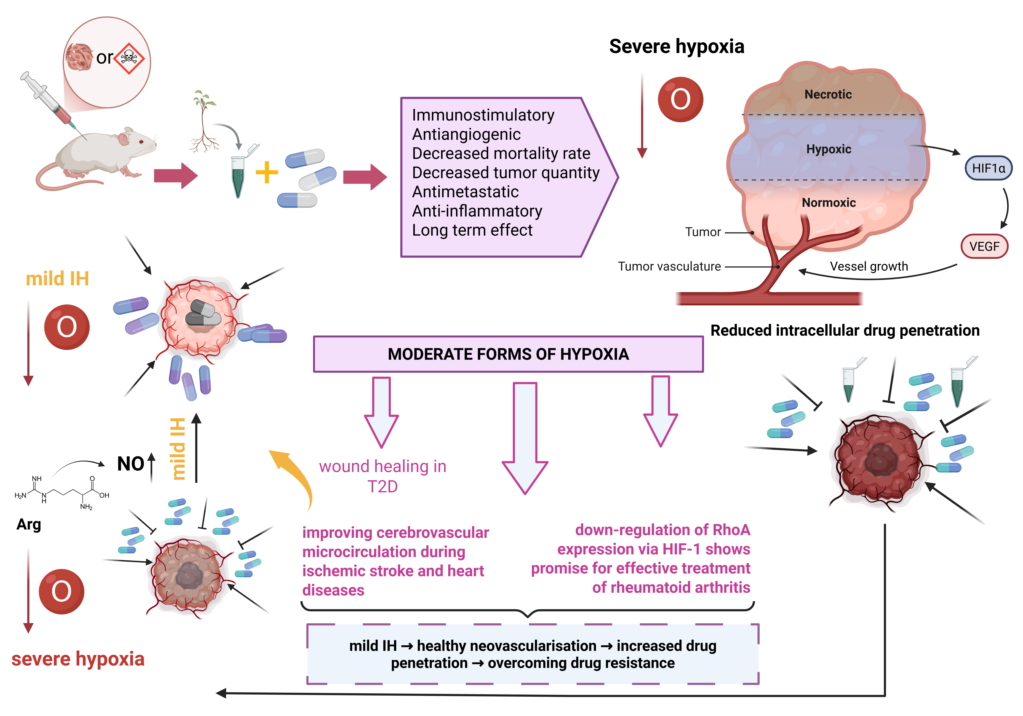
SHORT-TERM INTERMITTENT HYPOXIA AS A GATEWAYTO OVERCOME DRUG RESISTANCE IN BREAST CANCER TREATMENT

Slide 3
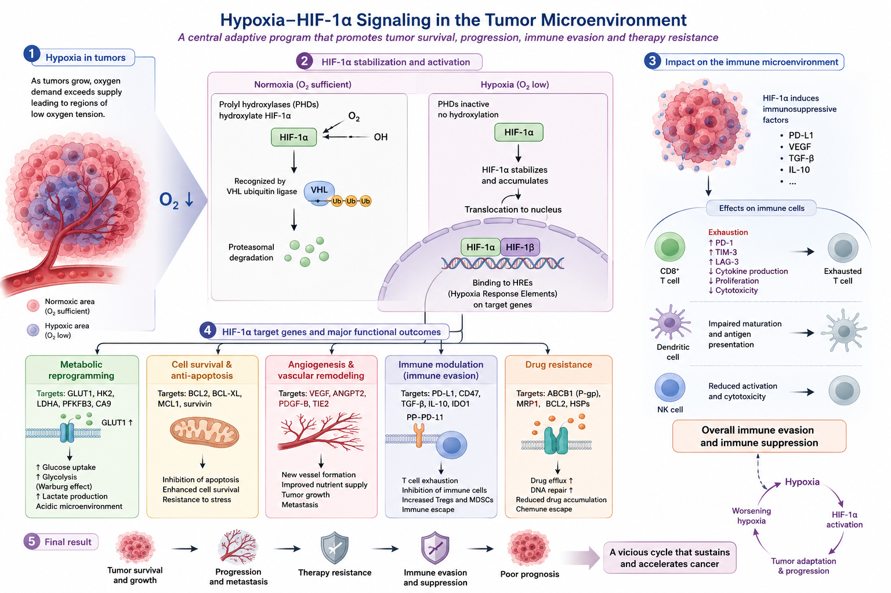

Slide 4
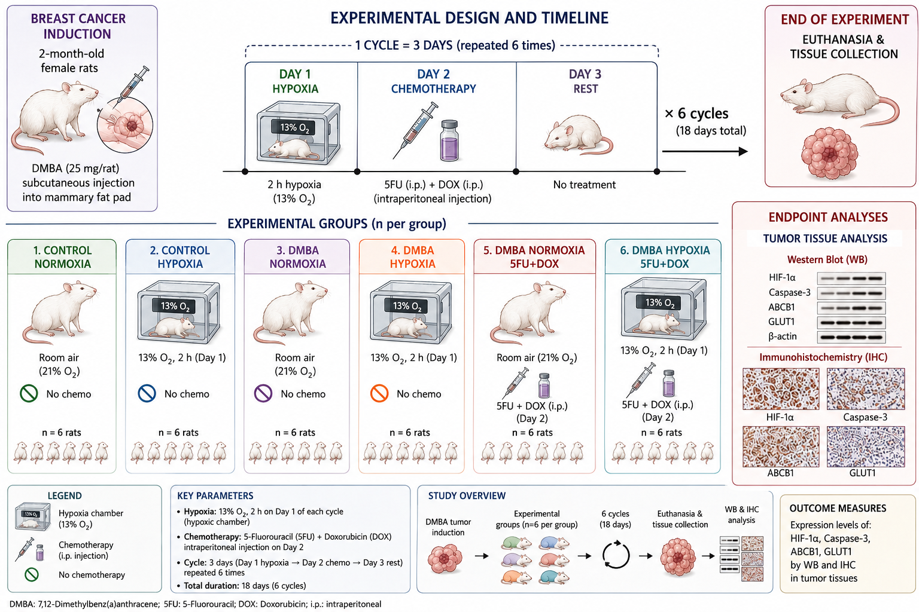
RESEARCH MODEL in vivo EXPERIMENTS

Slide 5

MODULATION OF THE HIF1A/ABCB1 AXIS BY DOXORUBICIN AND 5-FLUOROURACIL: IMPLICATIONS FOR DRUG RESISTANCE IN TUMOR TISSUE

Slide 6
FU-DOX MODULATES HIF-1A, ABCB1, AND CASPASE-3

Slide 7
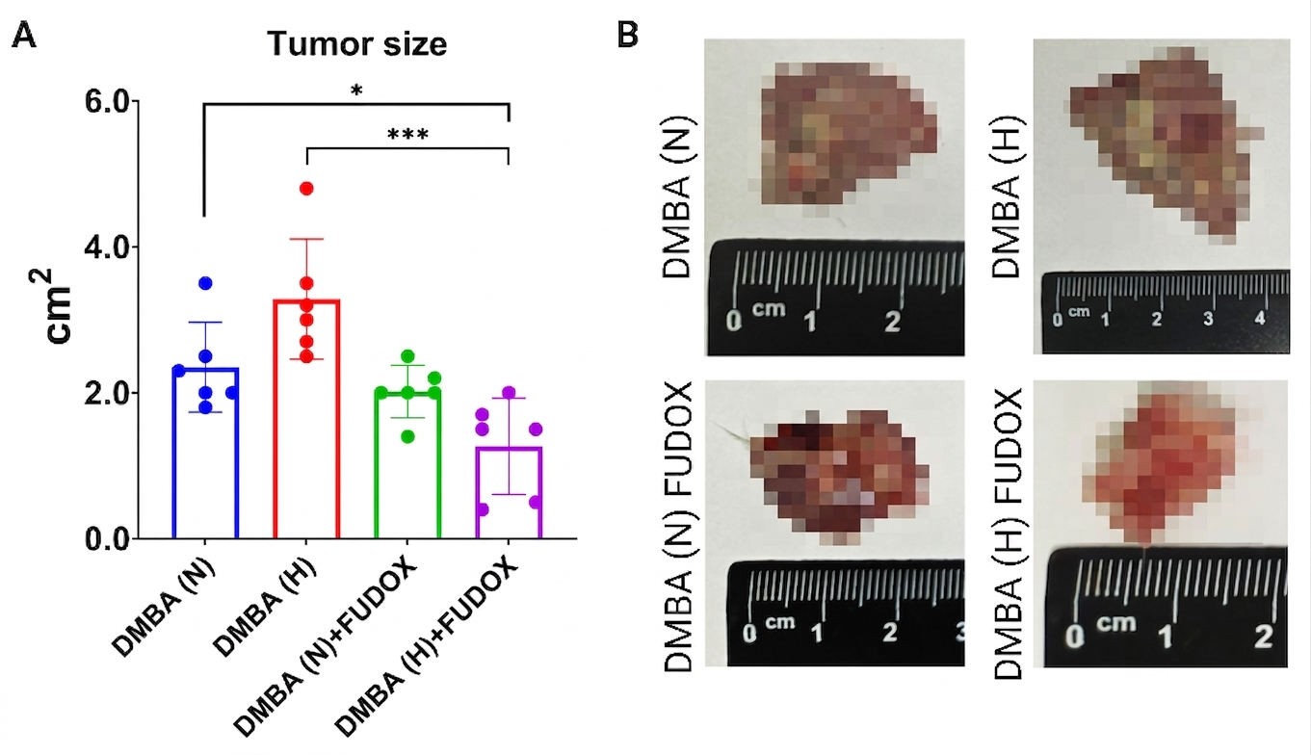
ASSESSMENT OF TUMOR GROWTH

Slide 8
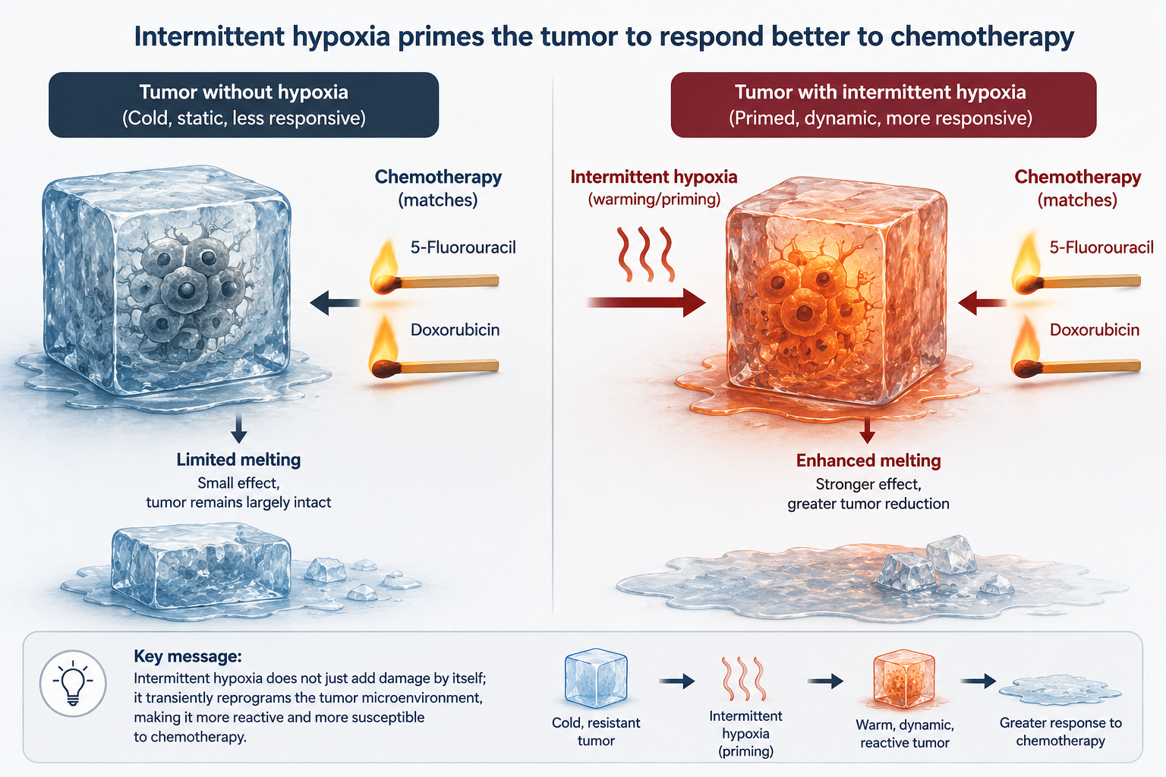

Slide 9
Signal Transduction in Experimental Patholgy
research group
Nadiryan Edita, PhD student, junior researcher
Hovhannsiyan Svetlana, PhD student, junior researcher
Karapetyan Hasmik, PhD, Researcher
Redox Alterations in Pathological Metabolism
Bone Marrow Microenvironment in Cancer
Metabolic Reprogramming in T2D

Slide 10
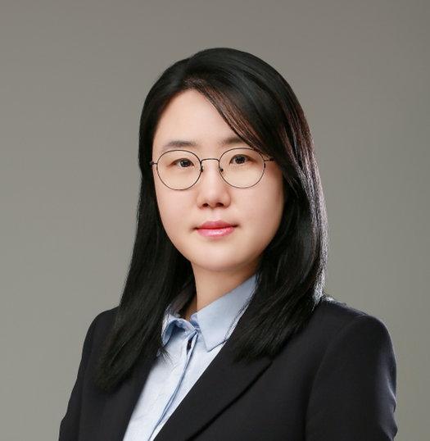
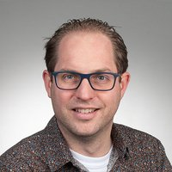
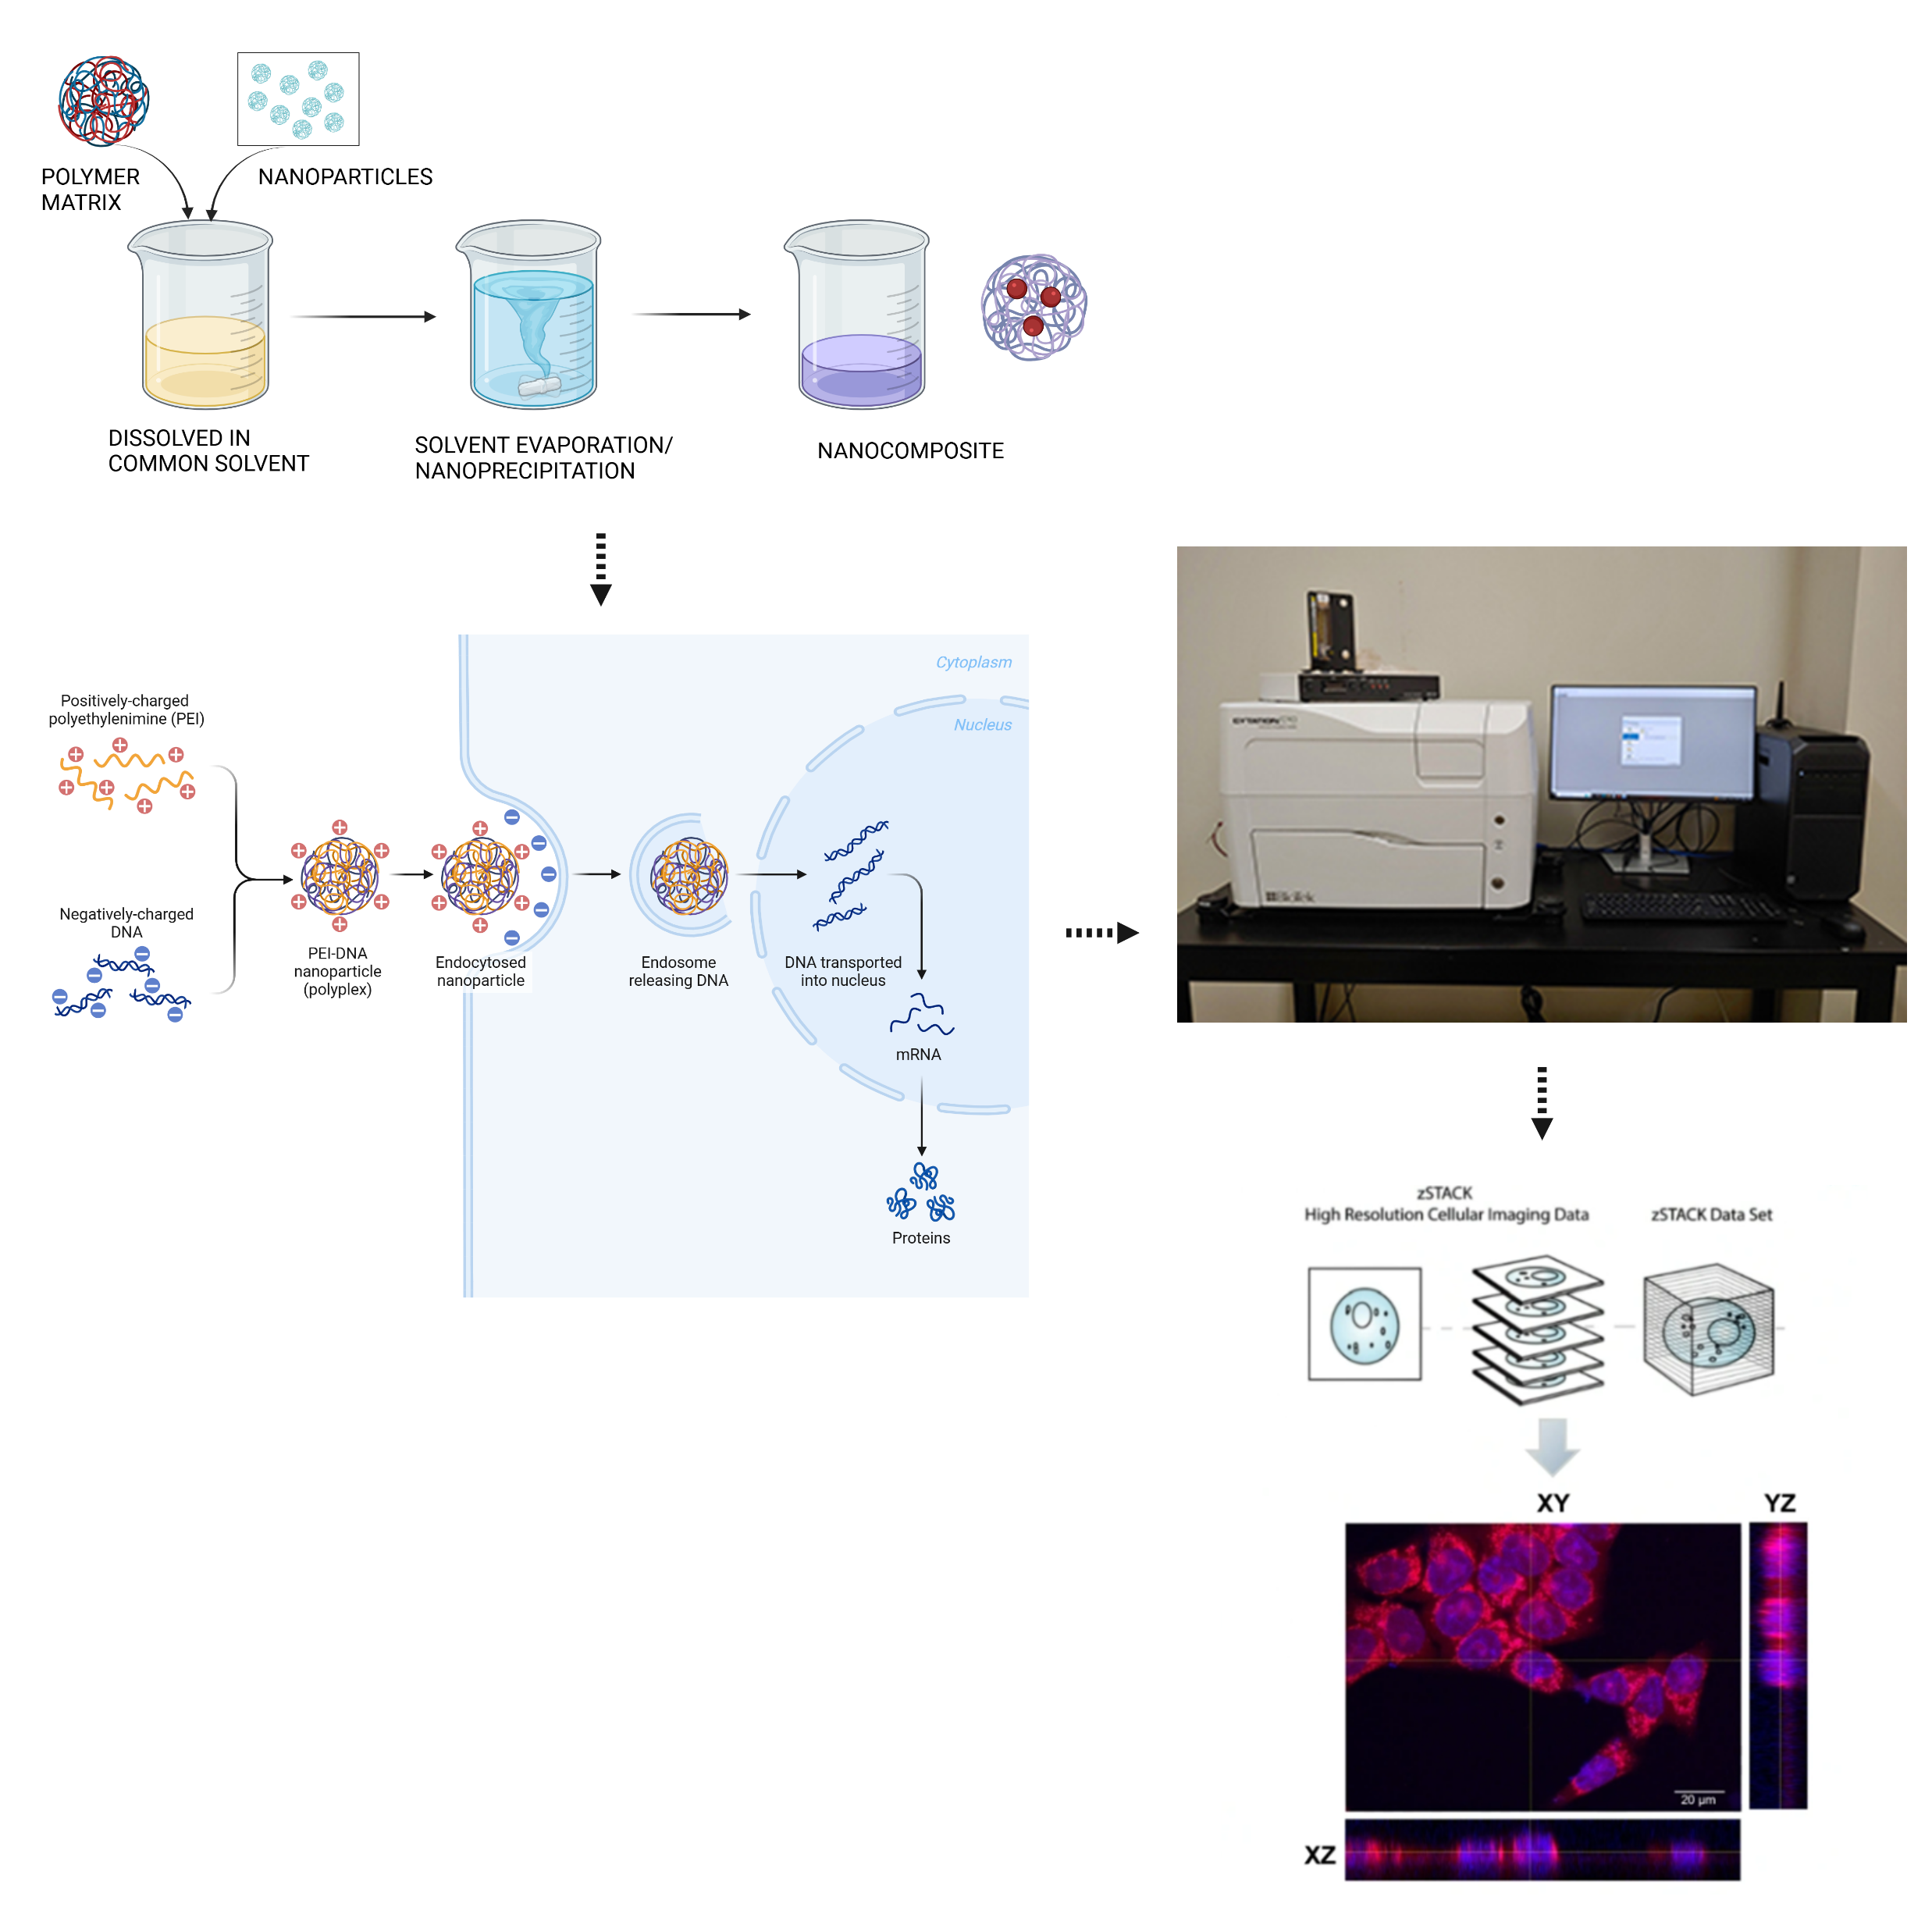
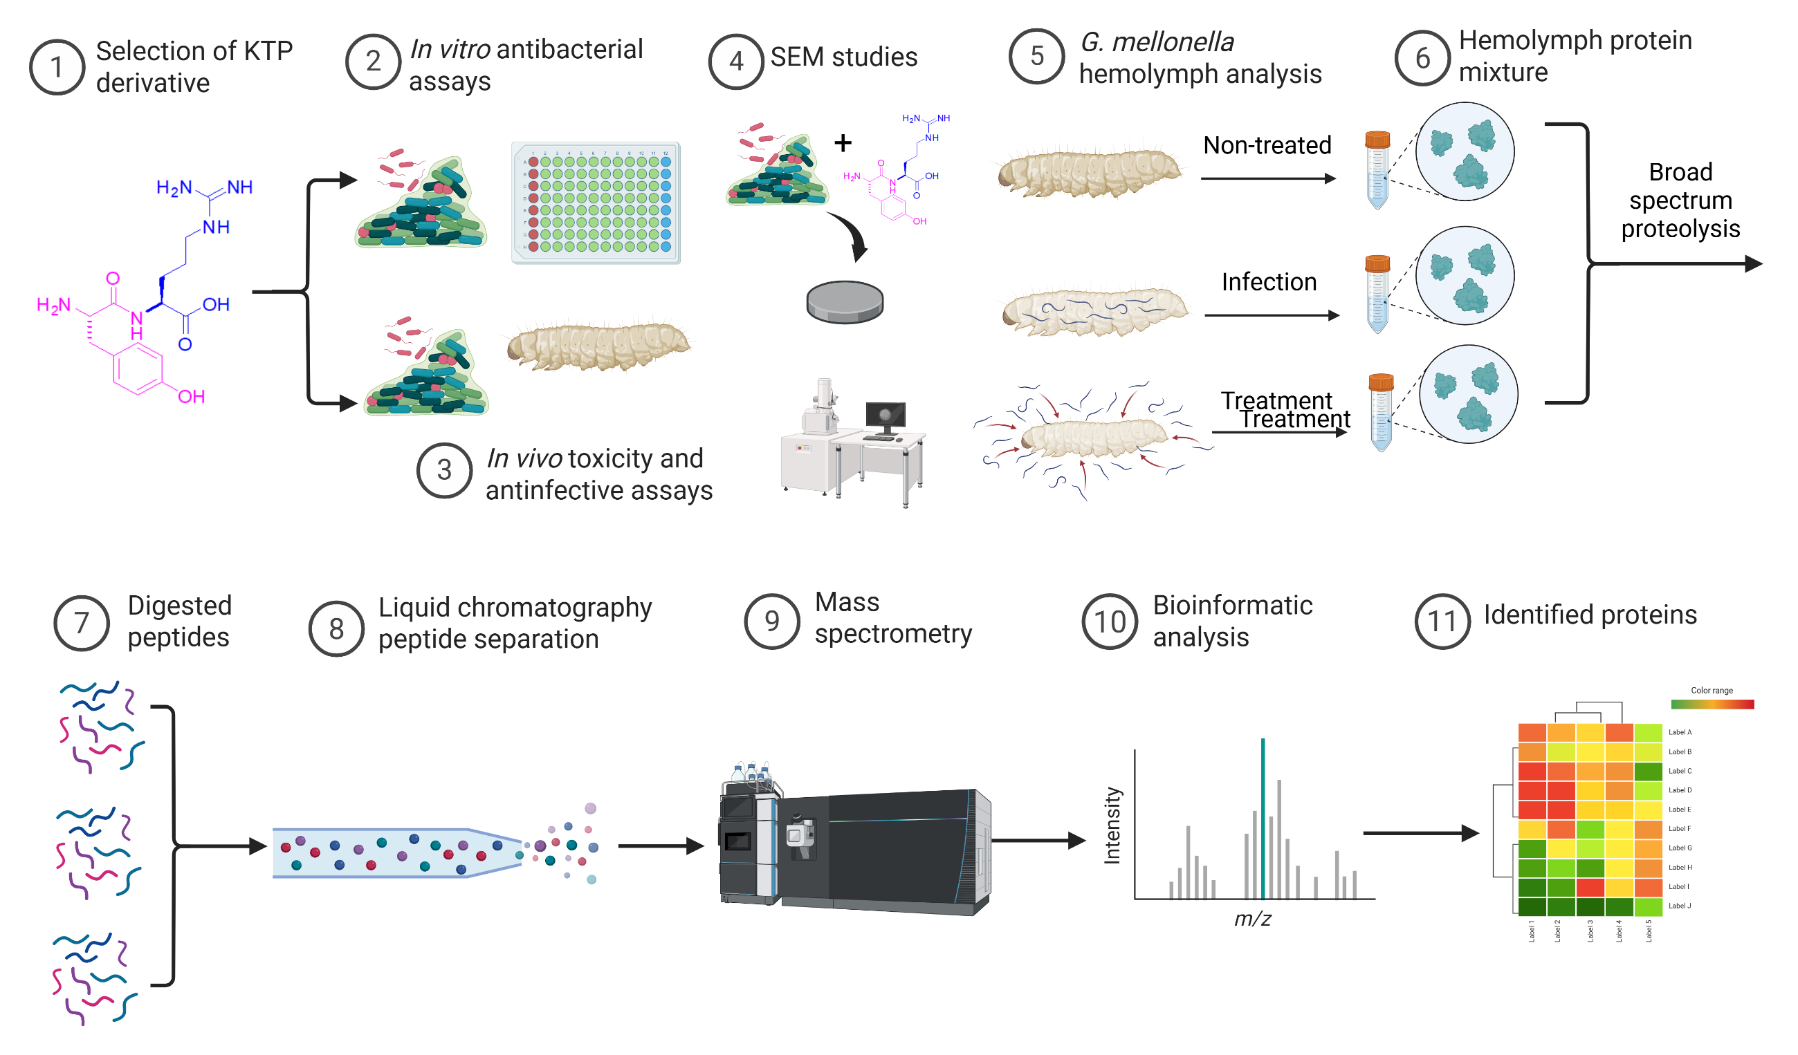
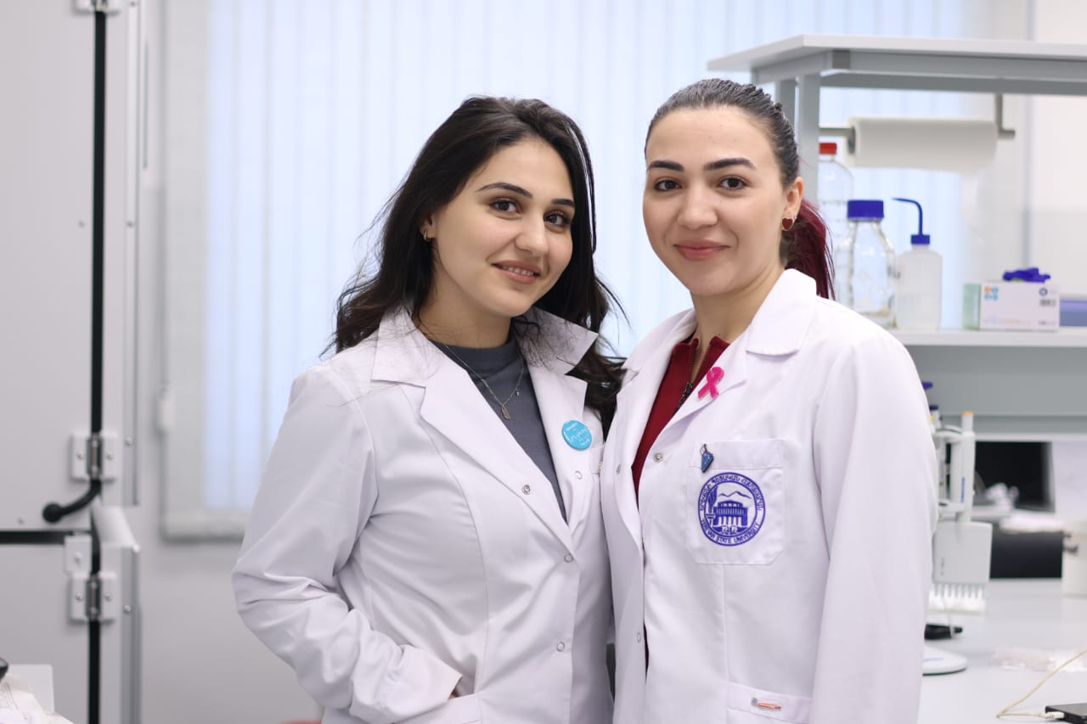
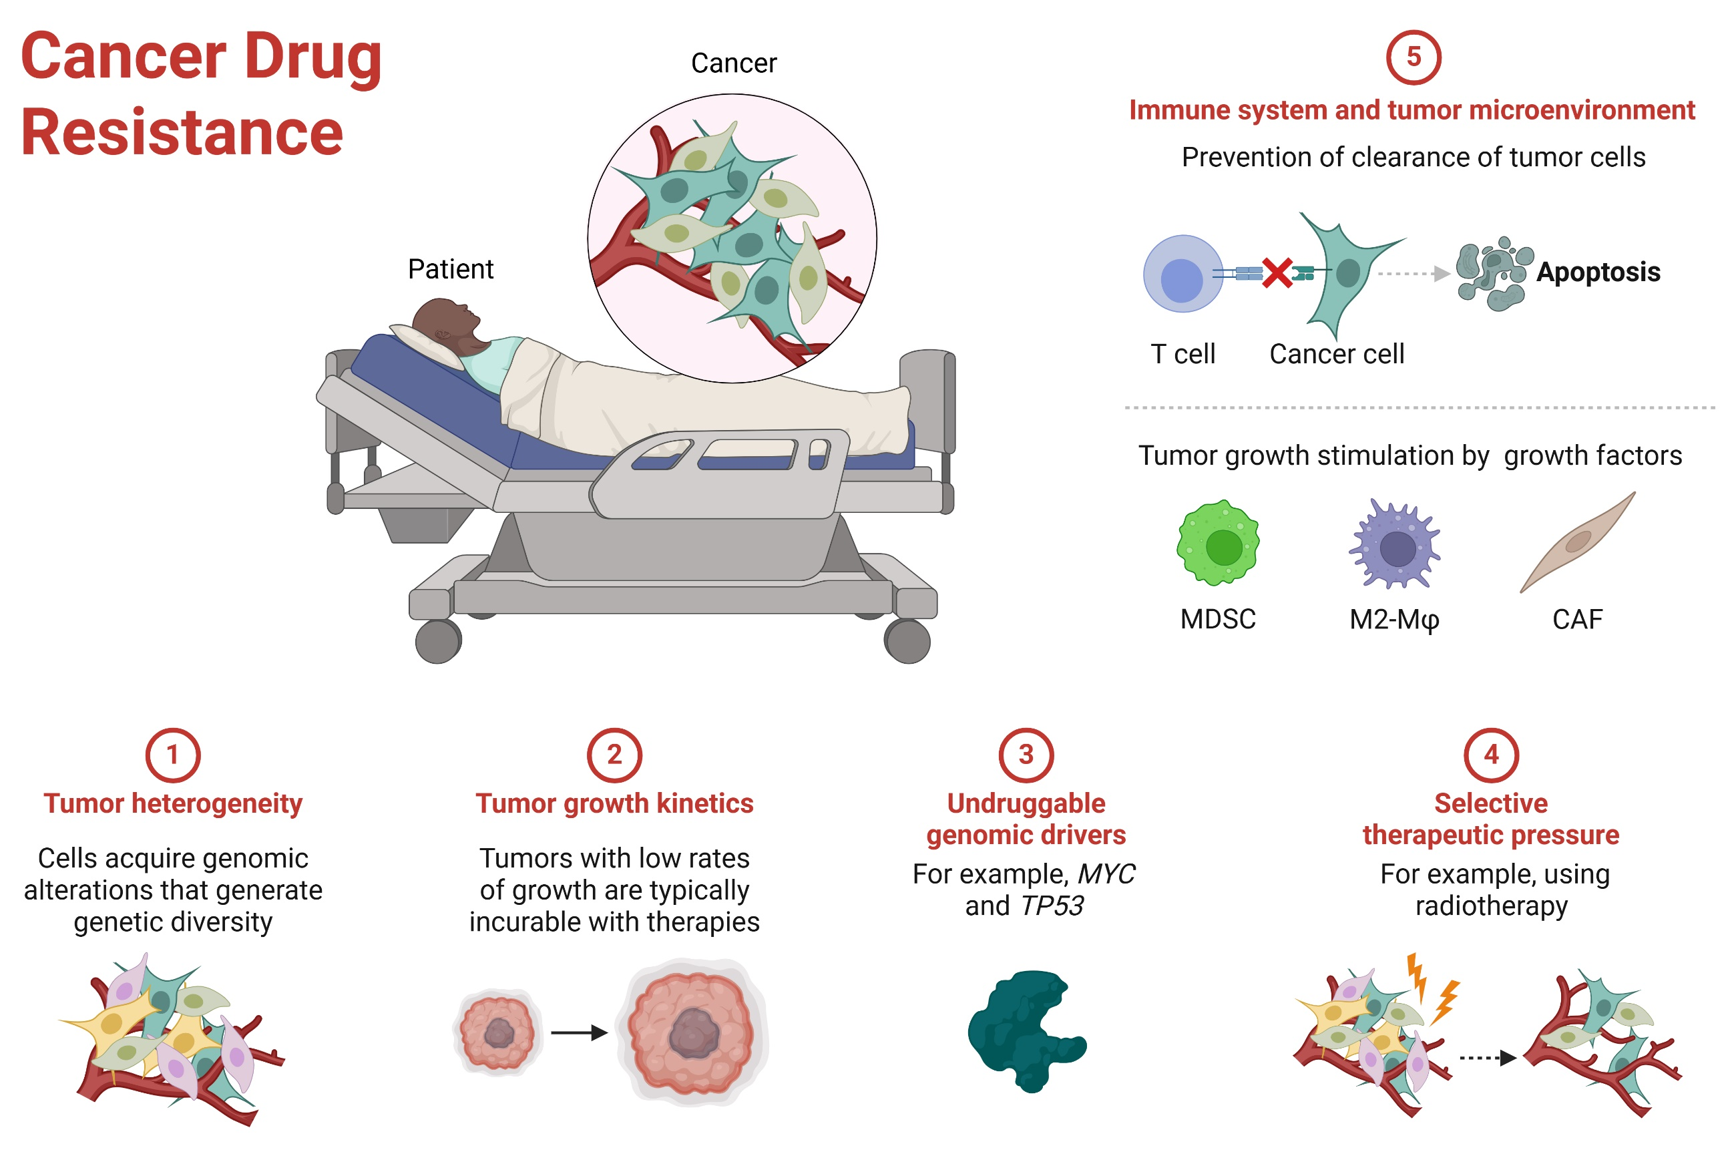


ADOX-L-Lysine
ADOX-L-arginine
Dr. Sangeun Lee
Prof. Dr. Martijn Riool
Nanocarrier for
Drug Delivery

Slide 11
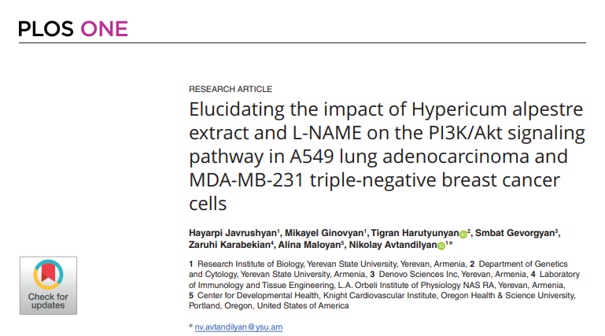

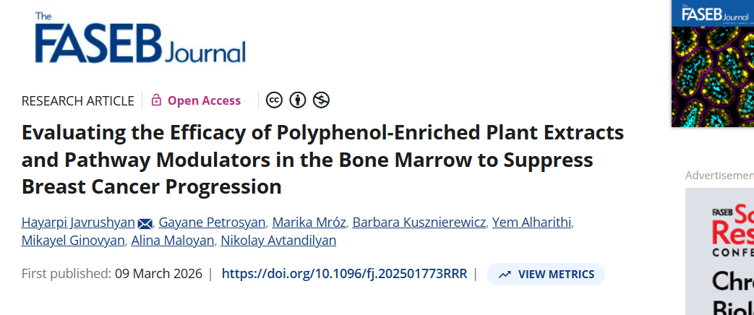

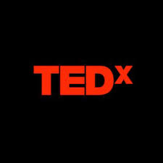

24WS-1F036 REPORT
2024- ongoing
Papers-
  2 articles (Q1) published
  3 articles (Q2, Q1) under review
Conference abstracts-
5+ local and international
Oral presentations-
4 oral presentations-2 panel talks, 1 keynote
TED talk

Slide 12





STEP GROUP REPORT
More than 10 scientific mobility visits, practical courses, trainings, international conferences, workshops, and COST, FEBS, EMBO, ERASMUS+ activities in Germany, Spain, France, Turkey, Romania, Slovenia and Portugal;
2 collaborations established.
Research group-7 papers (Q1 - 4, Q2 - 2, Q4 - 1)
6+ abstracts (oral or poster presentation)
presented at local conferences;

Slide 13
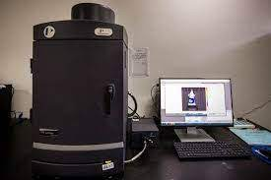
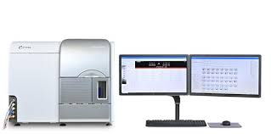
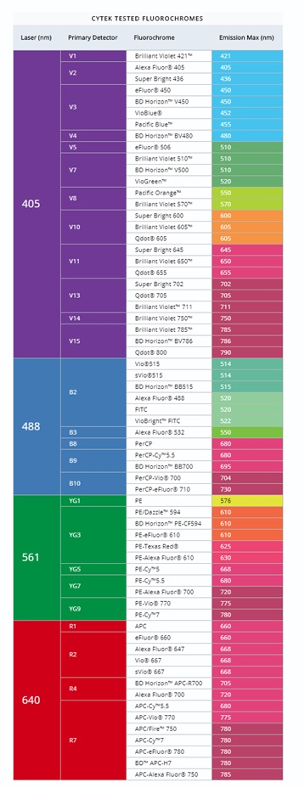
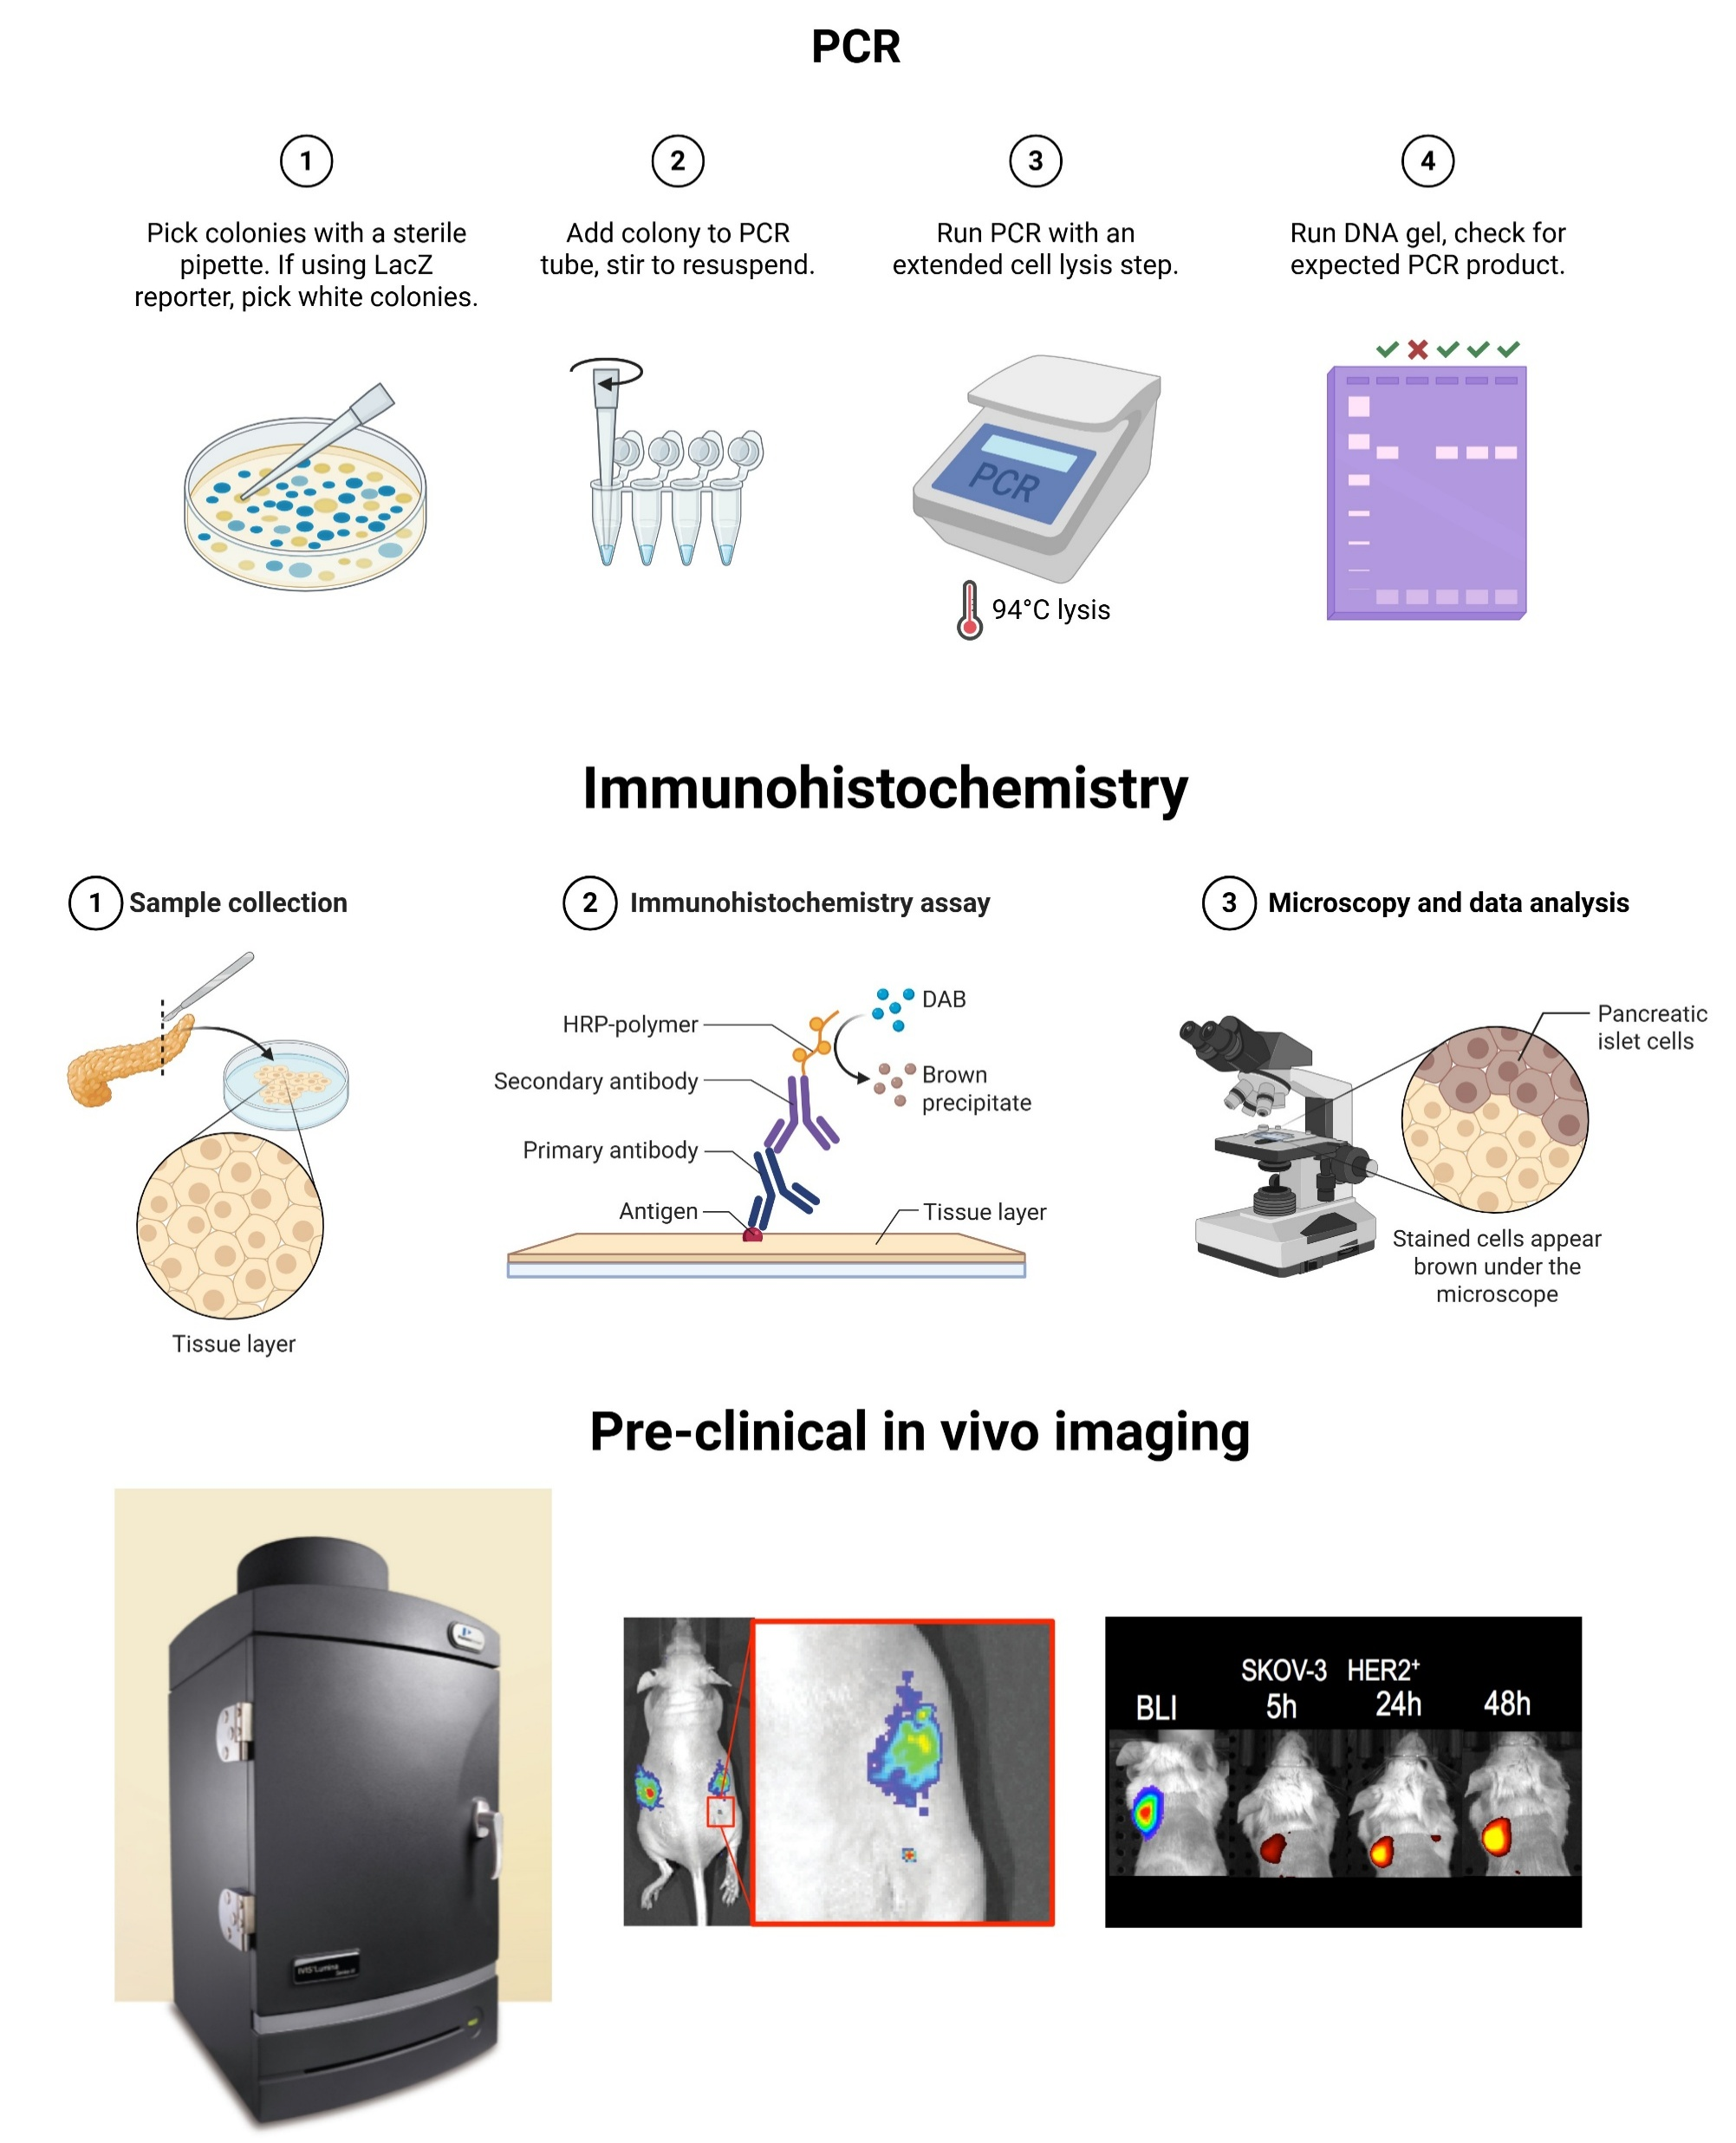
EXPANSION OF RESEARCH FUNDING DURING THE PROJECT
Competition for the Selection of Grant Applications for the Purchase of Scientific Instruments/Equipment Aimed at Modernizing Research Centers with Advanced Equipment
Pre-clinical in vivo imaging
Aurora CS-Cell Sorter – Cytek Biosciencesa

Slide 14
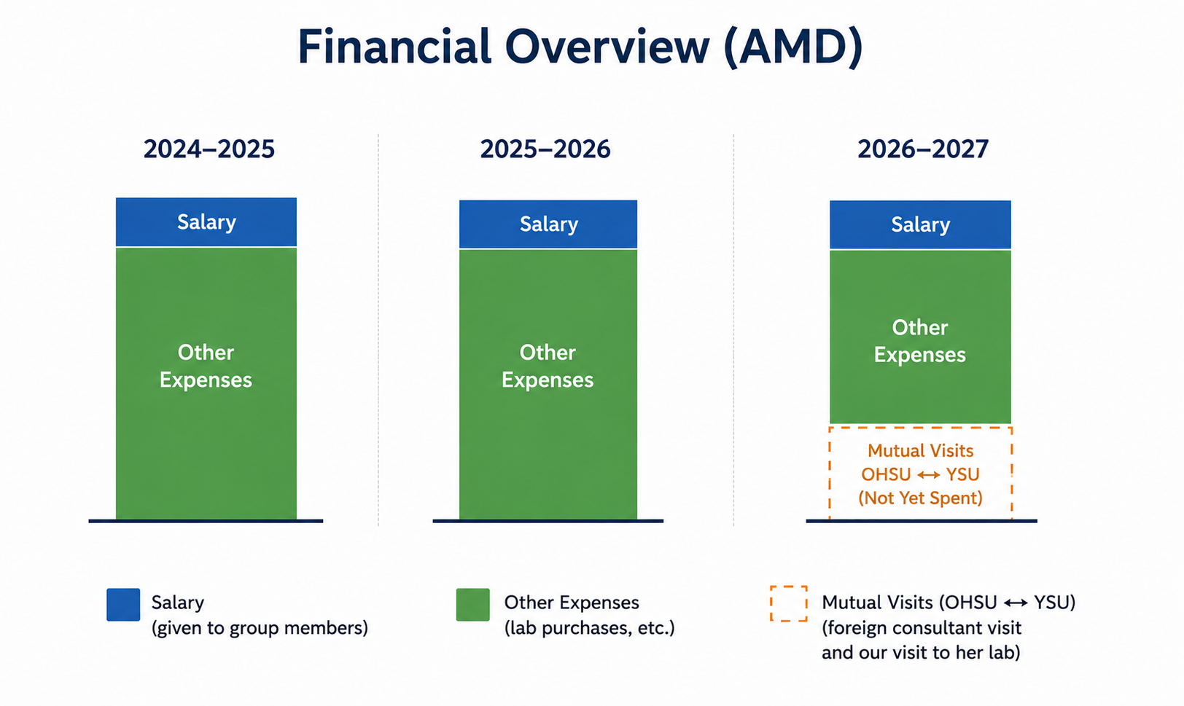

FINANCIAL REPORT
All purchases planned under the 2024–2025 and 2025–2026 budgets have been completed
Only the allocated funds for the mutual visit to the foreign consultant’s laboratory have not yet been spent.

Slide 15
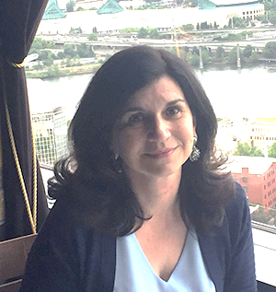
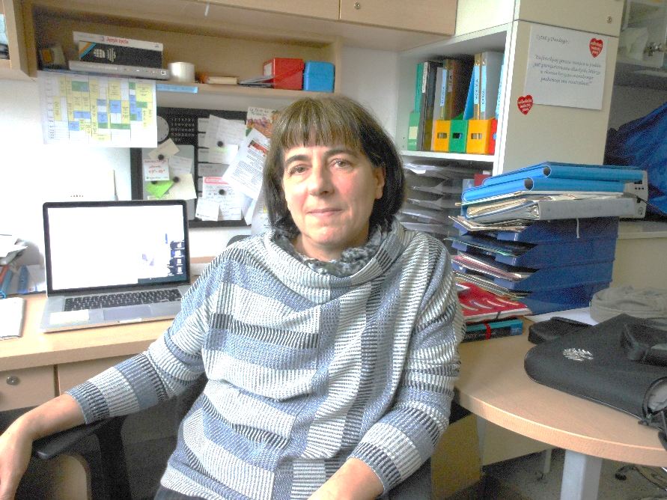
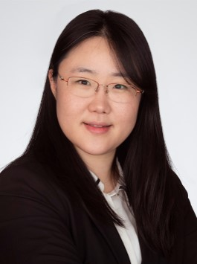
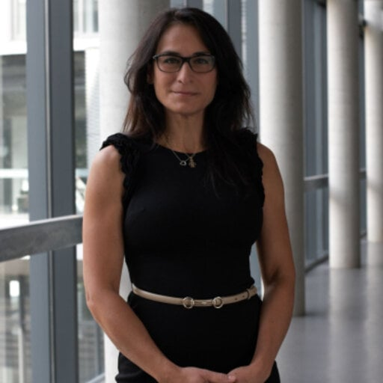



International Research Collaborations
Alina Maloyan-USA
Associate Professor of Medicine, Division of Cardiovascular Medicine, School of Medicine. Oregon Health and Science University, Portland, USA
Agnieszka Bartoszek-Poland
PhD, Professor at Gdansk University of Technology,
Sangeun Lee-Germany
Junior Professor of Pharmaceutical Biology, Saarland University, Germany
Martijn Riool, Regensburg, Germany
Bella B Manshian, Ph.D.
Translational Cell and Tissue
Research Unit,
KU Leuven, Belgium
Martijn Riool. PROF.DR. Research Associate, Medical Microbiology and Infection Prevention

Slide 16
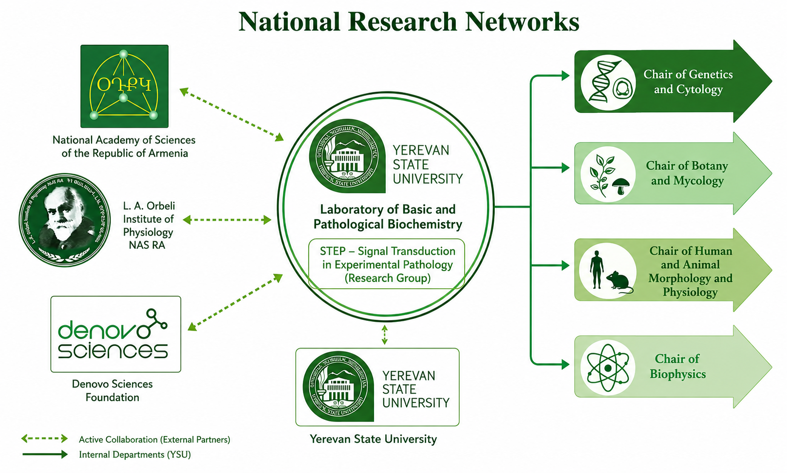
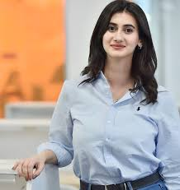

Slide 17
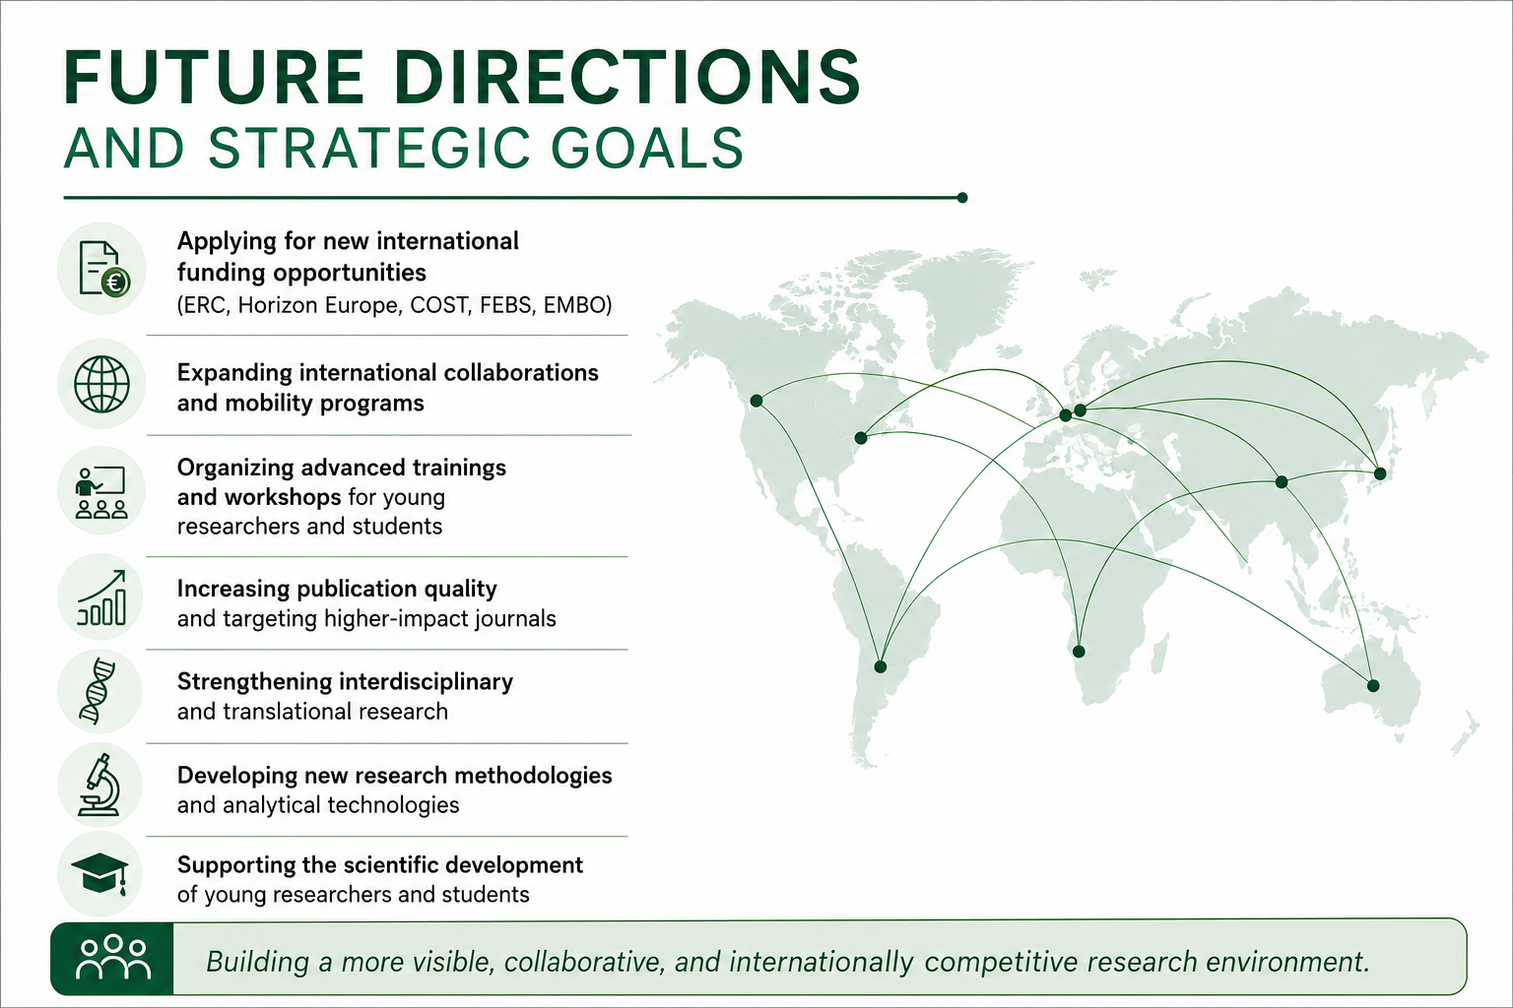

Slide 18

Thank y u!
hg.javrushyan@ysu.am
https://www.linkedin.com/in/hayarpi-javrushyan-496a37122/

