Slide 1





Առաջընթաց՝ արդյունավետ գիտությամբ «ԱԱԳ-2026»
Design and fabrication of sensor systems based on nanostructured materials (24LCG-2J001)
Synthesis and application of one- and two-dimensional nanostructures in flying detectors for recording greenhouse gases in the atmosphere (24FP-3B001)
Fabrication of high-performance detector (sensor) systems (25EDP-2J004)
Mikayel S. Aleksanyan
Head, YSU Center/Department of Materials Science and Nanotechnologies (Institute of Physics)
Doctor of Science (Engineering), Professor
E-mail: maleksanyan@ysu.am, nanotech@ysu.am
Phone: +37493534324, +37460710319
Address: Yerevan State University (YSU), Republic of Armenia, Yerevan, 0025, 1 Alex Manoogian

Slide 2



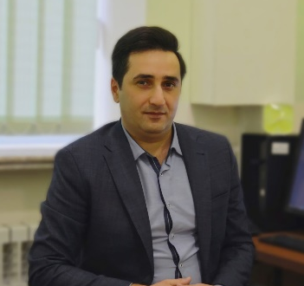
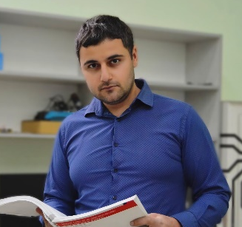

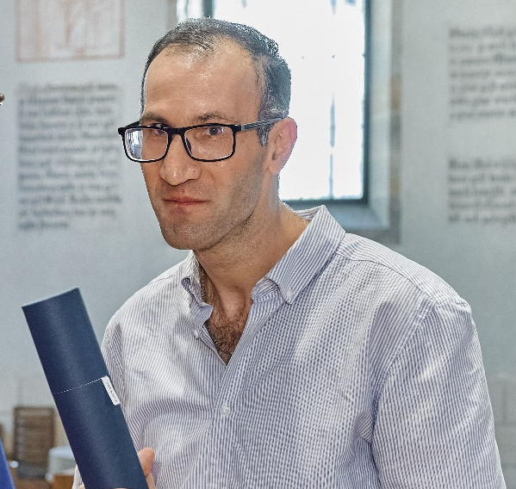
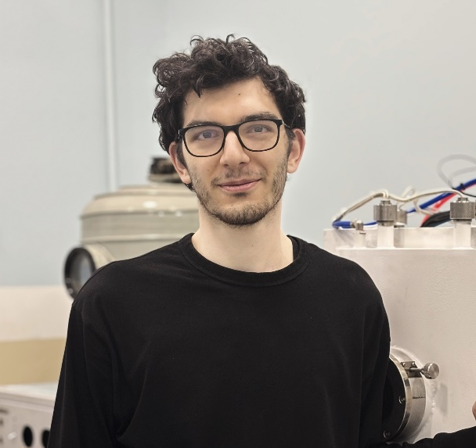
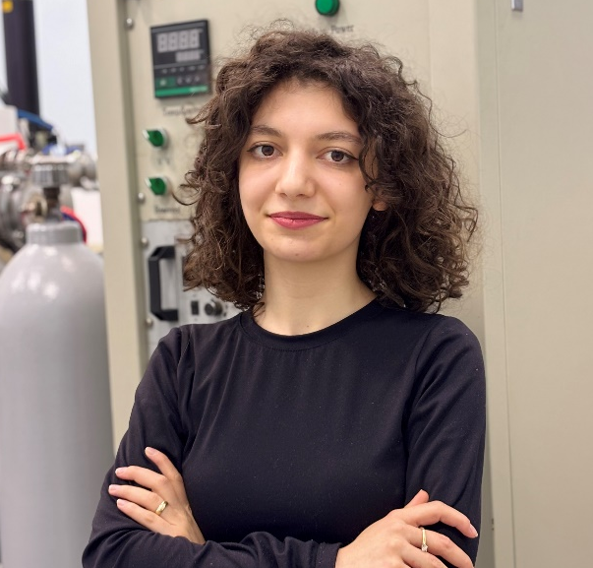
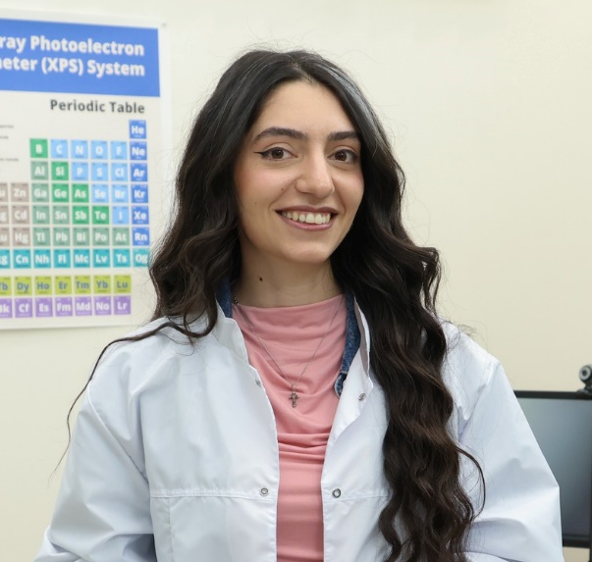
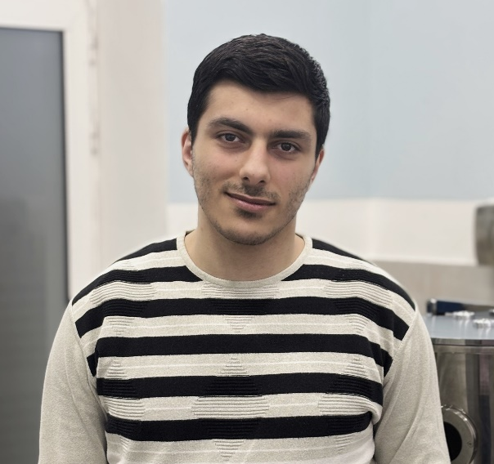


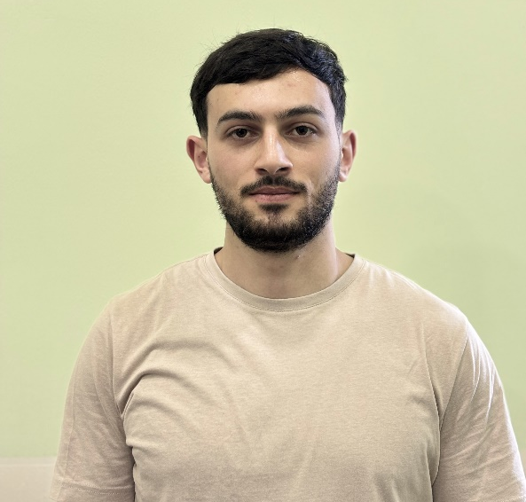
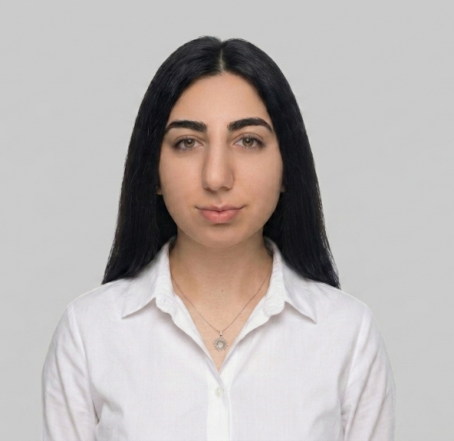
Center of Materials Science and Nanotechnologies
TEAM MEMBERS
MIKAYEL
ALEKSANYAN
Professor
ARTAK
SAYUNTS
PhD
GEVORG
SHAHKHATUNI
PhD
HAYK
KASPARYAN
PhD
DAVIT
KANANOV
PhD student
RIMA
PAPOVYAN
Master's student
ZARINE
SIMONYAN
Researcher
ANDRANIK
GRIGORYAN
Senior Engineers
GABRIEL
GEVORGYAN
Bachelor's student
QNARIK
HAMBARCUMYAN
Bachelor's student
TIGRAN
GHAZARYAN
Senior Engineers
SERINE
MARGARYAN
Bachelor's student

Slide 3
Grants activity
Synthesis and application of one- and two-dimensional nanostructures in flying detectors for recording greenhouse gases in the atmosphere, Higher Education and Science Committee, 24FP-3B001, 2024-2027
Design and fabrication of sensor systems based on nanostructured materials, Higher Education and Science Committee, 24LCG-2J001, 2024-2029
Fabrication of high-performance detector (sensor) systems, Higher Education and Science Committee (25EDP-2J004), 2025-2027
Grant for upgrading scientific centers with modern equipment (2023). Ministry of Education, Science, Culture and Sport RA Higher Education and Science Committee, XPS system, 240 000 000 AMD - M. S. Aleksanyan
Grant for upgrading scientific centers with modern equipment (2023). Ministry of Education, Science, Culture and Sport RA Higher Education and Science Committee, PLD system, 45 000 000 AMD - M. S. Aleksanyan
Grant for upgrading scientific centers with modern equipment (2024). Ministry of Education, Science, Culture and Sport RA Higher Education and Science Committee, Multiarc deposition system, 43 000 000 AMD - M. S. Aleksanyan
Grant for upgrading scientific centers with modern equipment (2025). Ministry of Education, Science, Culture and Sport RA Higher Education and Science Committee, Nano Frazer, 230 000 000 AMD - M. S. Aleksanyan
New generation sensors based on thin film structures for environmental pollution monitoring, Higher Education and Science Committee, 25EDP-2J004, 2027-2032
Synthesis and Application of Nanostructured Materials for Sensor Systems using Advanced Chemical Methods, “PostDoc-Armenia 2026” Higher Education and Science Committee, 2026-2028
Drift-Robust Thin Film Chemoresistor Arrays with Edge Machine Learning for Long-Term Gas Monitoring, NATO Science for Peace and Security - € 346.300.00

Slide 4


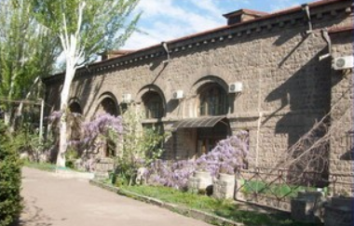
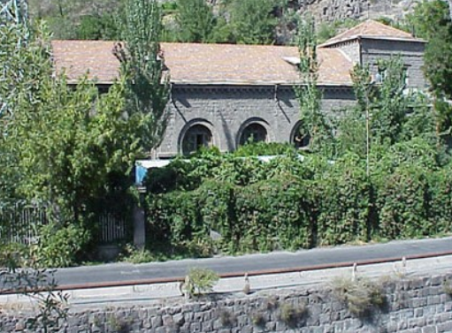
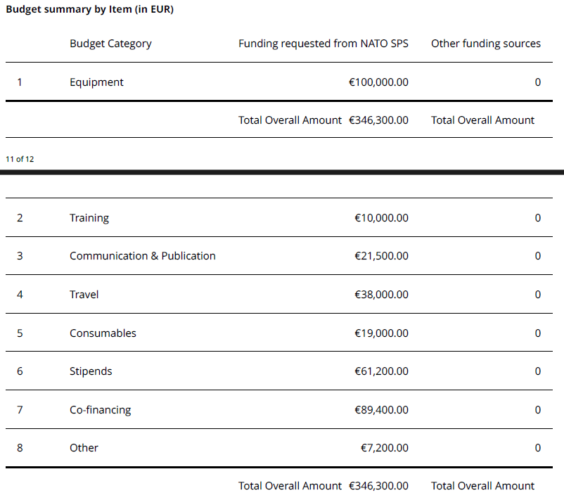

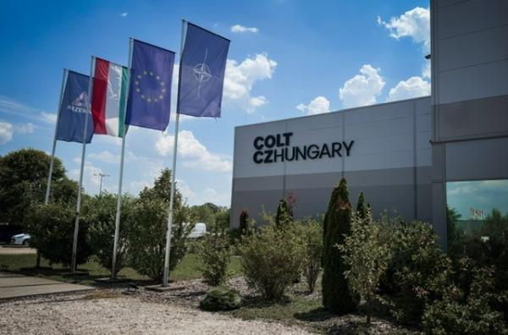
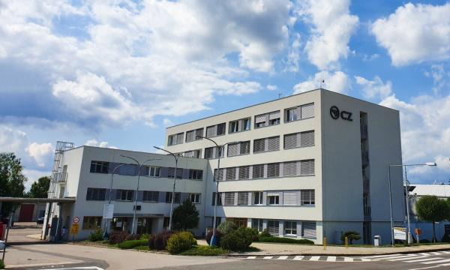
Available Grants
Drift-Robust Thin Film Chemoresistor Arrays with Edge Machine Learning for Long-Term Gas Monitoring NATO Science for Peace and Security - €346,300.00
Yerevan Telecommunication Research Institute
Colt CZ Group SE

Slide 5

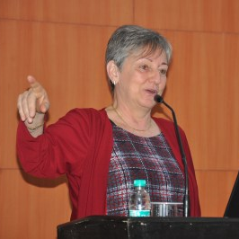


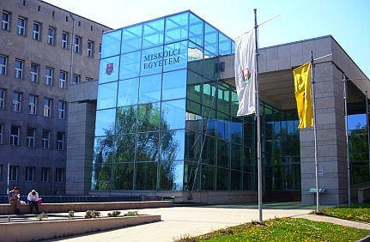

International collaborations
DUŠAN
KOPECKÝ
KLARA
HERNADI
NEFELI
LAGOPATI
Dušan Kopecký | Professor (Associate) | Ph.D. | University of Chemistry and Technology, Prague, Prague | VSCHT
Klara Hernadi, Professor | Laboratory of Applied Nanomaterials | Institute of Physical Metallurgy, Metal Forming and Nanotechnology | University of Miskolc, Hungary
Dr. Nefeli Lagopati, MSc, PhD
Assistant Professor of Biology-Nanomedicine
Laboratory of Biology, Faculty of Medicine
School of Health Sciences
National and Kapodistrian University of Athens
University of Chemistry
and Technology, Prague
University of Miskolc,
Hungary
Health Sciences National and
Kapodistrian University, Athens

Slide 6

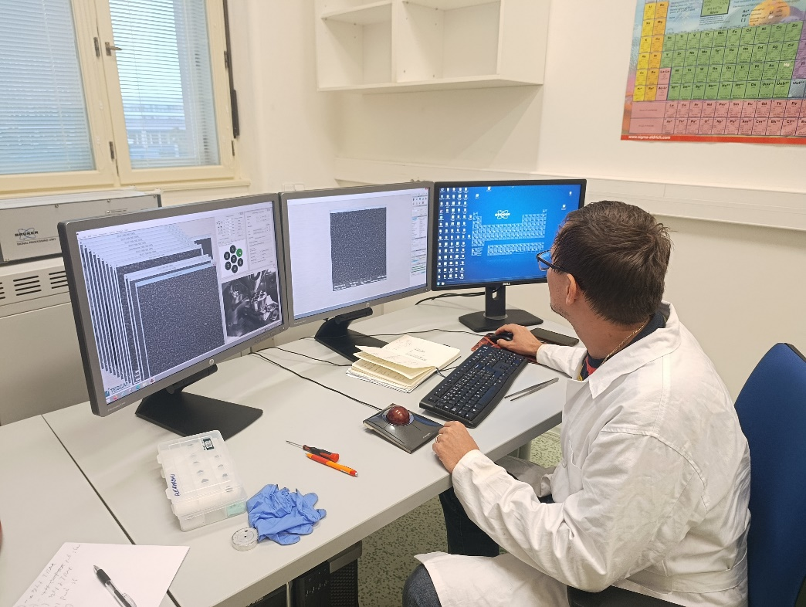
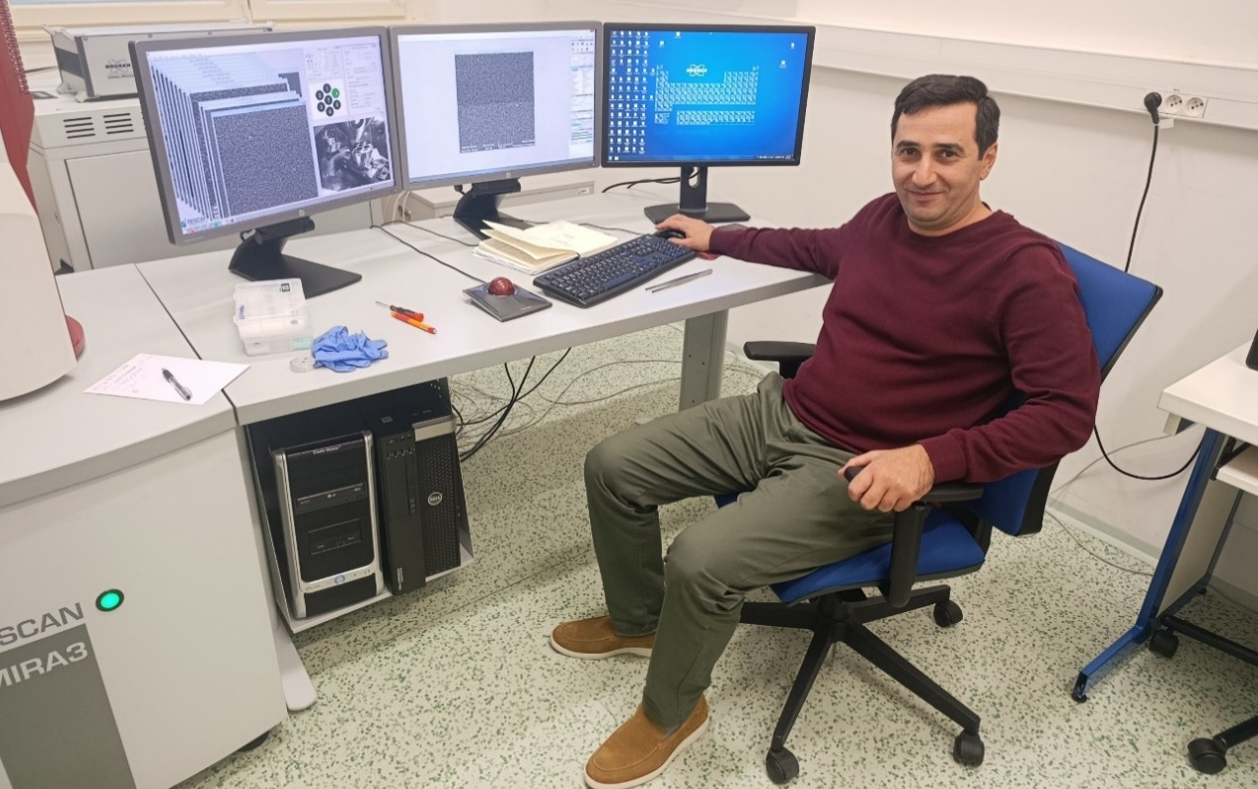

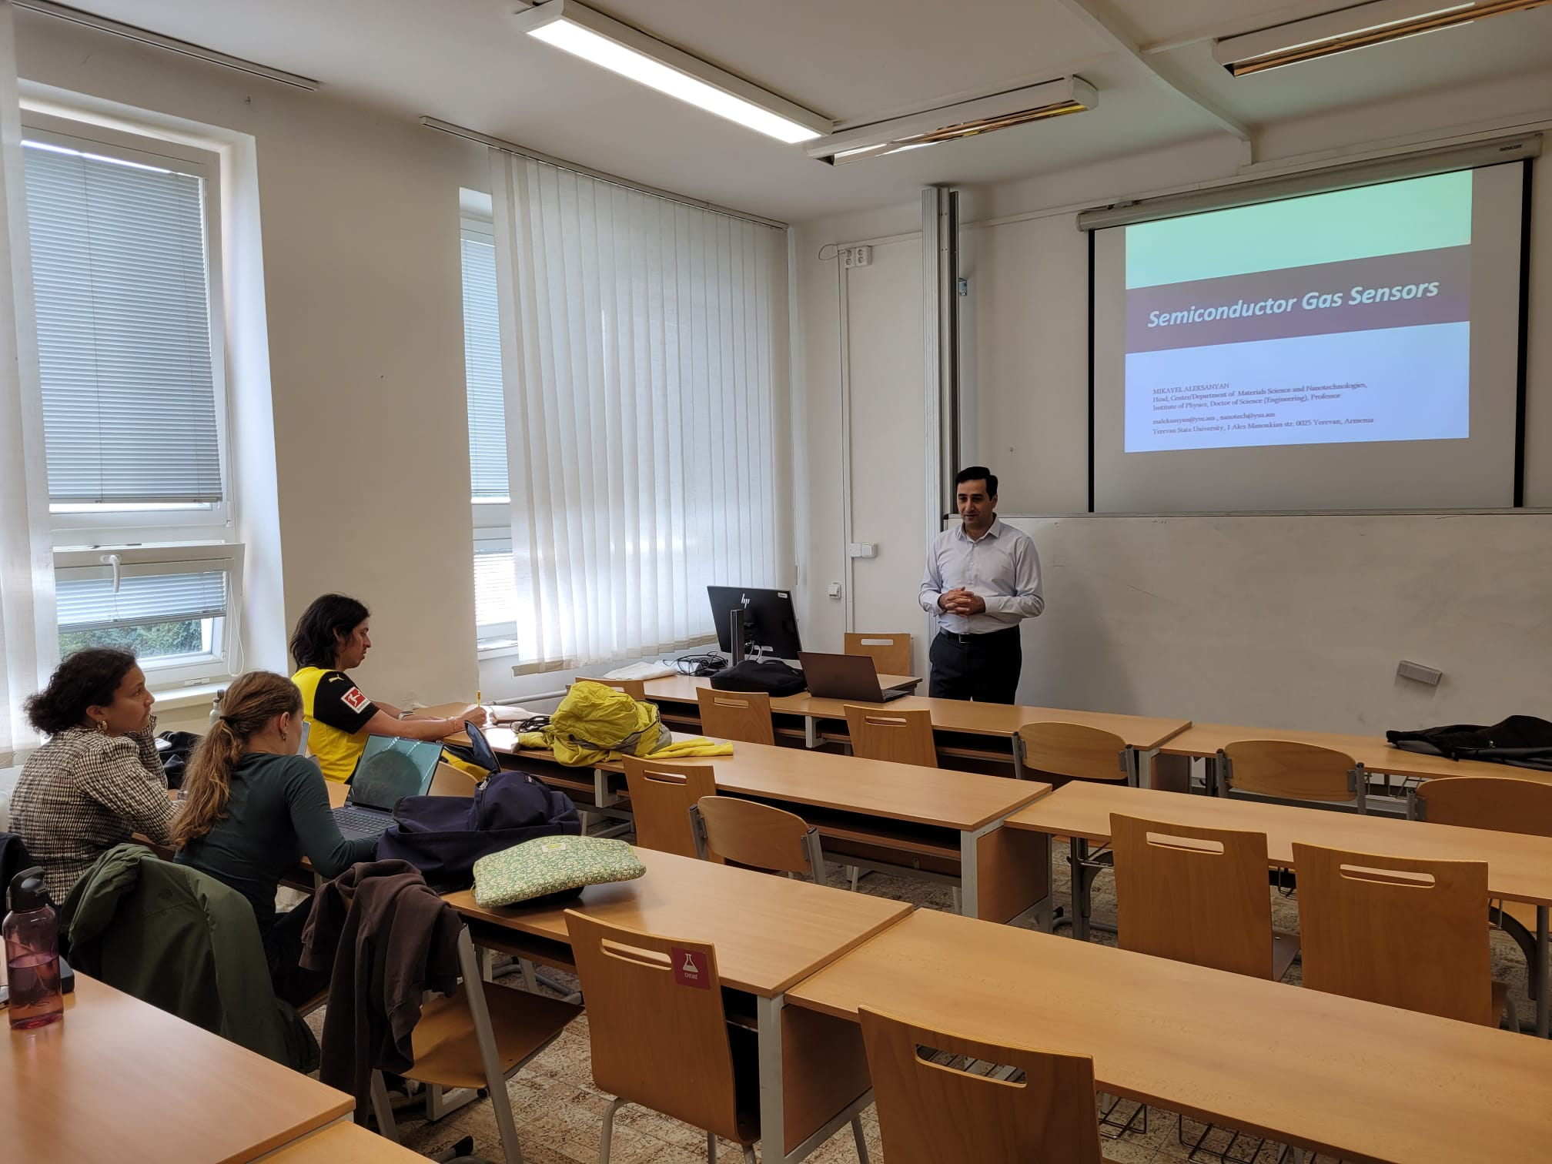
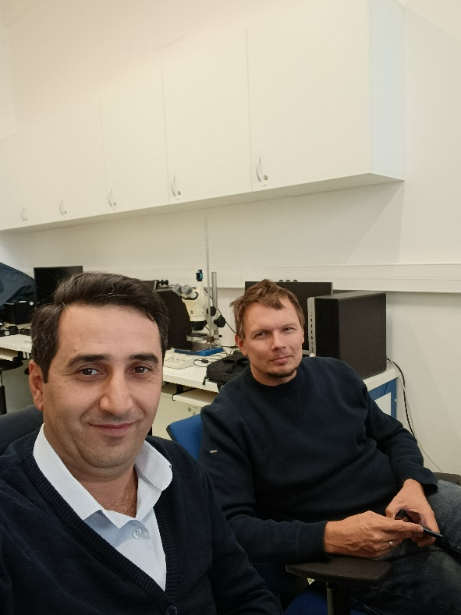
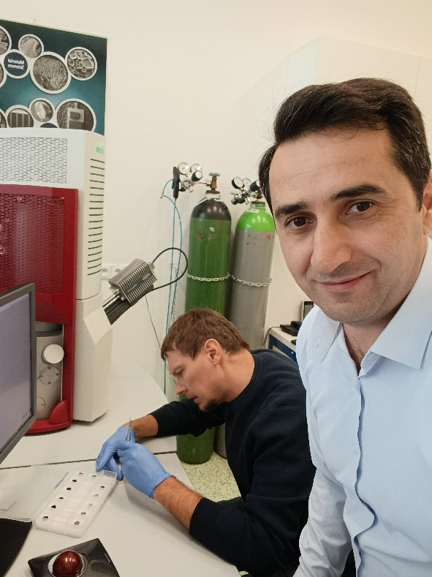
Visit to University of Chemistry and Technology
M. Aleksanyan's 15-day visit to the University of Chemical Technology Prague
Dušan KOPECKÝ | Professor (Associate) | Ph.D. | University of Chemistry and Technology, Prague, Prague | VSCHT
DUŠAN
KOPECKÝ
Kopecky's upcoming one-month visit to YSU will be from 10.06.2026 to 10.07.2026

Slide 7
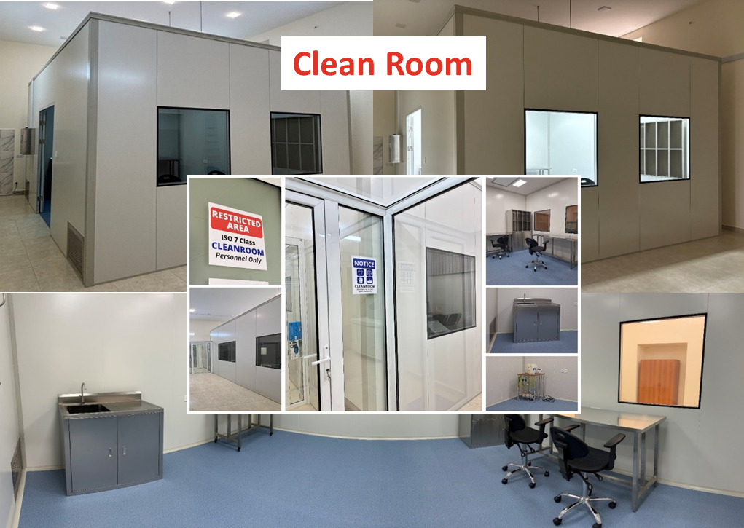
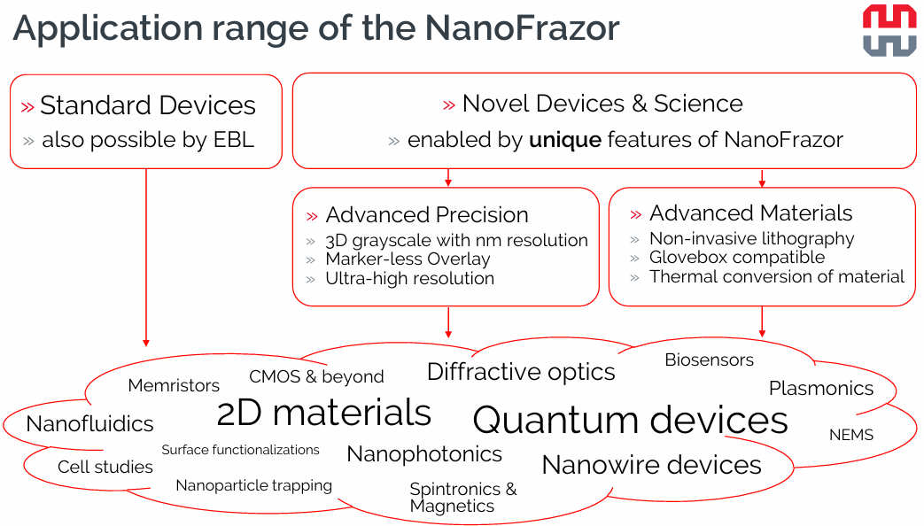
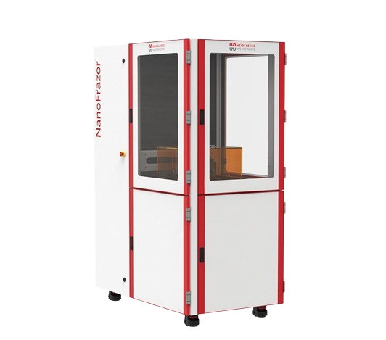
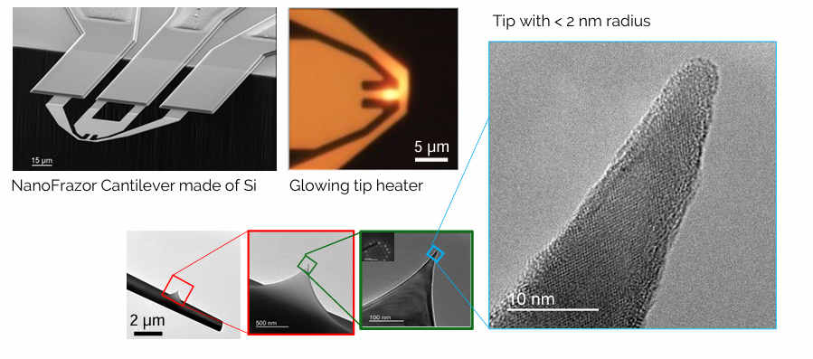
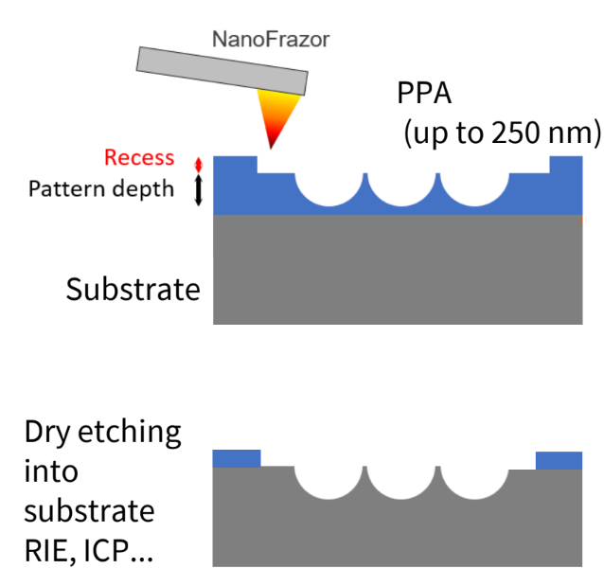
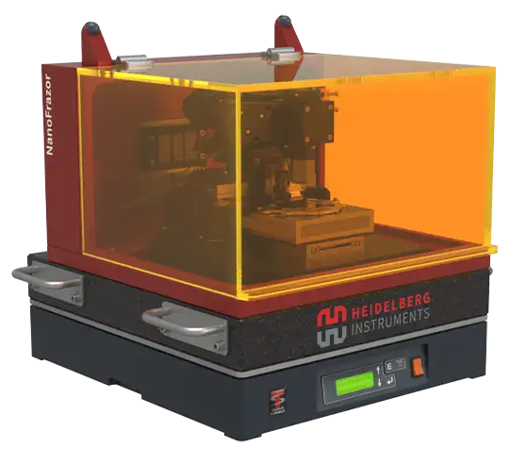
Material resources
NanoFrazor (230 000 000 AMD) - 2026
Ջերմային սկանավորող զոնդային լիտոգրաֆիայի իրականացում (Thermal Scanning Probe Lithography (t-SPL))
Մինչև 10-15 նմ չափսերի գերմաքուր նանոլարերի, նանոձողերի, քվանտային կետերի և այլ տեսակի նանոհամակարգերի ստացում գրեթե բոլոր տեսակի պինդմարմնային նյութերից
Առանց դիմակ (maskless) լիտոգրաֆիական պրոցեսի իրականացում
Մակերևույթի տոպոգրաֆիական պատկերի ստացում
Կամայական տեսքի մակերևույթների կտրում և հետազոտում
Ջերմային ասեղիկի միջոցով նյութի տեղային բուրեղական կառուցվածքի փոփոխություն՝ ամորֆից միաբյուրեղ և հակառակը

Slide 8

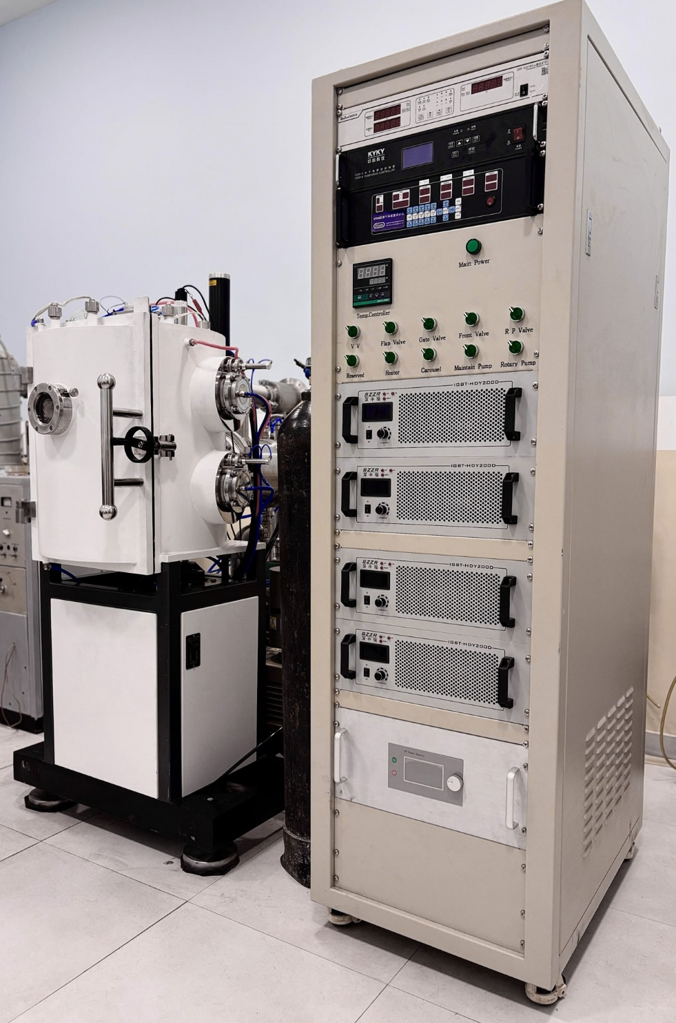
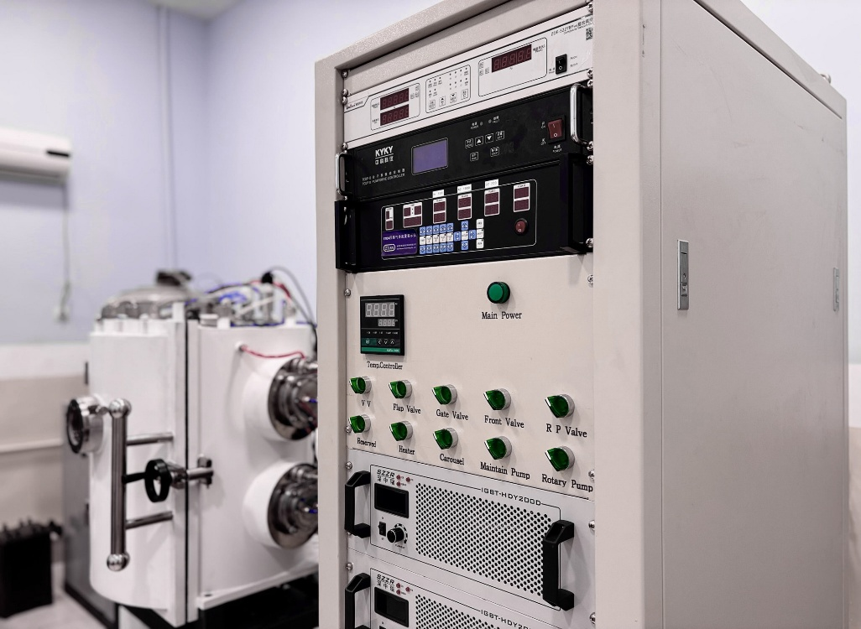
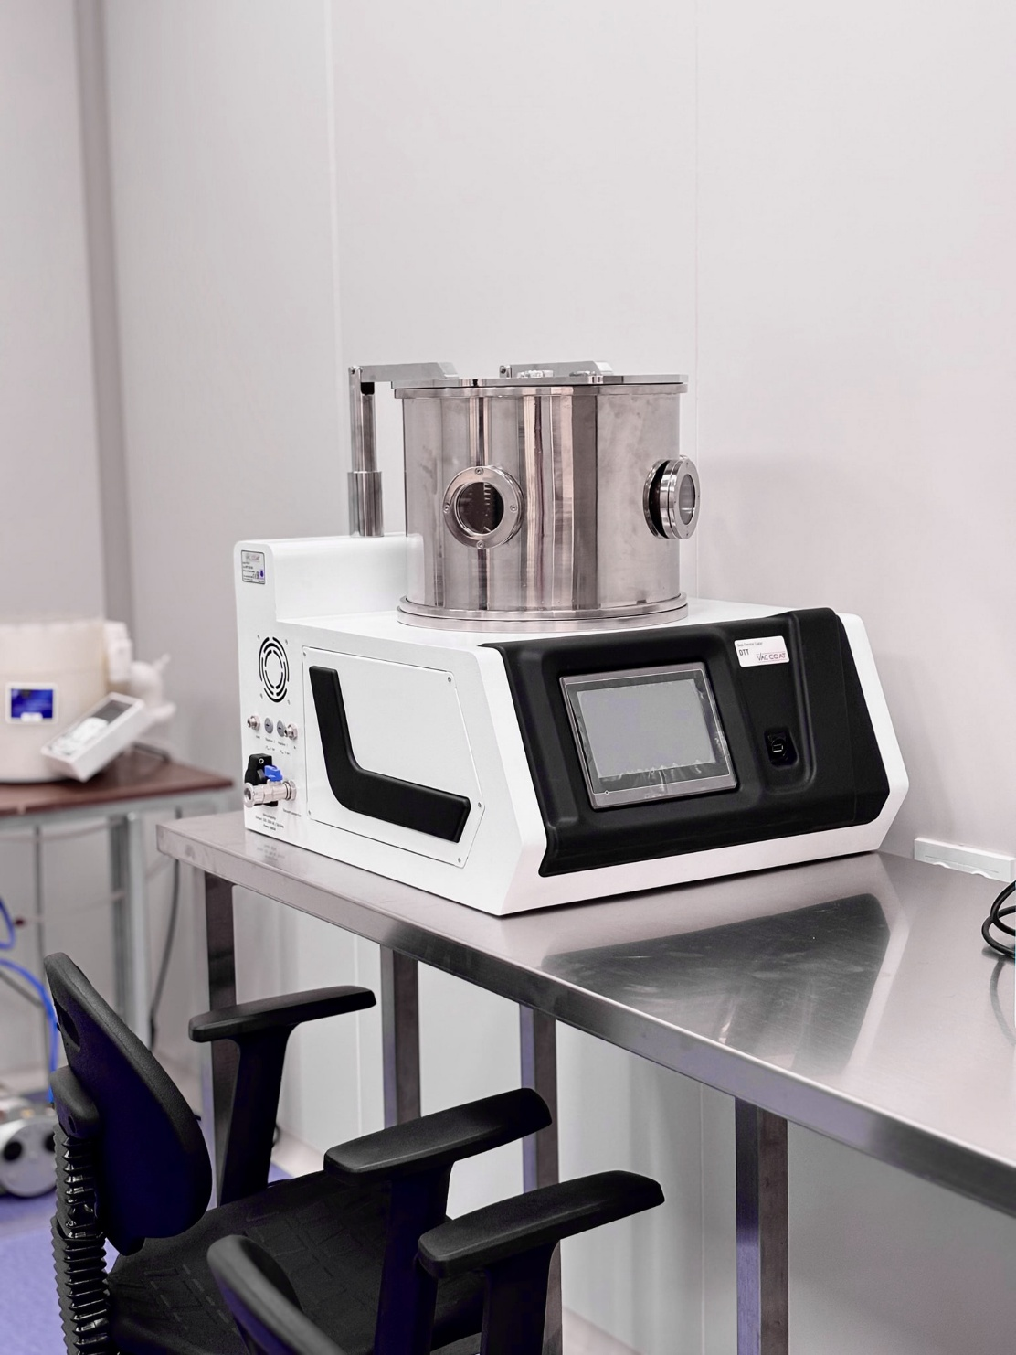
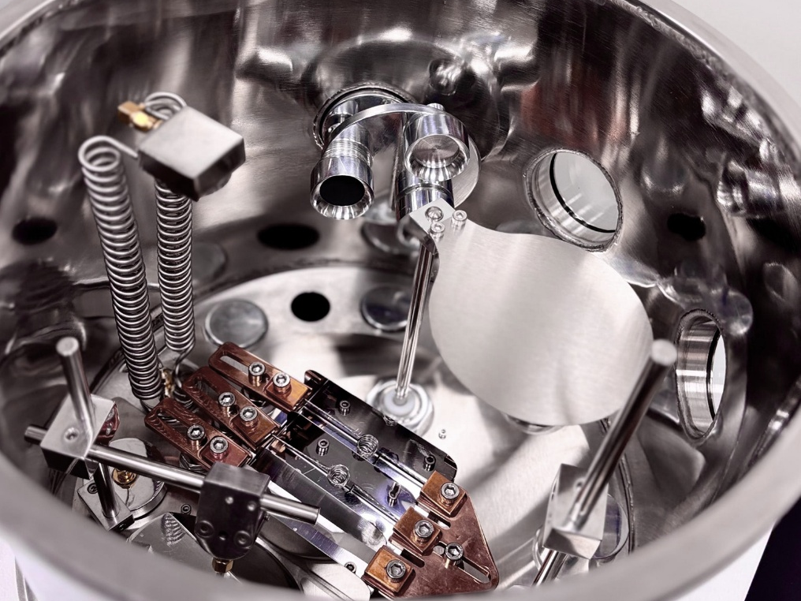
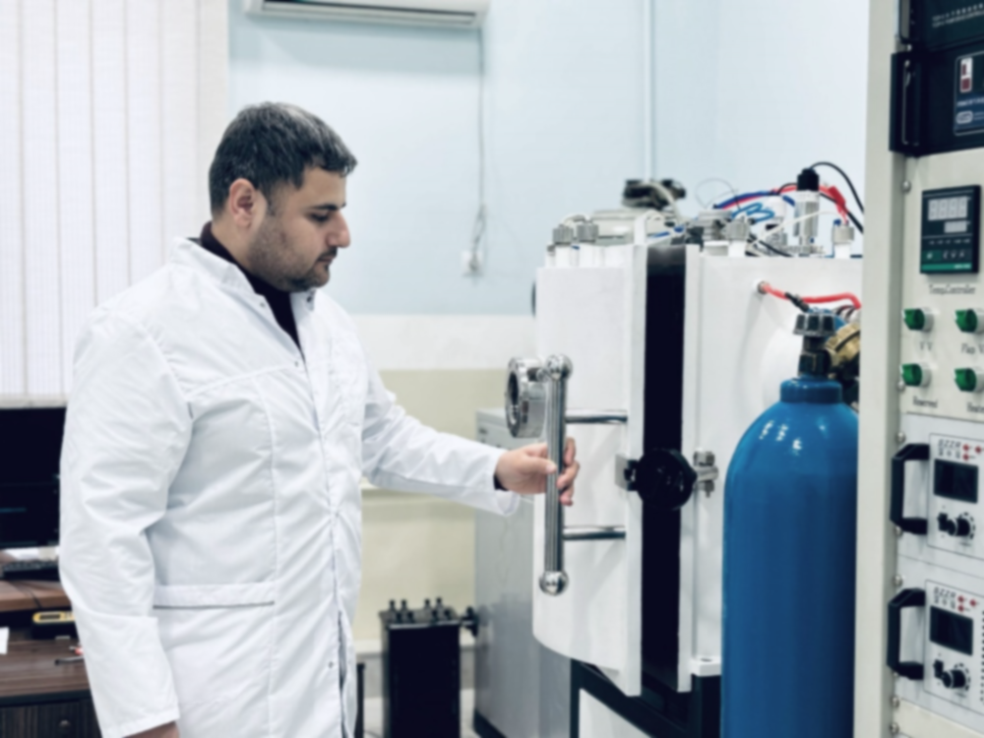
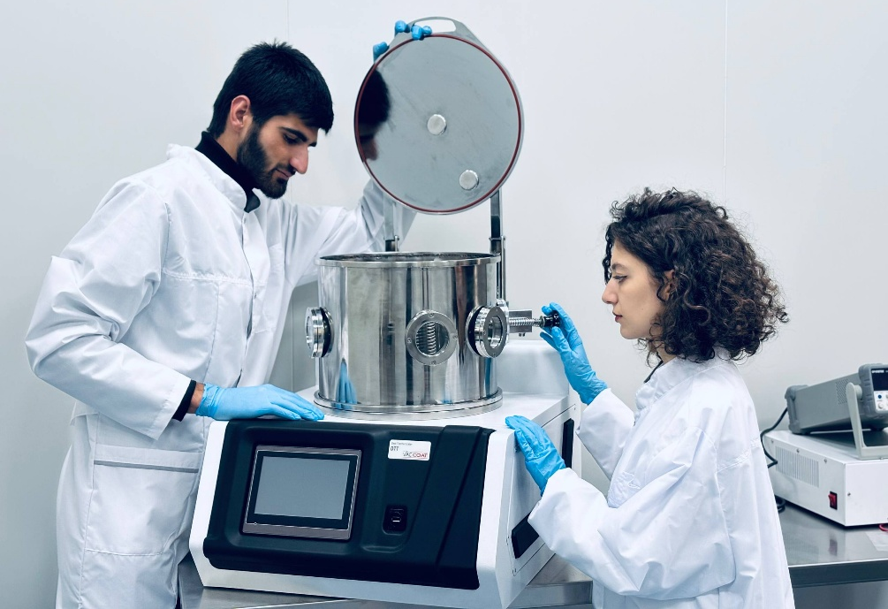
Material Resources
Already installed and in use in 2025
Multiarc deposition system
Pulsed Laser Deposition (PLD) system

Slide 9
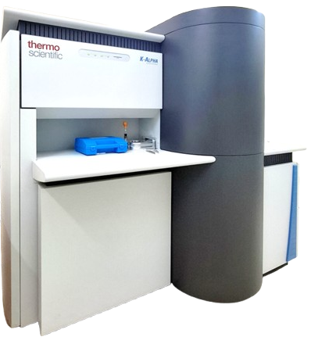






Research activity on XPS
Studies conducted with an X-ray photoelectron spectrometer՝
N | Հաստատություն | Պատասխանատու անձ | Նմուշ | Ամսաթիվ
1 | ԵՊՀ Նյութագիտության և նանոտեխնոլոգիաների կենտրոն | Հ. Մարգարյան | ZnO 2 - նմուշ | 22.02.25 թ.
2 | Նալբանդյանի անվան պետական ակադեմիա, քիմ. Ֆիզիկայի ինստիտուտ | Վ. Հայրապետյան | AzO, AzoZnO, WS₂, ZnOBsA, A₂O-BsA 9 - նմուշ | 18.03.25 թ.
3 | ԵՊՀ պինդ մարմնի ֆիզիկայի լաբորատորիա | Վ. Հարությունյան | CsPbBr3 4 - նմուշ | 28.03.25 թ.
4 | Նալբանդյանի անվան պետական ակադեմիա, քիմ. Ֆիզիկայի ինստիտուտ | Վ. Հայրապետյան | AlZnO, FeMoYZrHx, NbS2,Ti-PLD 10 - նմուշ | 03.09.25 թ.
5 | Նալբանդյանի անվան պետական ակադեմիա, <<Հեղուկ բյուրեղային նանոհամակարգեր>> գիտական խումբ | Հ. Ղարագուլյան | WSe₂ 5 - նմուշ | 22.02.25 թ.
6 | Նալբանդյանի անվան պետական ակադեմիա <<Հեղուկ բյուրեղային նանոհամակարգեր>> գիտական խումբ | Հ. Ղարագուլյան | WSe₂/InCbN/InSbN/InGaSbTiO₂ 4 - նմուշ | 09.09.25 թ.
7 | ԵՊՀ Նյութագիտության և նանոտեխնոլոգիաների կենտրոն | Կ. Ղամբարյան | In, N, Sb, Ga 4 - նմուշ | 12.09.25 թ.
8 | ԵՊՀ Տեսական և մաթեմատիկական ֆիզիկայի ամբիոն | Հ. Բադալյան | Os, Pt, Ti 6 - նմուշ | 25.09.25 թ.
9 | Հայաստանի ազգային պոլիտեխնիկական համալսարան | Ա. Ավետիսյան | TiO₂, NiO, Fe2O₃ 3 - նմուշ | 29.09.25 թ.
10 | ԵՊՀ Տեսական և մաթեմատիկական ֆիզիկայի ամբիոն | Հ. Բադալյան | Os, Pt, Ti 7 - նմուշ | 06.11.25 թ.
11 | Հայաստանի ազգային պոլիտեխնիկական համալսարան | Ն. Մարտիրոսյան | BaTiSr, BaTi, BaSrNP, BaSrTi, BaBiTi 7 - նմուշ | 11.11.25 թ.
12 | Ալիխանյանի անվան ազգային գիտական լաբորատորիա | Ն. Մարգարյան | Cu, O, Cl 5- նմուշ | 29.12.25 թ.
13 | Հայաստանի ազգային պոլիտեխնիկական համալսարան | Ն. Մարտիրոսյան | Հայաստանի ազգային պոլիտեխնիկական համալսարան | 10.11.25 թ
14 | Ալիխանյանի անվան ազգային գիտական լաբորատորիա | Ն. Մարգարյան | Cu, O, Cl 5 - նմուշ | 01.09.26 թ.
15 | Նալբանդյանի անվան պետական ակադեմիա, քիմ. Ֆիզիկայի ինստիտուտ | Մարինա Ժեժու | Pb, Te, Sb, Ge 2 - նմուշ | 24.02.26 թ.
16 | ԵՊՀ պինդ մարմնի ֆիզիկայի լաբորատորիա | Վ․ Հարությունյան | CsPbBr3 4 - նմուշ | 13․04․26 թ․
17 | Նալբանդյանի անվան պետական ակադեմիա, քիմ. Ֆիզիկայի ինստիտուտ | Վ. Հայրապետյան | ZnO, SiOx, TiO2, Al2O3 4 նմուշ | 03.04.26 թ․
18 | Նալբանդյանի անվան պետական ակադեմիա, քիմ. Ֆիզիկայի ինստիտուտ | Հ. Ղարագուլյան | C,N,O 4 նմուշ | 26․03․26 թ․
Ռադիոֆիզիկայի և էլեկտրոնիկայի ինստիտուտ
Ֆիզիկական հետազոտությունների ինստիտուտ
Ա.Բ. Նալբանդյանի անվան քիմիական ֆիզիկայի ինստիտուտ
Երևանի կապի միջոցների գիտահետազոտական ինստիտուտ
Հայաստանի ազգային պոլիտեխնիկական համալսարան
Ա.Ի. Ալիխանյանի անվան Ազգային Գիտական Լաբորատորիա
ԵՊՀ Ֆիզիկայի ինստիտուտ
…
Մասնավոր ընկերություններ…

Slide 10

Outline
Introduction
Sensor fabrication technologies
Growth of CNTs and MOX nanograins
Measurement of gas-sensing parameters
Gas sensing mechanism
Financial report

Slide 11



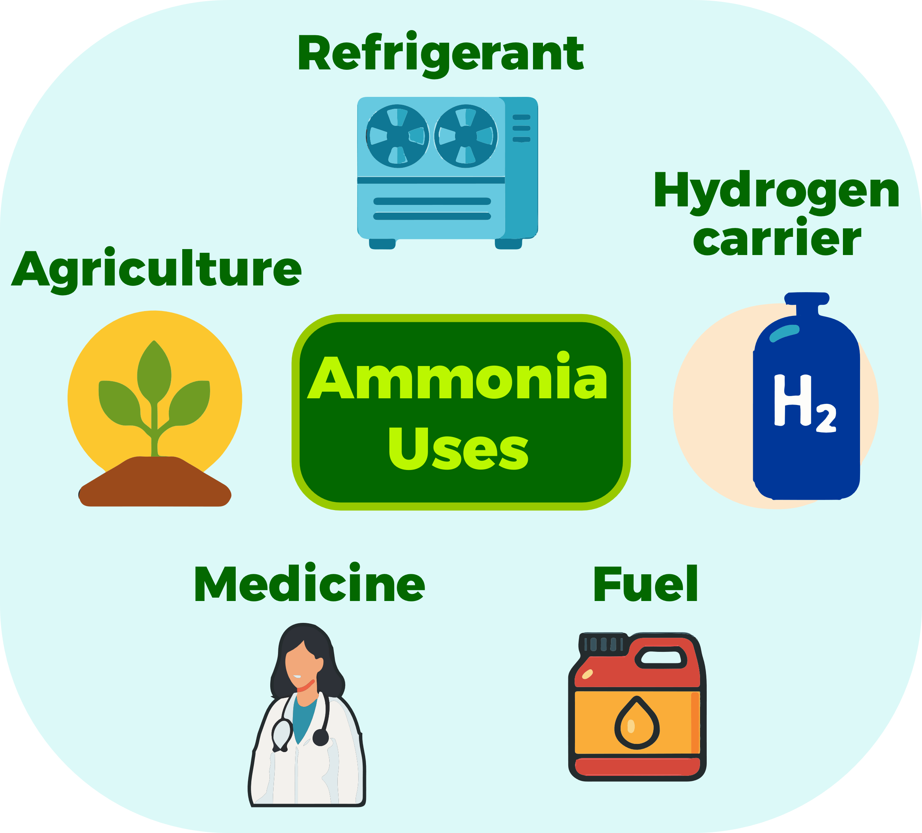
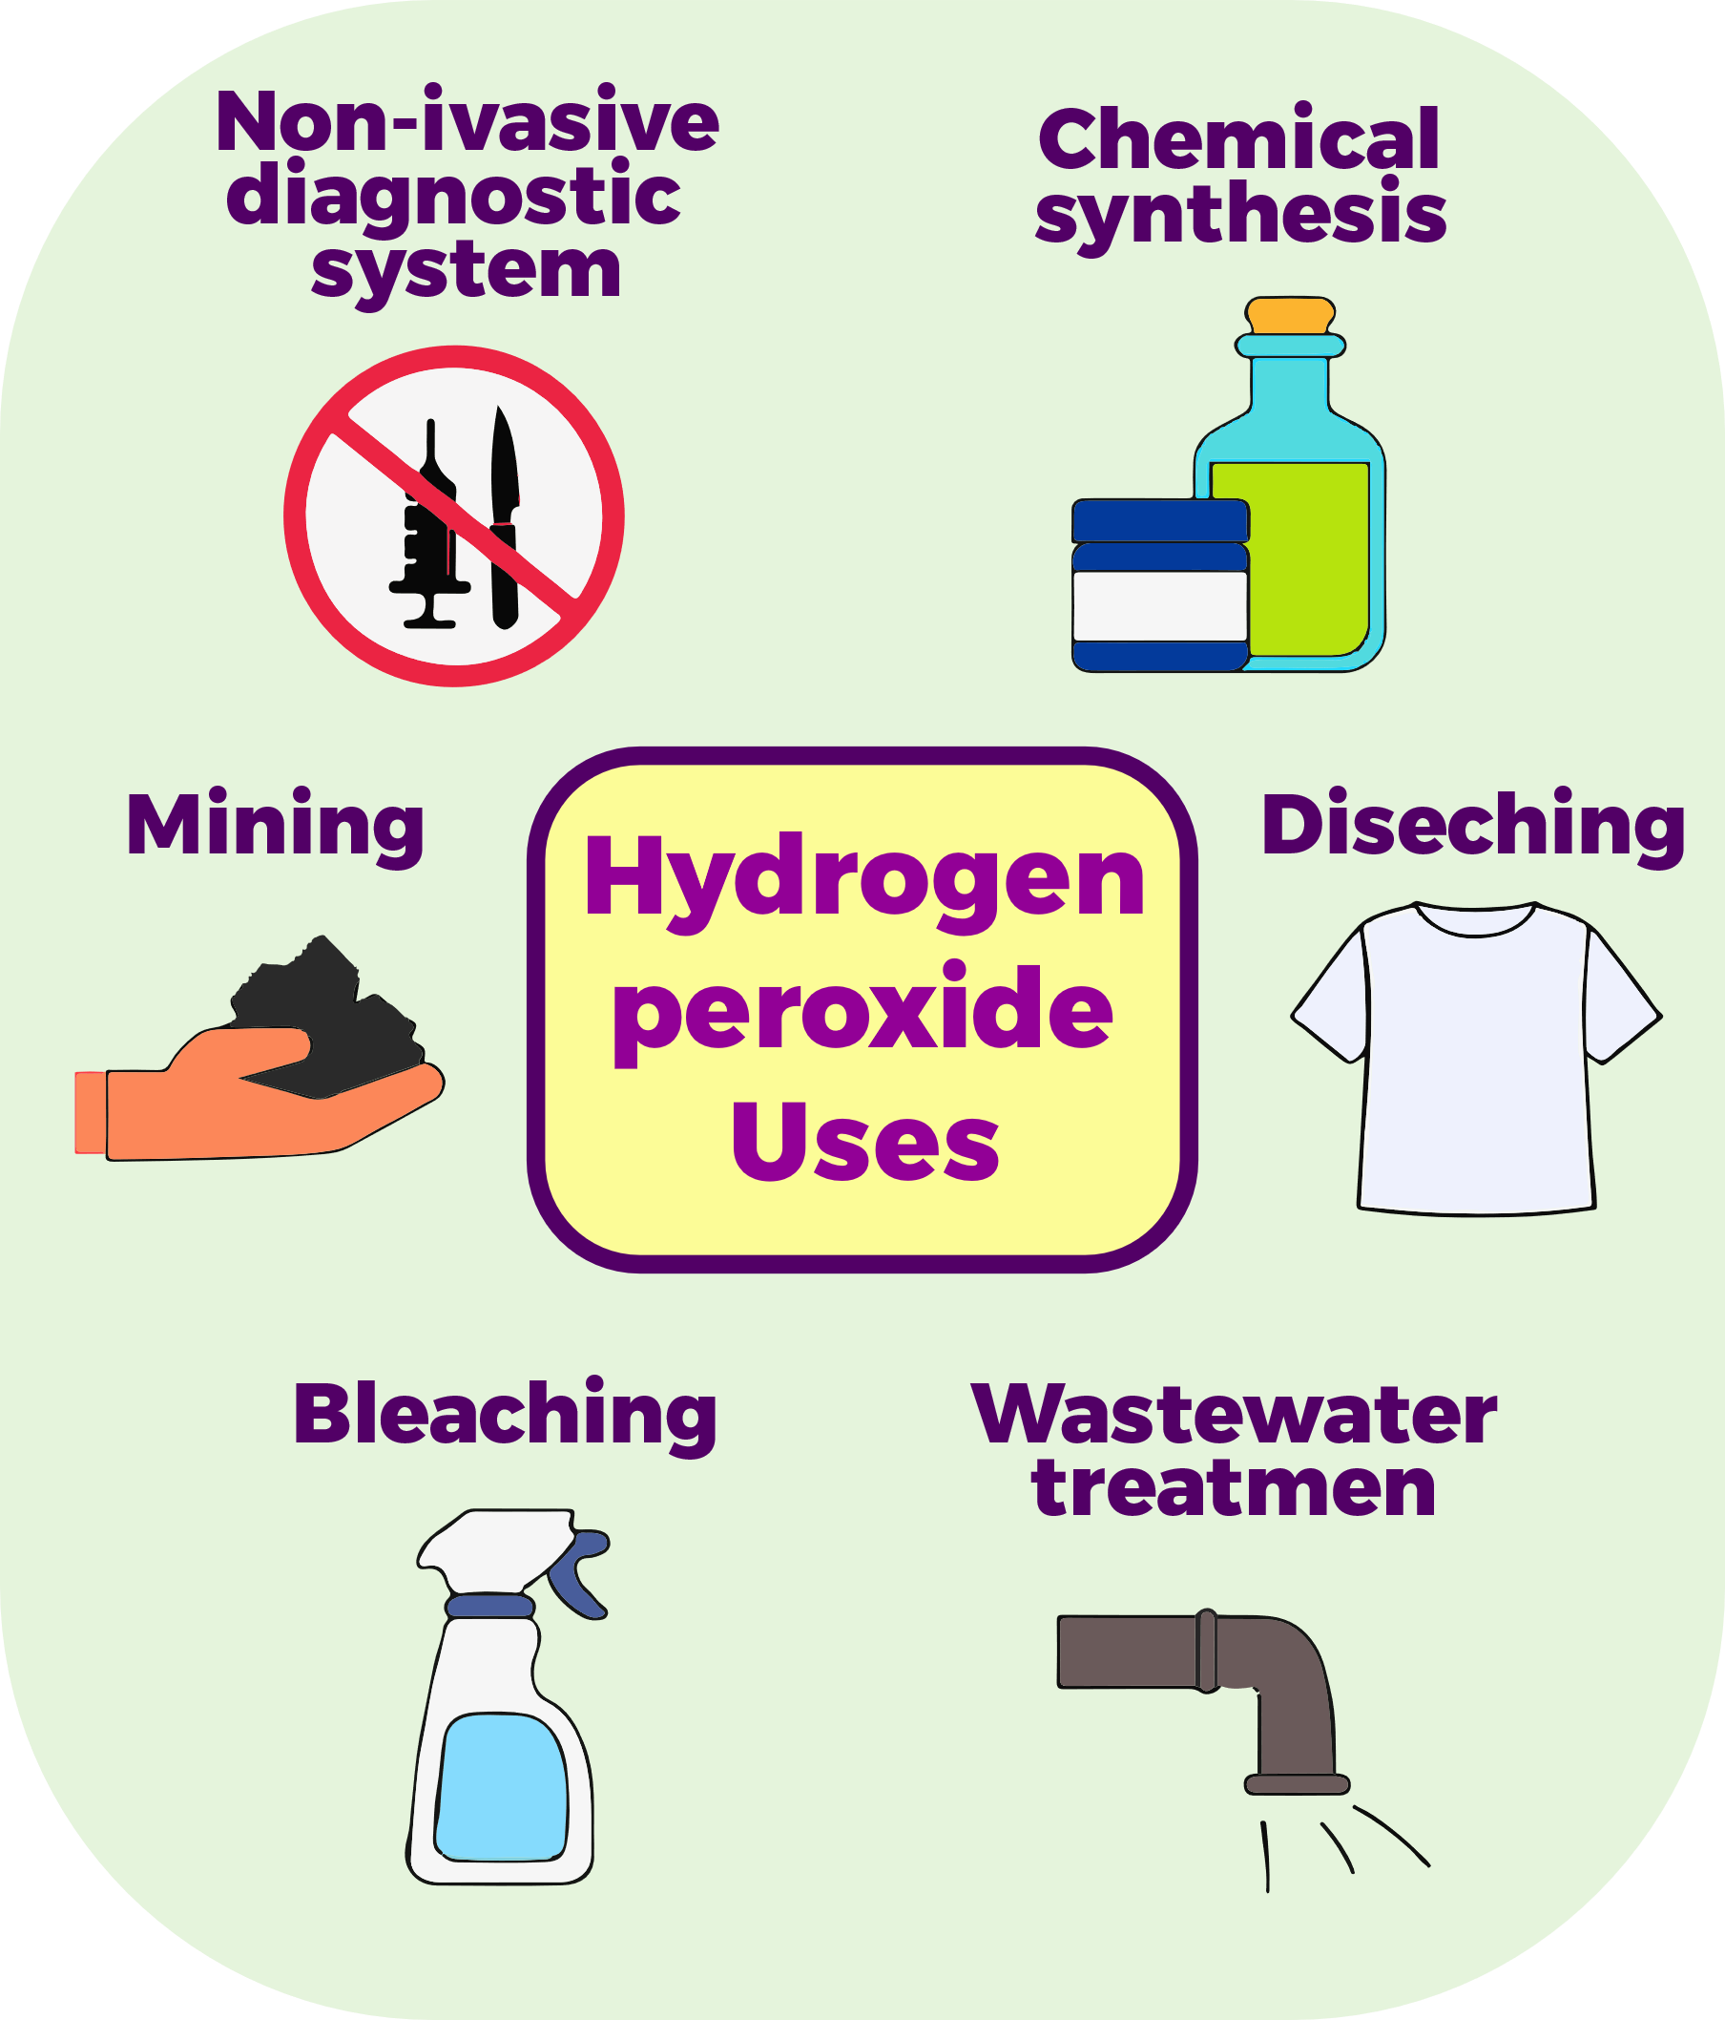


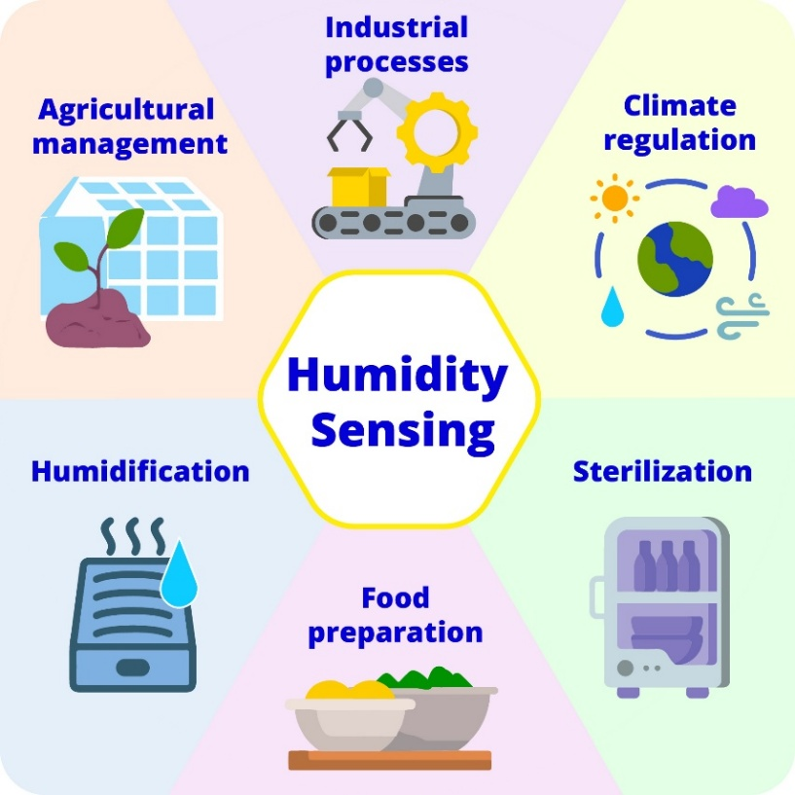
INTRODUCTION: Importance of Acetone, Ethanol, Hydrogen Peroxide, Humidity, CO₂, Ammonia, and Propylene Glycol Sensors

Slide 12
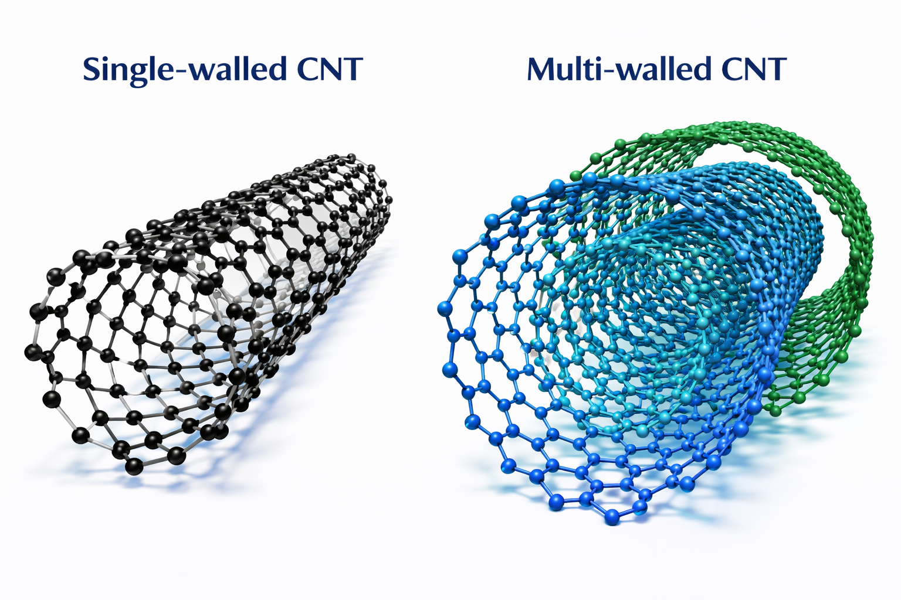
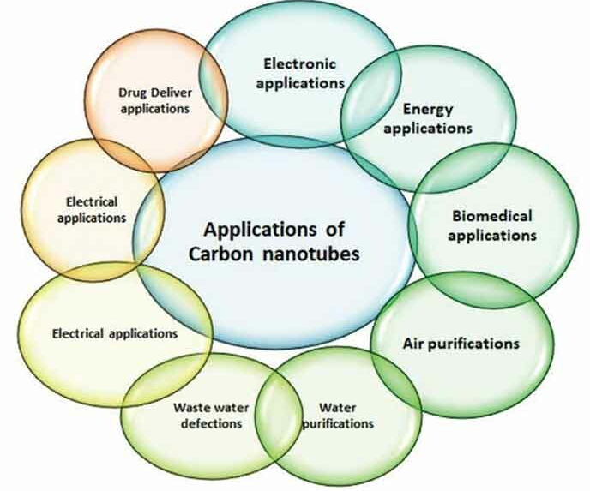
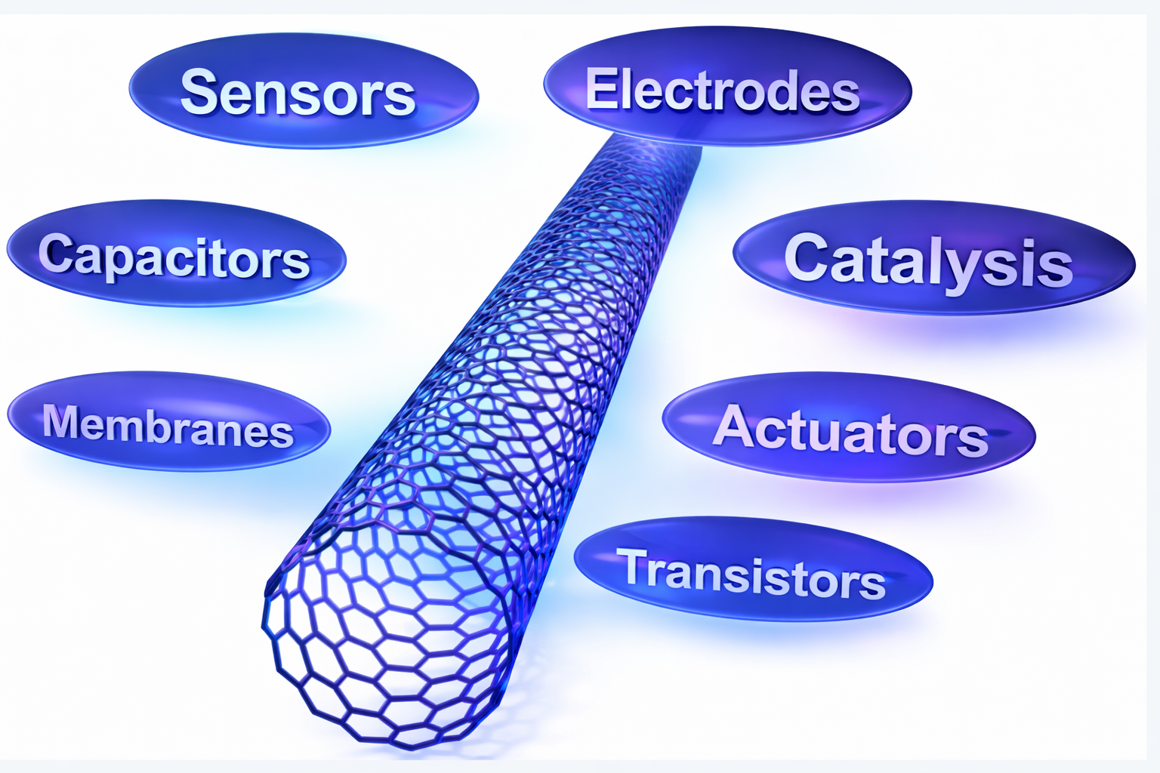
Multi-walled CNT
Single-walled CNT
INTRODUCTION: Carbon Nanotubes, Applications of Carbon Nanotubes
MWCNTs+
MOXs

Slide 13
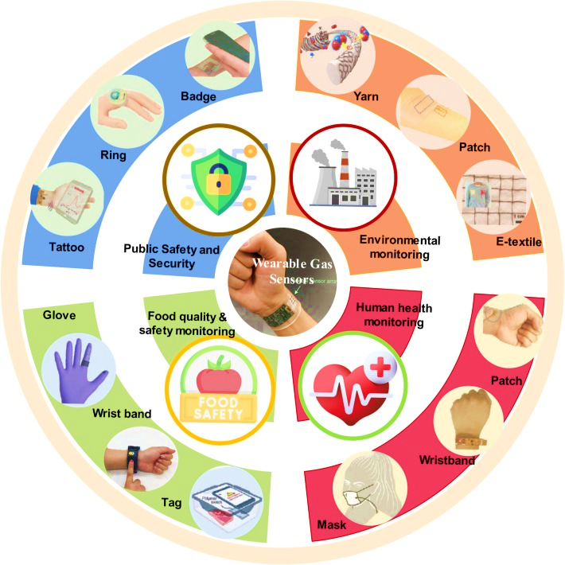
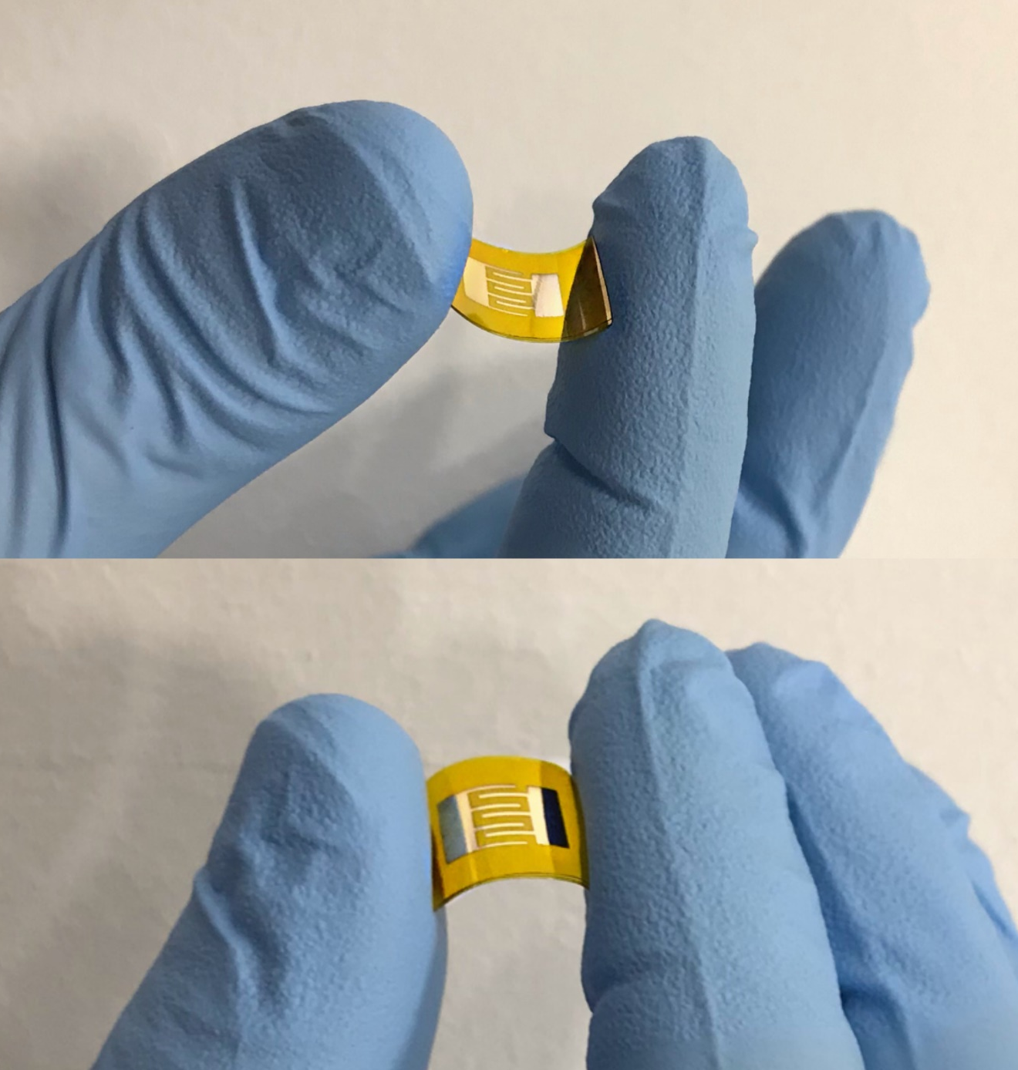
Application of flexible gas sensors
INTRODUCTION: Application of flexible gas sensors

Slide 14
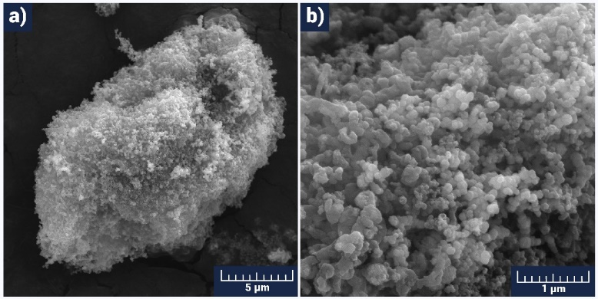
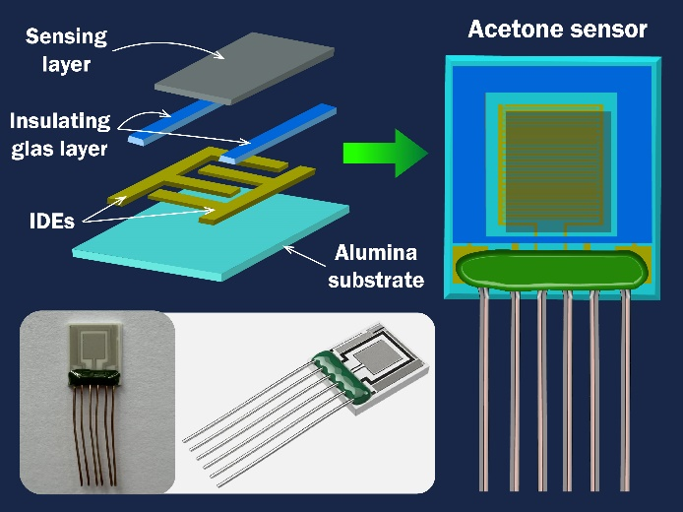
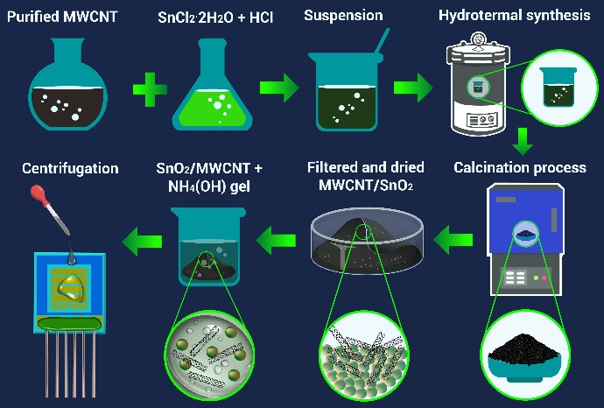
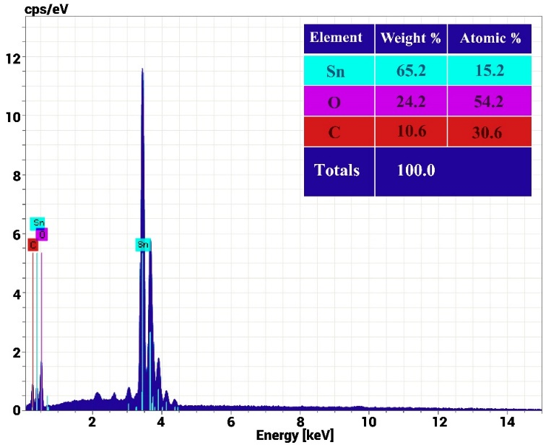
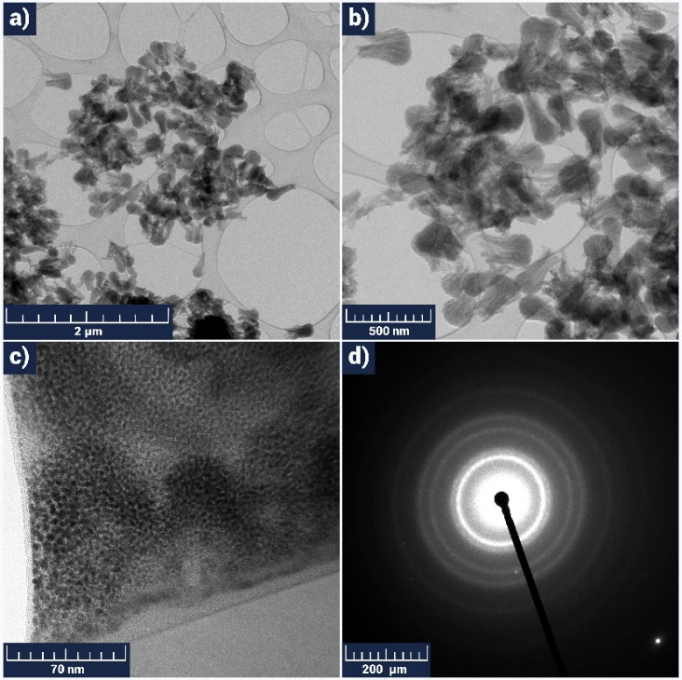
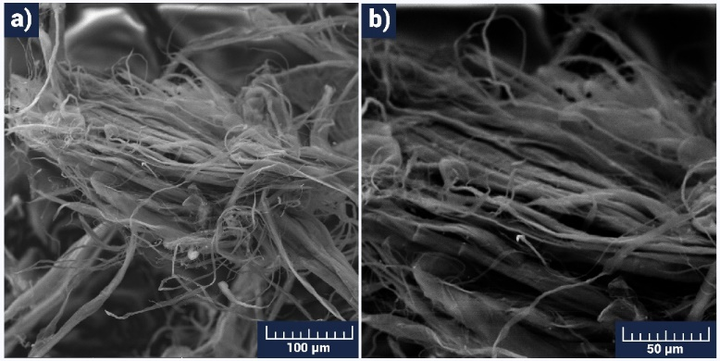
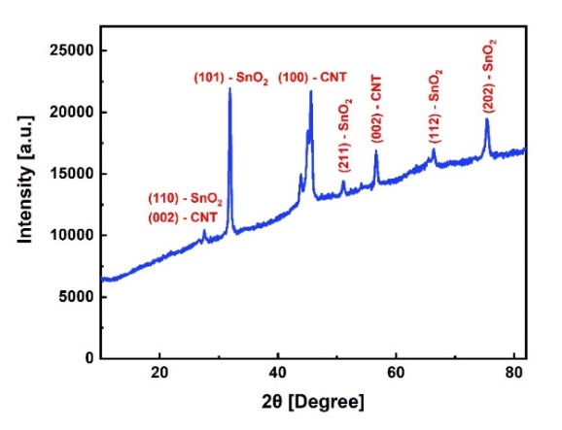
Center of Materials Science and Nanotechnologies
SnO2/MWCNTs nanostructured material for high-performance acetone and ethanol gas sensors (Fabrication and characterization)
INTRODUCTION: Application of flexible gas sensors
SEM images of the pristine SnO2 powder
The technological flow of SnO2/MWCNT sensor production.
Schematic illustration of the chemoresistive gas sensor structure.
EDX spectrum of the SnO₂/MWCNTs material.
XRD pattern of the SnO2/MWCNTs material.
Low (a, b) and high (c) resolution TEM images (with scalebar of 2 μm, 500 nm, and 70 nm, respectively) and SAED pattern (d) for the CNTs.
SEM image of the MWCNTs material with a scalebar of 100 μm (a) and 50 μm (b)

Slide 15
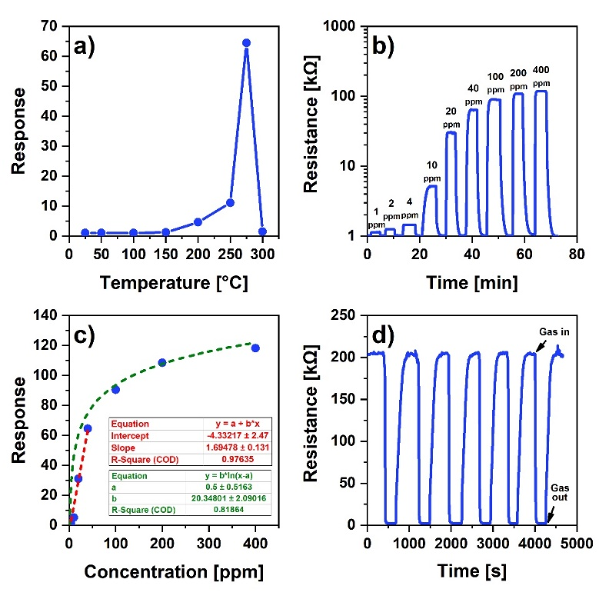



Center of Materials Science and Nanotechnologies
SnO2/MWCNTs nanostructured material for high-performance acetone and ethanol gas sensors (acetone and ethanol sensing results)
INTRODUCTION: Application of flexible gas sensors
Dependence of the acetone response on the operating temperature in the range of 25-300 °C at 40 ppm acetone concentration (a), acetone responses toward different concentrations at 275 °C (b), dependence of the sensor's response on acetone vapor concentration at 275 °C (c), and response repeatability of the sensor to 100 ppm acetone vapor expressed in 6 cycles at 275 °C (d).
Dependence of the ethanol response on the operating temperature in the range of 25-300 °C at 40 ppm ethanol concentration (a), gas responses of ethanol toward different concentrations at 200 °C (b), dependence of the sensor's response on ethanol vapor concentration at 200 °C (c), response repeatability of the sensor to 40 ppm ethanol vapor expressed in seven cycles at 200 °C (d).
Change in the dynamic response of the sensor reflecting the response and recovery times at 40 ppm ethanol (a), ethanol selectivity of the sensor to different environmental gases (b), comparison of sensor responses to 40 ppm of ethanol and acetone vapors at 200 °C (c), stability and baseline resistance of the sensor in 40 ppm ethanol vapor (d).
Change in the dynamic response of the sensor reflecting the response and recovery times at 40 ppm acetone (a), acetone selectivity of the sensor to different environmental gases (b), comparison of sensor responses to 40 ppm of ethanol and acetone vapors at 275 °C (c), stability and baseline resistance of the sensor in 400 ppm acetone vapor (d)

Slide 16



Center of Materials Science and Nanotechnologies
The influence of the growth parameters on RF-sputtered CNTs and their temperature-selective application in gas sensors (Fabrication and characterization)
INTRODUCTION: Application of flexible gas sensors
The experimental regimes for growing nanostructures
Sample № | Process | Sputter-ing duration | Gene-rator power | Working pressure | Sputtering gas | Substrate tempe-rature | Cathode current | Base pressure
SP1 | Ni sputtering (DC) | 20 s | - | 4.8×10⁻² Pa | Nitrogen | 400 °C | 300 mA | 8.3×10⁻⁴ Pa
 | Graphite sputtering (RF) | 4 h | 120 W | 3.3×10⁻² Pa | Nitrogen | 400 °C | - | 8.1×10⁻⁴ Pa
SP2 | Ni sputtering (DC) | 20 s | - | 4.7×10⁻² Pa | Argon | 400 °C | 300 mA | 8.1×10⁻⁴ Pa
 | Graphite sputtering (RF) | 4 h | 120 W | 3.1×10⁻² Pa | Argon | 400 °C | - | 8.2×10⁻⁴ Pa
SP3 | Ni sputtering (DC) | 20 s | - | 4.6 ×10⁻² Pa | Oxygen | 400 °C | 300 mA | 8.4×10⁻⁴ Pa
 | Graphite sputtering (RF) | 4 h | 120 W | 3.3×10⁻² Pa | Oxygen | 400 °C | - | 8.3×10⁻⁴ Pa
SP4 | Ni sputtering (DC) | 20 s | - | 4.8×10⁻² Pa | Nitrogen | 400 °C | 300 mA | 8.53×10⁻⁴ Pa
 | Graphite sputtering (RF) | 4 h | 140 W | 3.5×10⁻² Pa | Nitrogen | 400 °C | - | 8.1×10⁻⁴ Pa
SP5 | Ni sputtering (DC) | 10 s | - | 4.4×10⁻² Pa | Nitrogen | 400 °C | 300 mA | 8.6×10⁻⁴ Pa
 | Graphite sputtering (RF) | 4 h | 120 W | 3 ×10⁻² Pa | Nitrogen | 400 °C | - | 8.2×10⁻⁴ Pa
SP6 | Ni sputtering (DC) | 30 s | - | 4.7×10⁻² Pa | Nitrogen | 400 °C | 300 mA | 8 ×10⁻⁴ Pa
 | Graphite sputtering (RF) | 4 h | 120 W | 3.6 ×10⁻² Pa | Nitrogen | 400 °C | - | 8.4×10⁻⁴ Pa
SP7 | Cr sputtering (DC) | 20 s | - | 4.1×10⁻² Pa | Nitrogen | 400 °C | 300 mA | 7.9×10⁻⁴ Pa
 | Graphite sputtering (RF) | 4 h | 120 W | 3.2 ×10⁻² Pa | Nitrogen | 400 °C | - | 8.1×10⁻⁴ Pa
The process of the CNTs growing process and subsequent preparation of the gas sensing layer.
Actual photographs and schematic representation of the flexible Fe2O3:ZnO/CNTs sensor.
SEM image (a), low (b) and high (c) resolution TEM images, Raman spectra (d), SAED pattern (e), and EDX elemental mapping analysis of C and N elements (f) of the SP1 sample.

Slide 17






Center of Materials Science and Nanotechnologies
The influence of the growth parameters on RF-sputtered CNTs and their temperature-selective application in gas sensors (Fabrication and characterization)
INTRODUCTION: Application of flexible gas sensors
SEM (a) image, EDX elemental mapping analysis of Si (b), C (c), N (d), O (e), and Ni (f) elements and EDX spectrum (g) of the SP2 sample
SEM (a) image, EDX elemental mapping analysis of Si (b), C (c), N (d), and O (e), elements and EDX spectrum (f) of the SP3 sample
SEM (a) image, EDX elemental mapping analysis of Si (b), C (c), N (d), and O (e) elements, EDX spectrum (f), low (g) and high (h) resolution TEM images of the SP4 sample
SEM (a) image, EDX elemental mapping analysis of Si (b), C (c), N (d), and O (e) elements, and EDX spectrum (f) of the SP5 sample
SEM image (a), EDX elemental mapping analysis of Si (b), C (c), N (d), O (e), and Ni (f) elements, EDX spectrum (g), low (h) and high (i) resolution TEM images of the SP6 sample
SEM image (a), EDX elemental mapping analysis of Si (b), C (c), N (d), and O (e) elements, EDX spectrum (f), low (g) and high (h) resolution TEM images of the SP7 sample

Slide 18



Center of Materials Science and Nanotechnologies
The influence of the growth parameters on RF-sputtered CNTs and their temperature-selective application in gas sensors
(HPV and PGV sensing results)
The real-time response curves of the sensor at different operating temperatures with UV irradiation at 60 ppm PGV and PGV response vs. concentration at 150 °C.
Dependence of the HPV response on the operating temperature in the range of 25–150 °C at 6 ppm HPV concentration (a), selectivity of the sensor for HPV at 50 °C (b), HPV responses toward different concentrations at 50 °C (c), dependence of the sensor’s response on HPV vapor concentration at 50 °C (d).
Change in the dynamic response of the sensor reflecting the response and recovery times at 0.5 ppm of HPV (a), repeatability tests of the sensor to 0.5 ppm HPV at 50 °C (b), long-term stability of the sensor (c), stability of the response to multiple bending of the flexible sensor for 0.5 ppm HPV (d).

Slide 19








Center of Materials Science and Nanotechnologies
Fabrication and Characterization of MWCNTs Decorated ZnO Nanograins Based Sensor for Enhanced Performance Toward CO2 Gas (Fabrication and characterization)
INTRODUCTION: Application of flexible gas sensors
FTIR spectrum of the MWCNTs/ZnO and ZnO materials.
Block representation of the CO2 sensor fabrication.
Low a,b) and high c) resolution TEM images and d) SAED pattern for the ZnO material.
Schematic representation and b) actual photographs of the CO2 sensor.
SEM images of the MWCNT/ZnO material with the scalebar of 2 µm a) and 1 µm b).
TEM images (a – bright field, b – dark field) and EDX elemental mapping analysis of Si c), Zn d), O e) and C f) elements.
XPS survey spectrum a), high-resolution XPS spectrum of Zn2p b), C1s c), and O1s d) for the MWCNTs/ZnO material.
EDX spectrum of the MWCNTs/ZnO material.

Slide 20



Center of Materials Science and Nanotechnologies
Fabrication and Characterization of MWCNTs Decorated ZnO Nanograins Based Sensor for Enhanced Performance Toward CO2 Gas (CO2 sensing results)
The illustration of the CO₂ sensing mechanism for the MWCNTs/ZnO film.
a) Sensor resistance versus operating temperature with and without UV irradiation, b) sensor UV response at 150 °C, c) sensor response versus operating temperature with and without UV irradiation at 5000 ppm CO₂, d) dynamic response curves of the sensor to different concentrations of CO₂ at 150 °C.
a) CO₂ response versus concentration at 150 °C, b) repeatability tests of the sensor to 100 ppm CO₂ at 150 °C, c) selectivity of the sensor for CO₂ at 150 °C, d) long-term stability of the sensor for CO₂ at 150 °C.

Slide 21








Center of Materials Science and Nanotechnologies
Highly Sensitive Ammonia Gas Sensor Based on MWCNTs Saturated Fe2O3 Nanograins (Fabrication and characterization)
INTRODUCTION: Application of flexible gas sensors
Low (a, b) and high (c, d) resolution TEM images for the MWCNTs.
SEM images (a, b), particle size histogram (c), and thickness measurement results (d) of the Fe₂O₃ film.
Low (a, b) and high-resolution (c) TEM images and the SAED pattern (d) for the Fe₂O₃ material.
Schematic block diagram of the NH3 sensor fabrication (a), schematic illustration, and actual photograph of the sensor (b).
XPS survey spectrum (a), high-resolution XPS spectrum of Fe 2p (b), C 1s (c), and O 1s (d) for the Fe₂O₃/MWCNTs material.
Raman spectra of the MWCNTs.
EDX spectrum of the Fe₂O₃/MWCNTs material
FTIR spectra of the Fe2O3/MWCNTs and Fe₂O₃ materials.

Slide 22



Center of Materials Science and Nanotechnologies
Highly Sensitive Ammonia Gas Sensor Based on MWCNTs Saturated Fe2O3 Nanograins (Ammonia sensing results)
Ammonia-sensing mechanism for the Fe₂O₃/MWCNTs material.
(a) Sensor resistance vs operating temperature, (b) sensor response vs operating temperature at 250 ppm of NH₃, (c) dynamic response curves of the sensor to different concentrations of ammonia at 200 °C, (d) sensor response vs NH₃ concentration at 200 °C.
(a) Real-time response curve of the sensor at 3 ppm ammonia, representing the response and recovery times at 200 °C, (b) repeatability tests of the sensor to 30 ppm ammonia at 200 °C, (c) selectivity of the sensor for NH₃ at 200 °C, and (d) long-term stability of the sensor for ammonia at 200 °C.

Slide 23







Center of Materials Science and Nanotechnologies
Ultra-high selective hydrogen peroxide vapor sensor based on the Fe2O3/MWCNTs nanocomposite (Fabrication and characterization)
SEM images of the MWCNTs with the scalebars of 1 µm (a) and 500 nm (b).
TEM images of the MWCNTs with the scalebars of 70 nm (a) and 20 nm (b).
Actual photograph of the flexible sensor (a) and schematic illustration of its preparation steps (b).
Raman spectrum of the MWCNTs structure.
Low (a, b) and high-resolution (c) TEM images and SAED pattern (d) of the Fe2O3 material.
XPS survey spectrum (a), high-resolution XPS spectra of Fe2p (b), O1s (c), and C1s (d) for the Fe₂O₃/MWCNTs material.
FTIR spectrum of the Fe2O3/MWCNTs material.

Slide 24



Center of Materials Science and Nanotechnologies
Ultra-high selective hydrogen peroxide vapor sensor based on the Fe2O3/MWCNTs nanocomposite (HPV sensing results)
Selectivity of the sensor for 20 ppm of HPV at 100 °C.
(a) Sensor response vs. operating temperature at 60 ppm HPV, (b) dynamic resistance curve under the influence of 60 ppm of HPV at room temperature, (c) dynamic response curves at different concentrations of HPV at 100 °C (d) sensor response vs. HPV concentration at 100 °C.
(a) Real-time resistance curve of the sensor at 20 ppm HPV, representing the response and recovery times at 100 °C, (b) repeatability tests of the sensor to 20 ppm HPV at 100 °C, (c) long-term stability of the HPV sensor at 100 °C, (d) bending stability of the HPV sensor at 100 °C.

Slide 25








Center of Materials Science and Nanotechnologies
Enhanced humidity sensing performance of Fe₂O₃:ZnO/MWCNTs nanocomposite: fabrication and characterization (Fabrication and characterization)
The fabrication steps and the actual photograph of the Fe2O3:ZnO/MWCNTs sensor.
The schematic illustration of the humidity sensor.
Schematic block diagram of the humidity testing system.
SEM images of the Fe2O3/ZnO powder with the scalebars of 2 µm (a) and 1 µm (b).
SEM images (a, b), particle size histogram (c), and thickness measurement result (d) of the Fe₂O₃/ZnO film.
SEM images for MWCNTs with the scalebar of 5 µm (a) and 1 µm (b).
Low (a, b) and high-resolution (c) TEM images and SAED pattern (d) for the Fe₂O₃/ZnO material.
Low (a, b, c) and high (d) resolution TEM images for the MWCNTs.

Slide 26



Center of Materials Science and Nanotechnologies
Enhanced humidity sensing performance of Fe₂O₃:ZnO/MWCNTs nanocomposite: fabrication and characterization (Fabrication and characterization)
EDX spectrum of Fe2O3:ZnO/MWCNTs material.
EDX elemental mapping analysis of Fe (a), O (b), Zn (c), and C (d) in the Fe2O3:ZnO/MWCNTs material.
XPS survey spectrum a), high-resolution XPS spectrum of Fe2p b), Zn2p c), O1s d), and C1s e) for the Fe₂O₃:ZnO/MWCNTs material.

Slide 27



Center of Materials Science and Nanotechnologies
Enhanced humidity sensing performance of Fe₂O₃:ZnO/MWCNTs nanocomposite: fabrication and characterization (Humidity sensing results)
(a) UV response at room temperature (The inset is UV response at different temperatures), (b) sensor response vs. operating temperature at 22 % RH, (c) dynamic resistance curve of the sensor to 22 % RH at 250 °C, (d) dynamic response curves of the sensor to different concentrations of humidity (RH) at 250 °C.
(a) Sensor response vs. RH at 250 °C, (b) hysteresis curves of the sensor, (c) real-time response curve of the sensor at 22 % RH, representing the response and recovery times at 250 °C, (d) repeatability tests of the sensor to 22 % RH at 250 °C.
(a) selectivity of the sensor for humidity at 250 °C, (b) long-term stability of the sensor for 22 % RH at 250 °C, (c) sensor Nyquist curves in air and at 22 % RH (b), and (d) the proposed equivalent electrical circuit of the sensor.

Slide 28






Center of Materials Science and Nanotechnologies
Gas sensing mechanisms
Propylene glycol sensing mechanism
Humidity sensing mechanism
Acetone sensing mechanism
HPV sensing mechanism
Ethanol sensing mechanism
Hydrogen Peroxide sensing mechanism

Slide 29


Center of Materials Science and Nanotechnologies
PCB design and fabrication for gas detector

Slide 30
Center of Materials Science and Nanotechnologies
Publications
Mikayel Aleksanyan, Artak Sayunts, Gevorg Shahkhatuni, Zarine Simonyan, Davit Kananov, Rima Papovyan, Dušan Kopecký // Fabrication and Characterization of MWCNTs Decorated ZnO Nanograins Based Sensor for Enhanced Performance Toward CO₂ Gas / Advanced Materials Interfaces (Wiley), 2025, 12, 2500185, Q1
Gohar Shahnazaryan, Mikayel Aleksanyan, Artak Sayunts, Zarine Simonyan, Rima Papovyan, Gevorg Shahkhatuni // Study of a Nanostructured Co-Doped SnO₂ Sensor for Hydrogen Peroxide Vapor Detection Using Impedance Spectroscopy / ACS Omega, 2025, 10, 14452-14465, Q1
Mikayel Aleksanyan, Artak Sayunts, Gevorg Shahkhatuni, Zarine Simonyan, Davit Kananov, Rima Papovyan, Dušan Kopecký // Influence of the Growth Parameters on RF-Sputtered CNTs and Their Temperature-Selective Application in Gas Sensors / ACS Omega, 2025, 10, 34733-34746, Q1
Mikayel Aleksanyan, Artak Sayunts, Gevorg Shahkhatuni, Zarine Simonyan, Davit Kananov, Rima Papovyan, Dušan Kopecký // Highly sensitive ammonia gas sensor based on MWCNTs saturated Fe₂O₃ nanograins/ ACS Langmuir, 2025, 41, 26614−26627, Q1
Mikayel Aleksanyan, Artak Sayunts, Gevorg Shahkhatuni, Zarine Simonyan, Davit Kananov, Emma Khachaturyan, Rima Papovyan, Alena Michalcová, Dušan Kopecký // SnO /MWCNTs Nanostructured Material for High-Performance Acetone and Ethanol Gas Sensors / ACS Omega, 2025, 10, 7283-7294, Q1
Artak Sayunts, Rima Papovyan, Gevorg Shahkhatuni, Zarine Simonyan, Davit Kananov, Gabriel Gevorgyan, Dušan Kopecký, Mikayel Aleksanyan // Ultra-high selective hydrogen peroxide vapor sensor based on the Fe O /MWCNTs nanocomposite / International Journal of Smart and Nano Materials, 2026, 17 (1), 2637516, Q1
Gohar Shahnazaryan, Artak Sayunts, Gevorg Shahkhatuni, Rima Papovyan, Zarine Simonyan, Gabriel Gevorgyan, Andranik Grigoryan, Dušan Kopecký, Mikayel Aleksanyan // Study of a Flexible ZnO/MWCNTs Thin Film Sensor for Hydrogen Peroxide Vapor Detection by Impedance Spectroscopy / Nanotechnology, Science and Applications, 2026, Volume 19, 1-15, Q1
Artak Sayunts,, Gevorg Shahkhatuni, Zarine Simonyan, Davit Kananov, Emma Khachaturyan, Rima Papovyan, Alena Michalcová, Dušan Kopecký, Mikayel Aleksanyan. Enhanced humidity sensing performance of Fe₂O₃:ZnO/MWCNTs nanocomposite: fabrication and characterization/ ACS Omega, 2026, Accepted, Q1
Artak Sayunts,, Gevorg Shahkhatuni, Zarine Simonyan, Davit Kananov, Emma Khachaturyan, Rima Papovyan, Alena Michalcová, Dušan Kopecký, Mikayel Aleksanyan, R. Papovyan, M. Aleksanyan, Enhanced Sensing Performance of ZnO<Ni>/MWCNTs Nanocomposite for Ultrasensitive Ammonia Detection/ Surfaces and Interfaces, 2026, 12, Accepted, Q1
B. Semerjyan, D. Kananov, M. Aleksanyan, TRANSIMPEDANCE CONVERTER FOR HIGH RESISTANCE SENSORS USING MOS-PHOTOVARICA, Journal of Contemporary Physics (Armenian Academy of Sciences), 2026, 12, Accepted, Q4
Flexible Sensor Systems Based on Composite Nanostructures, Neutron Physics and Radiation Materials Conference, October 27–30, 2025, Yerevan, Armenia.
M. Aleksanyan, G. Shahkhatuni, Z. Simonyan, G. Shahnazaryan, R. Papovyan, D. Kananov, A. Grigoryan, G. Gevorgyan, G. Stepanyan, A. Sayunts // Fabrication and Characterization of CO2 Sensor Using ZnO<In> Nanograins / 2025 / SMSI 2025 Conference – Sensor and Measurement Science International, 307-308, Germany
R. Papovyan, A. Sayunts, G. Shahkhatuni, Z. Simonyan, D. Kananov, A. Grigoryan, G. Stepanyan, M. Aleksanyan, Synthesis of Rice-Shaped Fe₂O₃/MWCNT Nanocomposites for Gas Sensing Applications, 36th International Conference on Diamond and Carbon Materials (ICDCM 2026), August 30–September 3, 2026, Donostia–San Sebastián, Spain.
R. Papovyan, A. Sayunts, G. Shahkhatuni, Z. Simonyan, D. Kananov, A. Grigoryan, G. Stepanyan, M. Aleksanyan, Synthesis and Application of Carbon Nanotube-Based Nanocomposite Materials for VOC Sensing, 33rd IEEE International Conference on Electronics Circuits and Systems, November 8–11, 2026, Thessaloniki, Greece.
M. Aleksanyan, G. Shahkhatuni, Z. Simonyan, G. Shahnazaryan, R. Papovyan, D. Kananov, A. Grigoryan, G. Gevorgyan, G. Stepanyan, A. Sayunts, Highly Selective Ethanol Sensor Based on SnO2/MWCNTs Nanocomposite, EUROSENSORS 2026, Zurich | Switzerland, September 6 – 9, 2026

Slide 31
Center of Materials Science and Nanotechnologies
Financial report – 2025-2026
Wage amount | 33 160 000 AMD
Equipment, materials and services | 22 000 000 AMD
Scientific Visits | 2 000 000 AMD
Total balance for services | 3 500 000 AMD
Total balance for trips | 4 000 000 AMD
Total amount for 5 years | 189 800 000 AMD

Slide 32









Center of Materials Science and Nanotechnologies
Financial report (Equipment, materials and services )
UPS
DJI Mavic 3 Pro drone
Sputtering metal targets
Corning willow glass
MWCNTs
Chemical refrigerator
Metal oxide nanopowders

Slide 33










Center of Materials Science and Nanotechnologies
Public coverage

Slide 34








Օur participation in ԲանՈՒԳործ Expo-2025

Slide 35







Օur participation in Science Week 2025

Slide 36

Առաջընթաց՝ արդյունավետ գիտությամբ «ԱԱԳ-2026»
THANK YOU
Mikayel S. Aleksanyan
Head, YSU Center/Department of Materials Science and Nanotechnologies (Institute of Physics)
Doctor of Science (Engineering), Professor
E-mail: maleksanyan@ysu.am, nanotech@ysu.am
Phone: +37493534324, +37460710319
Address: Yerevan State University (YSU), Republic of Armenia, Yerevan, 0025, 1 Alex Manoogian

