Slide 1
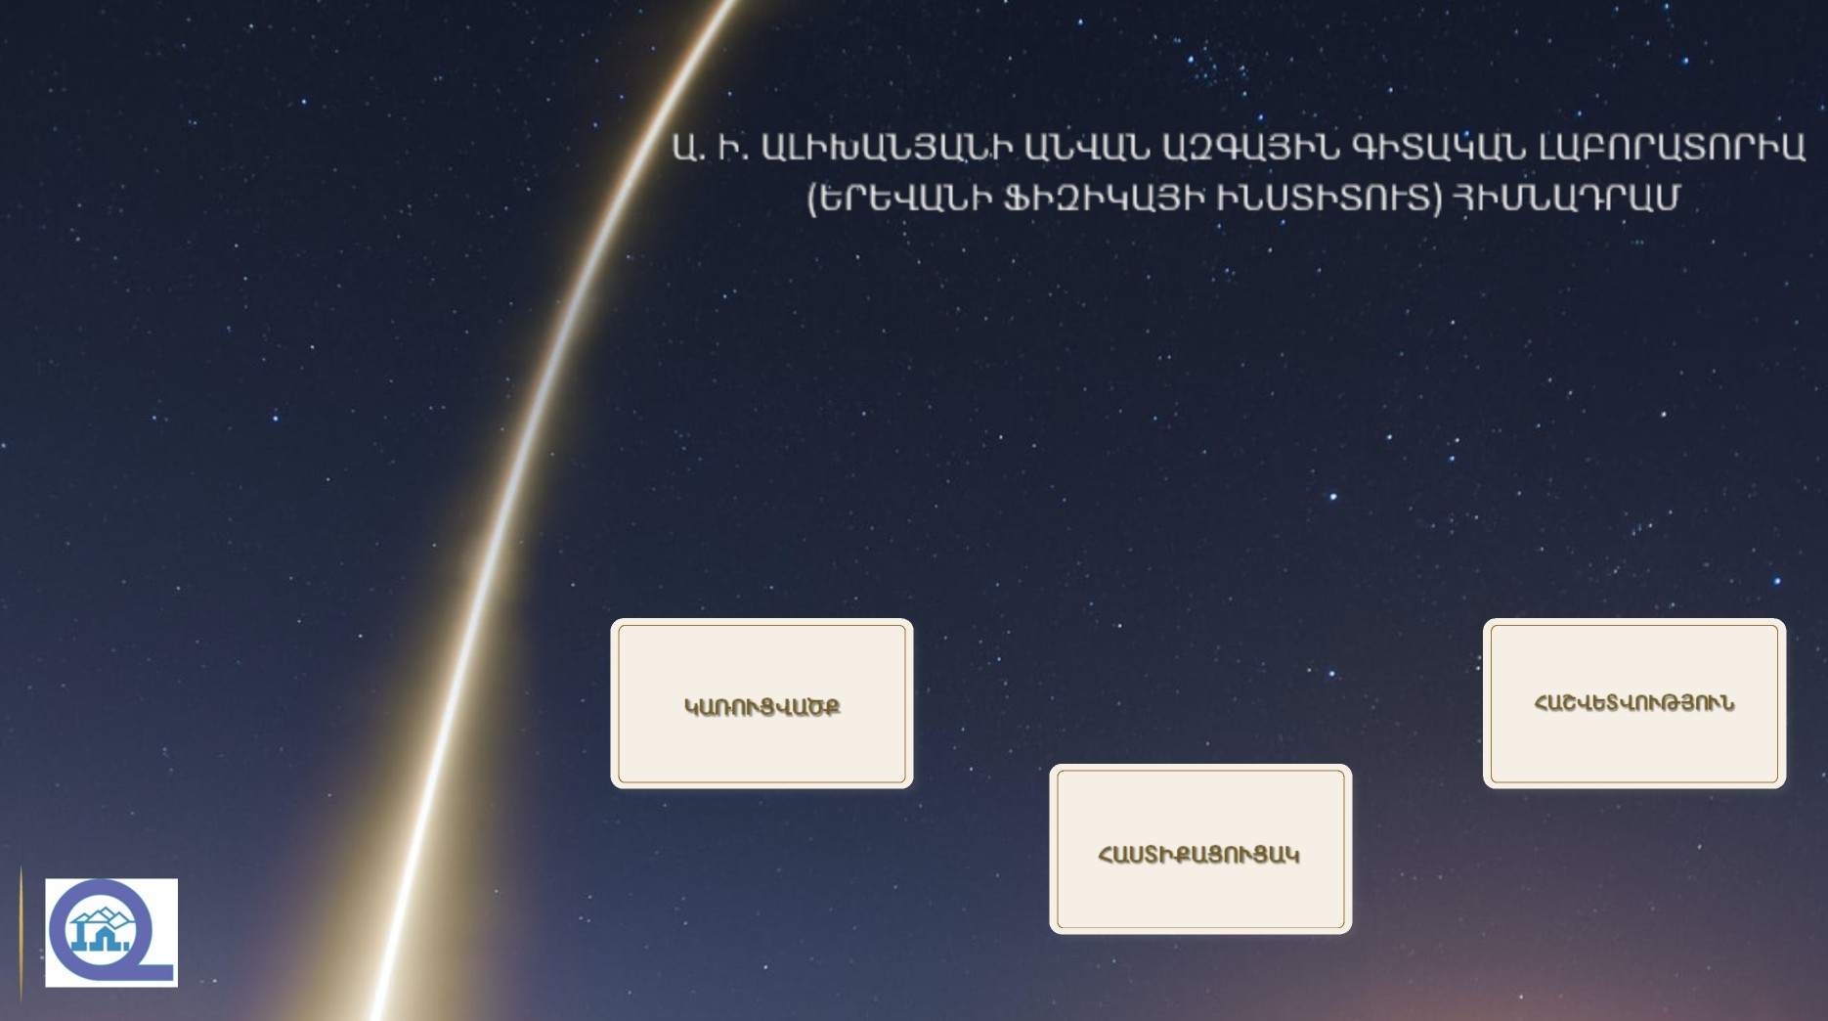
21AG-1C060
«Դուալություն բարձր սպինների և լարերի տեսություններում »
ԳԻՏԱԿԱՆ ԹԵՄԱՅԻ ԻՐԱԿԱՆԱՑՄԱՆ ՀԱՇՎԵՏՎՈՒԹՅՈՒՆ
ԱՌ 14․15․2026
ԿՈՆՖՈՐՄ ԱՆՈՄԱԼԻԱ

Slide 2
DUALITY IN GAUGE, HIGHER SPIN AND STRING THEORIES, AND ANOMALIES
S. Matinyan Center for Theoretical Physics (Theory Division) Principal Investigator: Ruben Manvelyan of A. Alikhanyan National Laboratory (Yerevan Physics Institute)
21AG-1C060
1.1
Phenomenology,
HEP Experiments
High Energy Theoretical Physics
Math.Physics
QFT
Main Theoretical Problems
Confinement
(Hadronization, Spin Crisis , …..)
Theory of Everything
(Unification of the all known interactions)
Quantum Gravity
Duality
Possible solution: AdS/CFT Conjecture
or Gauge/String Duality
Only Possible Solution: String/M Theory
Problem: Many different vacuums of string theories

Slide 3
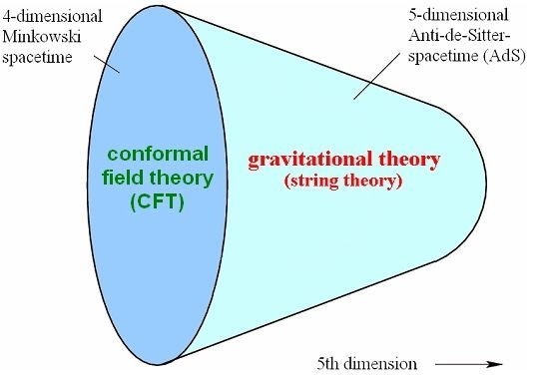
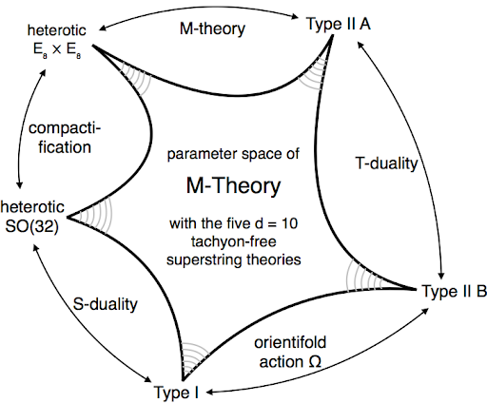
AdS/CFT Conjecture Dualities Between or Gauge/String Duality Different String Theories
21AG-1C060
1.2

Slide 4
Higher Spin Gauge Theories Anomalies
21AG-1C060
1.3
Higher spin gauge theory is one of the interesting, complicated and quick developing parts of modern theoretical physics
The reason of this is the fact that the spectrum of these theories includes all spin massless modes equipped with higher spin gauge symmetries and particularly the graviton realized here as a massless spin-two field. The similar, but massive modes exist in the (super) String theory
So, therefore the spectrum of String theory can be obtained from massless higher spin gauge theory by spontaneously breaking of higher spin symmetry.
So it is Gauge theories with Highest Possible Gauge Symmetries and can be involved in all tests of all possible Dualities, AdS/CFT and other mind games to construct
THEORY OF QUANTUM GRAVITY
Anomalies arises when we have two similar
symmetries on
CLASSICAL LEVEL
Then on quantum level these symmetries start to clash and as a result of this contradiction one of symmetries should be dropped due to
Quantum Anomaly
Therefore Investigations of Quantum Anomalies (In particular in the case of HS Gauge Theories) are the best way to understand quantum consistency of the constructing theory and it’s right physical spectrum.

Slide 5
Three point correlation function of conformal conserved currents in d dimensional boundary 2024-2025-2026
21AG-1C060
1. 4
AdS/CFT Duality
Cubic Interaction of Higher Spins in d+1 dimensional AdS space
Three point correlation function of conformal conserved currents in d dimensional boundary
Perturbation regime in bulk theory
Strong- Coupled regime
Singularity of three point correlation function at coincident points (main singularity)
Singular part of on-shell action
Generalize Conformal Anomaly

Slide 6
Quantum Anomaly
21AG-1C060
1.5
Classic Theory
Quantum Theory
Classic Action/Equation of motion
Quantum Effective Action/Functional Integral and Correlation Function
Symmetries and corresponding invariants
Singularity of Effective action/correlation functions at coincident points (main singularity)
Conformal Anomaly

Slide 7
Effect.Action/Singularity/Anomaly
21AG-1C060
1.6
??
??
Similar Classic
Symmetries
Symmetry of Quantum Effective action ???
Quant.Cons. Cond. (Ward Identity)

Slide 8
SingularityAnomaly
21AG-1C060
1.7
Singularity change this game:
Only one will survive in quantum world

Slide 9
Team Members : all members are affiliated in Theory Division of AANL
21AG-1C060
2.1
Our group consists of two Leading Scientific Researchers (including Principal Investigator), two Young Scientists (Postdocs) and two advanced PhD students (Aspirants)
 | Degree | Position | D. of Birth | Ph.D Supervisor | Postdoc
Ruben Manvelyan | Doc. of Sci. | L.S.R, Առ․Գ․Ա | 1963
Ruben Mkrtchyan | Doc. of Sci. | L.S.R, Առ․Գ․Ա | 1955
Hasmik Poghosyan | Ph.D (2018) | S.R, Գ․Ա․ | 1991 | G. Sarkissian (YSU) | Univ. di Bologna
Gabriel Poghosyan | Ph.D (2018) | S.R, Գ․Ա․ | 1992 | R. Manvelyan
Maneh Avetisyan | Ph.D (2022) | S.R, Գ․Ա․ | 1996 | R. Mkrtchyan
Melik Karapetyan | Ph.D (2022) | S.R, Գ․Ա․ | 1996 | R. Manvelyan

Slide 10
We Had Already Important Achievements in Area of
DUALITY IN GAUGE, HIGHER SPIN AND STRING THEORIES, AND ANOMALIES
21AG-1C060
2.2
Construction of the covariant cubic interaction in flat space and connection with the
interaction in one dimension less AdS space.
Ruben Manvelyan with coauthors, papers of 2010 - 2021.
Investigation of the HS anomalous conserved currents and bulk-to-bulk propagators in AdS space (2005-2010).
Construction of all possible Weyl invariant actions in d=4 for spin three field in a general gravitational background (2018) .
We present an off-shell generating function for all cubic interactions of Higher Spin gauge fields
constructed in our papers.arXiv:1003.2877. It is written in a very compact way, and have a remarkable structure.
Development of the universality approach in the gauge theories and Lie algebras.
Ruben Mkrtchyan with coauthors, papers of 1981 and 2011 - 2021.
Non-perturbative Chern-Simons/topological string duality.
Duality of Chern-Simons theory (with exceptional groups) to refined topological string theory.
Diophantine classification of simple Lie algebras, universal quantum dimension formulae, connection with
configurations theory.
Now this is a separate field, initiated by us, developing in other centers, also (Loughborough, ITEP, Berkeley, JINR).
New developments in such classical field as the theory of simple Lie algebras is highly non-trivial achievement.

Slide 11
Important Achievements for 2021-2022-2023-2024
DUALITY IN GAUGE, HIGHER SPIN AND STRING THEORIES, AND ANOMALIES
21AG-1C060
2.3
We have advanced in construction of QUARTIC INTERACTION of HS fields:
Constructed some special case of local quartic interaction of two scalars and two higher spin gauge fields (spin 4). The result leads to necessity to include spin 6-gauge modes in resulting interaction.
Investigated commutator of linearized HS gauge transformation and discovered that in r.h.s of commutator exists HS gauge transformations with parameters corresponding to the HS fields with Mixed Symmetry.
Melik Karapetyan, Ruben Manvelyan, Karapet Mkrtchyan, On correlation functions of higher-spin currents in arbitrary dimensions d>3, arXiv:2309.05129. Journal of High Energy Physics, 2024, 2024 (3), 31.
We develop further the universality approach to the simple Lie algebras and apply it to
Chern-Simons/topological string duality problem. The main achievements are
Derivation of partition function of refined Chern-Simons theory on S3 for an arbitrary gauge group
Extension of duality to all classical groups. Besides that, a new, “modularity-neutral”, definition of constant maps contribution in topological strings is given, and new matrix model for refined Chern-Simons theory is presented.

Slide 12
Publications of 2021-2022
21AG-1C060
2.4
M. Karapetyan, R. Manvelyan and G. Poghosyan, ``On special quartic interaction of higher spin gauge fields with scalars and gauge symmetry commutator in the linear approximation,'' Nucl. Phys. B 971, 115512 (2021) doi:10.1016/j.nuclphysb.2021.115512.
M. Karapetyan, Commutator of higher spin gauge transformation. Proceedings of Science, Vol 412, (2022)
https://doi.org/10.22323/1.412.0043.
M. Karapetyan, R. Manvelyan, Local quartic interaction of scalars with higher spin gauge fields and commutator of linear gauge transformations, Proceedings of Science, Vol 394, (2021)
https://doi.org/10.22323/1.394.0012.
M.Y. Avetisyan and R.L. Mkrtchyan, On linear resolvability of universal quantum dimensions, arXiv:2101.08780,
Journal of Knot Theory and its Ramifications, Vol. 31, No. 2 (2022) 2250014,https://doi.org/10.1142/S0218216522500146.
M.Y. Avetisyan, R.L. Mkrtchyan, On partition functions of refined Chern-Simons theories on S3, https://arxiv.org/abs/2107.08679 , JHEP, 2021, 33 (2021). https://doi.org/10.1007/JHEP10(2021)033
M.Y. Avetisyan, R.L. Mkrtchyan. arXiv:2205.12832, On refined Chern-Simons / topological string duality for classical gauge groups. Submitted to JHEP.

Slide 13
Publications of 2021-2022
21AG-1C060
2.4_1
Davide Fioravanti, Hasmik Poghosyan, Rubik Poghossian // A Young diagram expansion of the hexagonal Wilson loop (amplitude) in $$ mathcal{N} $$ = 4 SYM / Journal of High Energy Physics, 2021, 2021 (10), 41, WOS-ԱԳ (IF) ունեցող պարբերական, 10.1007/JHEP10(2021)154, 1029-8479.
Hasmik Poghosyan // Recursion relation for instanton counting for SU(2) $$ mathcal{N} $$ = 2 SYM in NS limit of Ω background / Journal of High Energy Physics, 2021, 2021 (5), 27, WOS-ԱԳ (IF) ունեցող պարբերական, 10.1007/JHEP05(2021)088, 1029-8479.
M.Y. Avetisyan, R.L. Mkrtchyan, Uniqueness of universal dimensions and configurations of points and lines, arXiv:2101.10860, Geometriae Dedicata (2022) 216:41, https://doi.org/10.1007/s10711-022-00699-2.
H. Poghosyan and R. Poghossian, ``RG flow between W$_{3}$ minimal models by perturbation and domain wall approaches,'' JHEP 08, 307 (2022) doi:10.1007/JHEP08(2022)307 [arXiv:2205.05091 [hep-th]].

Slide 14
Publications of 2022-2025
21AG-1C060
2.4_2
M. Y. Avetisyan, R. L. Mkrtchyan // On linear resolvability of universal quantum dimensions / Journal of Knot Theory and Its Ramifications, 2022, 31 (02), 2250014/24, WOS-ԱԳ (IF) ունեցող պարբերական, 10.1142/S0218216522500146, 0218-2165, 1793-6527.
M. Y. Avetisyan, R. L. Mkrtchyan // Uniqueness of universal dimensions and configurations of points and lines / Geometriae Dedicata, 2022, 216 (4), 41/16, WOS-ԱԳ (IF) ունեցող պարբերական, 10.1007/s10711-022-00699-2, 0046-5755, 1572-9168.
M. Y. Avetisyan, R. L. Mkrtchyan // On refined Chern-Simons/topological string duality for classical gauge groups / Journal of High Energy Physics, 2022, 2022 (11), 097/20, WOS-ԱԳ (IF) ունեցող պարբերական, 10.1007/JHEP11(2022)097, 1029-8479, 1029-8479.
M.Y. Avetisyan, R.L. Mkrtchyan // Two-fold refinement of non simply laced Chern-Simons theories / Journal of Geometry and Physics, 2023, 191, 104907, WOS-ԱԳ (IF) ունեցող պարբերական, 10.1016/j.geomphys.2023.104907, 03930440.
Hasmik Poghosyan, Rubik Poghossian // RG flow between W3 minimal models by perturbation and domain wall approaches / Journal of High Energy Physics, 2022, 2022 (8), 50, Scopus, 10.1007/JHEP08(2022)307, 1029-8479, 1029-8479.

Slide 15
Publications of 2022-2025
21AG-1C060
2.4_3
Armen Poghosyan, Hasmik Poghosyan // A note on RG domain wall between successive $$
{A}_2^{(p)} $$ minimal models / Journal of High Energy Physics, 2023, 2023 (8), 25, Scopus, 10.1007/JHEP08(2023)072, 1029-8479.
Melik Karapetyan // Commutator of higher spin gauge transformation. / Proceedings of science, 2022, 412, Session 11, Scopus, 10.22323/1.412.0043, 1824/8039, 1824/8039.
Melik Karapetyan, Ruben Manvelyan, Karapet Mkrtchyan, On correlation functions of higher-spin currents in arbitrary dimensions d>3, arXiv:2309.05129. Journal of High Energy Physics, 2024 (3), 31.
Hasmik Poghosyan, Rubik Poghossian // A note on rank 5/2 Liouville irregular block, Painlevé
I and the $$ mathcal{H} $$0 Argyres-Douglas theory / Journal of High Energy Physics, 2023, 2023
(11), 23, Scopus, 10.1007/JHEP11(2023)198, 1029-8479

Slide 16
Publications of 2022-2025
21AG-1C060
2.4_4
M. Avetisyan, A.P. Isaev, S.O. Krivonos, R. Mkrtchyan - The Uniform Structure of g^4, Russian Journal of Mathematical Physics, 2024, 31 (3), 379-388, arxiv:2311.05358
R.L. Mkrtchyan - On the self-duality of su(N) theories,Nuclear Physics B, 2026, 1022, 117266, arxiv:2507.10371
R. L. Mkrtchyan - On the universal Casimir spectrum, International Journal of Modern Physics A, 2026, 41 (05), 26500417, arxiv: 2509.13707
R.L. Mkrtchyan - Universal quantum dimensions: γ-independent factors, arxiv:2602.05418, Mod Physics Lett, in press
R. L. Mkrtchyan - The Casimir Eigenvalues on ad^k of su(N) are Linear on N, Physics of Particles and Nuclei Letters, 2026, 23 (2), 127-130, arxiv:2506.13062
M.Y. Avetisyan, R.L. Mkrtchyan - Universal quantum dimensions: γ-dependent factors, Physics Letters B, 2026, 878, 140466

Slide 17
Participation in Conferences 2022-2023-2024
21AG-1C060
2.5
Ruben Manvelyan // On Correlation Functions for Conformal Higher Spin Currents in d
dimension / 2023
Mkrtchyan R.L. // Trebling of Kahler parameter, Klein bottles and constant maps in the refined
Chern-Simons dualities / 2023
Mkrtchyan R.L. // Refined Chern-Simons/topological string duality for classical gauge groups /
2022
Հասմիկ Պողոսյան // Rank 5/2 Liouville irregular block and applications to gauge theory /
2023
Հասմիկ Պողոսյան // RG flow between W_3 minimal models / 2023
Maneh Avetisyan // Vogel's Universality, Simple Lie Algebras, and Geometrical Configurations /
2022 / none, none
Maneh Avetisyan // “Representation theory of the simple Lie algebras from the Point of View of Vogel’s Universality / 2022 / none, none
Maneh Avetisyan // Simple Lie Algebras and Configurations / 2023 /
Ruben Manvelyan, 5th Mons Workshop on Higher Spin Gauge Theories 08․01-12․01, 2024, invited talk: On Correlation Functions for Conformal Higher Spin Currents in d dimension,

Slide 18
Publications of 2022-2025
21AG-1C060
2.5_2
Armen Poghosyan, Hasmik Poghosyan // A note on RG domain wall between successive $$
{A}_2^{(p)} $$ minimal models / Journal of High Energy Physics, 2023, 2023 (8), 25, Scopus, 10.1007/JHEP08(2023)072, 1029-8479.
Melik Karapetyan // Commutator of higher spin gauge transformation. / Proceedings of science, 2022, 412, Session 11, Scopus, 10.22323/1.412.0043, 1824/8039, 1824/8039.
Melik Karapetyan, Ruben Manvelyan, Karapet Mkrtchyan, On correlation functions of higher-spin currents in arbitrary dimensions d>3, arXiv:2309.05129. Journal of High Energy Physics, 2024 (3), 31.
Hasmik Poghosyan, Rubik Poghossian // A note on rank 5/2 Liouville irregular block, Painlevé
I and the $$ mathcal{H} $$0 Argyres-Douglas theory / Journal of High Energy Physics, 2023, 2023
(11), 23, Scopus, 10.1007/JHEP11(2023)198, 1029-8479
M. Karapetyan and R. Manvelyan, ``Constructive approach to solution of the conservation condition for conformal higher spin tree-point correlation function with equal spins,'' JHEP 09 (2025), 073,
doi:10.1007/JHEP09(2025)073, [arXiv:2505.16634 [hep-th]].

Slide 19
Participation in Conferences 2025-2026
21AG-1C060
2.6
1)ITEP-JINR-YerPhI workshop on “Modern Trends in Vogel Theory”, Dubna, 21-23 April 2025
a) R.L. Mkrtchyan, “Diophantine classification of simple Lie algebras”
b) R.L. Mkrtchyan, “Universality and refined Chern-Simons theory”
2). International conference “Frontiers of Lie Theory: Computational Aspects and Applications”, Poland, Będlewo, 28 September - 4 October 2025.
R. L. Mkrtchyan, “Vogel’s universality and its applications”, plenary talk.
3). R. Manvelyan, ``Boundary Correlators and Bulk Cubic Interactions for Higher Spins: Constructive Approach and Anomaly”, Mons University Workshop ``Conformal higher spins, twistors and boundary calculus”, Mons, Belgium, 30 Jun -04 July 2025.
4)․ H.Poghosyan, ``”Exact expressions for 5 point Lioville conformal blocks with a level-two degenerate field insertion”, The XIII International Symposium on Quantum Theory and Symmetries (QTS-13), 28.07.25 - 01.08.25, YSU, Yerevan,Armenia.

Slide 20


Our Foreign Partner, Collaborator: Prof. Stefan Theisen from Max Planck Inst. for Gravitational Physics
(Albert Einstein Institute), Potsdam, Germany
21AG-1C060
INTERNATIONAL COLLABORATION
2.7
Joint Publications:
R. Manvelyan, K. Mkrtchyan, R. Mkrtchyan and S. Theisen, On Higher Spin Symmetries in AdS5," JHEP 1310 (2013) 185, [arXiv:1304.7988 [hep-th]]
S. M. Kuzenko, R. Manvelyan and S. Theisen, On-shell superconformal higher spin multiplets in four dimensions, JHEP 1707 (2017) 034 , [arXiv:1701.00682 [hep-th]].
In September of 2014
R. Manvelyan and S. Theisen organized
International Workshop in Yerevan:
“Frontiers in field and string theory”,
with support of Volkswagen Foundation
In April-May of 2022 ,November-December 2022 and October-November 2023
R. Manvelyan visited Max Planck Inst. for Gravitational Physics and had fruitful collaboration and several important discussions with Stefan Theisen about Three Point Correlation Function of
Higher Spin Conserved Currents and Possible Structure of Conformal Anomaly in this Case

Slide 21
PhD theses defenses
21AG-1C060
2.8
M. Avetisyan,
„Vogel's Universality and its Applications“,
July 6, 2022, Yerevan Physics Institute.
M. Karapetyan,
„Interacting Higher Spin Theories in Flat and AdS Spaces“
September 8, 2022, Yerevan Physics Institute.

Slide 22
CURRENT DEVELOPMENT AND ATTACKED TASKS
21AG-1C060
2.9
UNIVERSALITY and refined Chern-Simons/ topological strings duality:
Current efforts are concentrated on obtaining the complete picture of refined Chern-Simons/ topological strings duality. This means extension of previous results to all possible gauge groups, including exceptional ones.
Other related directions are double refinement of Chern-Simons theory for non-simply-laced gauge groups, study of abovementioned matrix theory, extension of “universality island” in simple Lie algebras, etc.
Three Point Correlators for Conformal Higher Spins and HS Conformal Anomaly in d=4
Definition and construction of two and three point correlation functions for traceless conserved higher spin currents in any dimensions. Derivation of the structure of conservation conditions for general correlation function
Occurrence of an anomaly in quantum case and investigation of the structure of conformal anomaly for higher spin correlation function in d=4

Slide 23
Ambition:
21AG-1C060
2.10
Project is on the frontier of modern theoretical and mathematical physics. We study the same problems and theories, which are in the scope of study in the world’s leading centers.
We teach our students that there is no any separate “Armenian” science, one should aim to work on a world-class level, and contribute into solution of the most important problems.

Slide 24
MAIN PROBLEM and OBSTACLE
21AG-1C060
2.11
Lack of Interested Students

Slide 25
Thank You for Your Attention

