Slide 1


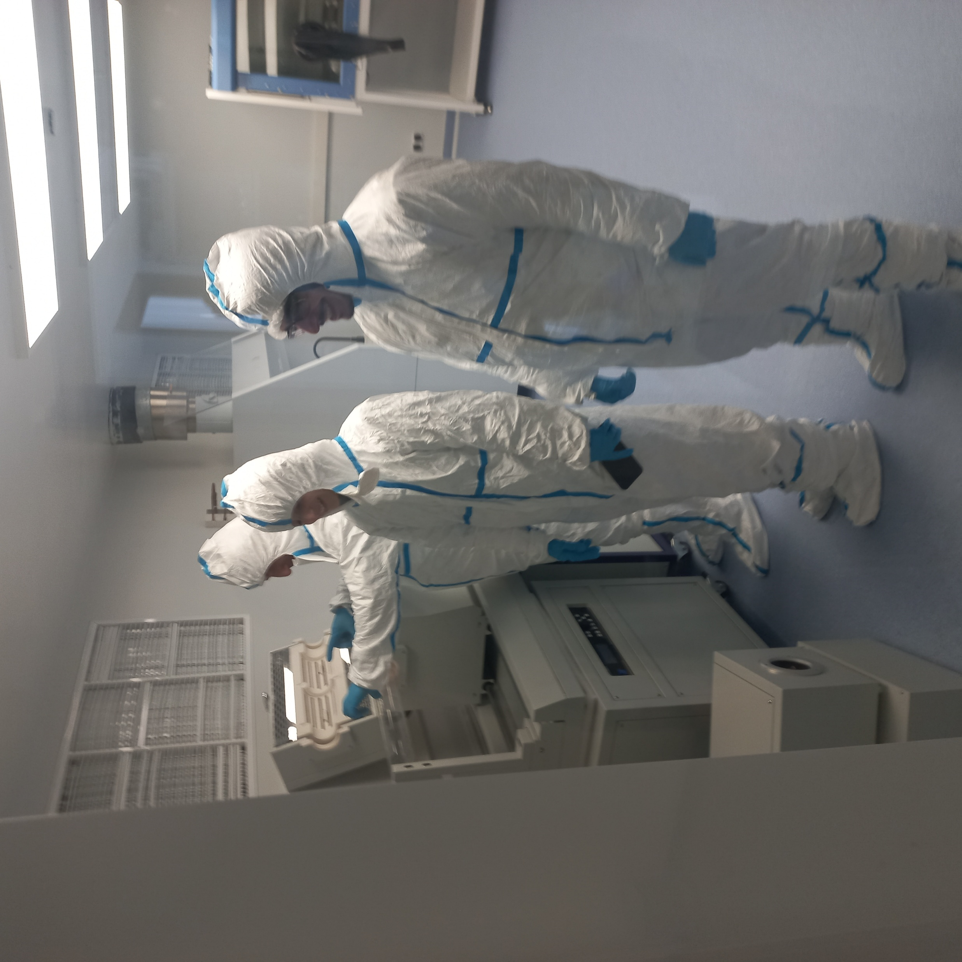

Development and Investigation of Moiré Devices for Terahertz Quantum Detectors
Narek Margaryan
n.margaryan@yerphi.am,
nanostructures.nanomaterials@gmail.com,
A. Alikhanyan National Science Laboratory
(Yerevan Physics Institute)

Slide 2
Table of content
Laboratory and activities
Scientific directions and objectives
Tailoring optical properties of graphene and silicon through functionalization

Slide 3
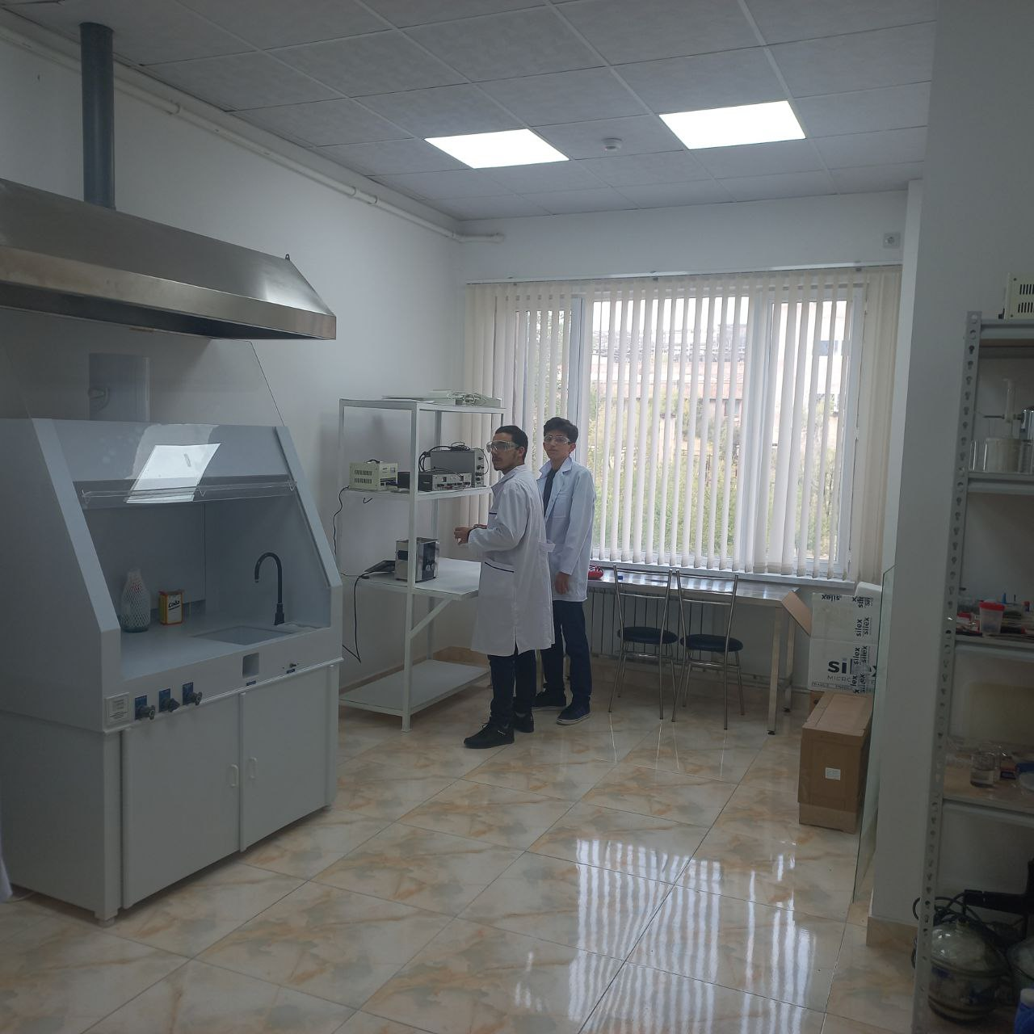
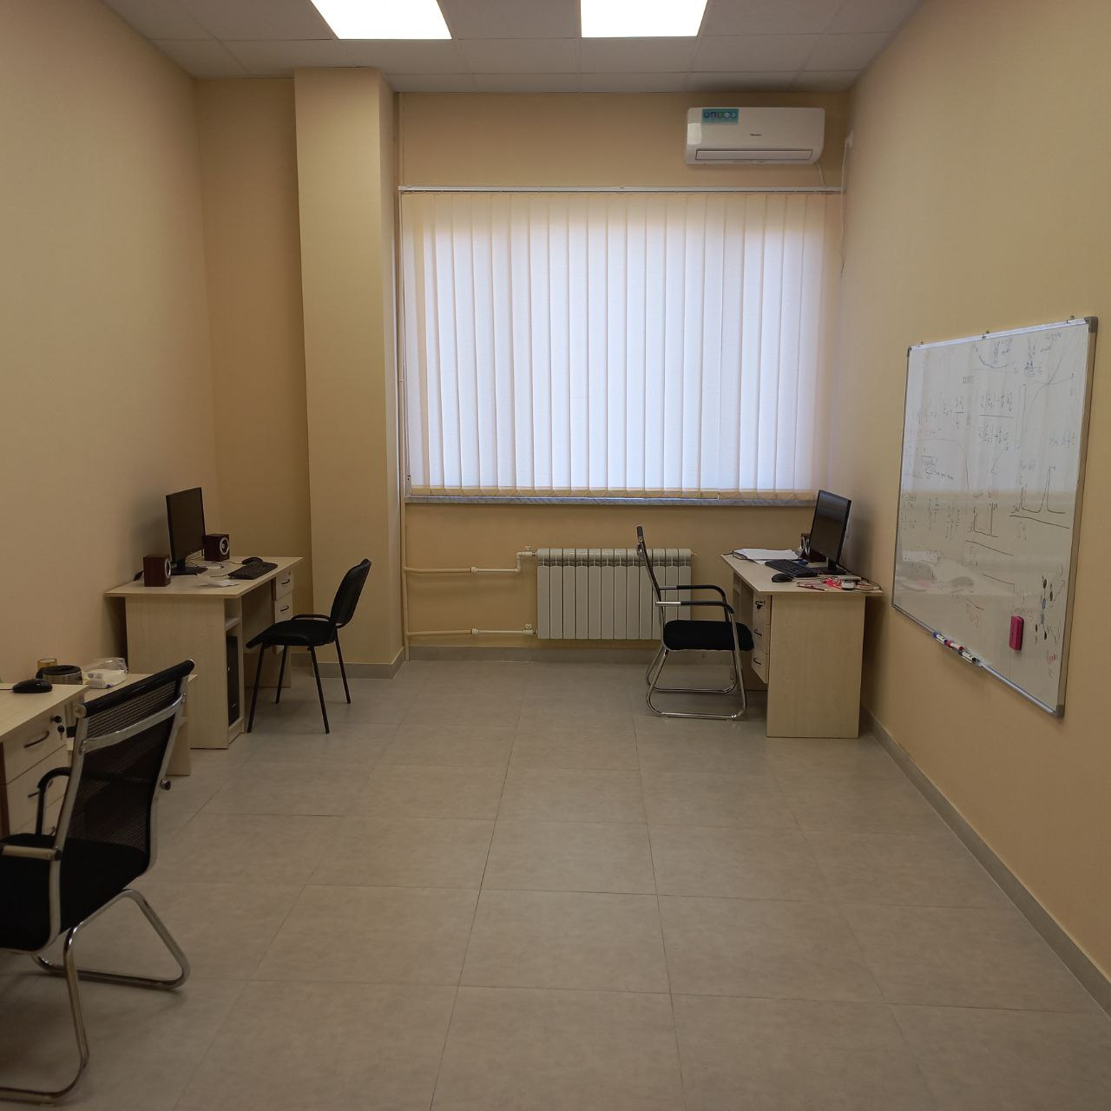
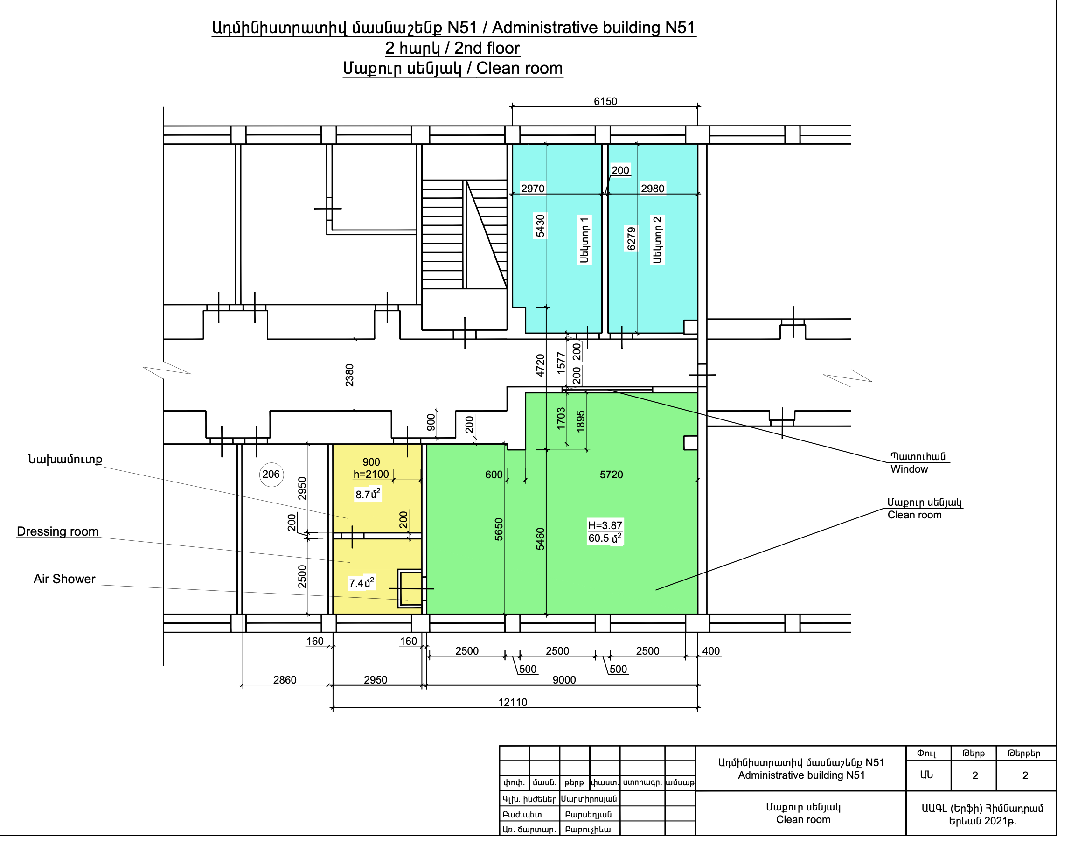
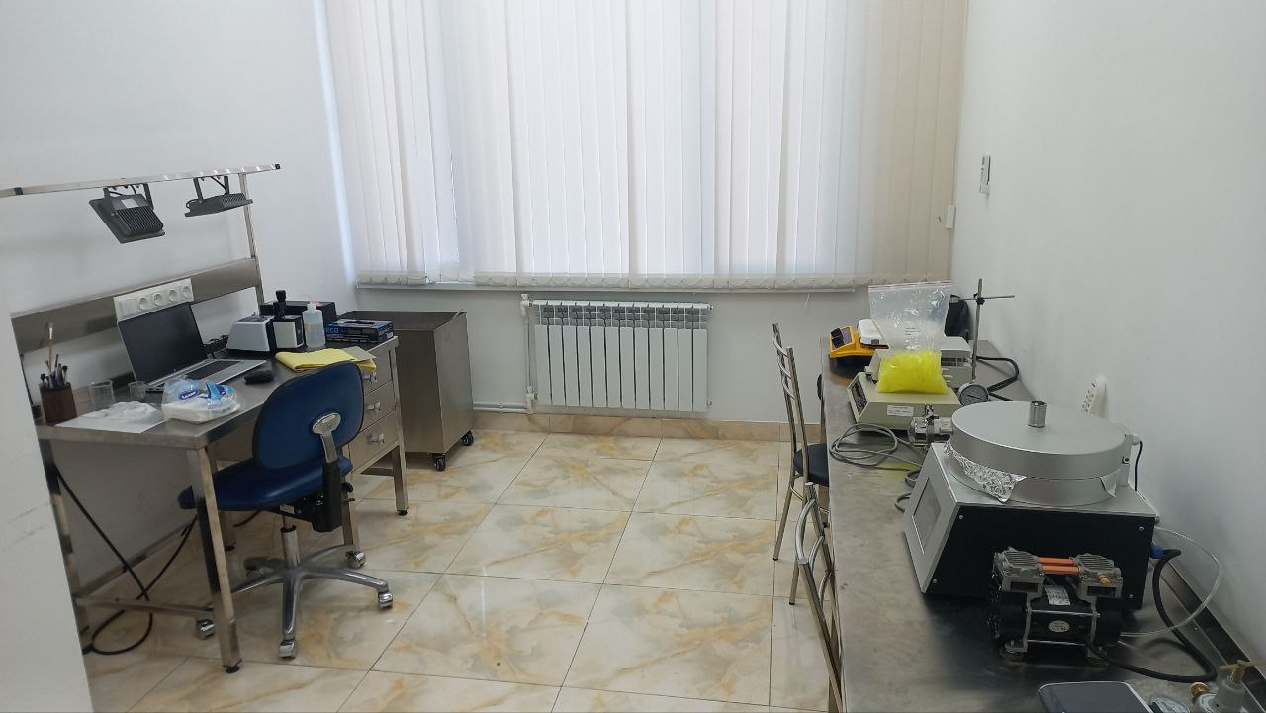
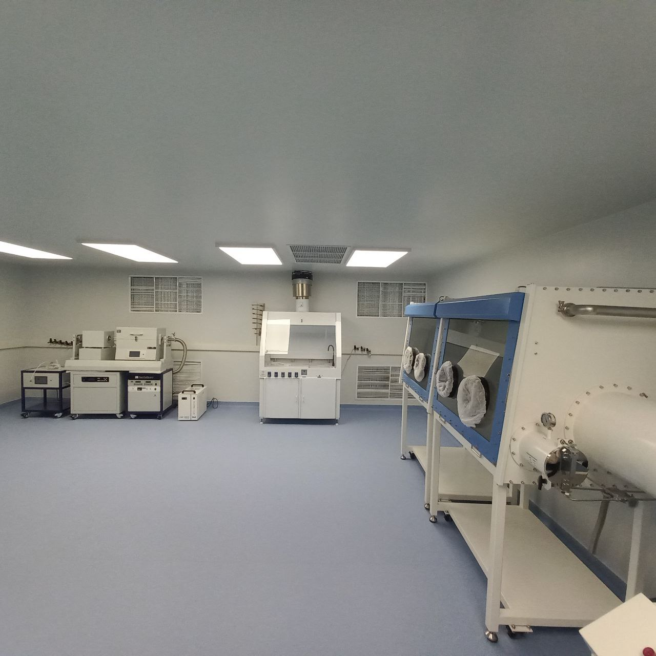
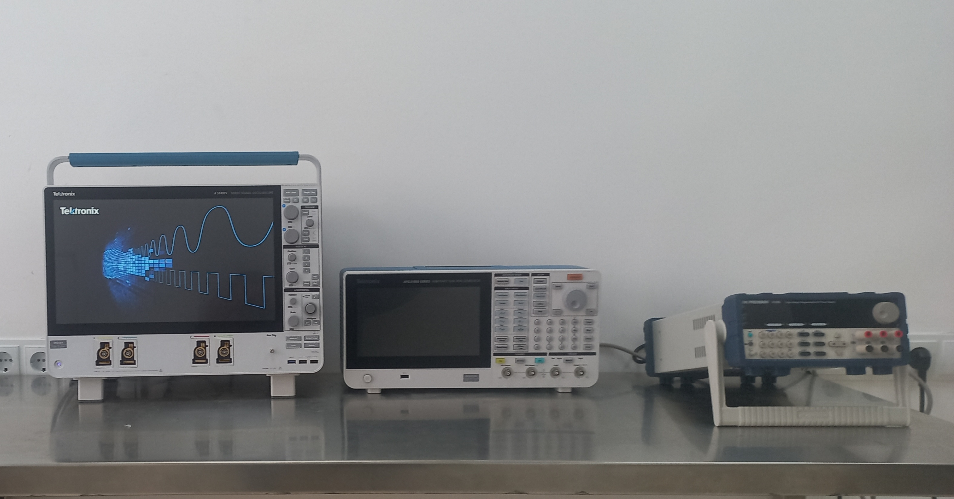
The Laboratory
Data Analysis
Petr Stepanov
Image credit: Matteo Ceccanti

Slide 4
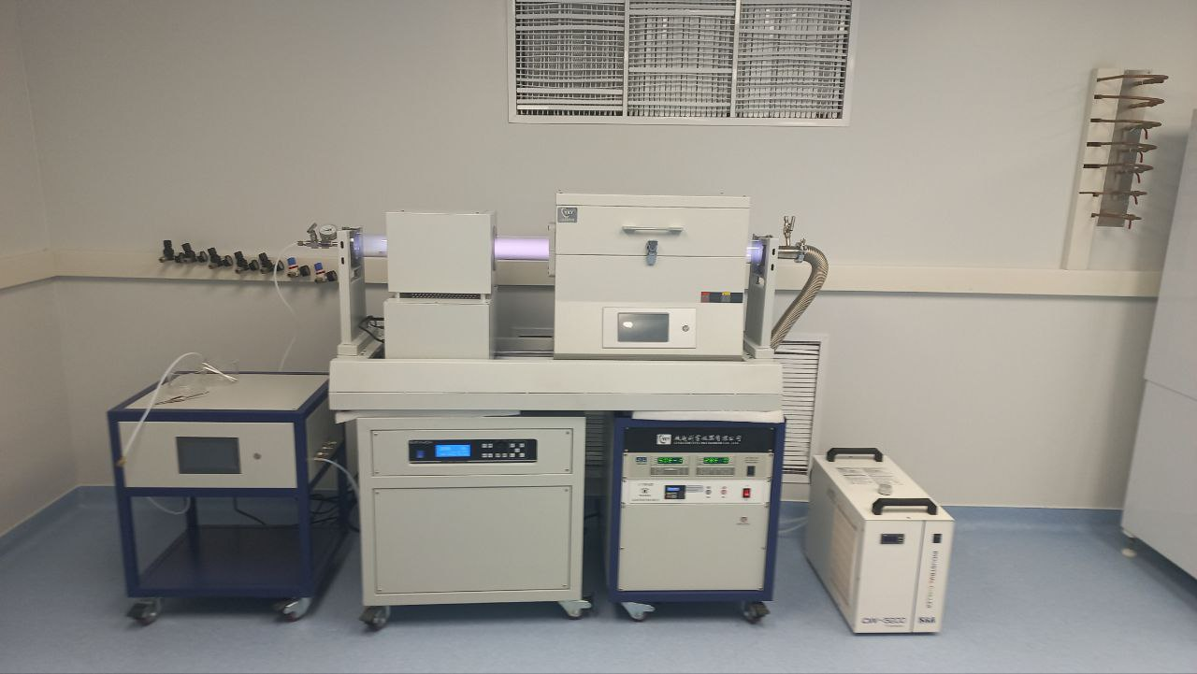
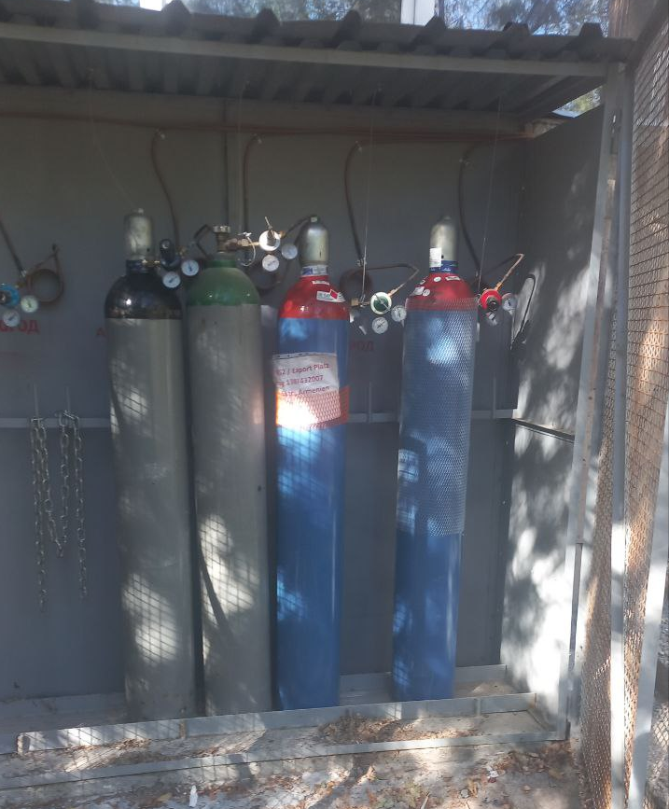
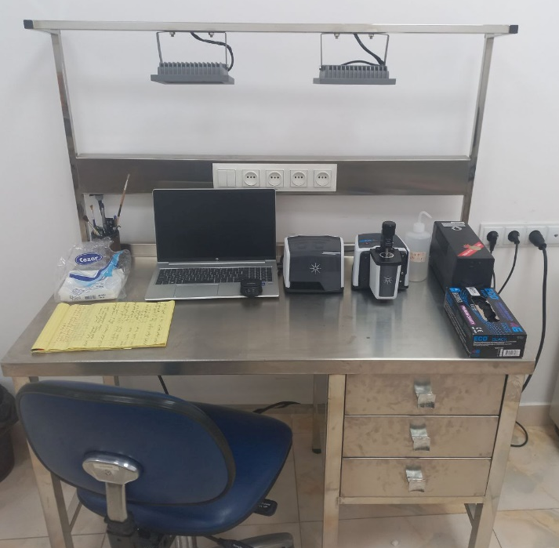
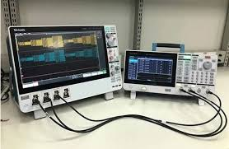
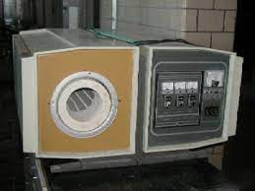
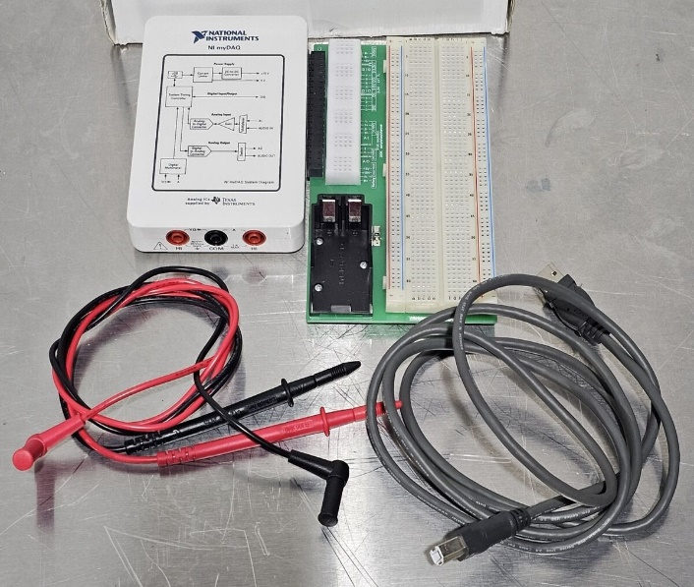
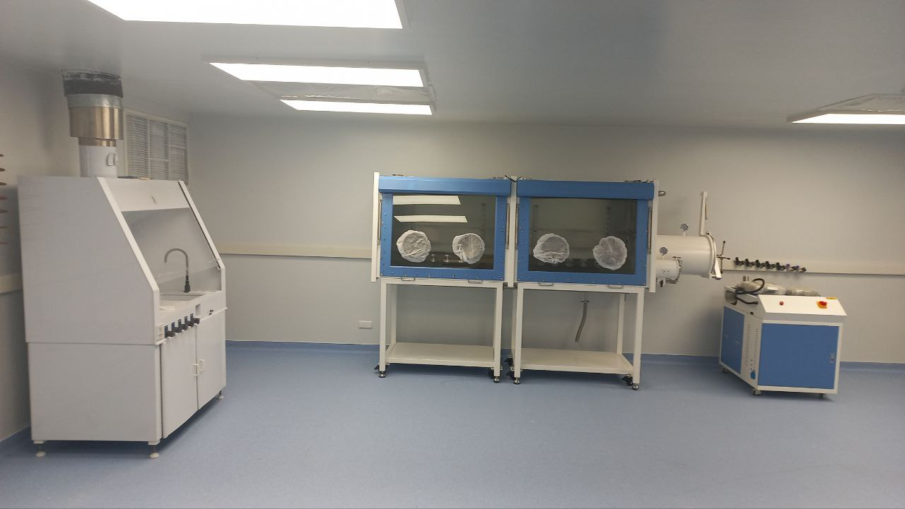
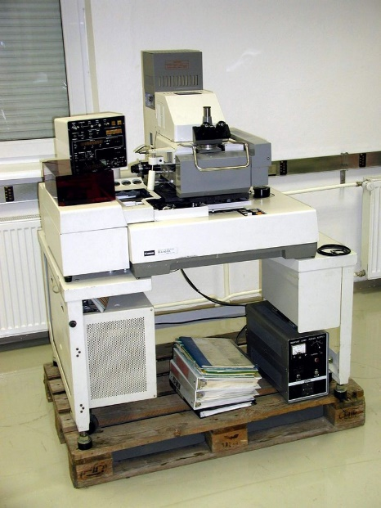
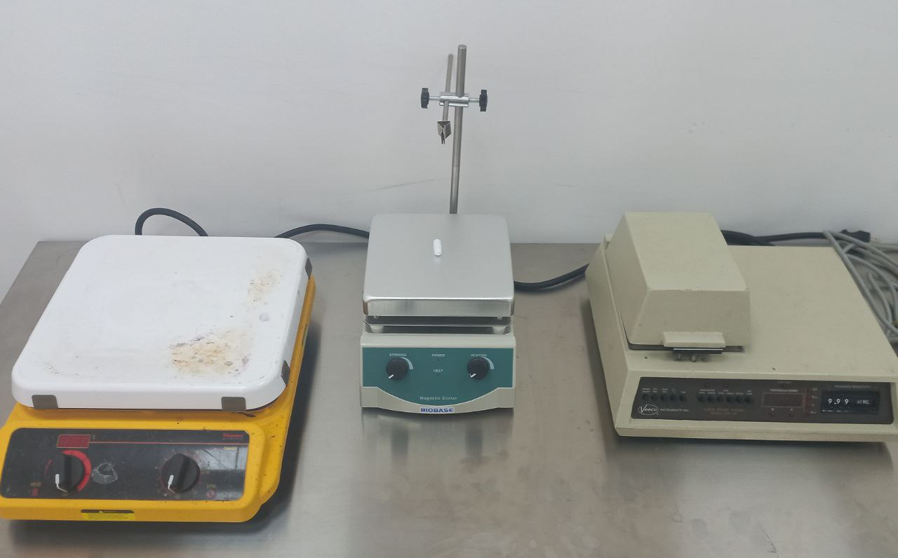
Laboratory Equipment
Plasma Enhanced Chemical Vapor Deposition System (PECVD)
Magnetron spattering system
Two section Glove Box
Diffusion tube furnace
Pulse heat unit
Spin Coater
Two fume hoods (wet benches)
Two hot plates with magnetic spinners
Two ultrasonic baths
Two Canon Mask Aligners
Stainless steel chamber for the treatment of samples in gas media
FTIR spectrometer
NI DAQ and el. devices
DC generators
Signal Analyser
System for plaiting and electrolysis
Function generator and osciloscope
Four probe system for sheet resistance measurements
Alpha-Step Stylus Profiler

Slide 5
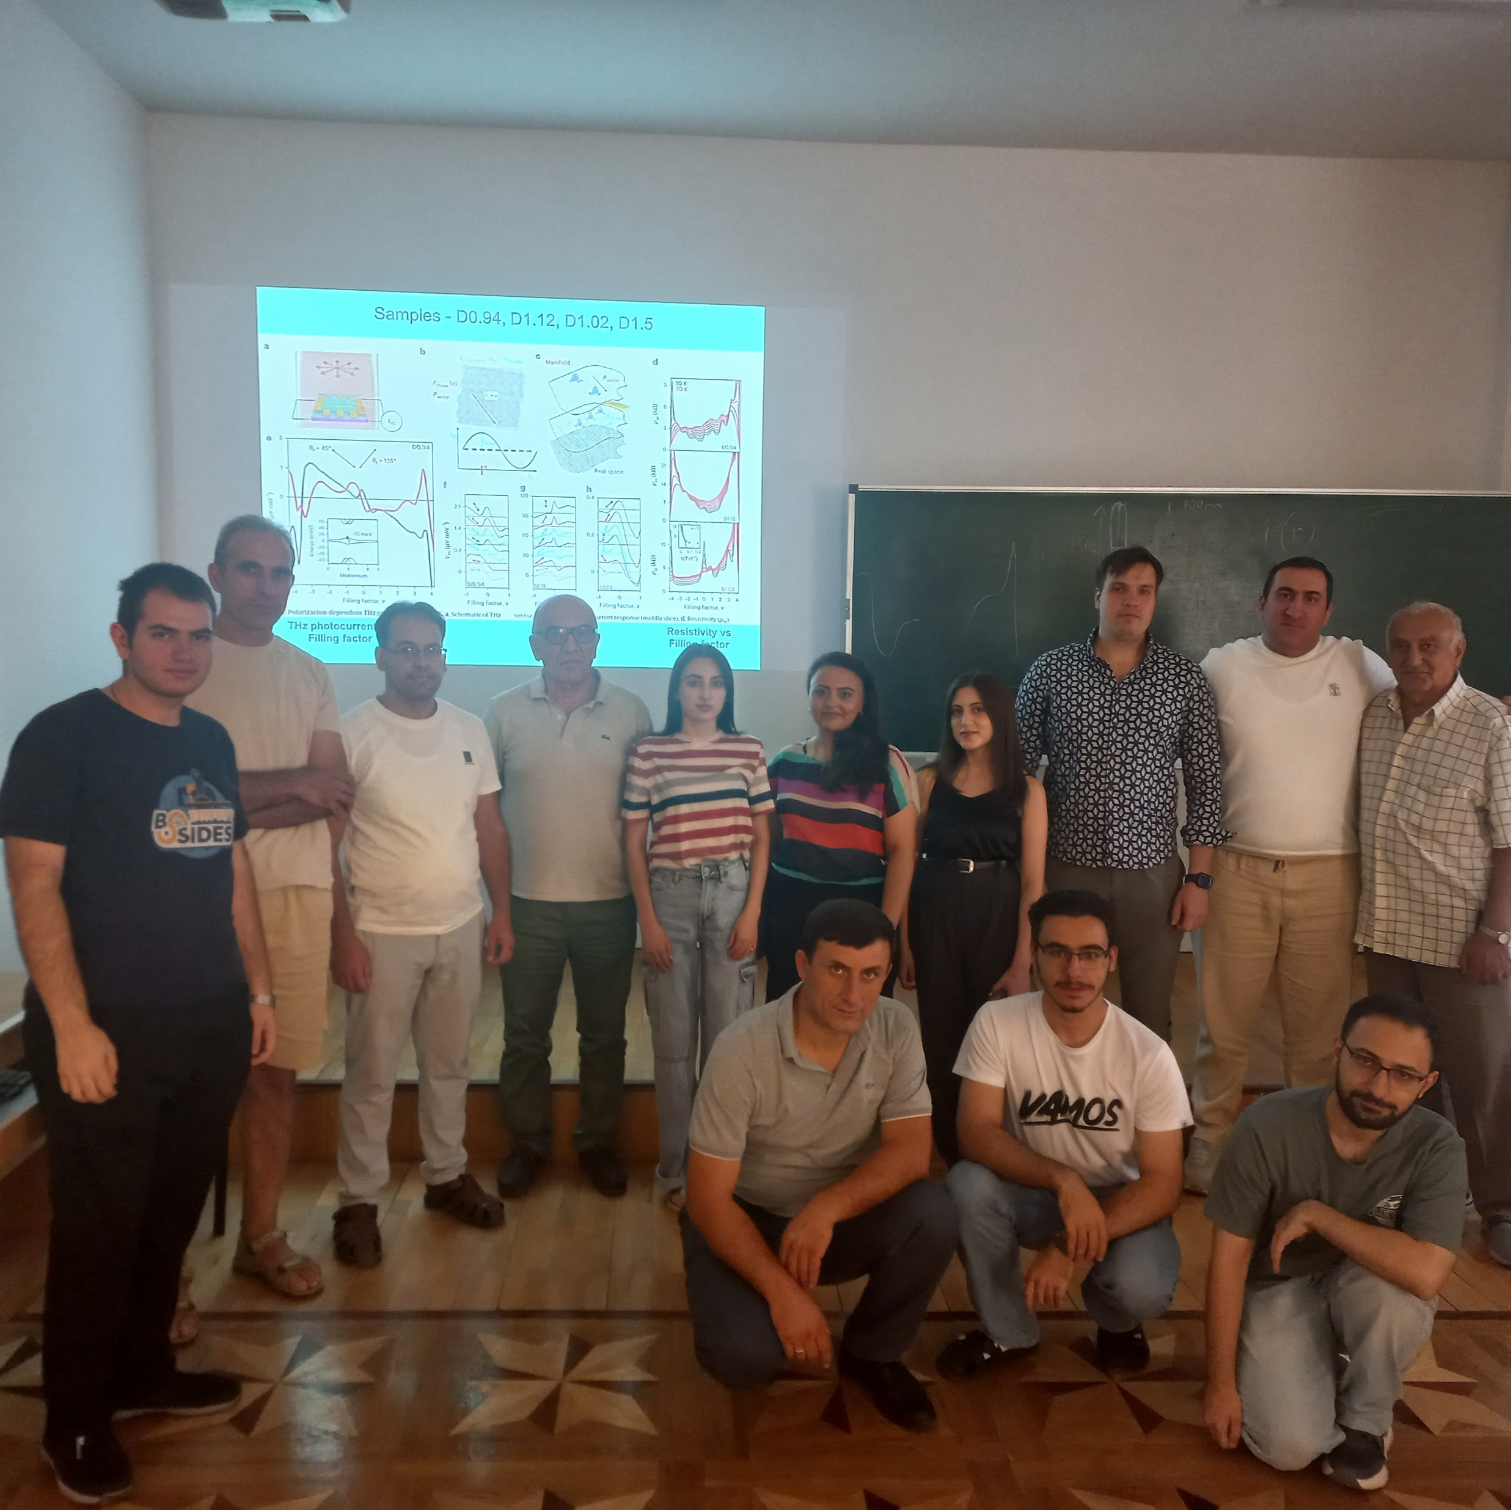
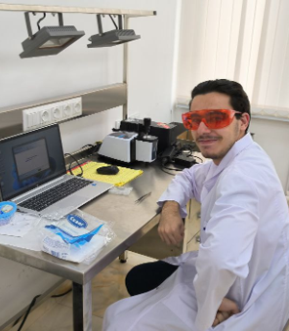
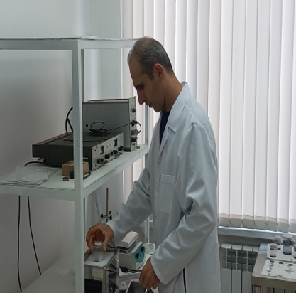
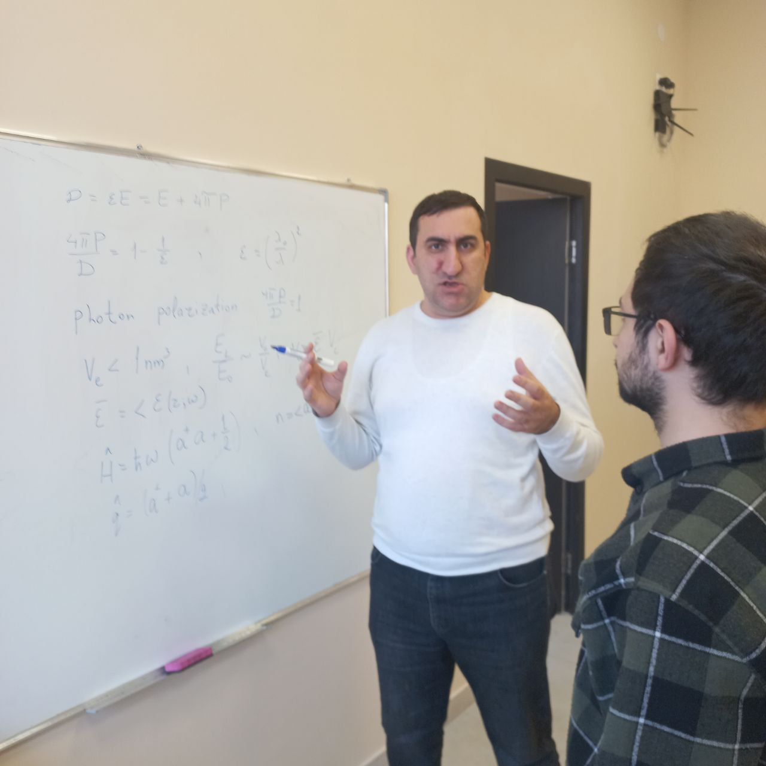
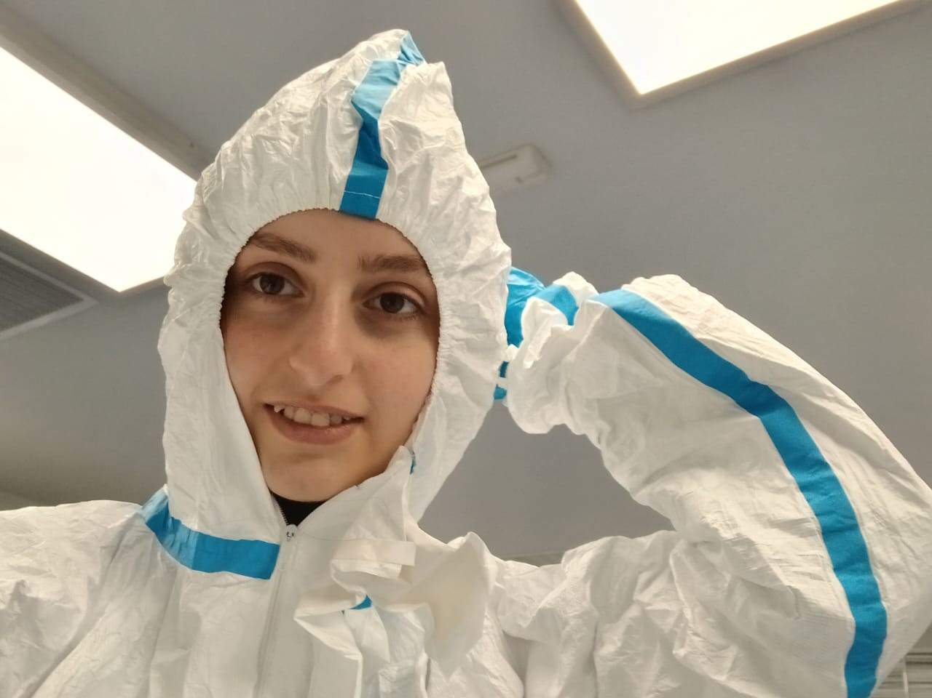
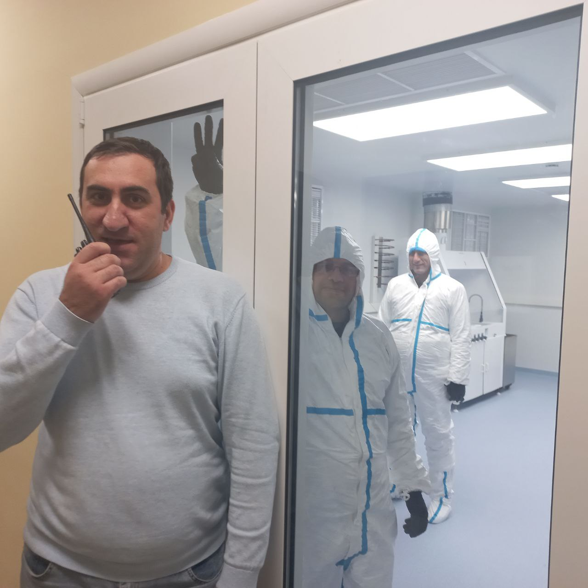
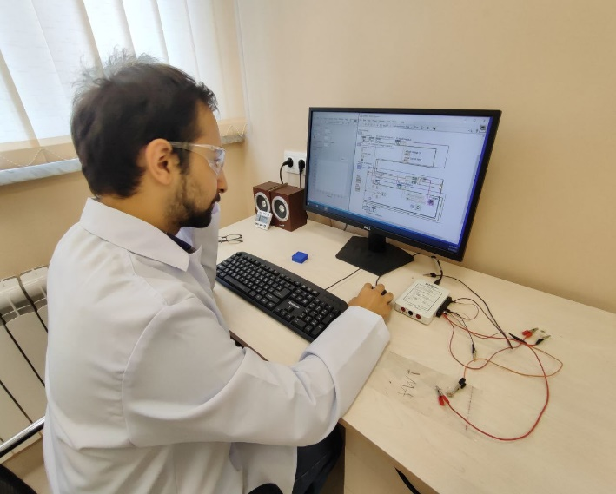
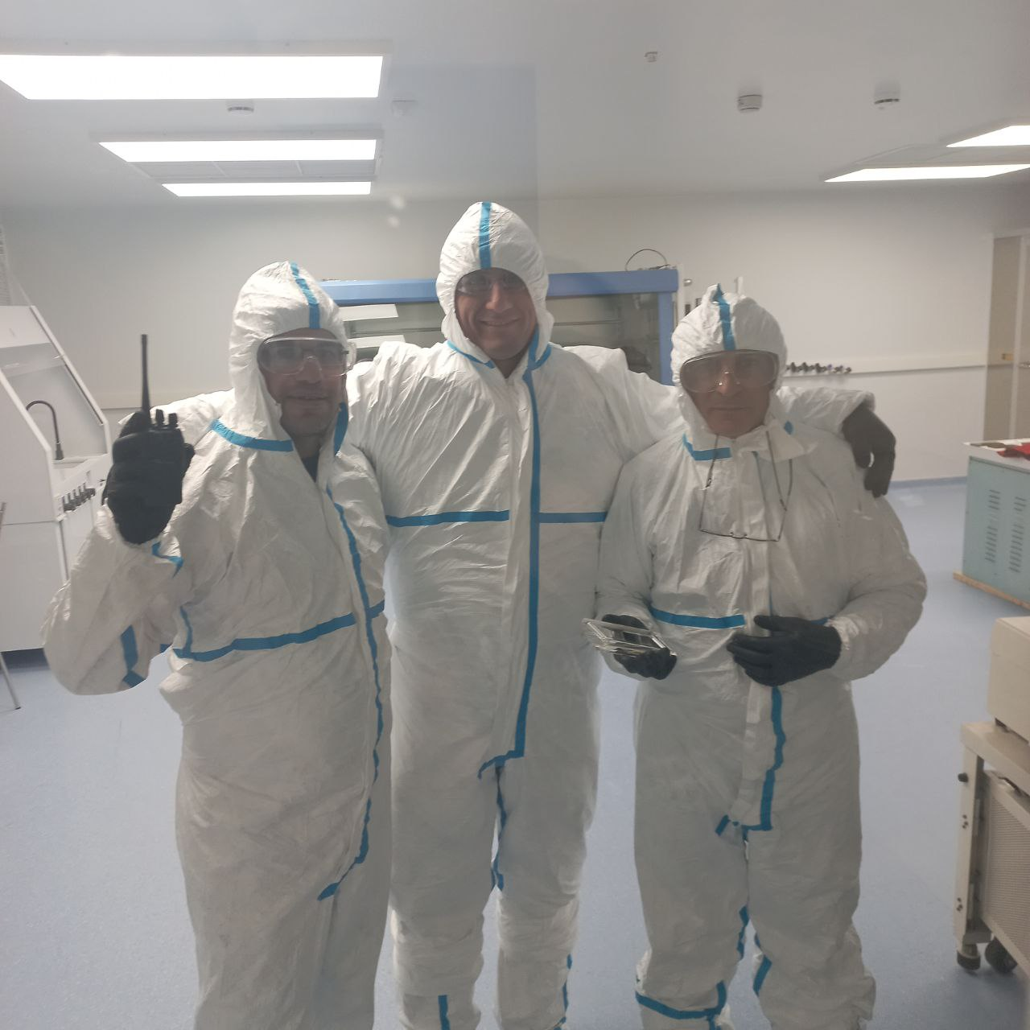
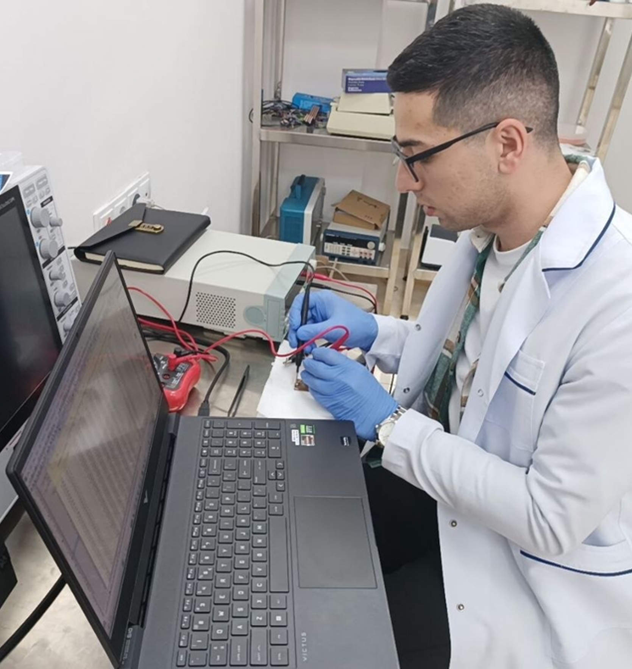
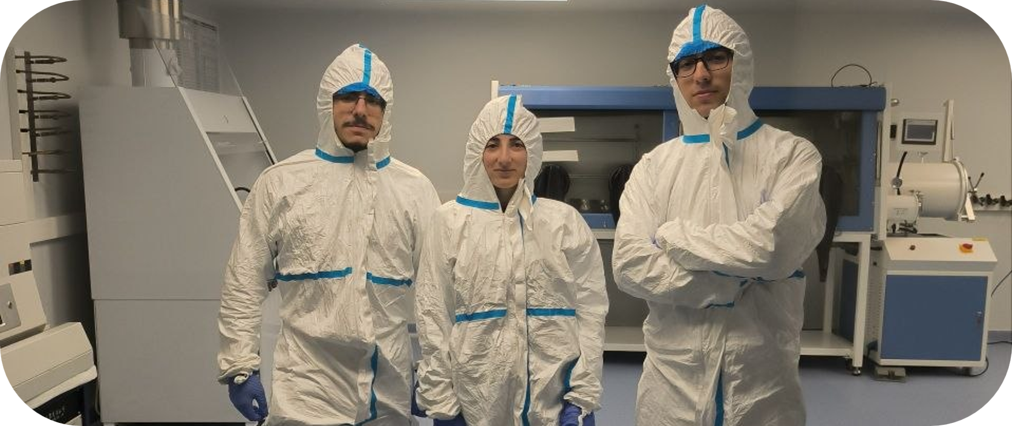
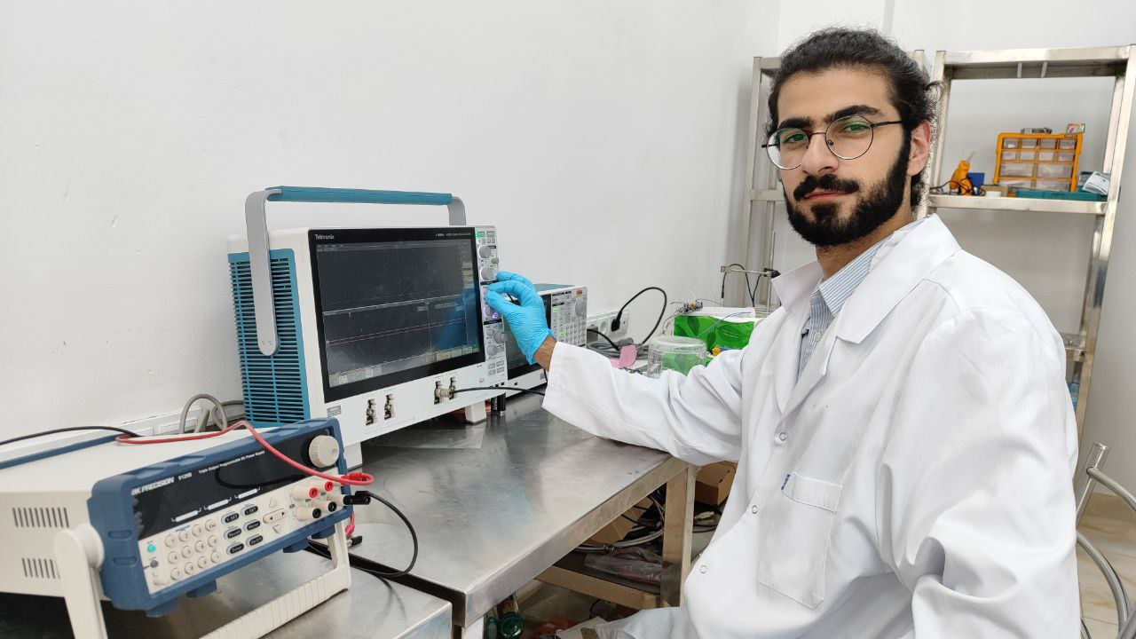
Our Team

Slide 6
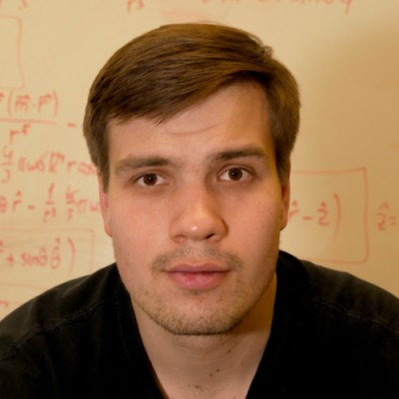
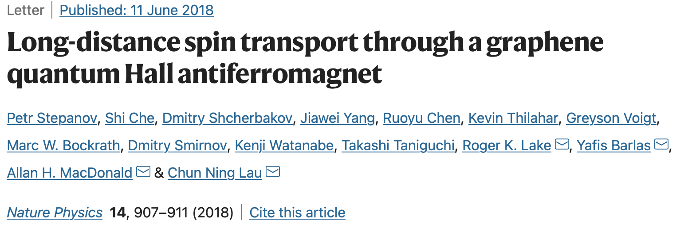
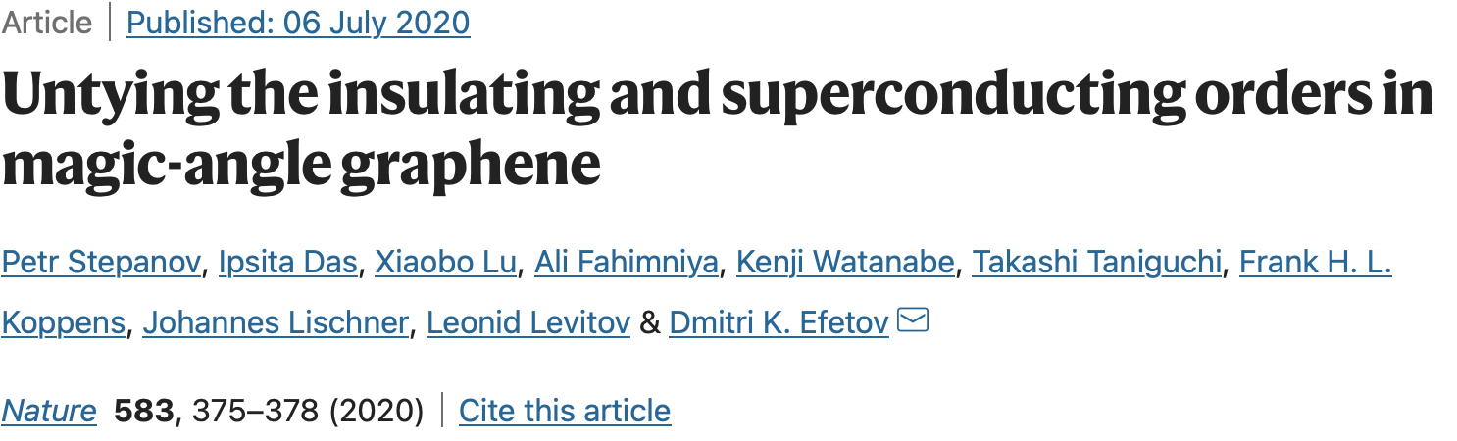
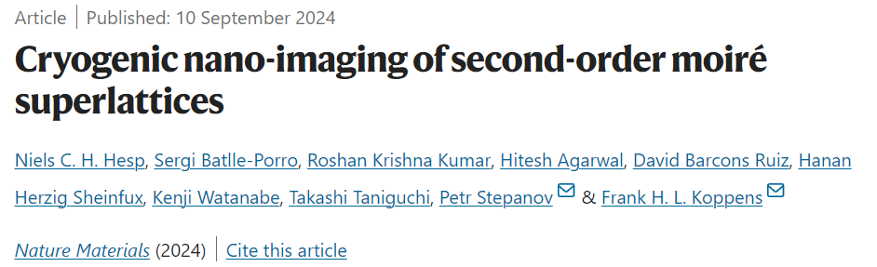
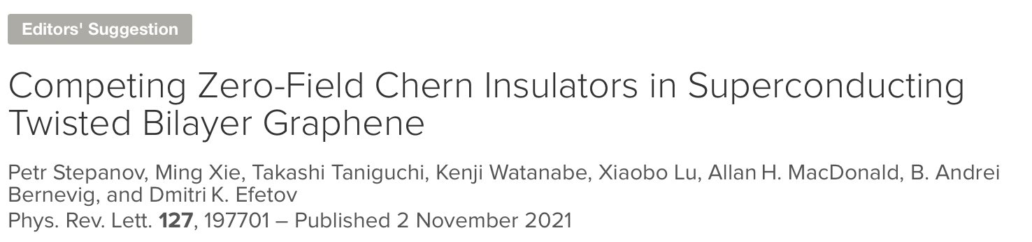
Foreign Partner
Dr. Petr Stepanov
University of Notre Dame,
South Bend, USA
H-index: 19
>25 publications, 1 patent, 2 News&Views articles.
Citations >3000 (Google Scholar) including papers in
Nature (x2), Nature Physics (x5), Nature Materials (x2), PRL (x5),
PNAS (x1), Science Advances (x1), NanoLetters (x4).
highlighted by: JCCMs, the New York Times, Le Monde, Spektrum,
Physics Today, Physics World and more.
Petr Stepanov
Image credit: Matteo Ceccanti

Slide 7
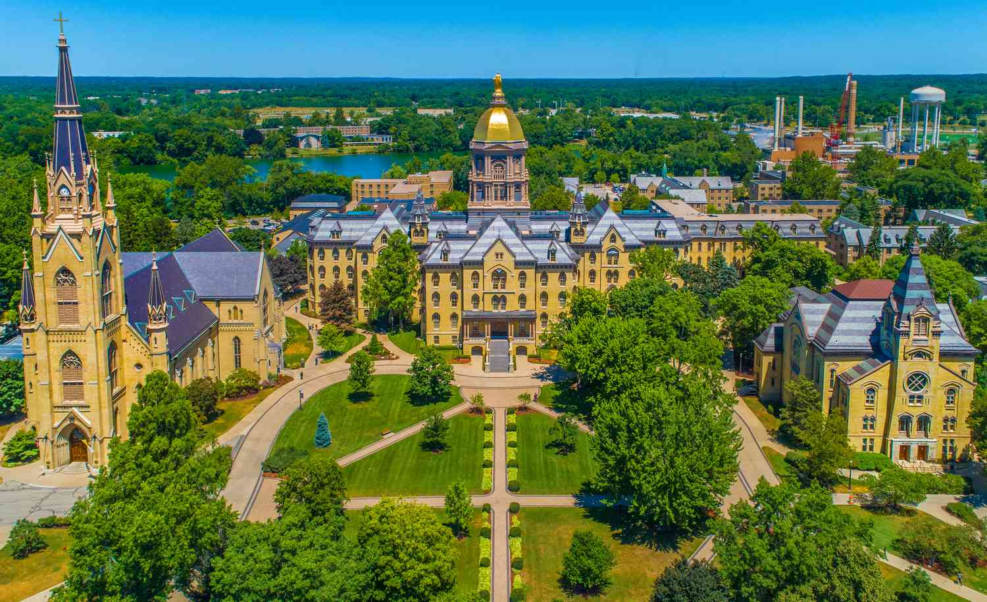
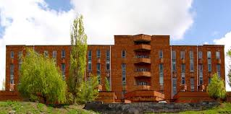
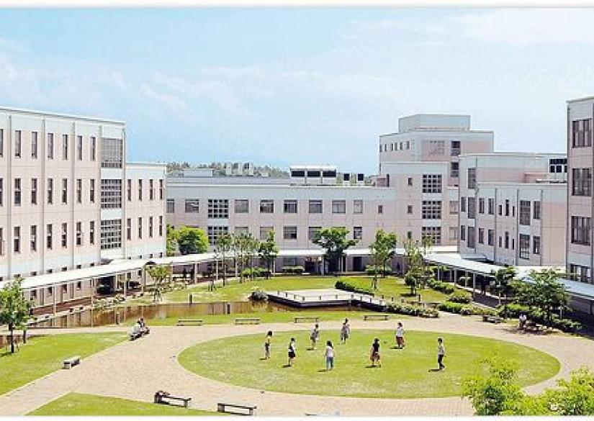
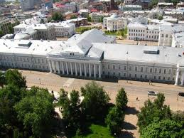
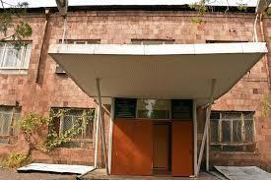
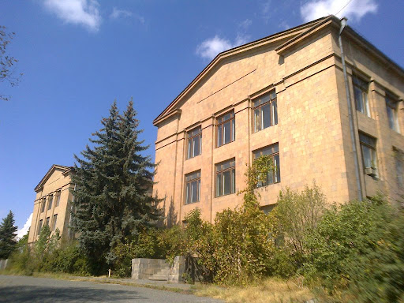
Collaborations
AANL
Nanostructure Photocathodes for The RF Timing team,
Close collaboration with the Optical Spectroscopy group,
Collaboration with The Isotopes Research and Production Department (Cyclotron team) ,
Collaboration with The Matinyan Center for Theoretical Physics,
Collaboration with vibrating wire studes group.
2. Institute of Chemical Physics,
3. The Institute of General and Inorganic Chemistry.
4. Scientific Technological Center of Organic and Pharmaceutical Chemistry

Slide 8



Scientific achievements for the last 1.5-year period
Scientific publications in Web of Science-6/11,
Summer schools and trainings-5,
Presentations in international conferences- 6
International and local scientific projects-4,
Young and mid-carrier researchers having background in Quantum Moire devices, material science, material characterisation and spectroscopy.
International collaboration-University of Notre Dame, Niigata University, Kazan federal University.
International scientific collaboration.

Slide 9
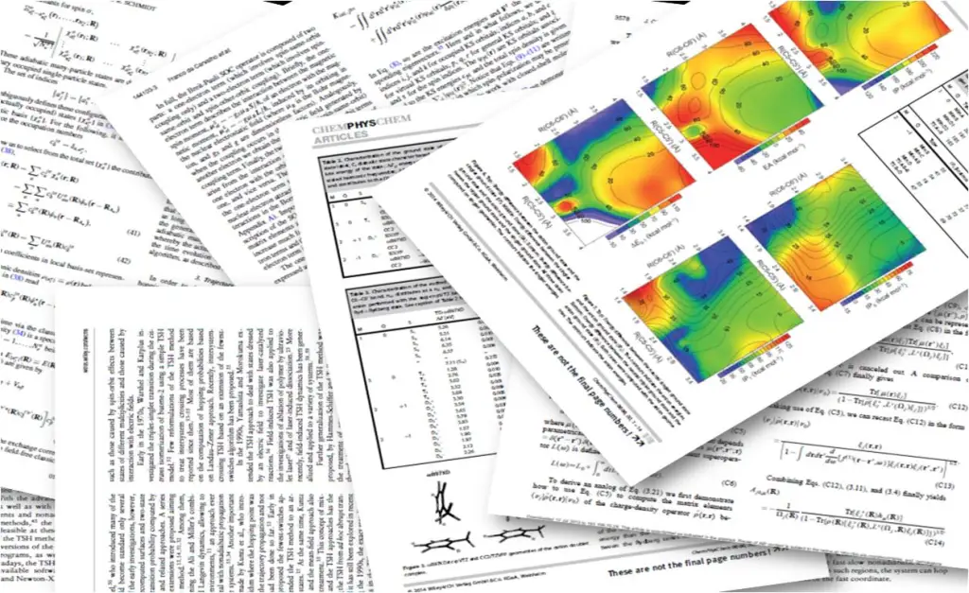
The research was supported by the Higher Education and Science Committee of MESCS RA (Research project № 24LCG-1C015).
Tigran Ohanyan, Arevik Arestakyan, Gurgen Elbakyan, Hayk Beglaryan, Eduard Aleksanyan, Narek Margaryan *, Radiation tolerance of solution-processed indium tin oxide under proton irradiation, Materials Letters 416 (2026) 140688.
Hovhannes Badalyan, Astghik Hovhannisyan, Arevik Arestakyan, Eduard Aleksanyan, Narek Margaryan*, Momentum-Enabled Near-Infrared Luminescence in Silicon Decorated with Ultrasmall Gold Nanoparticles, ACS Omega , 11, 5664−5668 (2026).
N. Margaryan et al, Enhancement of Infrared Absorption of Liquid-Phase Exfoliated Graphene by 15.5 MeV Proton Irradiation in Ambient Conditions, Materials Letters 399 (2025) 139035.
N. Margaryan et al, Thermal reduction and fractal analysis of liquid phase exfoliated graphene. Nuclear Instruments and Methods in Physics Research Section A: Accelerators, Spectrometers, Detectors and Associated Equipment, 1075, 170407, (2025).
V.R. Gareyan, N.B. Margaryan, Z.S. Gevorkian. Modern Theoretical Approach for Description of Antireflectivity Physics of Particles and Nuclei, Volume 56, Issue 6 (2025).
V. Gareyan, N. Margaryan, Zh. Gevorgyan, Nanoroughness-induced antireflection and haze effects in opaque systems, Phys. Rev. A 110, 063523, (2024).

Slide 10
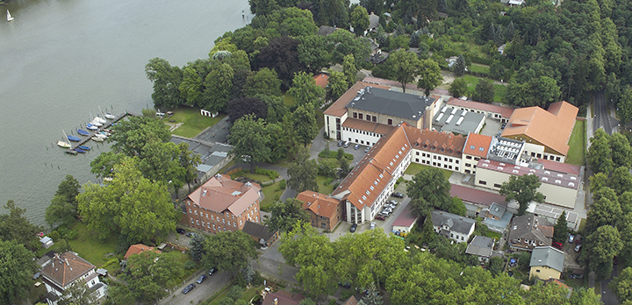
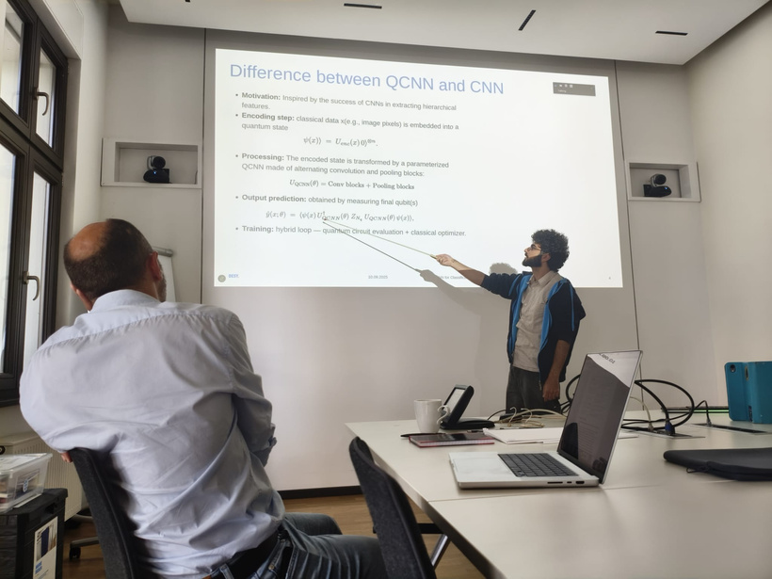
Harutyun Vasilyan: DESY, Zeuthen, Germany:
International Summer Student Programme
• Attend lectures on various scientific topics
• Work on a research project under the guidance of a supervisor
• Explore different labs and facility sites at DESY Zeuthen, DESY Hamburg and its partner institutions
• Connect and network with students and researchers from around the world
Now Harutyun uses the acquired knowledge to simulate the irradiation of graphene with high energy proton beam.

Slide 11


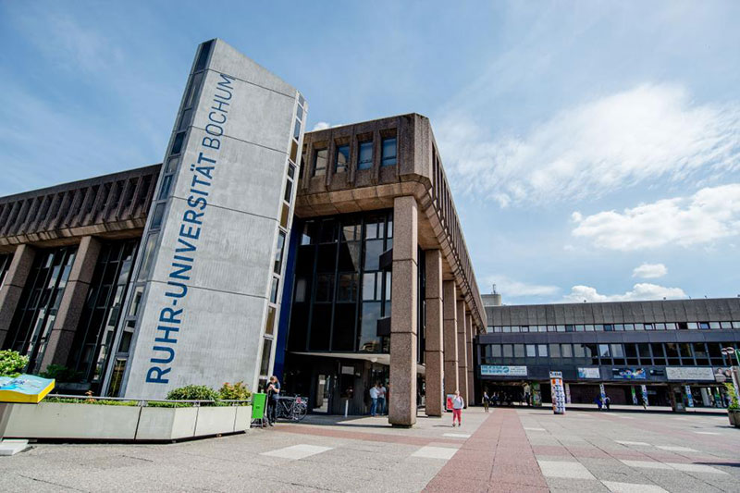
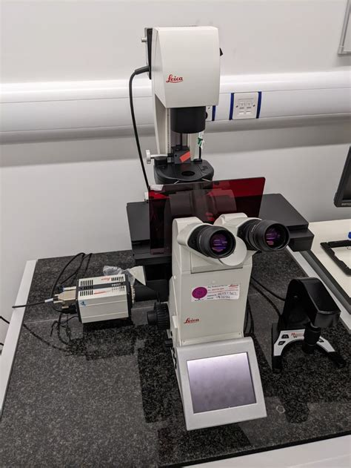
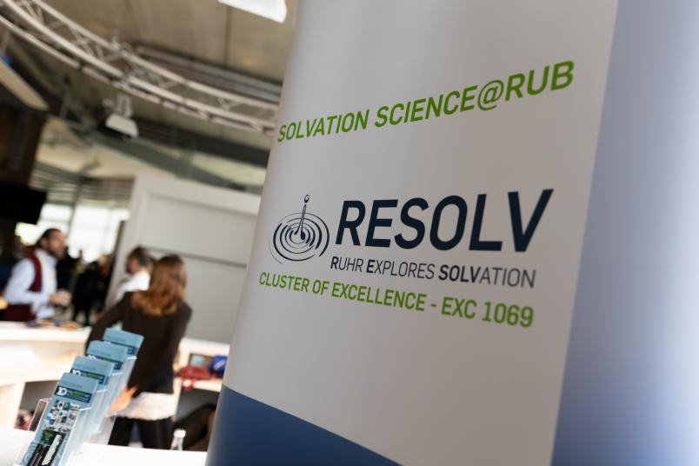
The iGSS Cluster of Excellence RESOLV
Ruhr University, Bochum
Attended lectures focused on solvation science topics led by international experts
Presented and discussed research during an interactive poster session
Participate in hands-on training sessions using the Leica DMi8 S Fluorescence Microscope with a 488 nm laser scanner
Connected and exchanged ideas with researchers and students from diverse scientific backgrounds

Slide 12
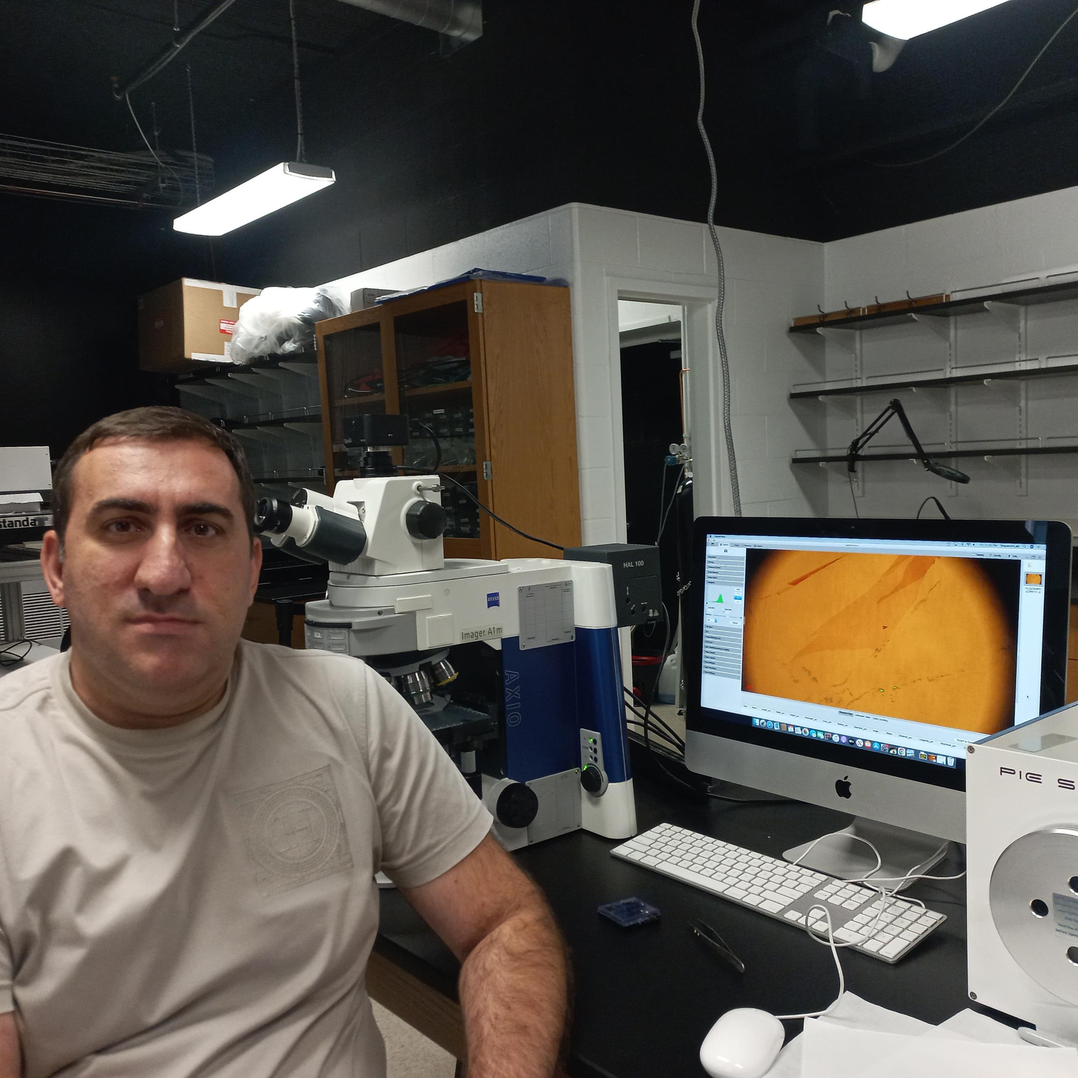
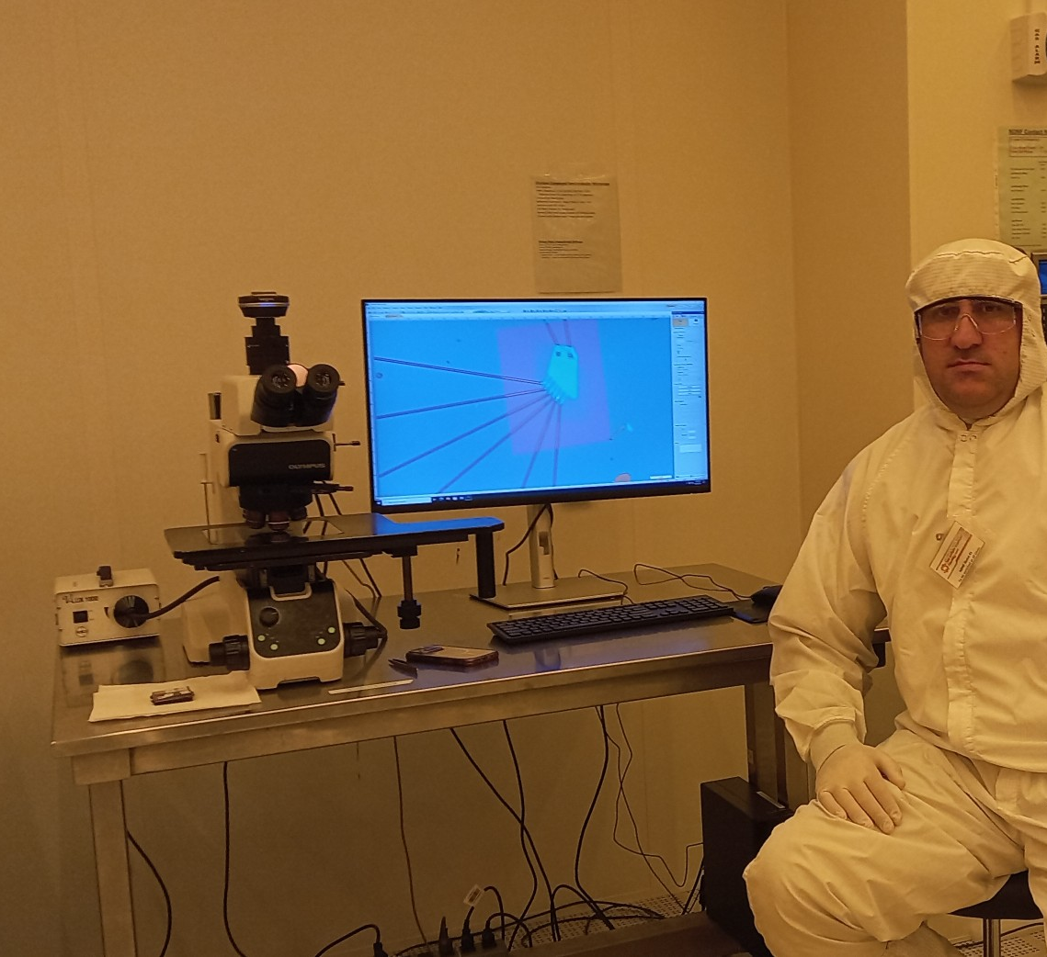
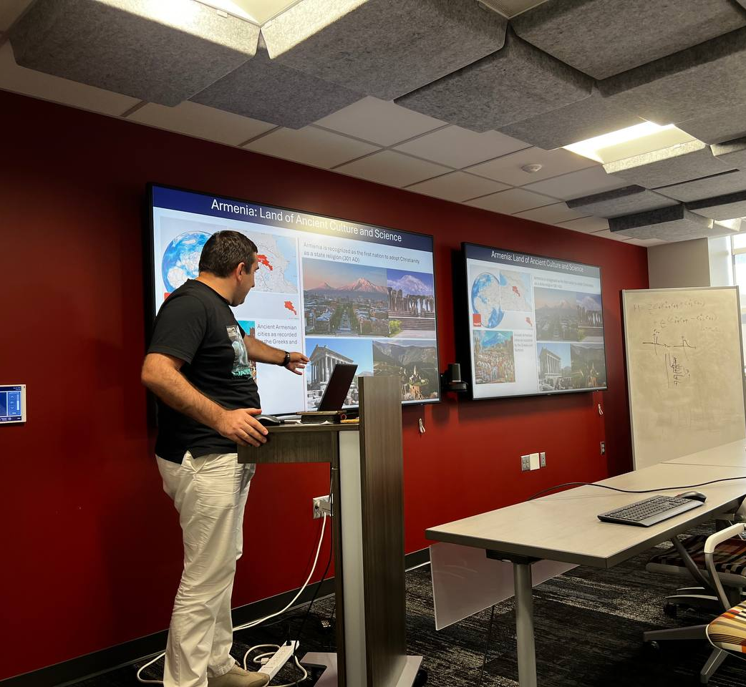
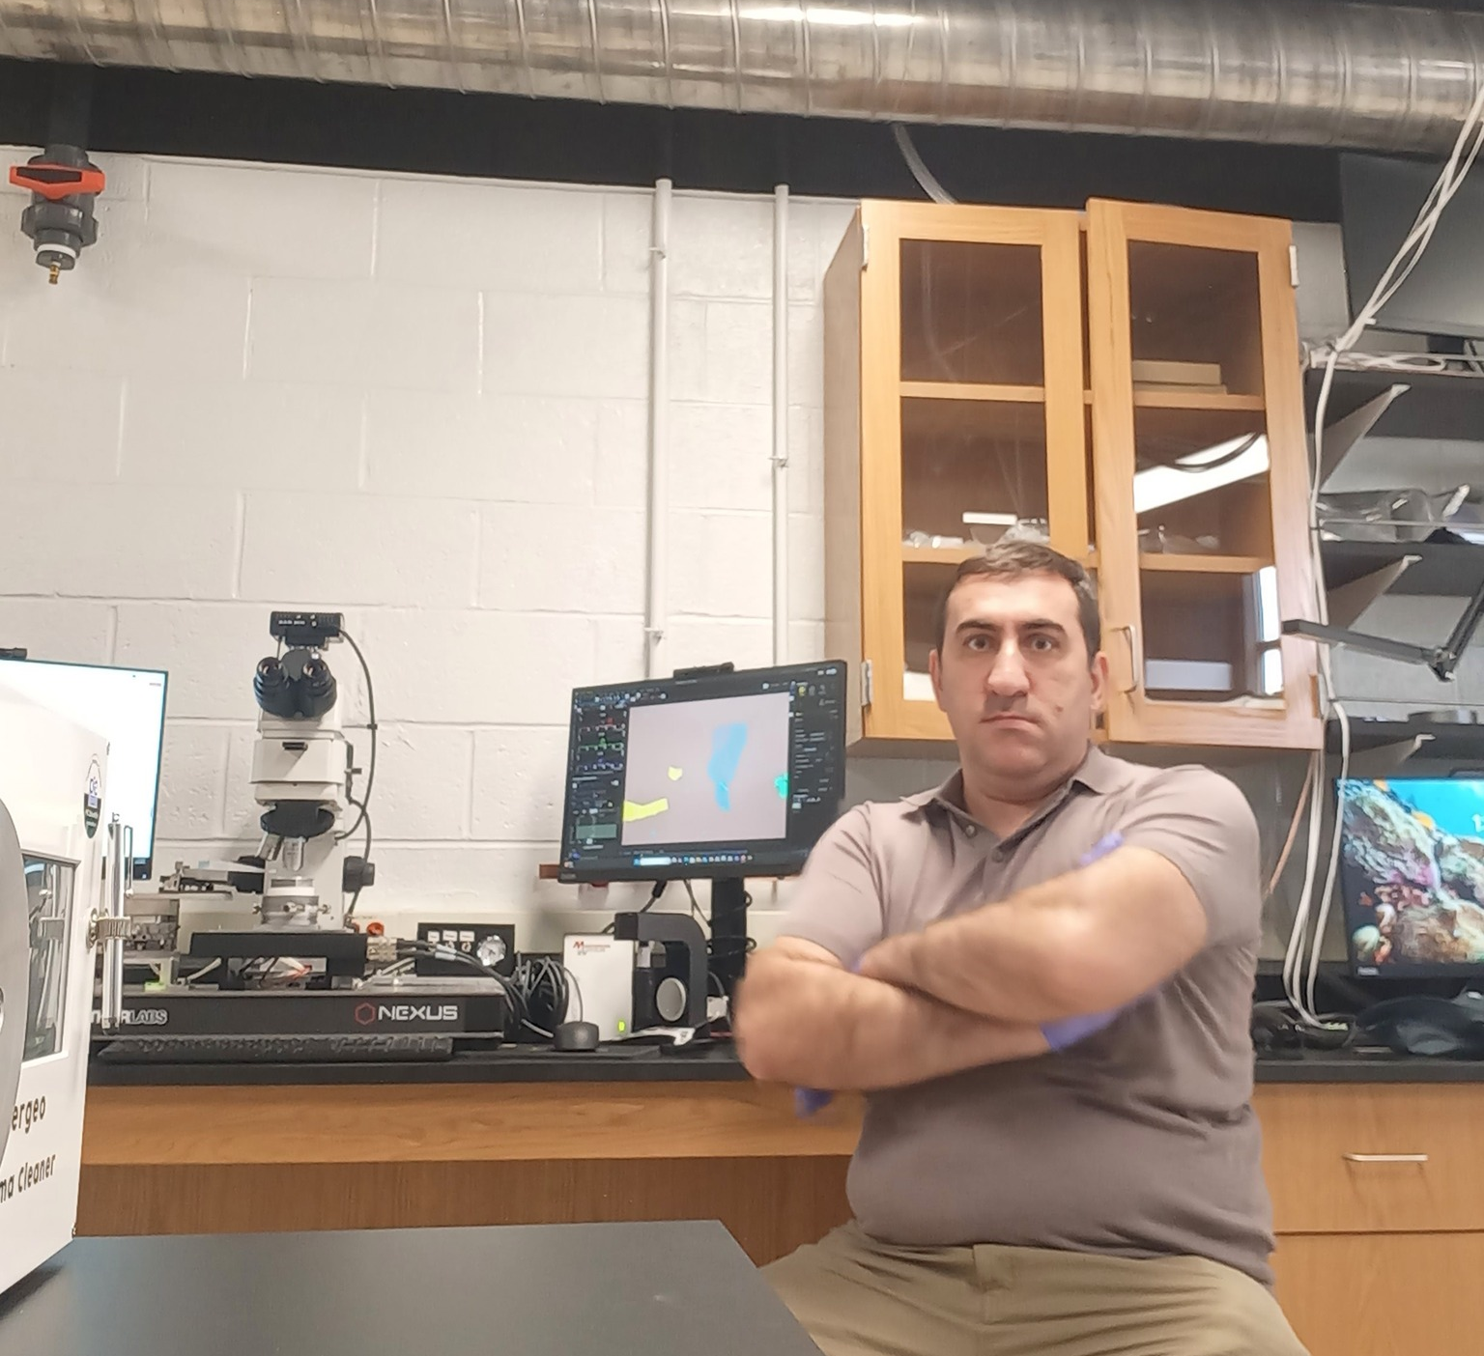
Visits to Notre Dame
Transfer setup for Moire structures
“Know how” in exfoliation and stacking
Electron beam lithography and nanofabrication
Seminars and discussions on fundamental aspects

Slide 13
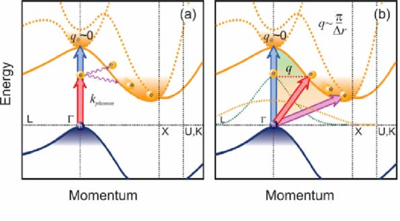
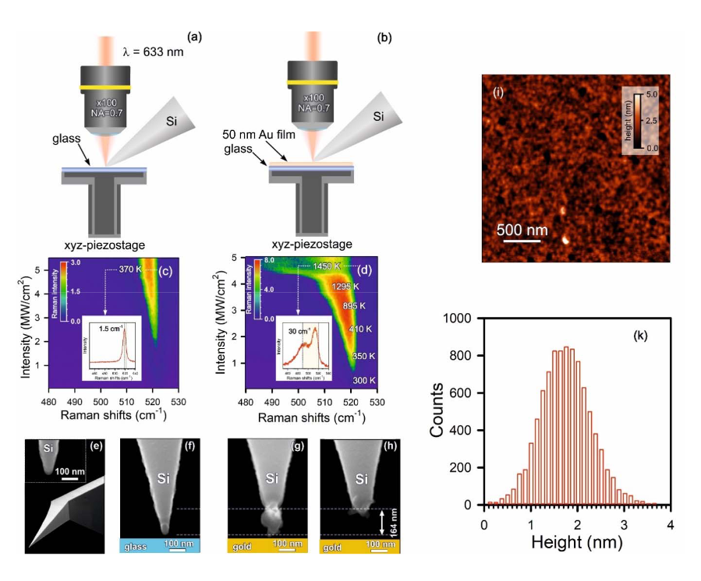




Now about silicon research
k=2π/λ << $2π/a$
Heisenberg Uncertainty Principle
$$σ_{r}σ_{k}=(1+n/2)$$
$σ_{r}=\frac{d}{2\sqrt{2\ln{2}}}$≈$\frac{d}{2.355}$
(FWHM)
d (nm) | $σ_{k}$(${nm}^{−1}$) | λ (nm)
0.38 | 9.2 | 1127
0.4 | 8.82 | 945
0.85 | 4.28 | 633
Kharintsev et al, ACS Nano, 2024

Slide 14
Heating of silicon tip through raman thermometry

Slide 15

Sensing of tip apex temperature through raman thermometry and cantilever phase transition

Slide 16






Light absorption spectra of GNP/Si structures
(a) Energy-momentum diagram of pure silicon, (b) absorbance spectra of a pristine silicon wafer and silicon wafers coated with gold nanoparticles (GNPs) in the size ranges of 1.8 nm and 2.0–4.0 nm, (c) fitting of formed absorbance edge with Fermi-Dirac distribution and fitting parameters, (d) reflectivity spectra of a pristine silicon wafer and silicon wafers coated with gold nanoparticles (GNPs) in the size ranges of 1.8 nm and 3.0 nm.
Size distribution of nanoparticles with average diameters of 1.8 nm and 3.0 nm.

Slide 17



Light absorption spectra of GNP/Si structures
300 K
320 K
Absorbance spectra in the visible, long-wavelength and near-infrared regions for pristine silica, 0.4 -3.2 nm distribution, and 4-MBA, polymer and citrate functionalized nanoparticle-coated silica samples.
Fermi-Dirac distribution fitting of the absorbance of silicon samples coated with polymer (a) and citrate (b) functionalized nanoparticles.

Slide 18



Light absorption spectra of GNP/Si structures
1296 K
1683 K
1372 K
Bose-Einstein distribution fitting of the absorbance of silicon samples coated with 4-MBA (a), polymer (b) and citrate (c) functionalized GNPs.

Slide 19


Raman spectroscopy of pristine silicon and photoluminescence of GNPs
Power (mW) | I_{L/}I_{R}
1 | 0.014
10 | 0.244
25 | 0.570
50 | 1.584
758 nm excitation laser Raman spectra of pristine silicon sample for 1mW, 10 mW, 25 mW, 50mW powers of 758 nm excitation laser.
The ration of phonon-assisted luminescence and main Raman peak (520 cm⁻¹) intensities .
Photoluminescence of (0.4-3.2) nm GNPs.

Slide 20


Raman spectroscopy of pristine silicon/GNP structures
(a) Raman spectra of a pristine silicon wafer and silicon wafers coated with 1.8 nm and 3.0 nm gold nanoparticles (GNPs). (b) Comparison of the Raman spectra measured using excitation laser powers of 25 mW and 50 mW.

Slide 21
Thank you very much!

