Slide 1





Mean-Field Game Theory and Applications
Presenter T. Bakaryan
Institute of Mathematics NAS RA
Dilijan, Armenia, 2026

Slide 2

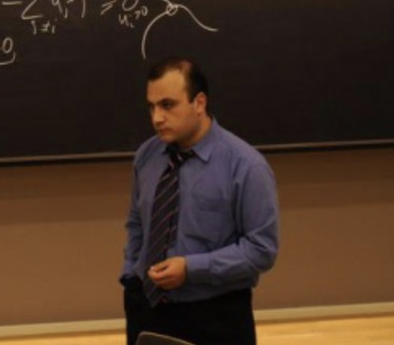
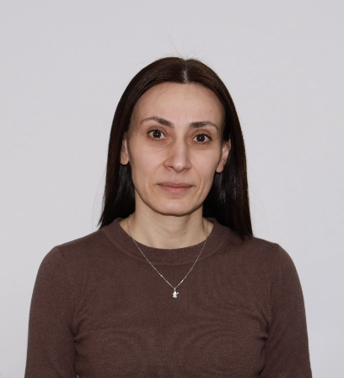




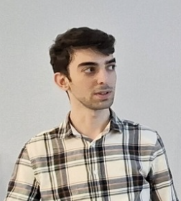



Subdivision at Institute of Mathematics NAS RA
Differential Games, Related Differential Equations and Applications
Integration Grant
24IRF-1A001
Head
Tigran Bakaryan
Lusine Poghosyan
Ishkhanuhi Hakobyan
Avetik Arakelyan
Smbat Aghekyan
Anna Manucharyan
AUA
Tigran Melkonyan
AUA
Davit Alaverdyan
YSU
Milena Ispiryan
NPUA
Arpine Amirkhanyan
YSU
Vahagn Makaryan
NPUA

Slide 3


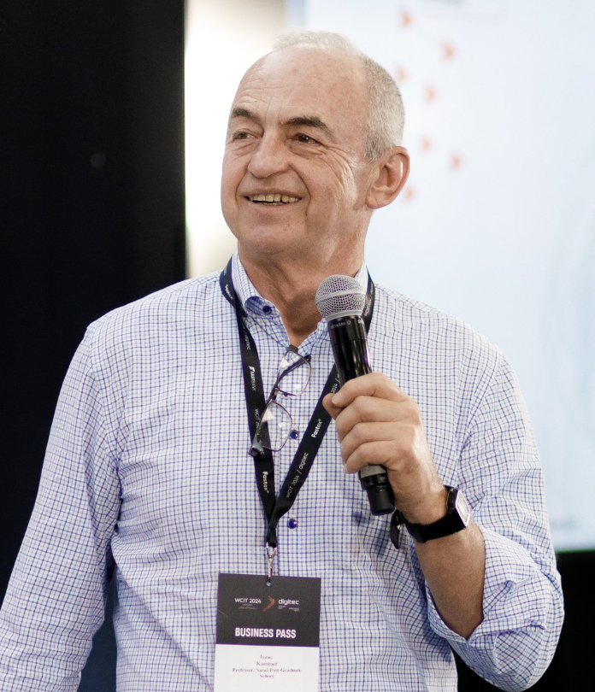
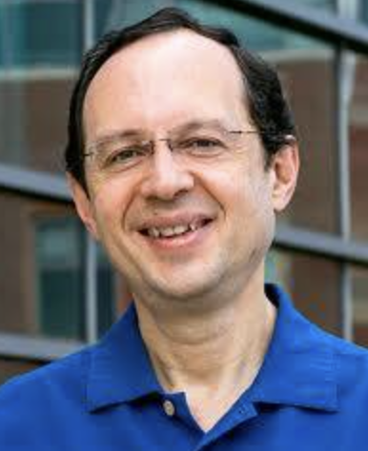

Subdivision at Institute of Mathematics NAS RA
Differential Games, Related Differential Equations and Applications
Partner
Diogo Gomes
KAUST, KSA
Isaac Kaminer
Naval Postgraduate School,USA
Xianjin Yang
Caltech, USA
Naira Hovakimyan
UIUC, USA
Tarek Abdelzaher
UIUC, USA
Publications
Submissions
In Progress
A. Arakelyan and R. Barkhudaryan, “Convergence of Physics-Informed Neural Networks for Fully Nonlinear PDEs,” Journal of Computational and Applied Mathematics, 2025. (Q1)
M. Aramyan, A. Manucharyan, L. Poghosyan, T. Bakaryan, and N. Hovakimyan, “Game-Theoretic Coordination for Time-Critical Missions of UAV Systems,” IEEE Transactions on Control of Network Systems, accepted, 2026. (Q1)
T. Bakaryan, C. Aoun, R. L. Ribeiro, N. Hovakimyan, and D. Gomes, "Hessian Riemannian Flow for Multi-Population Wardrop Equilibrium," AIMS Mathematics, accepted, 2026 (Q2)
A. Almadeh, T. Bakaryan, D. Gomes, and M. Ucer, “Ranking Mean-Field Planning Games,” submitted to Nonlinear Analysis, arXiv:2603.02921, 2026. (Q1)
L. Poghosyan, A. Manucharyan, M. Aramyan, N. Hovakimyan, and T. Bakaryan, “Distributed MPC for Coordinated Path-Following,” submitted to CDC, arXiv:2603.24748, 2026.
A. Arakelyan, T. Bakaryan, D. Alaverdyan, N. Hovakimyan, and I. Kaminer, “A Mean-Field Game Model for Large-Scale Attrition in Attacker-Defender Systems,” submitted to CDC, arXiv:2604.02101, 2026.
I. Hakobyan, X. Yang, N. Hovakimyan, T. Abdelzaher, T. Bakaryan, “Multi-Population Opinion Dynamics Mean-Field Game”, 2026.
T. Melkonyan, L. Poghosyan, A. Manucharyan, N. Hovakimyan, and T. Bakaryan, “Distributed MPC for Coordinated Path-Following Under Time-Varying Communication Networks”, 2026.
A. Arakelyan, T. Bakaryan, D. Alaverdyan, N. Hovakimyan, and I. Kaminer, “A Mean-Field Game Model for Population-Wise Attrition in Attacker--Defender Systems”, 2026.
T. Bakaryan, D. Gomes, I. Hakobyan, L. Hovhannisyan, “Delayed Collective Dynamics in Nomadic Mean Field Games”, 2026
M. Ispiryan, V. Makaryan, L. Poghosyan, T.Bakaryan, “Fourier-Based Approximation for Optimal Control Problems”, 2026

Slide 4

Mean-Field Game Theory and Applications
Optimization, Optimal Control
Single agent
Decision Making Process
Multi-agent
Game Theory
Huge number of agents
Mean-Field Game Theory

Slide 5


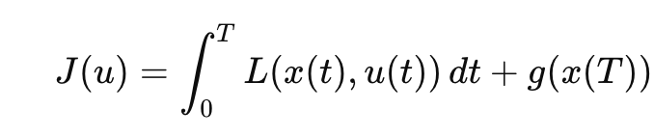
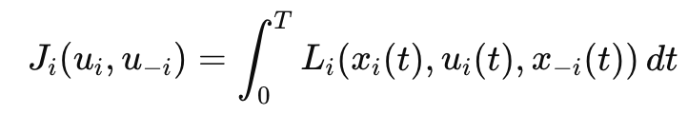
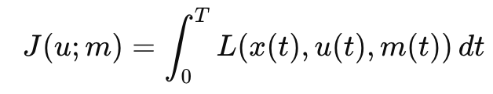
Mean-Field Game Theory and Applications
Optimal Control
Game Theory
Mean-Field Game Theory
A single decision maker:
Several decision makers:
Huge number of decision makers:
and minimizes a cost:
each agent minimizes a cost:
representative agent minimizes a cost:
Meaning:
Each UAV controls only its own motion, but its objective depends on the behavior of the other UAVs.
Meaning:
Each UAV controls its own motion, but reacts to the distribution of the whole population.
Example: A UAV selects its control inputs to reach a target or track a given trajectory, subject to physical constraints, while minimizing energy consumption, travel time, or risk.
Example: During the flight, several UAVs choose their own control strategies. They must keep a safe distance from each other to avoid collisions, maintain a desired formation, or compete for limited space or mission objectives.
Example:
A large number of drivers choose routes to reach their destinations. Each driver minimizes travel time, while the travel time depends on the overall traffic density on the roads.

Slide 6
Mean-Field Game Theory and Applications
Optimal Control
Game Theory
Mean-Field Game Theory
A single decision maker:
Several decision makers:
Huge number of decision makers:
and minimizes a cost:
each agent minimizes a cost:
representative agent minimizes a cost:
Challenges and Problems:
Existence
Uniqueness
Efficient numerical methods
Convergence guarantees
Challenges and Problems:
Existence
Uniqueness
Numerical methods
Convergence guarantees
Challenges and Problems:
Efficient numerical methods
Numerical tractability
Convergence guarantees

Slide 7
N-player Game

Slide 8

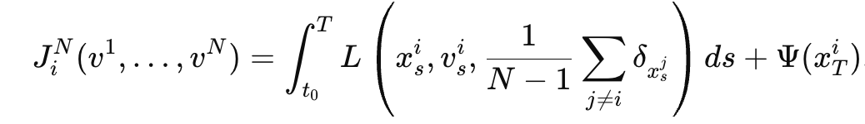
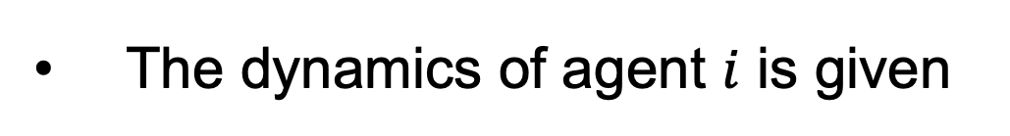
N-player Game
Consider a N-agent game, where the i-th player has state $x_{t}^{i}$ .
The dynamics of agent $i$ is given
Each agent aims to minimize its utility function
controls are implicitly coupled through the mean-field term.
terminal cost
the mean-field term

Slide 9

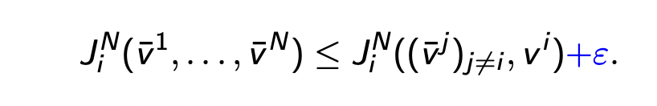
Nash Equilibrium
We say that is a Nash (-ε) equilibrium if for all i
non-optimal strategy
No one has anything to gain by changing only one's own strategy.
The Nash equilibrium is the outcome, where everybody choses the best strategy to the others best strategies. Which is to say that all strategies are mutual best responses, where no player has any interest in switching strategies.

Slide 10
Nash Equilibrium: Examples
Example (Prisoner’s Dilemma): Player 1. In the case, where Player 2 stays quiet, it makes sense for Player 1 to confess. In the case Player 2 confess, for Player 1 it still is better for him to confess.
 |  | Player 2
 |  | Confess | Remain silent
Player 1 | Confess | (5,5) | (0,10)
 | Remain silent | (10,0) | (2,2)

Slide 11
Nash Equilibrium: Examples
Example (Harmony Game): Consider two companies, which have the choice to cooperate, the payoff function can still dictate whether cooperation is achieved or not.
 |  | Company 2
 |  | Cooperation | Decline
Company 1 | Cooperation | (9,9) | (4,7)
 | Decline | (7,4) | (3,3)

Slide 12
Nash Equilibrium: Examples
Example (Battle of the Sexes): In the Battle of the Sexes game, there appear to be two stable, pure strategy Nash Equilibria. It is when both the man and the woman chose the same option.
 |  | Woman
 |  | Boxing | Shopping
Man | Boxing | (2,1) | (0,0)
 | Shopping | (0,0) | (1,2)

Slide 13
Nash Equilibrium: Examples
Example (Matching Pennies): In this game, the two players have opposite goals. Player 1 always wants to match options with Player 2, and Player 2 wants to make the opposite choice of Player 1.
 |  | Player 2
 |  | Heads | Tails
Player 1 | Heads | (1,-1) | (-1,1)
 | Tails | (-1,1) | (1,-1)

Slide 14
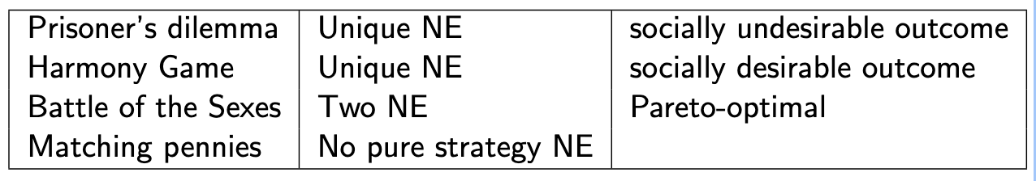
Nash Equilibrium: Remark
Nash equilibria may:
be socially desirable or undesirable;
be Pareto-optimal or Pareto-inefficient;
fail to exist in some games;
be non-unique, leading to multiple possible outcomes.

Slide 15
Why N-player Game, Nash Equilibrium?
Decision Making
Autonomy
Scalability
Conflicting interests
Cooperation

Slide 16
Mean-Field Game Theory

Slide 17
Introduction to MFG
The mean-field game (MFG) theory aims to model and analyze systems with many interacting rational agents.
MFG theory was introduced by J-M. Lasry and P-L. Lions in [Lasry and Lions, 2006] and independently by M. Huang, P. Caines, and R. Malham´e in [Huang et al., 2006].

Slide 18

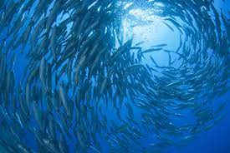
Introduction to MFG
MFG theory suggests instead of tracking all interactions, consider the asymptotic behavior of the population in the limit N → ∞.
This allows to reduce the N-agent problem into a one-agent problem, which is suitable from the modeling point-of-view and lessens the cost of computations.

Slide 19
Introduction to MFG
MFG models can be understood as an approximation to N-agent games at the asymptotic regime N → ∞.
The information about the systems is captured only by the distribution of agents in the space.
Distribution
Density function of population

Slide 20
N-player Game
Consider a N-agent game, where the i-th player has state $x_{t}^{i}$ .
The dynamics of agent $i$ is given
Each agent aims to minimize its utility function
controls are implicitly coupled through the mean-field term.
terminal cost
the mean-field term

Slide 21
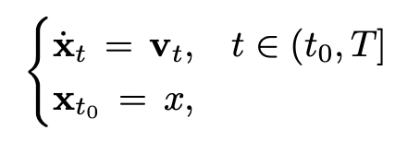
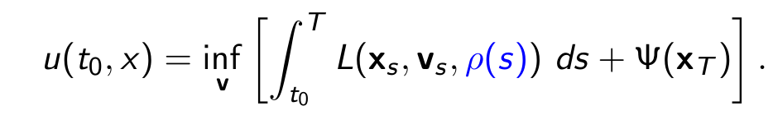
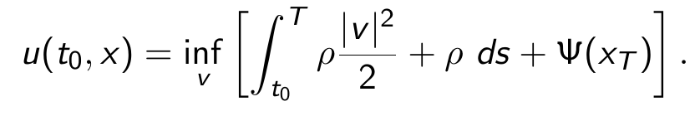
Mean-Field Game Control
Let the state of the representative agent is governed by ODE
where $v_{t}$ is a control and $x∈R^{n}$ is a given initial state.
This agent seeks to solve:
mean-field limit
In particular,

Slide 22
Mean-Field Game Idea
1.Assume a population distribution 𝜌(t,x) is given.
A representative agent treats 𝜌(t,x) as fixed, because one agent has negligible influence on the whole population.
The agent solves an optimal control problem using dynamic programming.
The optimal control determines how the population evolves.
At equilibrium, the guessed distribution and the resulting distribution coincide.

Slide 23
Mean-Field Game Idea
1.Assume a population distribution 𝜌(t,x) is given.
A representative agent treats 𝜌(t,x) as fixed, because one agent has negligible influence on the whole population.
The agent solves an optimal control problem using dynamic programming.
The optimal control determines how the population evolves.
At equilibrium, the guessed distribution and the resulting distribution coincide.
Given 𝜌
solve optimal control
problem
obtain optimal
behavior
update population
distribution

Slide 24
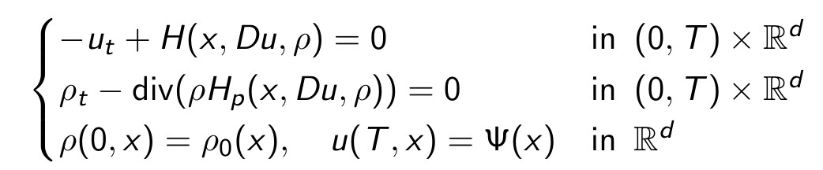
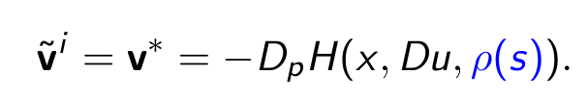
Mean-Field Game System
The value function, u, and the agents’ distribution in the space, m, solve
HJB equation
FP equation
initial distribution
terminal cost
$H$ is the Legendre dual of Lagrangian, $L$.
Solving MFG system (obtaining $(u,ρ)$ ), we get optimal control, v*,

Slide 25
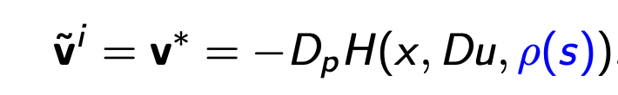


Connection With N-player Game
All agents choose mean-field game control; that is,
The agents dynamics become
In certain cases, it was proven that is a Nash -ε equilibrium for the N-player game. Nevertheless, in practice, MFG models have shown promising results in various fields, including economics, finance, and engineering.

Slide 26
Game-Theoretic Coordination For Time-Critical Missions of UAV Systems

Slide 27
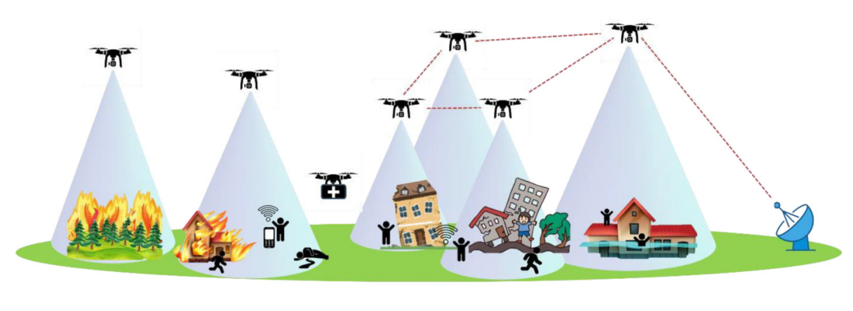
Coordinated Mission
Cooperative flight of UAVs can be leveraged in challenging scenarios to:
• Enhance surveillance and monitoring efforts in large, dynamic areas.
• Support search and rescue operations.
• Assist in extinguishing forest fires, by mapping and containing fire spread.
• Strengthen military defense strategies through coordinated swarm
  Sequential monitoring: UAVs visit and monitor a set of points of interest, while maintaining a desired temporal separation between each other.
  Swarm attack: a group of UAVs used to conduct a collective attack on a target.
Notes:
Bounded rationality refers to the idea that individuals have limited cognitive resources and can only take into account a limited amount of information when updating their opinions. Confirmation bias refers to the tendency of individuals to seek out and give more weight to information that confirms their existing beliefs.
Demographic characteristics can have a significant impact on cognitive behaviors related to opinion formation and decision-making. For example, individuals with conservative political views may be more likely to rely on their existing beliefs and values when making decisions, while individuals with liberal political views may be more open to new information and perspectives.
Overall, the outcome of bounded confidence in opinion dynamics models can be complex and depend on a variety of factors. However, polarization and fragmentation are two common outcomes

Slide 28
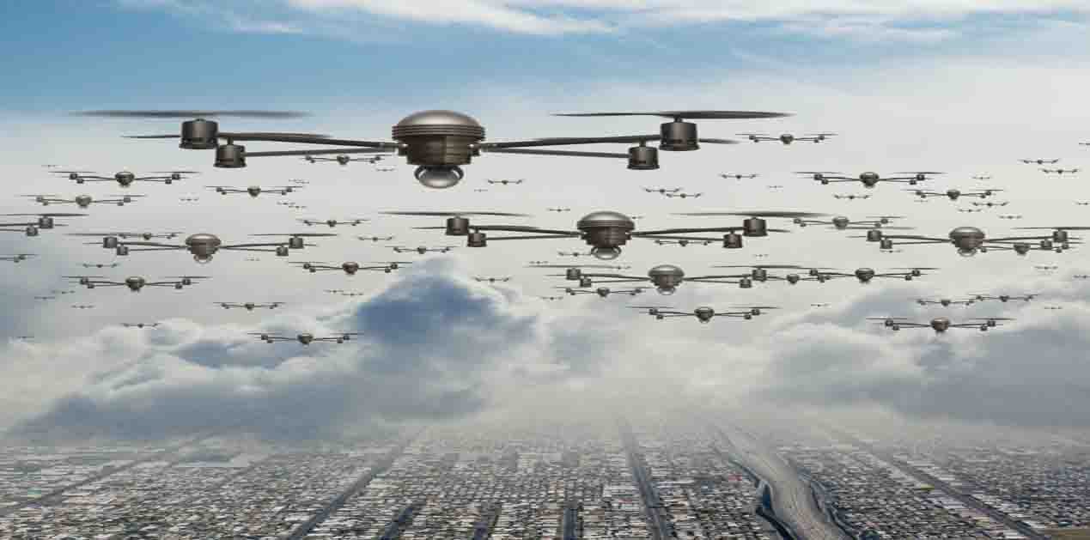
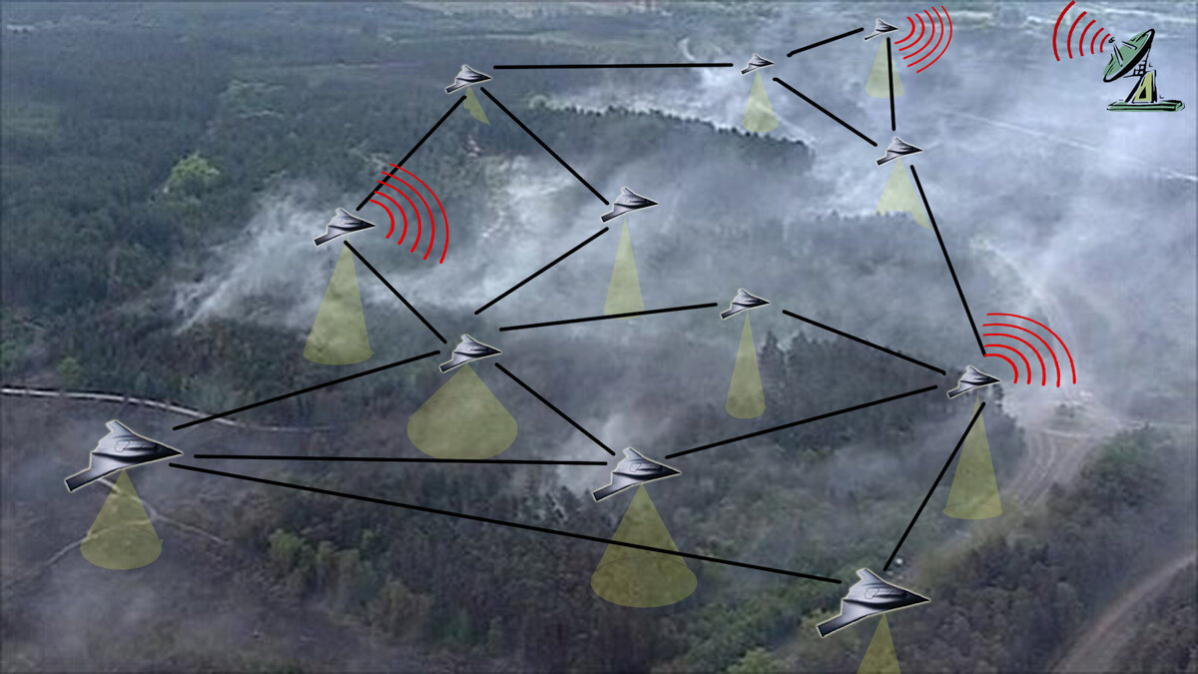
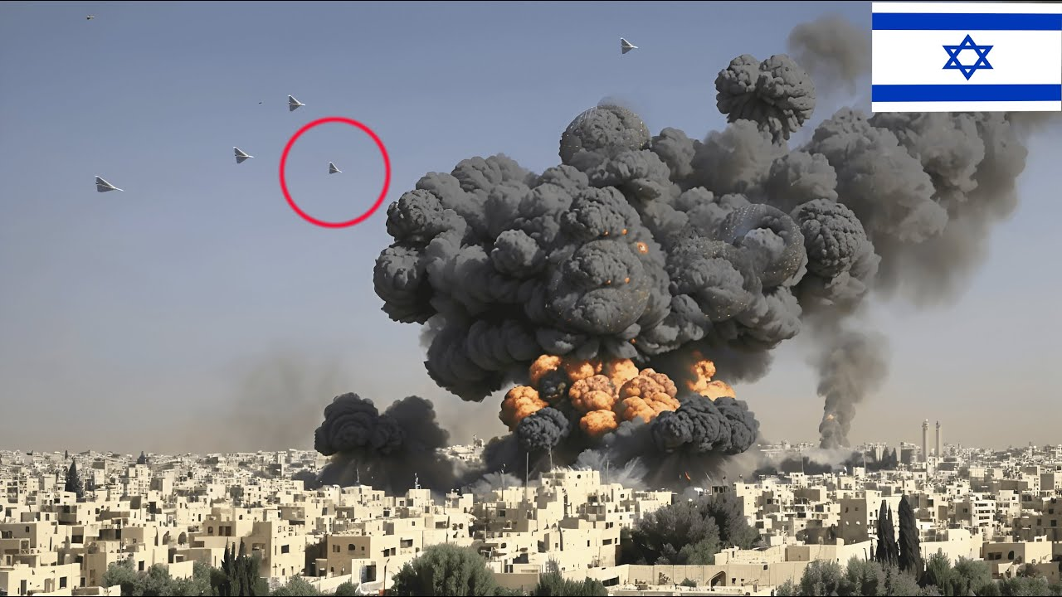
Time-Critical Coordinated Mission
Cooperative flight of UAVs can be leveraged in challenging scenarios to:
• Sequential monitoring: UAVs visit and monitor a set of points of interest, while maintaining a desired temporal separation between each other.
Swarm attack: a group of UAVs used to conduct a collective attack (simultaneous arrival) on a target.
Swarm tracking: a group of UAVs used to track a moving target.
Notes:
Bounded rationality refers to the idea that individuals have limited cognitive resources and can only take into account a limited amount of information when updating their opinions. Confirmation bias refers to the tendency of individuals to seek out and give more weight to that confirms their existing beliefs.
Demographic characteristics can have a significant impact on cognitive behaviors related to opinion formation and decision-making. For example, individuals with conservative political views may be more likely to rely on their existing beliefs and values when making decisions, while individuals with liberal political views may be more open to new information and perspectives.
Overall, the outcome of bounded confidence in opinion dynamics models can be complex and depend on a variety of factors. However, polarization and fragmentation are two common outcomes

Slide 29
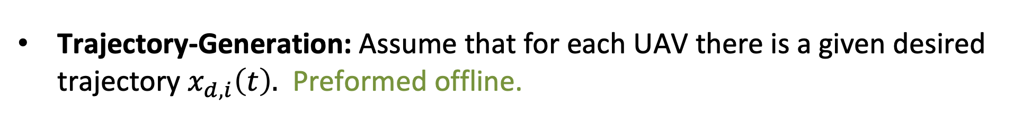
Coordinated Path Following
Consider a system of N UAVs.
Trajectory-Generation: Assume that for each UAV there is a given desired trajectory $x_{d,i}\left(t\right).$ Preformed offline.
Path Following: Assume that each UAV has an autopilot (low-level controller) that UAV follows the desired trajectory with given specifications
Time-Coordination: UAVs coordinate to execute the mission. Preformed online.

Slide 30

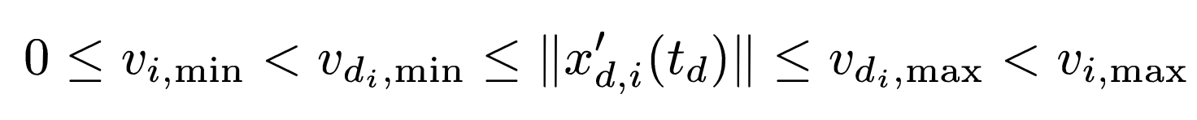
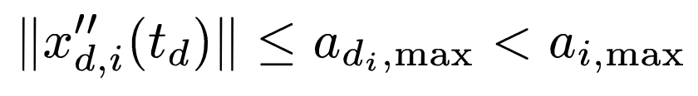
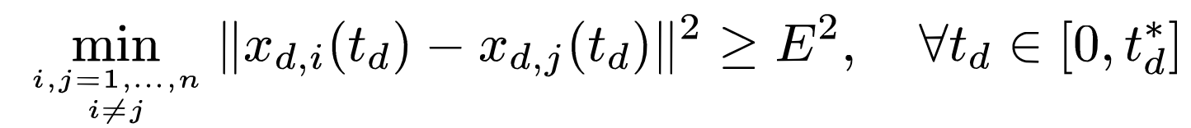

Trajectory-Generation
Trajectory-Generation: We are given desired trajectory
Dynamic constraints
Temporal separation between the paths
Temporal separation between the paths

Slide 31





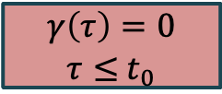
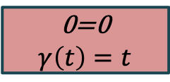
Virtual Time
Virtual time: For each UAV, for each desired trajectory, we define virtual time
The virtual time maps actual (clock) time, $t$, to mission planning time $t_{d}$.
0
$$t_{1}$$
T
t
Actual time
Ideal case
0
$$t_{1}$$
T
0=0
$$γ\left(t\right)=t$$
Virtual time
0
$$t_{0}$$
T
t
Actual time
Late lunch
0
T
Virtual time
$$γ\left(τ\right)=0$$
$τ≤$ $t_{0}$

Slide 32


Virtual Time
Virtual time: For each UAV, for each desired trajectory, we define virtual time
The virtual time maps actual (clock) time, $t$, to mission planning time $t_{d}$.
Ideal case $γ_{i}\left(t\right)=t_{d}=t$
Ideal case $γ_{i}\left(t\right)≠t_{d}$
Actual state
Desired state

Slide 33

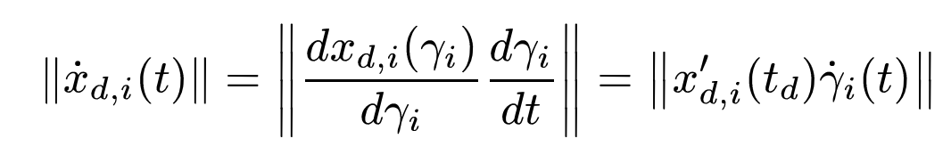


Virtual Time
Virtual time: For each UAV, for each desired trajectory, we define virtual time
The virtual time maps actual (clock) time, $t$, to mission planning time $t_{d}$.
Desired trajectory: Using the virtual time, we generate new desired trajectory for each UAV
Constraints in terms of virtual time:
Desired speed is guaranteed if:

Slide 34


Mathematical Formulation Of Coordination
Because all UAVs’ trajectories are parametrized by , then the time coordination can be achieved by imposing the following condition
Desired performance is guaranteed by

Slide 35
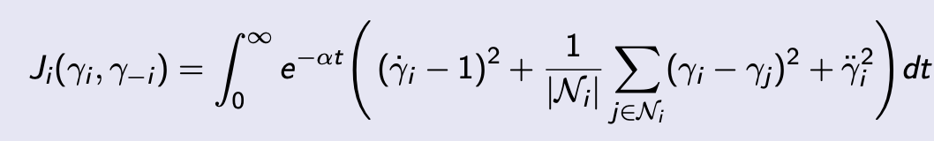
Problem Formulation
Problem: Consider a system of N UAVs. Each UAV (agent) over seeks to minimize
where${ 𝒩}_{i}$ is the neighborhood of the agent i at time t

Slide 36
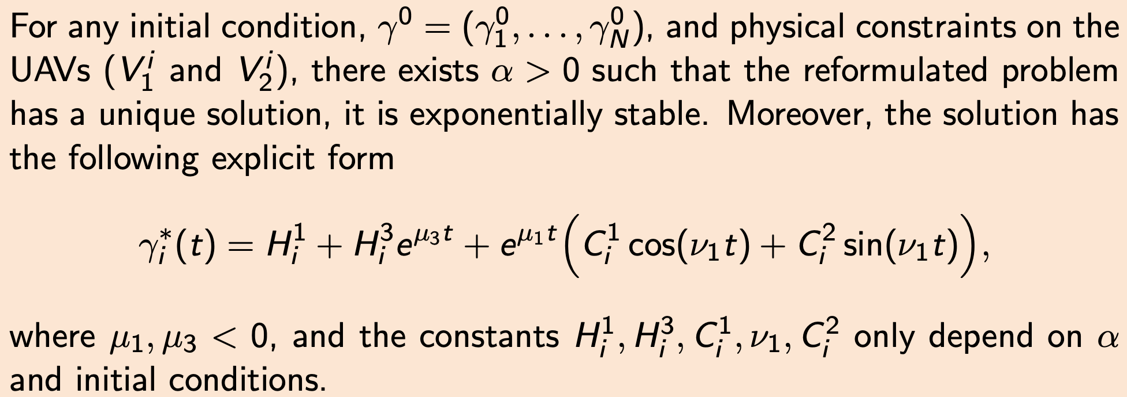
Theoretical Result
Theorem (Existence, Uniqueness, Stability)

Slide 37
Numerical Method
We develop model predictive control (MPC) based method that approximates the solution to continuous time problem.
The algorithm accommodates real-world challenges such as communication constraints, path-following errors and dynamic environments.
We assume that the communication network remains static during each MPC step but may change between steps.

Slide 38
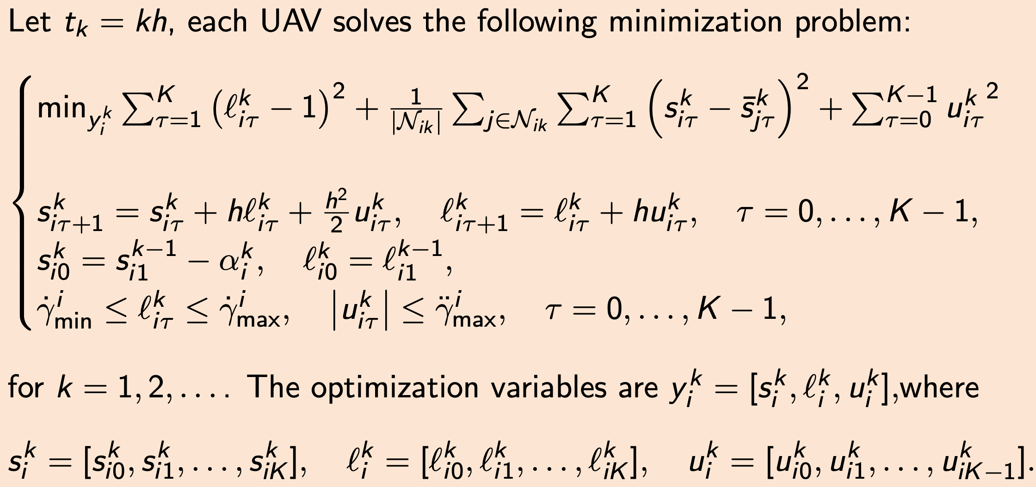
Discrete Problem
Discrete Problem

Slide 39
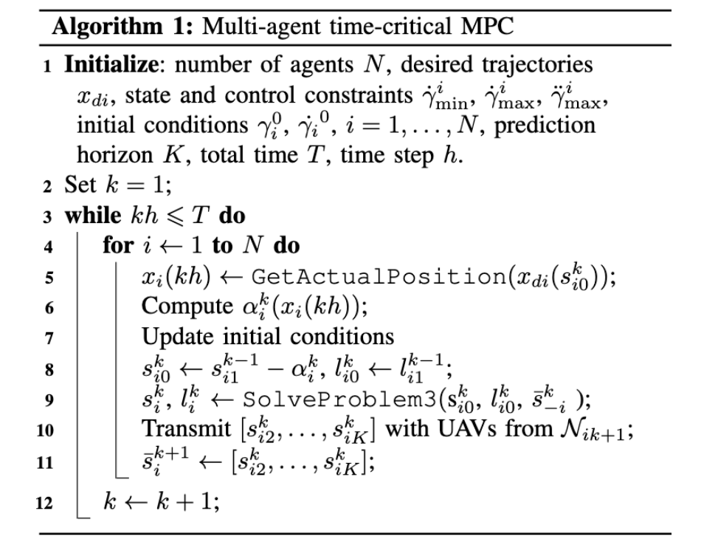
Algorithm

Slide 40
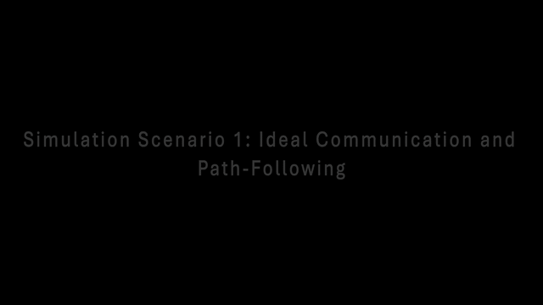
Simulations: Scenario 1

Slide 41
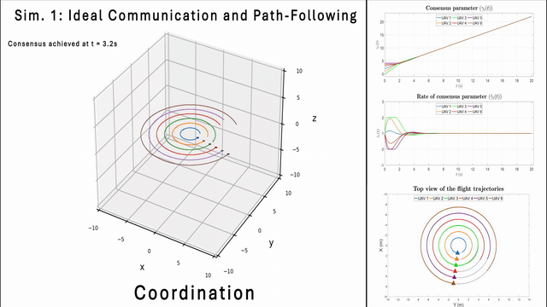
Simulations: Scenario 2

Slide 42
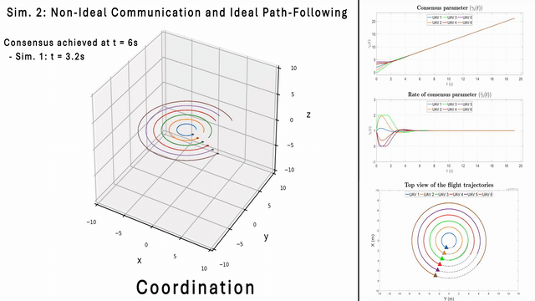
Simulations: Scenario 3

Slide 43
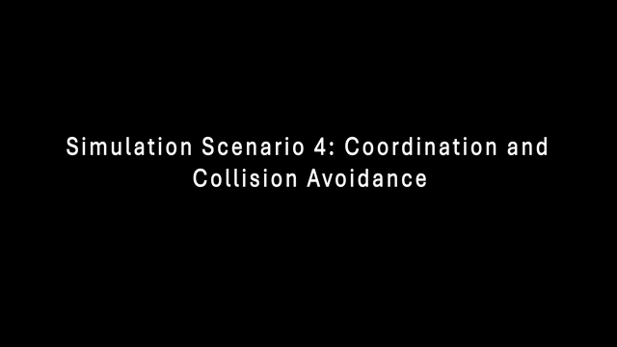
Simulations: Scenario 4

Slide 44
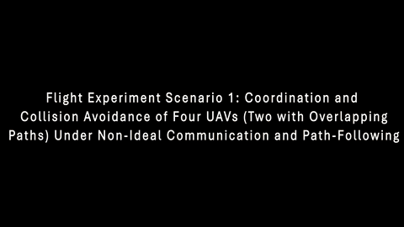
Flight Experiments: Scenario 1

Slide 45
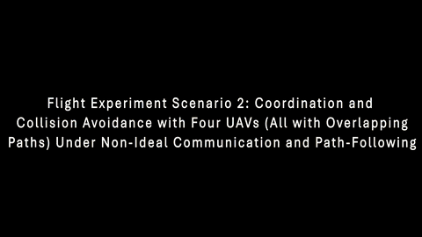
Flight Experiments: Scenario 2

Slide 46
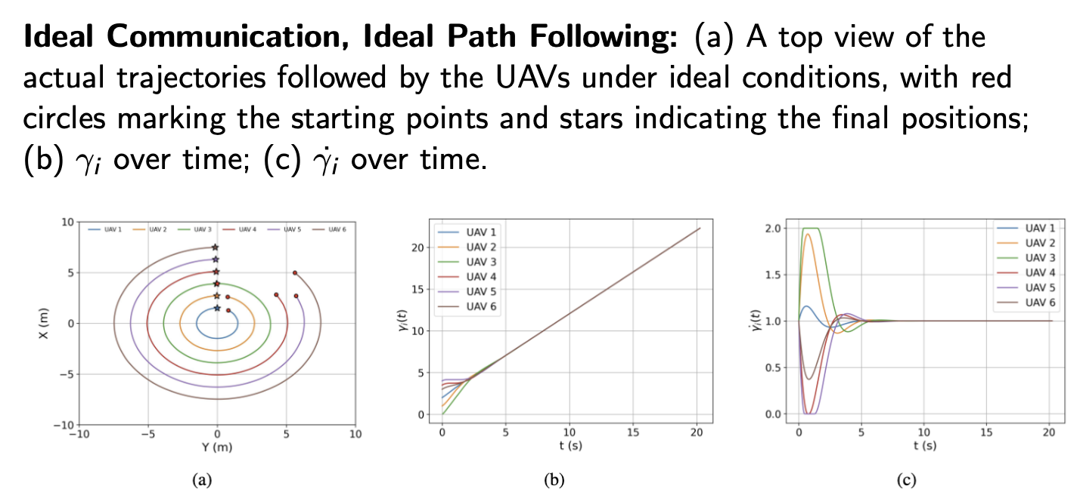
Simulations: Scenario 1

Slide 47
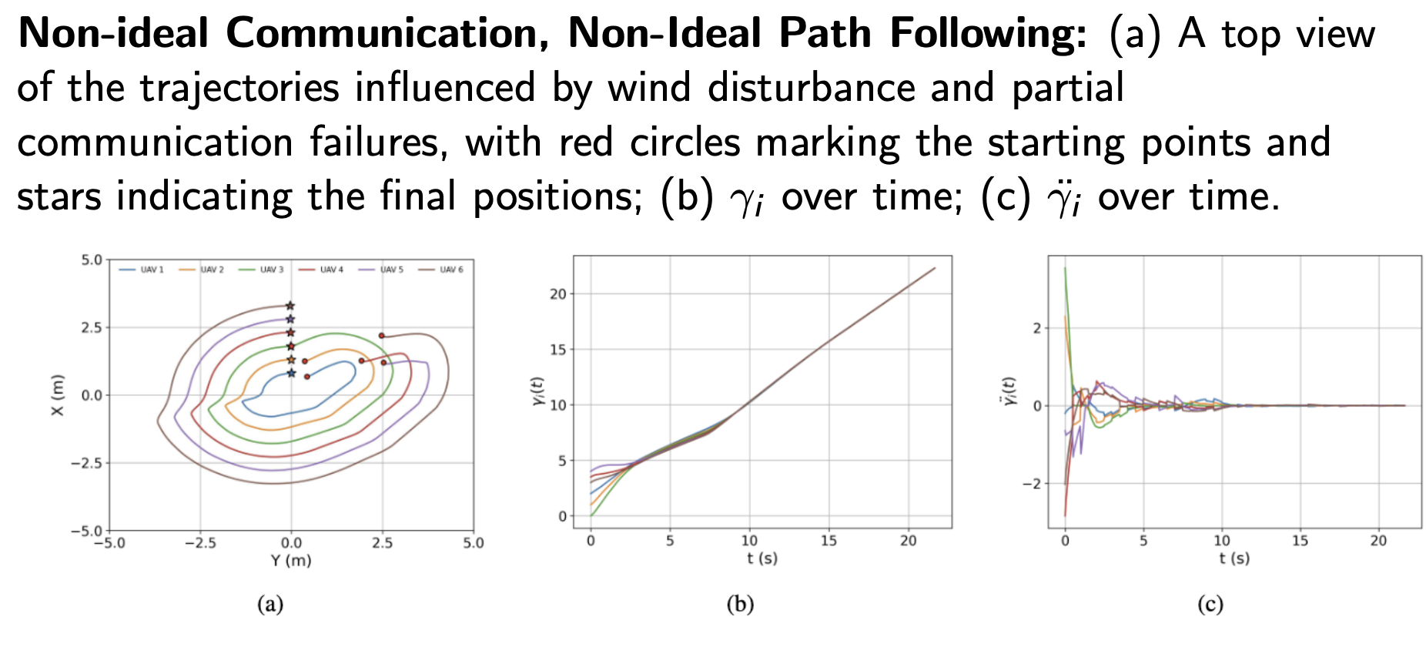
Simulations: Scenario 2

Slide 48
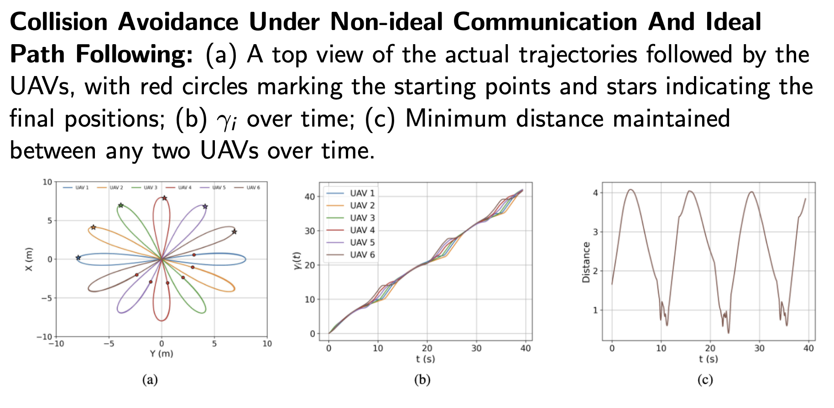
Simulations: Scenario 3

Slide 49
Mean-Field Game
Attacker-Defender Model

Slide 50
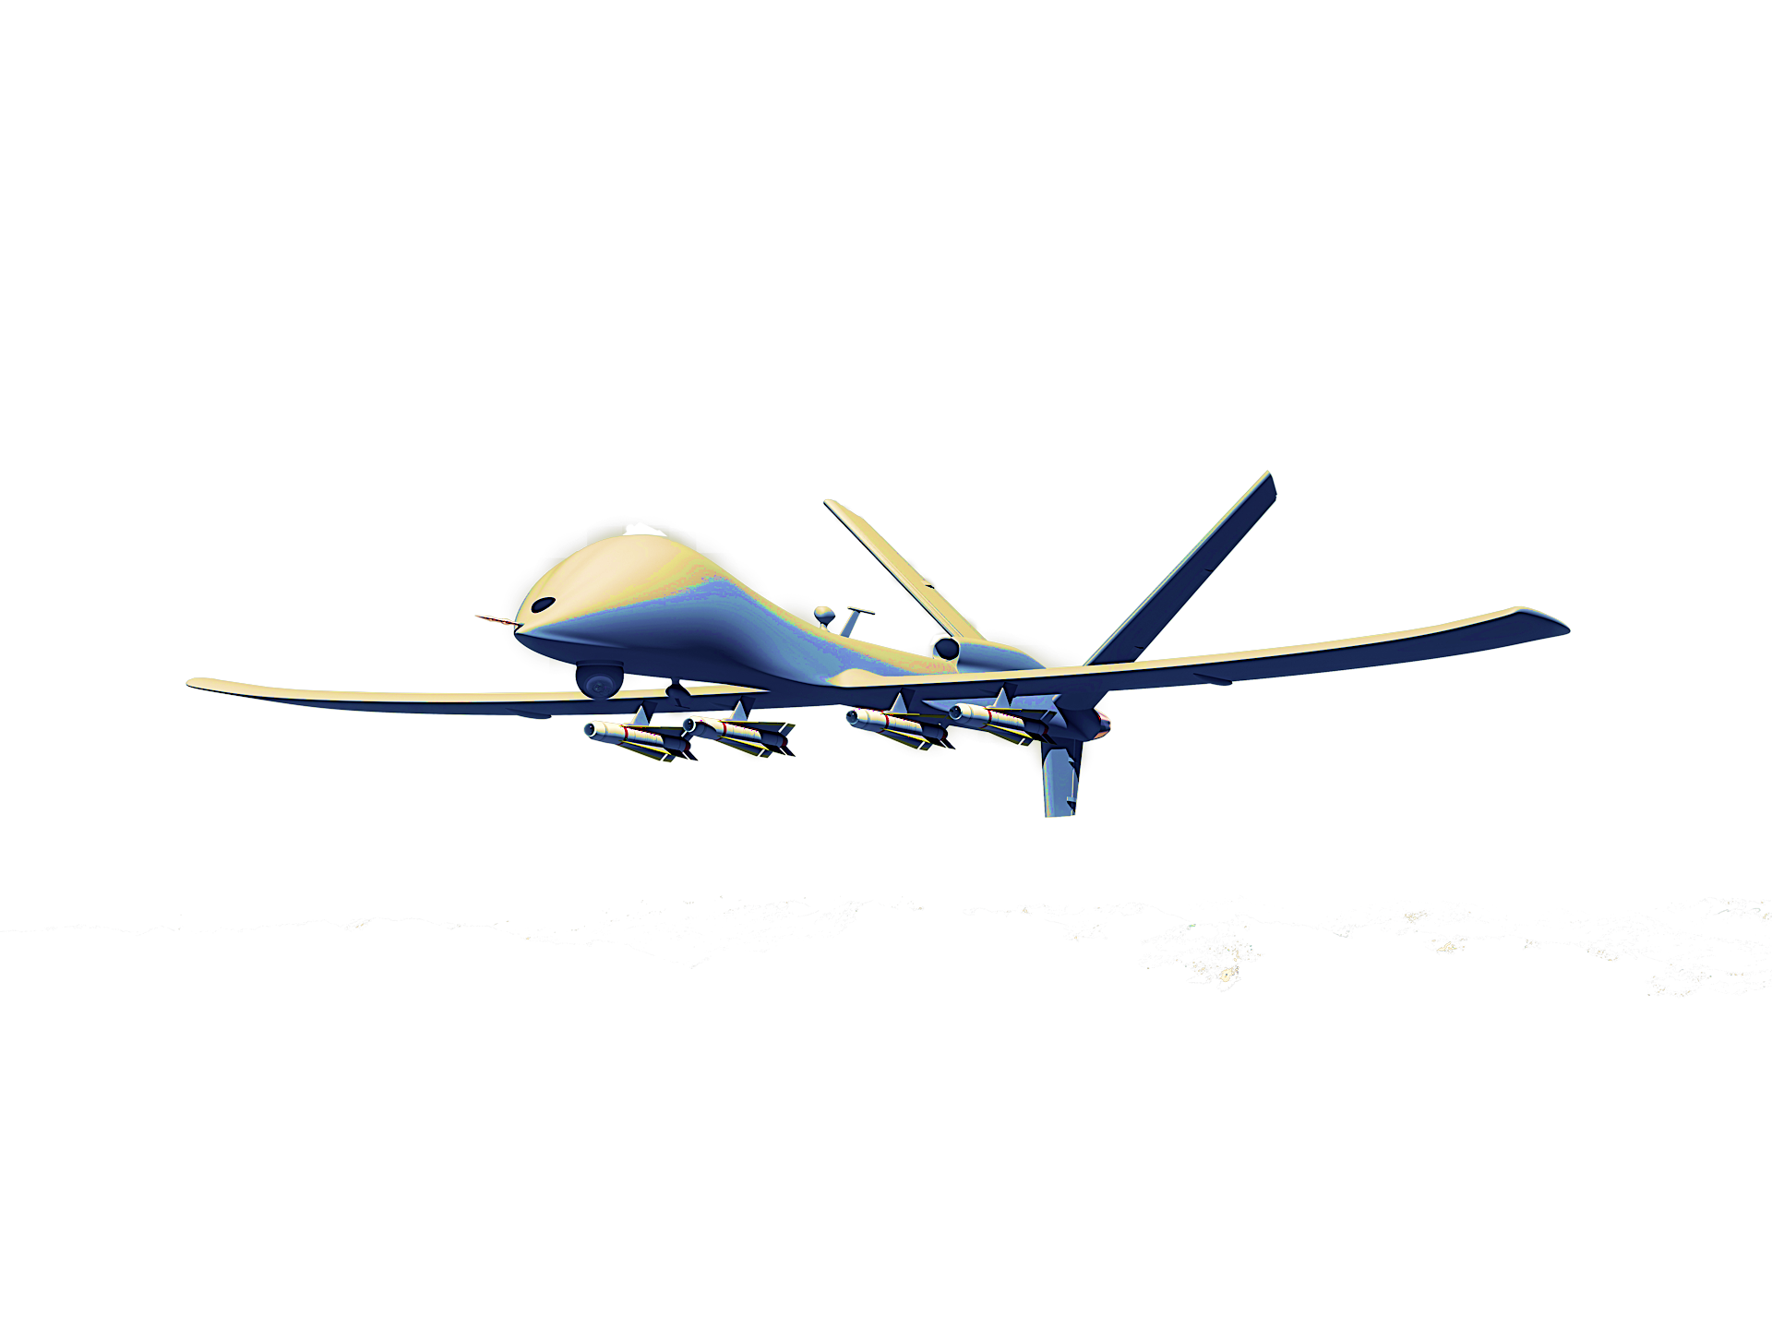
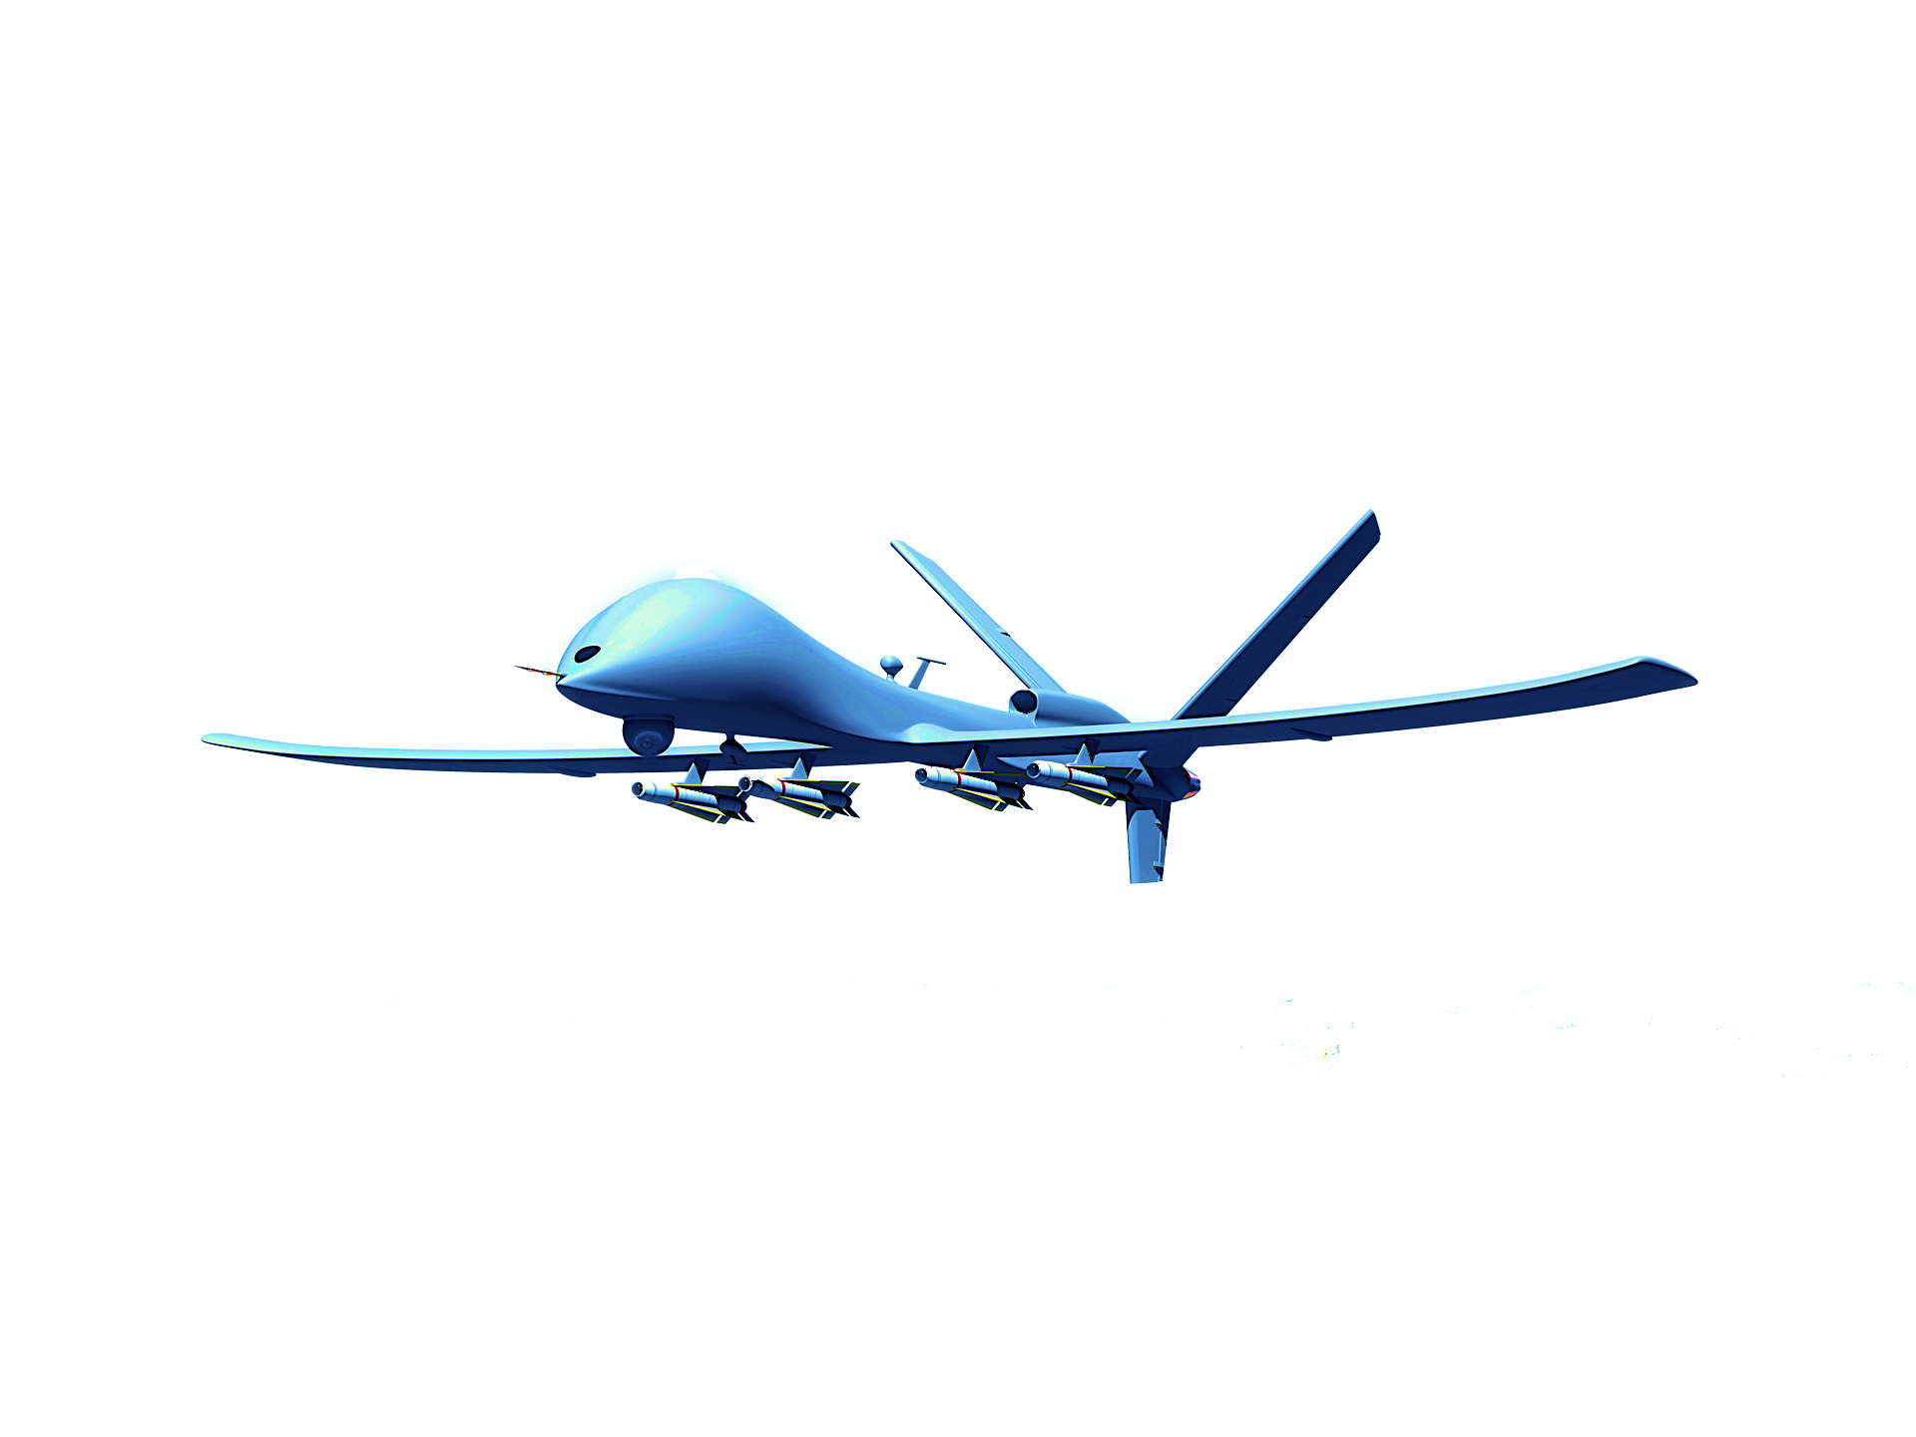

Objective
Attackers
Defenders
HVU
Attackers’ weapon range
Defenders’ weapon range
Suitable framework for modeling swarm-on-swarm engagements
Find optimal strategy for defenders to protect HVU

Slide 51
Overview
Frederick Lanchester, in 1916, initiated quantitative analysis of warfare based on force ratios.
  Lanchester’s linear law: used for one-on-one fights
  Lanchester’s square law: used for one-on-several engagements:
Koopman’s search theory, in 1946, probabilistic detection and optimal search strategies:
Stone’s attrition model, in 1977, developed equations for mutual attrition in conflicts
Washburn’s Mutual Attrition Function, in 2002, introduced game-theoretic approaches to attrition
Kaminer’s Swarm on Swarm engagement, in 2018, agent-based swarm on swarm model
Our group’s Swarm on Swarm, in 2024, population-based swarm on swarm model

Slide 52



Attrition Modeling
Attrition (instantaneous) rate is the probability of destruction of the target. The rate depends on distance, field-of-view, fire rate. One-one and one-several.
Fire rate
distance
field-of-view

Slide 53
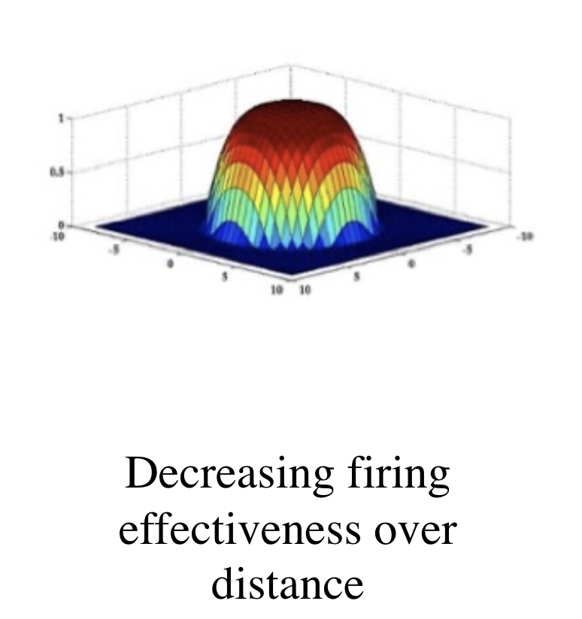
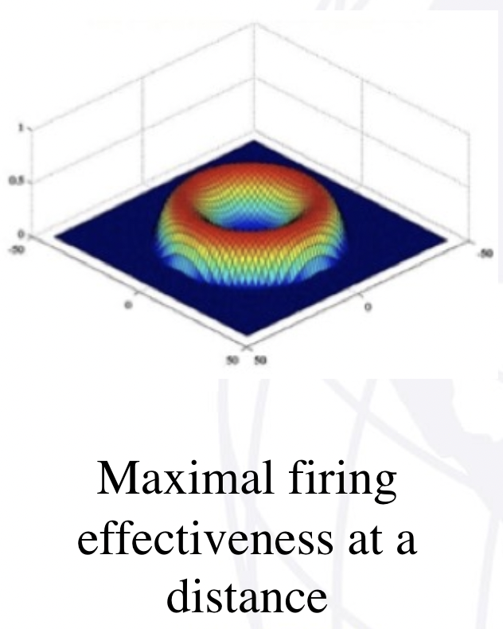
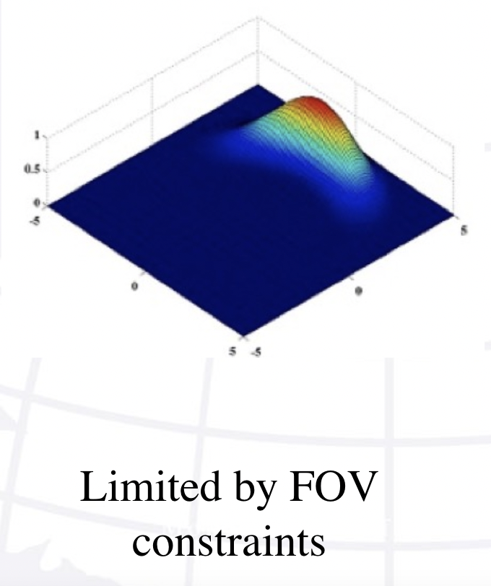
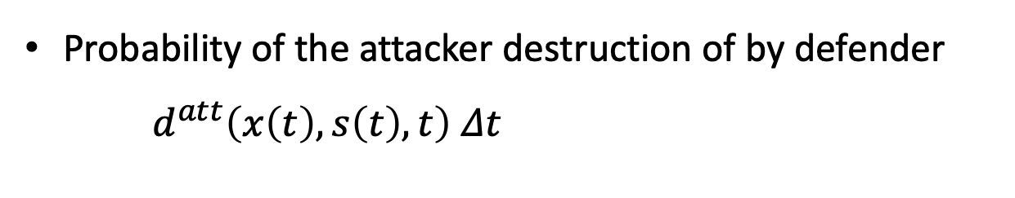
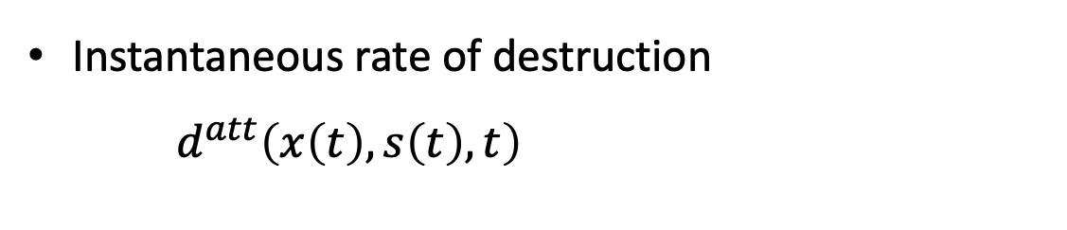
Attrition Modeling
Instantaneous rate of destruction $d^{att}\left(x\left(t\right),s\left(t\right),t\right)$
Attrition rate is defined by
  Distance
  Field-of-View
  Fire Rate
Probability of the attacker destruction of by defender $d^{att}\left(x\left(t\right),s\left(t\right),t\right)$ $Δt$

Slide 54




Problem formulation
Defenders determine their control $u$ to maximize the probability of survival of HVU $P(t_{f})$.
Suppose that we have $N$ Attackers and $M$ Defenders.
HVU
$N$ Attackers
$M$ Defenders
$K$ HVUs

Slide 55






Population Attrition Modeling
Survival probability of attacker $i$ from defender $k$ over $\left[t, t+Δt\right]$
state dependent
frequency dependent
density dependent
$$d^{att}\left(W_{p}\left(\frac{1}{M}\sum{δ_{s_{k}\left(t\right)}}\left(s\right),\frac{1}{N}\sum{δ_{x_{i}\left(t\right)}}(x),t\right)\right)Δt$$
$$d_{ik}^{att}\left(s_{k}\left(t\right),x_{i}\left(t\right),t\right)Δt$$
$$d^{att}\left(W_{p}\left(μ(t),m\left(t\right)\right)\right)Δt$$
where $μ, m$ are probability density functions of the populations of attackers and defenders, respectively.
$$m$$
$$μ$$
55

Slide 56
















Attrition Modeling
(Original model) $Q_{ik}(t)$: Survival probability of attacker $i$ from the defender $k$ over $\left[0, t\right]$
Survival probability of attacker $i$
from defender $k$ over $\left[0, t\right]$
Survival probability of attacker $i$ from defender $k$ over $\left[t, t+Δt\right]$
$$Q_{ik}(t)$$
$$1−d_{ik}^{att}\left(s_{k}\left(t\right),x_{i}\left(t\right)\right)Δt$$
time
$$0$$
$$t$$
$$t+Δt$$
(N player model) $Q_{ik}(t)$: Survival probability of N attackers from the M defenders over $\left[0, t\right]$
$$d^{att}\left(W_{p}\left(\frac{1}{M}\sum{δ_{s_{j}\left(τ\right)}}\left(s_{k}\left(t\right)\right), \frac{1}{N}\sum{δ_{x_{j}\left(τ\right)}}(x_{i}\left(t\right))\right)\right)$$
$$Q(t)$$
time
$$0$$
$$t$$
$$t+Δt$$
(MFG model) $Q(t)$: Survival probability of attackers located at $\left[0, t\right]$
$$Q(t)$$
$$1−d^{att}\left(W_{p}(μ(t),m\left(t\right))\right)Δt$$
time
$$0$$
$$t$$
$$t+Δt$$

Slide 57



Attrition Modeling
(Original model) Survival probability of attacker $i$ from defender $k$ over $\left[0, t+Δt\right]$ : $Q_{ik}\left(t+Δt\right)=Q_{ik}(t)(1−d_{ik}^{att}\left(s_{k}\left(t\right),x_{i}\left(t\right),t\right)Δt)$
${\dot{Q}}_{ik}\left(t\right)=−Q_{ik}(t)d_{ik}^{att}\left(s_{k}\left(t\right),x_{i}\left(t\right),t\right)$ $⇔$ $Q_{ik}\left(t\right)=e^{−\int_{0}^{t}{d_{ik}^{att}\left(s_{k}\left(τ\right),x_{i}\left(τ\right),τ\right)dτ}}$.
(N player model) Survival probability of N attackers from M defender over $\left[0, t\right]:$
$\dot{Q}\left(t\right)=−Q\left(t\right)d^{att}\left(W_{p}\left(\frac{1}{M}\sum{δ_{s_{j}\left(τ\right)}}\left(s_{k}\left(t\right)\right), \frac{1}{N}\sum{δ_{x_{j}\left(τ\right)}}\left(x_{i}\left(t\right)\right)\right)\right)$
$$Q\left(t\right)=e^{−\int_{0}^{t}{d_{ik}^{att}\left(W_{p}\left(\frac{1}{M}\sum{δ_{s_{j}\left(τ\right)}}\left(s_{k}\left(τ\right)\right), \frac{1}{N}\sum{δ_{x_{j}\left(τ\right)}}(x_{i}\left(τ\right))\right)\right)dτ}}$$
(MFG model) Survival probability of population of attackers from the population of defenders over $\left[0, t\right]$:$Q\left(t+Δt\right)=Q\left(t\right)(1−1−d^{att}\left(W_{p}\left(μ(t),m\left(t\right)\right)\right)Δt)$
$\dot{Q}\left(t\right)=−Q\left(t\right)d^{att}\left(W_{p}(μ(t),m\left(t\right))\right)⇔Q\left(t\right)=e^{−\int_{0}^{t}{d^{att}\left(W_{p}\left(μ(τ),m\left(τ\right)\right)\right)dτ}}$.

Slide 58





High Value Unit
(Original model)
HVU survival probability: $P\left(t\right)=\prod_{i=1}^{N}{P_{att_i}\left(t\right)}$: $\dot{P}\left(t\right)=−P\left(t\right)\sum_{i=1}^{N}{d_{i}^{HVU}\left(s_{HVU}\left(t\right),x_{i}\left(t\right),t\right)Q_{i}\left(t\right).}$
$P\left(t\right)=exp⁡\left(−\int_{0}^{t}{\sum_{i=1}^{N}{d_{i}^{HVU}\left(s_{HVU}\left(τ\right),x_{i}\left(τ\right),t\right)\prod_{k=1}^{M}{Q_{ik}(τ)}}}dτ\right)$.
(N player model) Survival probability of HVU from the population of attackers over $\left[0, t\right]$ is $P_{att}\left(t\right)$
${\dot{P}}_{att}\left(t\right)=−P_{att}\left(t\right)d_{}^{HVU}\left(W_{p}\left(\frac{1}{N}\sum{δ_{S_{HVU}}}(x_{i}\left(t\right), \frac{1}{N}\sum{δ_{x_{j}\left(t\right)}}(x_{i}\left(t\right)\right)\right)Q_{}(t)$, $i=1, …,N$.
(MFG model) Survival probability of HVU from the population of attackers over $\left[0, t\right]$ is $P\left(t\right)$
$$\dot{P}\left(t\right) =−P\left(t\right)d^{HVU}\left(s_{HVU}\left(t\right),m\left(t\right),t\right)Q\left(t\right),$$
$P\left(t\right)=e^{−\int_{0}^{t}{d^{HVU}\left(s_{HVU}\left(τ\right),m\left(τ\right),τ\right)e^{−\int_{0}^{τ}{\int{d^{att}\left(μ(θ),m\left(θ\right),τ\right)ds}dθ}}dτ}}$.
HVU
$$μ$$

Slide 59


Cost Function
Note that
We consider the following Pareto optimal version of minimizer
Leading to

Slide 60

MFG System
The Mean-Field Game system is given by
$${−w}_{t}−∆w+H(m,D w,μ)=0$$
$$μ_{t}−∆μ−{div}_{s}\left(H_{p}(m, D w,μ)μ\right)=0$$
${ m}_{t}−∆m+{div}_{x}\left(u_{attc} m\right)=0$,
where $H(t,x,m,μ,p)=\max_{q}\left(−L\left(m,q,μ\right)−qp\right).$
Theorem: The MFG system has a classical solution, $w$.
The Mean-Field control is
$$u=−H_{p}\left(m, D w,μ\right).$$
Control functions of N-player problem is given by
$$u_{k}(x)=−H_{p}\left(m(s), D w(s),μ(s)\right).$$

Slide 61

Simulations: Scenario 1
HVU, initial state of defenders, attackers are given by Normal distributions.
HVU (1, 1) with deviation σ = √0.1
Defenders initial distribution is located at (3, 1) with deviation σ = √0.05. The defenders are concentrated.
Attackers start from (4, 4) with deviation σ = √0.5 and optiamally move to (0, 0).
Sigma_h=0.14176613
Lambda_h = 1381.9
Sigma_a = 0.14176613
Lambda_a = 5.5276

Slide 62

Simulations: Scenario 1
HVU, initial state of defenders, attackers are given by Normal distributions.

Slide 63

Simulations: Scenario 2
HVU, initial state of defenders, attackers are given by Normal distributions.
HVU (1, 1) with deviation σ = √0.1
Defenders initial distribution is located at (3, 1) with deviation σ = √0.75. The defenders are spread out.
Attackers start from (4, 4) with deviation σ = √0.5 and optimally move to (0, 0).

Slide 64

Simulations: Scenario 2
HVU, initial state of defenders, attackers are given by Normal distributions.

Slide 65

Simulations: Scenario 3
HVU, initial state of defenders, attackers are given by Normal distributions.
HVU (1, 1) with deviation σ = √0.1
Defenders initial distribution is located at (3, 1) with deviation σ = √30. The defenders are overly spread out.
Attackers start from (4, 4) with deviation σ = √0.5 and optiamally move to (0, 0).

Slide 66

Simulations: Scenario 3
HVU, initial state of defenders, attackers are given by Normal distributions.

Slide 67

Simulations: Nice Scenarios

Slide 68

Simulations: Nice Scenarios

Slide 69

Simulations: Nice Scenarios

Slide 70

Simulations: Nice Scenarios

Slide 71

Simulations: Nice Scenarios

Slide 72
Simulations: Nice Scenarios

Slide 73

Simulations: Nice Scenarios

Slide 74
Thank you!

Slide 75



ODE to Transport equation
Consider a population of agents whose microscopic dynamics is governed by the following ODE
$$b$$
where $b$ is Lipschitz vector field.
The vector field $b$ induces a flow that transports the population pushing it forward or backward in time:

Slide 76


Objective
Study the opinion evolution in web domain.
The number of agents is huge.
The source of information is enormous.

Slide 77




Opinion Dynamics Models
Cognitive Models
Computational representations of human cognition
Opinion Dynamics Models
ABSTRACTION of cognitive process
Mathematical models of opinion evolution/spreading within a population over time
Focus on COLLECTIVE level: interactions, aggregate dynamics of groups
COMPONENTS: network structure, influence rules (update rules), confidence boundary, …
MODELS: Degroot, BC (HK), Deffuant-Weisbuch (DW), …
Focus on INDIVIDUAL level: processing information, decision-making, belief- formation, …
MODELS: Multi-Store, ACT-R, Soar,…
REFLECTION of cognitive process
Key words: accuracy , scalability

Slide 78
Opinion Dynamics Models: Contributions
Bounded confidence: state dependent model
Kernel methods: "similarity measure" function
Group bias: statistical distance defines "group similarities”
Well-posedness of the considered models
Trade-off between complexity and scalability
Integration of control into the models

Slide 79
Bounded Confidence Mechanism
Confirmation bias (selective exposure) is the tendency to seek out information that confirms pre-existing beliefs while avoiding information that contradicts them.
Biased assimilation is the tendency to interpret information in a way that supports a desired conclusion.
Bounded confidence is the tendency of individuals to interact with like-minded individuals and consume information that aligns with their existing beliefs.
1. U. Peters, “What is the function of confirmation bias?,” Erkenntnis, vol. 87, no. 3, pp. 1351–1376, 2022.
2. G. W. Allport, The nature of prejudice. Addison Wesley Publishing Company, 25 ed., 1979.
3. M. Suzuki and Y. Yamamoto, “Characterizing the influence of confirmation bias on web search behavior,” Frontiers in Psychology, vol. 12, 2021
Notes:
In opinion dynamics, selective exposure reinforce bounded confidence by causing individuals to only interact with like-minded individuals and consume information that aligns with their existing beliefs.

Slide 80


Bounded Confidence Model
Bounded Confidence Neighborhood
-1
1
Bounded confidence may create echo chambers, where individuals only interact with others who share similar opinions, leading to group polarization or fragmentation.
1. G. Deffuant, D. Neau, F. Amblard, and G. Weisbuch, “Mixing beliefs among interacting agents,” Advances in Complex Systems, vol. 3, no. 01 n04, pp. 87–98, 2000.
2. H. Rainer and U. Krause, “Opinion dynamics and bounded confidence: models, analysis and simulation,” 2002
3. M. Moussa ̈ıd, J. E. K ̈ammer, P. P. Analytis, and H. Neth, “Social influence and the collective dynamics of opinion formation,” PLOS ONE, vol. 8, pp. 1–8,
11 2013.
Notes:
In opinion dynamics, selective exposure reinforce bounded confidence by causing individuals to only interact with like-minded individuals and consume information that aligns with their existing beliefs.

Slide 81








Opinion Dynamics Models
Consider population of $N$ agents with $X_{t}^{i}∈\left[−1,1\right]=Ω$.
$$i$$
$$w_{t}^{ij}$$
General dynamics:
where
$$j$$
Update rule:
.
Influence of agent $j$ on agent $i$ is described by
(Weighting process)
Remark: to ensure scalability, we assume that $w_{t}^{ij}$ is state dependent
$w_{t}^{ij}=w$($X_{t}^{i}$, $X_{t}^{j}$).

Slide 82




“Local” Kernel Method
Update rule:
“Local” kernel method:
bounded confidence level of agent $i$
Opinion “similarities” are determined by $κ_{d}:$ how an agent assigns weights to its neighbors.
Local methods: bounded confidence 𝜀.
C. Xu, J. Li, D. Sun, J. Li, T. Abdelzaher, J. Graham, M. Macy, C. Lebiere, and B. Szymanski, “The paradox of information access: On modeling polarization in the age of information,” IEEE Transactions on Control of Network Systems, pp. 1–12, 2023.

Slide 83



State Dependent BC Model
The dynamics are given by
where $μ_{0}^{i}$ is the initial distribution of agent $i$ and .
Well-posedness: the existence and uniqueness are proven
Let the kernel $κ_{d}(∙,∙,ε)$ be piece-wise continuous in $ℝ^{2}$ and $κ_{d}\left(x,x,ε\right)≥σ>0$ for all $x∈[−1,1]$. Then, the ODE system has a global solution, denoted by ${\left\{X_{t}^{i}\right\}}_{i=1}^{N}$. Moreover, the solution ${\left\{X_{t}^{i}\right\}}_{i=1}^{N}$stays in $Ω^{N}.$
Proposition:

Slide 84







Examples of Kernels:
1. Uniform kernel:
2. Hat-like kernel:
$w^{i2}$
$0.5$
$w^{i1}$
$$X^{1}$$
$X^{2}$
Collapses to HK dynamics
Introduces ”stubborn” behaviors

Slide 85





Examples of Kernels (Sim):
”slower” dynamics near extreme states
More polarized due to extreme ones

Slide 86



Population-biased Models: Motivation
Group affiliation reflects an activation of social category/identity during a discussion (e.g., gender, political belief, …)
Bloggers from the same party interact more, while interaction between bloggers from different parties even with similar interests is insignificant.
1. L. A. Adamic and N. Glance “The Political Blogosphere and the 2004 U.S. Election: Divided They Blog” Proceedings of the 3rd international workshop on Link discovery, 2005

Slide 87

Population-Biased Models: Motivation
Distribution defines “populations”
The distributions of their opinions naturally characterize their “group- identity”.
1. Balietti, Stefano, et al. "Reducing opinion polarization: Effects of exposure to similar people with differing political views," Proceedings of the Nation Academy of Sciences, 2021

Slide 88


Similarities Between Agents
Consider population $Λ$ of $N$ agents, which are divided into $P$ sub-populations; that is, $Λ=\bigcup_{k=1}^{P}{Λ^{k}}$.
Each sub-population $Λ^{k}$ is described by its distribution $μ_{t}^{Λ^{k}}$.
The distance between two populations is defined by the statistical distance between the corresponding distributions
Similarities between agents are defined by their group affiliations and the distance between the corresponding populations.

Slide 89




Intuition Behind The Model
In the BC model, the agents update their opinions based on their neighbors' opinions, regardless of the neighbors’ group affiliations.
However, agents from different sub-populations may interact differently, even if their opinions are close.
weighting
influencing
no weight
influencing
weighting
BC Model
Multi-population Model

Slide 90





Population-Biased Models
Dynamics: a reweighting process based on sub-populations
where is the normalizing factor.
Kernel methods: the population-wise weights are defined by
where $K:ℝ^{2}→ℝ^{+}$ is a kernel that measures the similarity between two populations. Example:
$K=e^{−d\left(μ_{t}^{Λ(i)},μ_{t}^{Λ(j)}\right)}$.

Slide 91

Time-Varying Multi-Population Model
Update rule: A “close-loop” update rule
Individual cognitive process
Opinion evolution affects population
Each agent from every sub-population updates its opinion; hence, the collective state of each sub-population is updated, and consequently, their distributions are updated as well. Therefore, the interaction of sub-populations changes.
Opinion evolution affects population
Activation of social identities
TIME

Slide 92




Insights of The Model
Mean-field limit of the model:
mass of sub-population $Λ^{r}$ in the neighborhood
neighborhood w.r.t sub-population $Λ^{r}$
neighborhood
neighborhood

Slide 93










Insights of The Model
Recall that $μ^{r}$ is the density function of $r$-th sub-population $Λ^{r}$ at time $t$.
neighborhood w.r.t sub-population $Λ^{r}$
the agent $X_{t}^{k}$
collective effect of $V^{r}$
weighting by using $p_{kr}$
the agent $X_{t}^{k}$
mass of sub-population $Λ^{r}$ around the agent
mass of $V^{r}$
weighting by using $p_{kr}$

Slide 94

Isolated VS Integrated
Dynamics defined by the empirical and actual distributions:

Slide 95




Multi-Population Controlled Dynamics
Dynamics:
Each agent aims to minimize
Particularly,
where is a given desirable opinion for the sub-population
$$X_{d}^{Λ(i)}$$
$$Λ\left(i\right).$$

Slide 96





Control of Multi-Population Limiting Case
Dynamics:
where
Each agent aims to minimize
Particularly,
where
$$X_{d}^{Λ_{k}}$$
where is a given desirable opinion for the representative agent $k$.

Slide 97


Multi-Population Optimality Condition
The optimality conditions lead to MFG systems
where

Slide 98
Multi-Population Optimality Condition
The MFG systems
Let the kernel functions are positive and Lipschitz.
Hamiltonians are convex in the second variable.
The system of MFG systems has classical solution.

Slide 99
Simulations

Slide 100



Stubbornness Effect
Agents are open to others, more interactions, fast consensus.
Agents are stubborn, less interactions, slow consensus.

Slide 101



Control effect
More interactions, mass domination, poor control.
Less interactions, less mass, good control.

Slide 102



Interaction Intensity Effect Weak
Weak-interaction between populations

Slide 103


Interaction Intensity Effect Strong
Strong interaction between populations

Slide 104




Interaction Intensity Effect On Control
Mass effect

Slide 105
Interaction Intensity Effect On Control
Mass effect with strong and weak interactions

Slide 106




Interaction Effect On Neural Population
Strong interactions
Asymmetric interactions

Slide 107




Interaction Effect On Neural Population Control
Strong interactions
Asymmetric interactions

