Slide 1
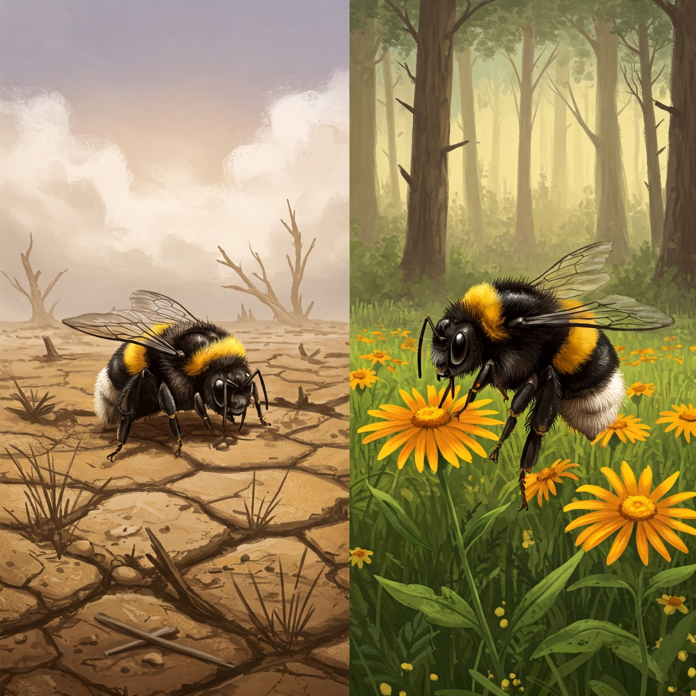

BOMPAR - Modelling outbreaks of Bombus parasites under various scenarios of climate change and developing adaptation plans to mitigate the negative consequences for natural ecosystems and agriculture
Valeriya Vavilova,
PhD, Senior Researcher, Laboratory of Molecular Parasitology,
Scientific Center of Zoology and Hydroecology,
National Academy of Sciences of the Republic of Armenia.

Slide 2
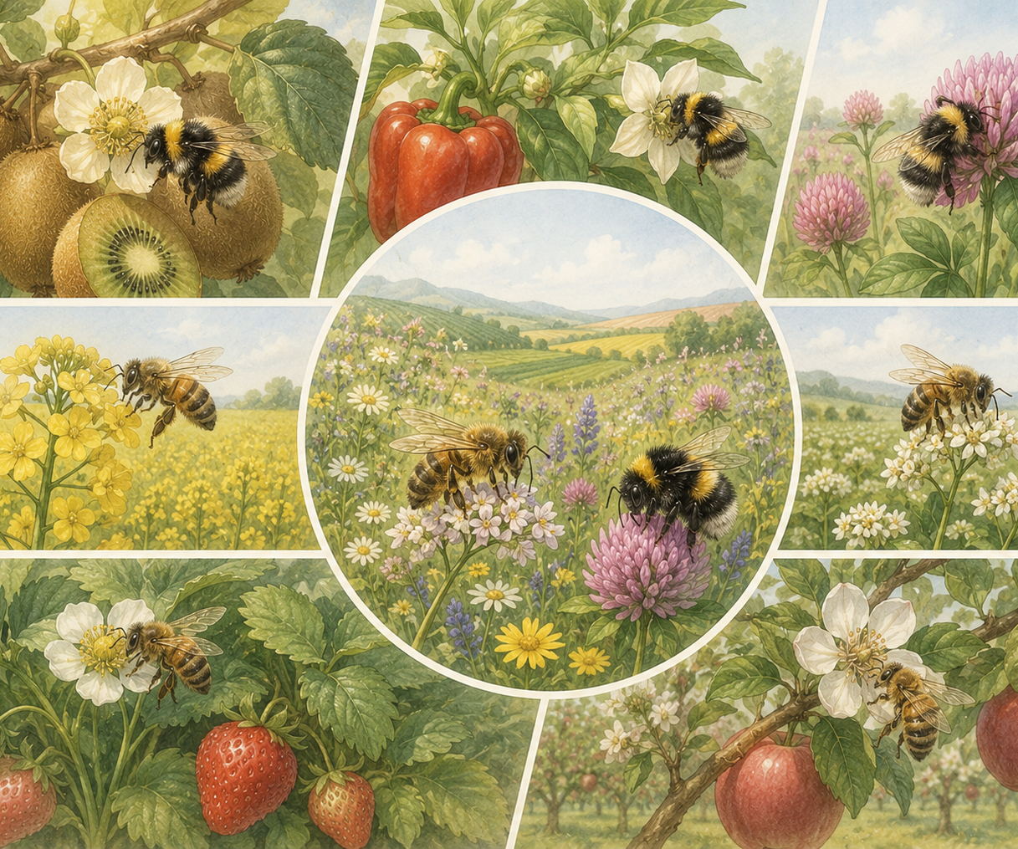
Bumblebees are one of the main pollinators
Main distinguishing features of bumblebees:
Robust size
Long tongues
Buzz-pollination behavior (high-frequency buzzing to release pollen from flowers)
Ability to forage at lower temperatures

Slide 3
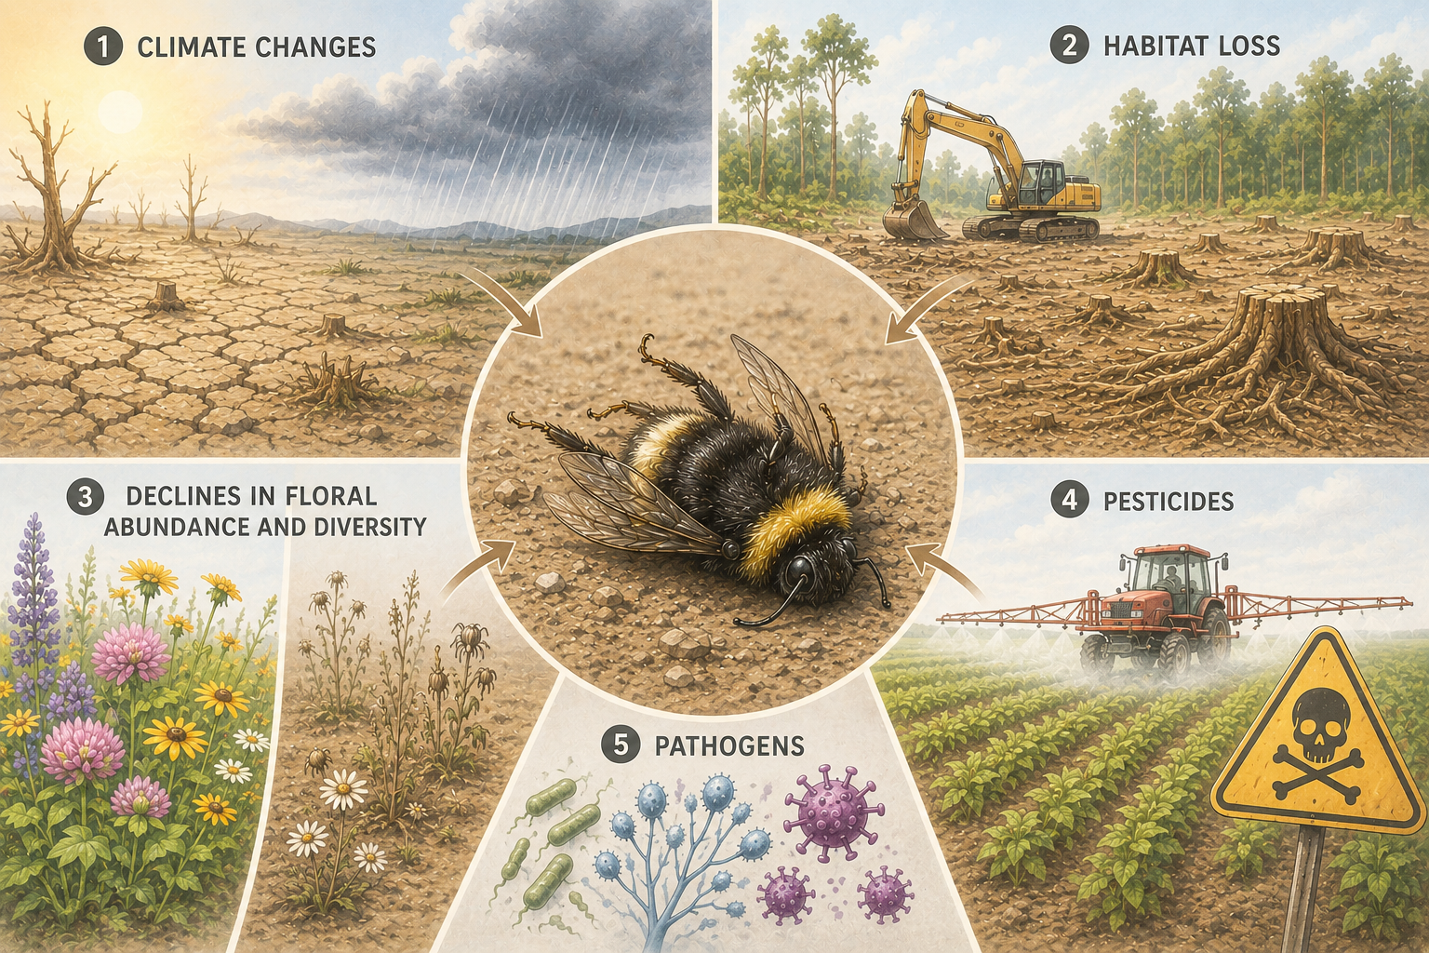
Bumblebee decline

Slide 4
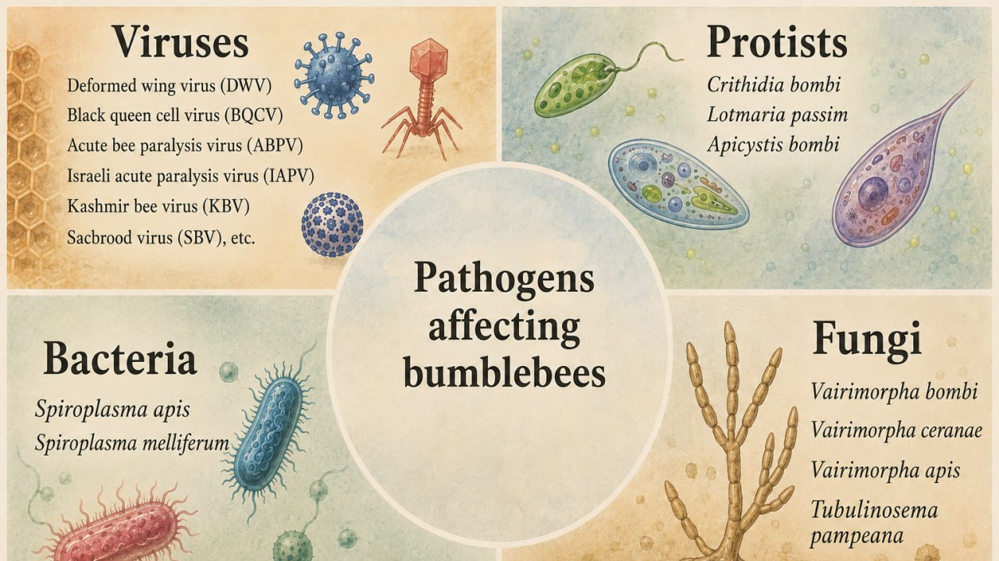

Slide 5
Our team
Valeriya Vavilovа, PhD
Temine Harutyunyan, PhD
Martin Rukhkyan, PhD
Gurgen Karapetyan, MS Student
Yana Mkrtchyan, BSc Student
Tigran Ghrejyan, entomologist
Project coordination, execution of molecular genetic research, conducting training sessions for young scientists
Database development, statistical and spatial data analysis, results interpretation, and communication through articles and presentations
Field sampling, contributing to project documentation, including research protocols or methodologies, data entry and management
Assisting in the initial stages of data analysis using basic statistical tools or software, helping with the preparation of experiments or laboratory procedures
Researching and summarizing relevant scientific papers and articles, learning and practicing various laboratory techniques
Field sampling and species identification based on morphology, as well as assisting in the preparation of a bumblebee catalog

Slide 6
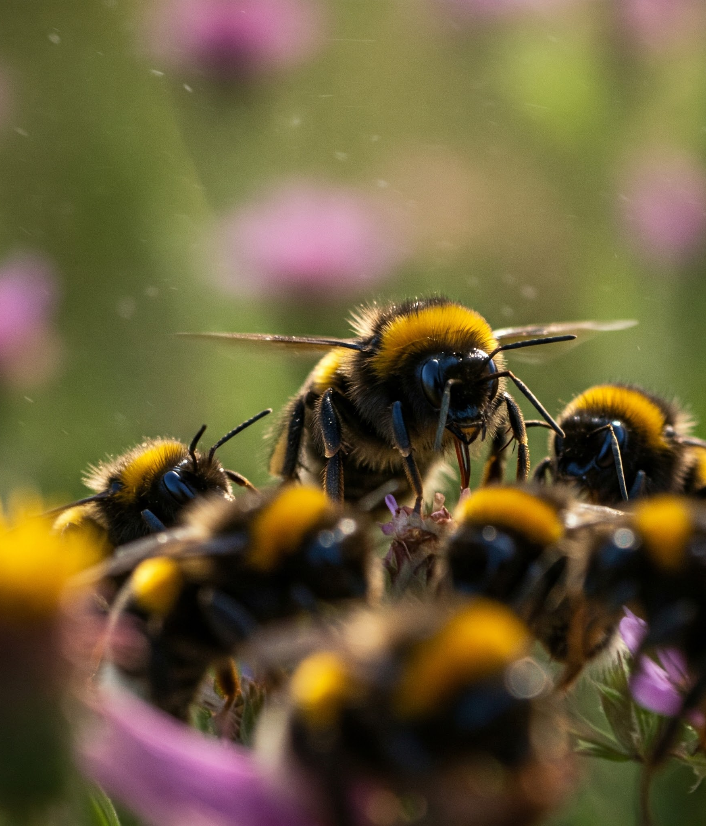
Project goals

Slide 7
Goal 1. Inventory of bumblebees and their parasite fauna in Armenia.
Goal 2. Prioritization of the parasites and pathogens of bumblebees in Armenia.
Goal 3. Modeling outbreaks of bumblebee parasites and pathogens in Armenia.
Goal 4. Assessment of the risks of transmitting new pathogens and parasites from natural and artificial cycles.
Goal 5. Development of scientifically justified and nature-based adaptation measures aimed at decreasing the probability of potential outbreaks of bumblebee parasites and pathogens in Armenia.
Goal 6. To disseminate the project results among the scientific, policymaking, and broader community.

Slide 8
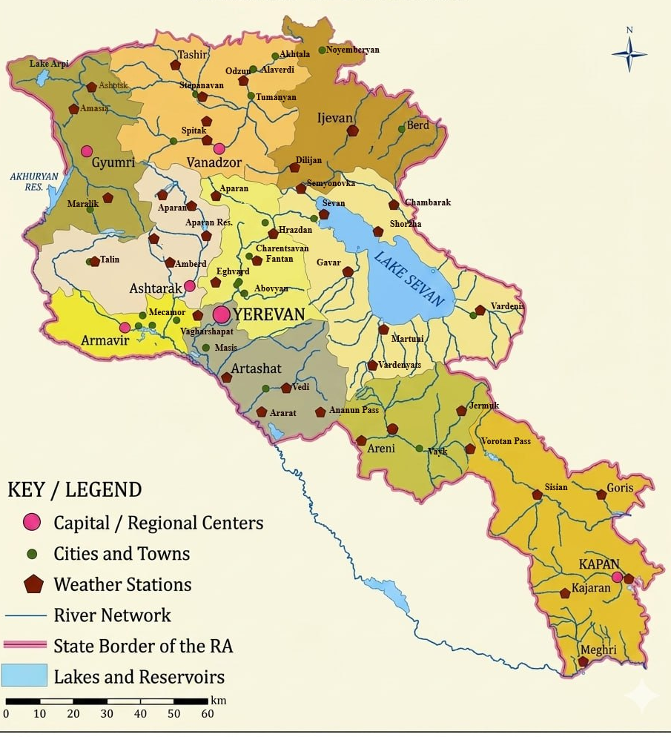
Species diversity
Nine sampling locations* were investigated, covering a range of climatic zones, including meadows, steppes, forests, and semi-deserts.
A total of 220 bumblebee specimens were collected during field surveys.
Morphological identification of the specimens revealed that they belong to 8 species:
It was noted that B. zonatus occurred at all sampling locations.
* - Sampling sites are marked in green on the map.
Bombus argillaceus | Bombus laesus
Bombus armeniacus | Bombus niveatus
Bombus brodmannicus | Bombus persicus
Bombus handlirschianus | Bombus zonatus

Slide 9
Molecular biology results
Nucleic acids (DNA/RNA) were successfully isolated from all collected bumblebee samples.
DNA barcoding was performed for molecular confirmation of species identity using the COI gene.
Experiments have been initiated to optimize PCR conditions and subsequent Sanger sequencing for the detection of major bumblebee pathogens, listed above.

Slide 10

New lab

Slide 11
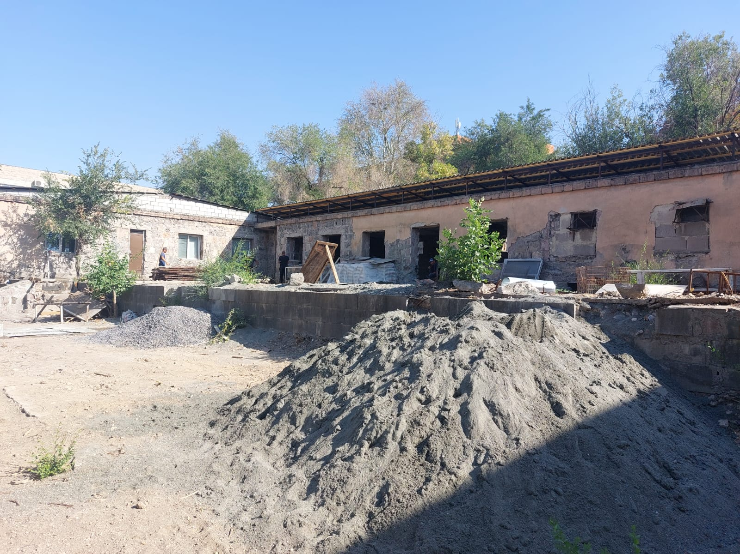
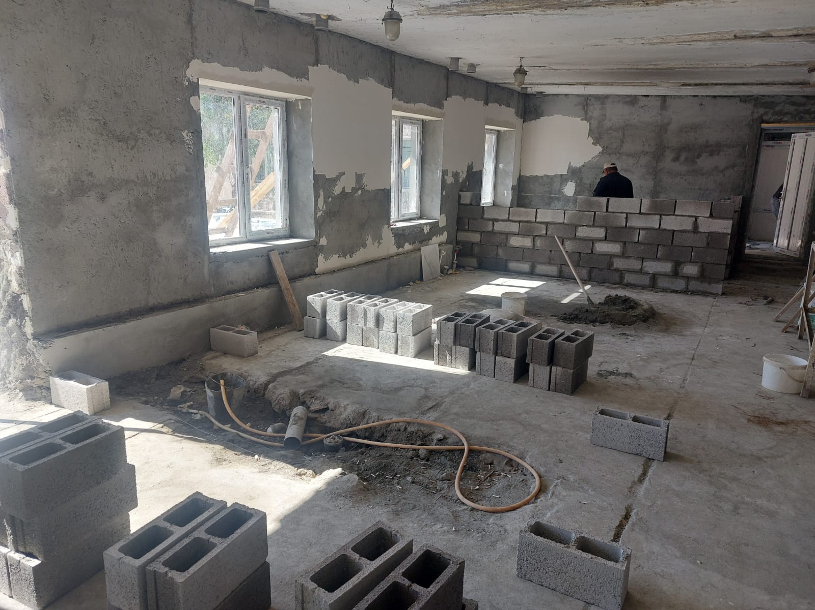
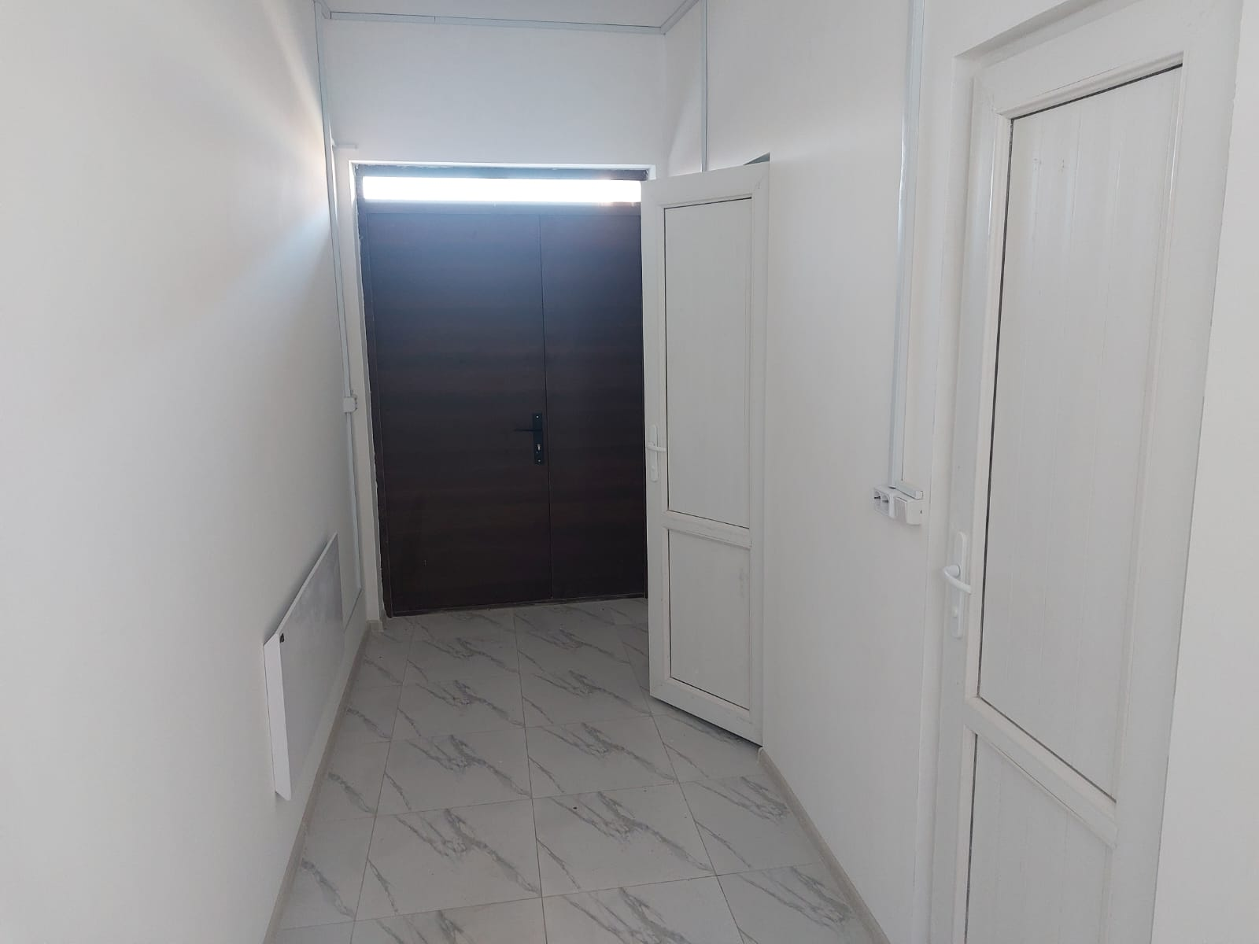
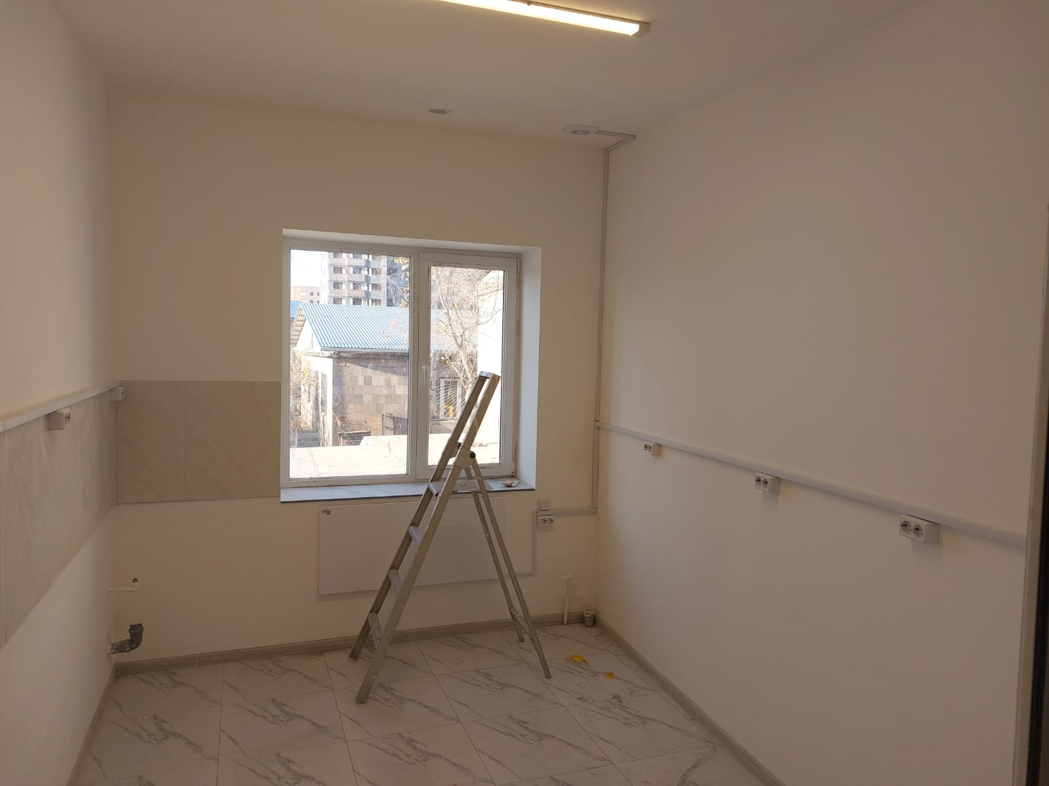
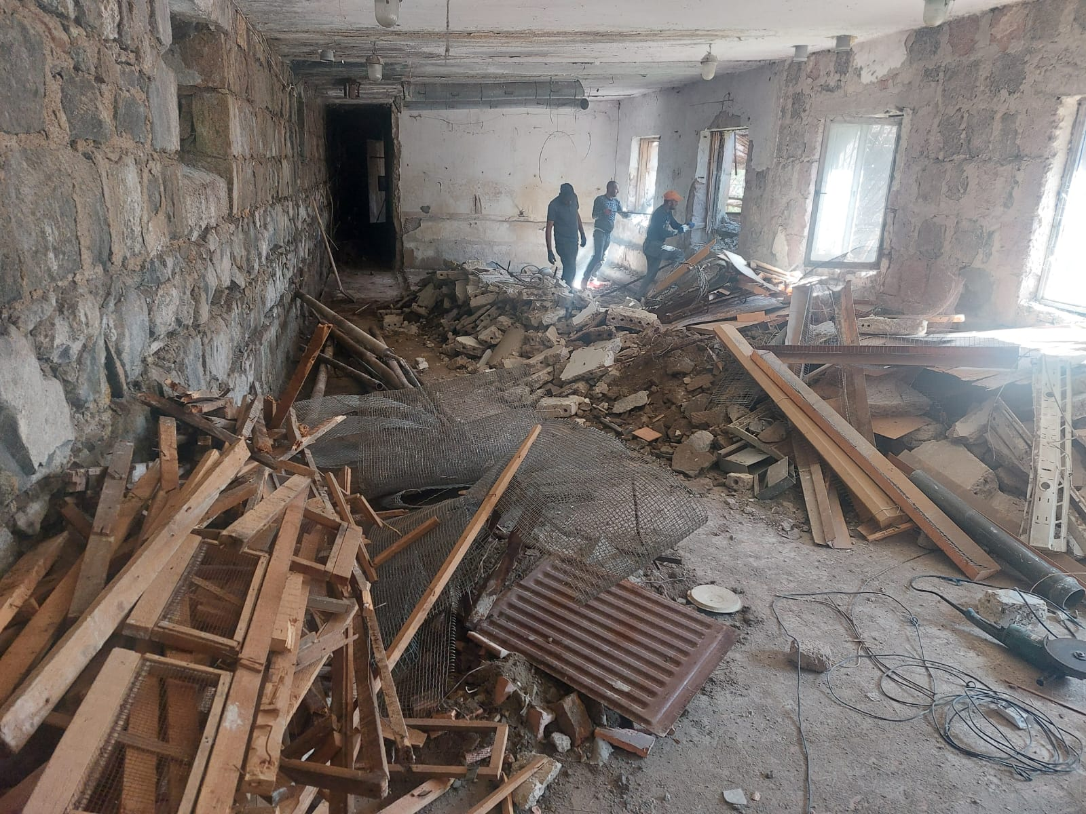
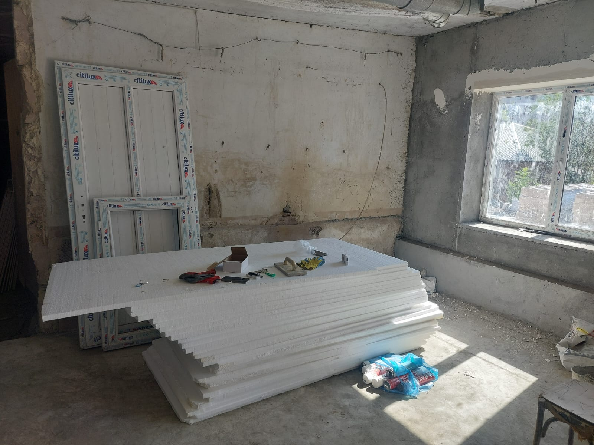
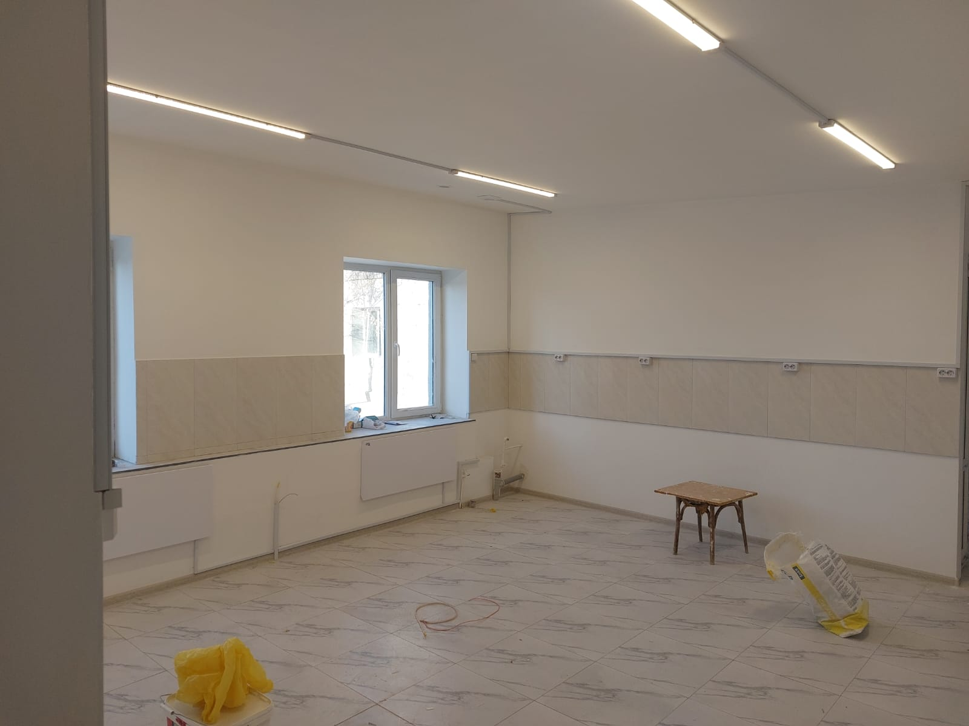
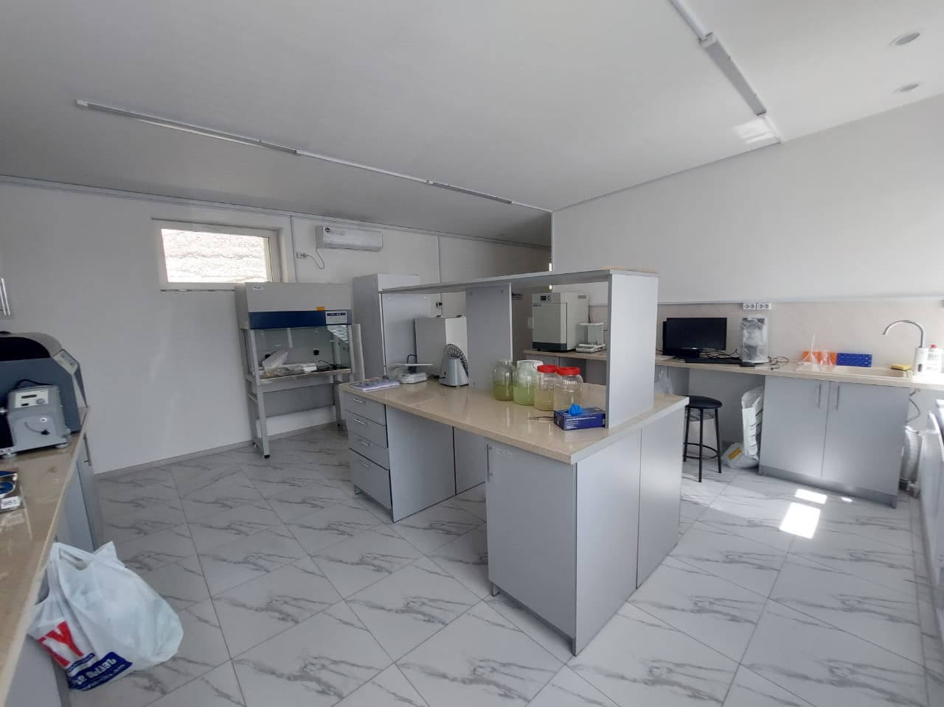
Real lab. “before” and “after”

Slide 12

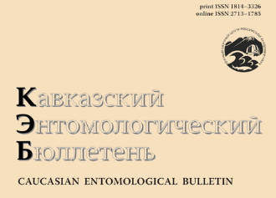
Publications
Conference theses:
Mkrtchyan Ya. et al. Bumblebee (Hymenoptera, Apidae, Bombus) diversity in forest, semidesert, and steppe ecosystems of Armenia
Publication:
Annotated taxonomic list of representatives of Bombus genus (Apidae, Hymenoptera) in Armenia

Slide 13
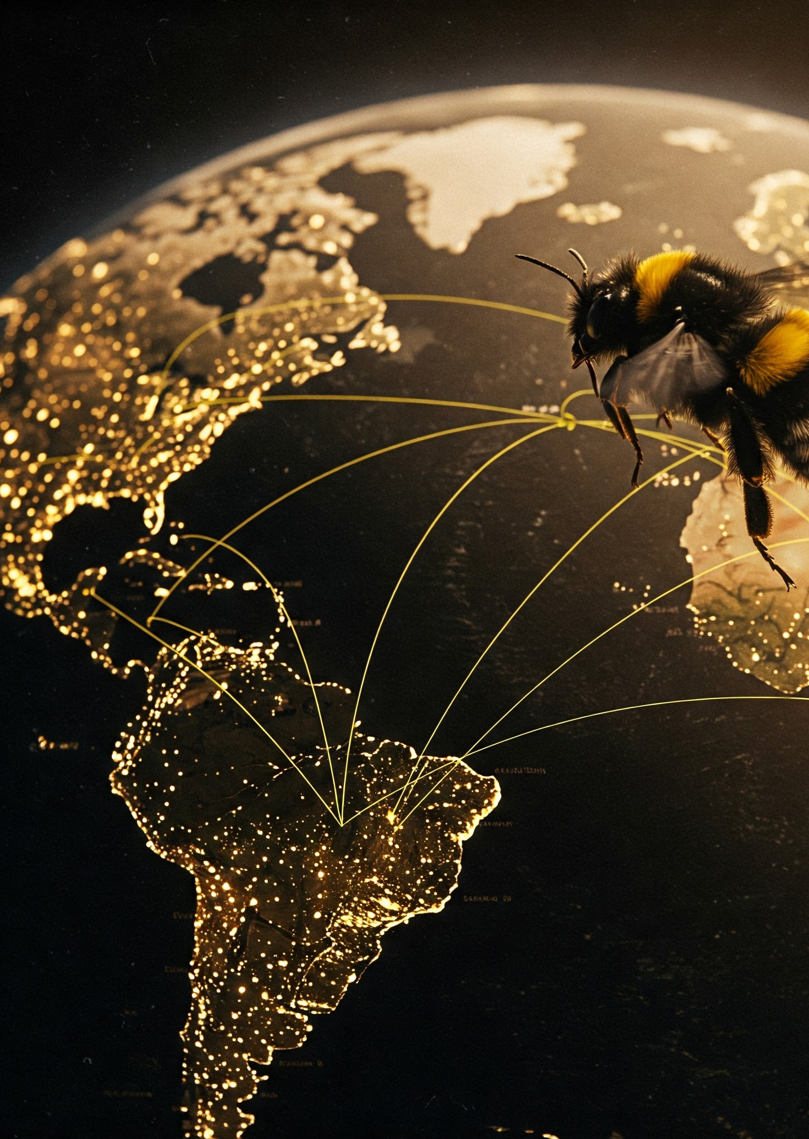
Collaborations

Slide 14



Lena Wilfert, PhD
Institute of Evolutionary Ecology and Conservation Genomics
University of Ulm, Germany
Inga Bazukyan, PhD
Yerevan State University,
Department of Biochemistry, Microbiology and Biotechnology
Vyacheslav Yurchenko, PhD
University of Ostava,
Czech Republic

Slide 15
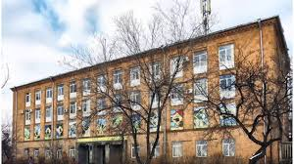
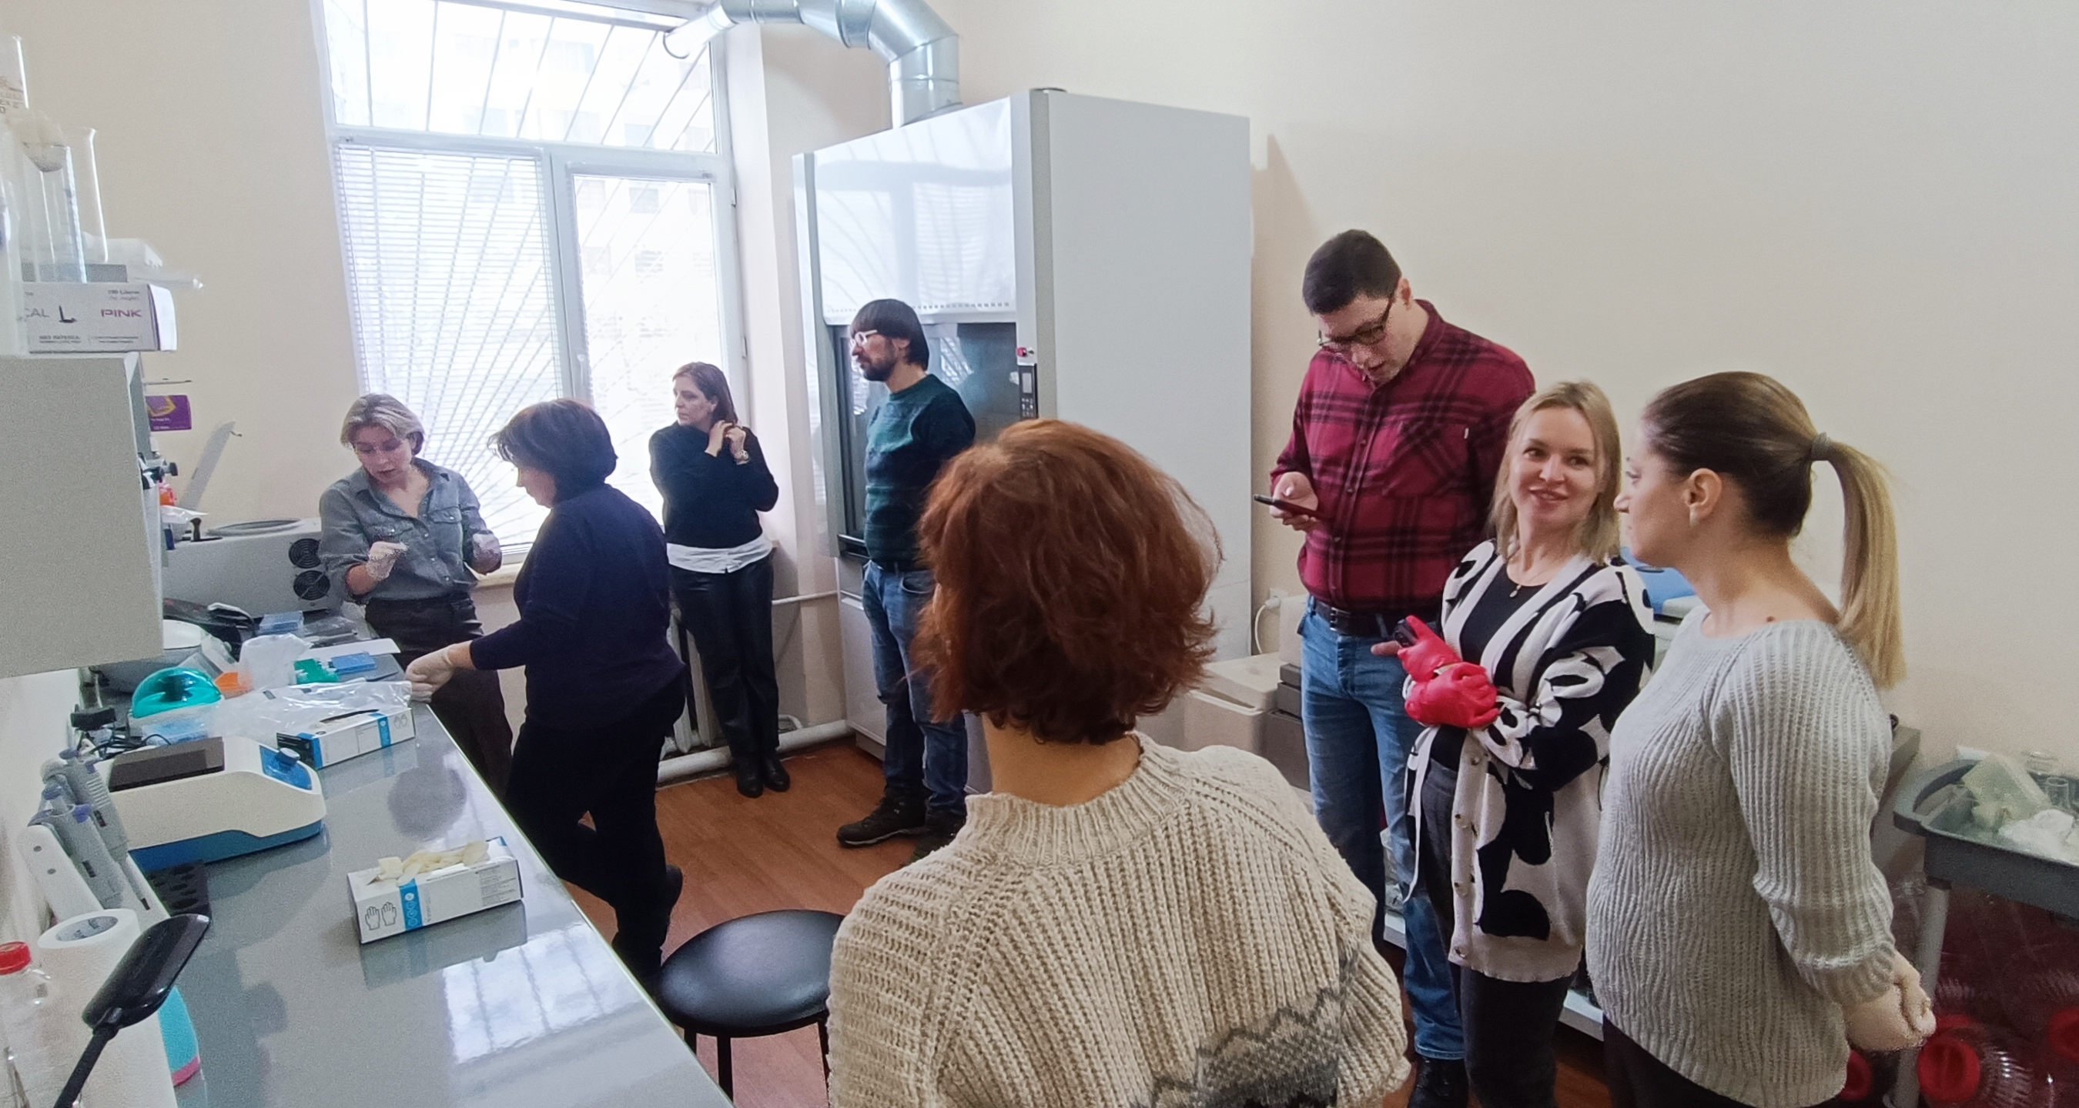
SCIENTIFIC CENTER OF ZOOLOGY AND HYDROECOLOGY NAS RA
Laboratory of Molecular Parasitology

Slide 16
Thank you

Slide 17
